Slide 1

SQL PROJECT
FINANCE & SUPPLY CHAIN ANALYTICS
AT ATLIQ HARDWARE
Presented by Veerendra Sai Yelubandi

Slide 2
TABLE OF CONTENTS
About AtliQ
Business Model
Problem Statement
Project Overview
Schemas
Reports
Conclusion

Slide 3
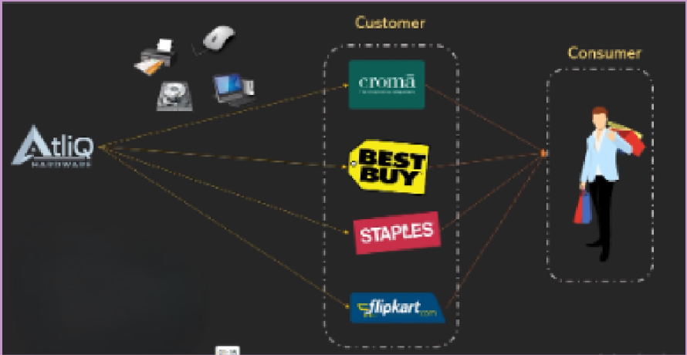
ATLIQ HARDWARE AND BUSINESS MODEL
AtliQ Hardware is a distinguished global leader in electronics manufacturing, specializing in the production and distribution of an extensive range of high-quality hardware products. Our offerings include personal computers, printers, mice and a variety of other computer peripherals, serving the diverse needs of customers worldwide.

Slide 4
PROBLEM STAMENT & PROBLEM OVERVIEW
AtliQ Hardware is currently facing performance challenges due to the increasing size and complexity of its Excel files. To address this, the company has formed a dedicated team of data analysts to leverage MySQL for extracting valuable insights and enhancing operational efficiency
Problem Statement
The Scope of this project entails conduction an in-depth analysis of the dataset provided by AtliQ Hardware. The primary goal is to derive actionable insights regarding sales performance, market dynamics, customer behavior, and to forecast supply chain trends
Problem Overview

Slide 5
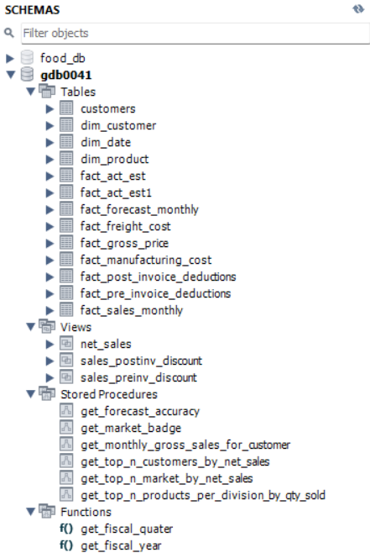

SCHEMAS
These Datas are provided by AtliQ Management
Views allow you to save and reuse complex SELECT statements, making it easier to query large datasets without repeating the same logic.
A stored procedure in MySQL is a precompiled set of SQL statements that encapsulates business logic, enhances reusability, performance, security, and maintainability, and reduces network traffic.
A function in MySQL is a stored program that returns a single value and can be used in SQL statements, providing reusability, modularity, and the ability to encapsulate logic for calculations or data manipulations.

Slide 6
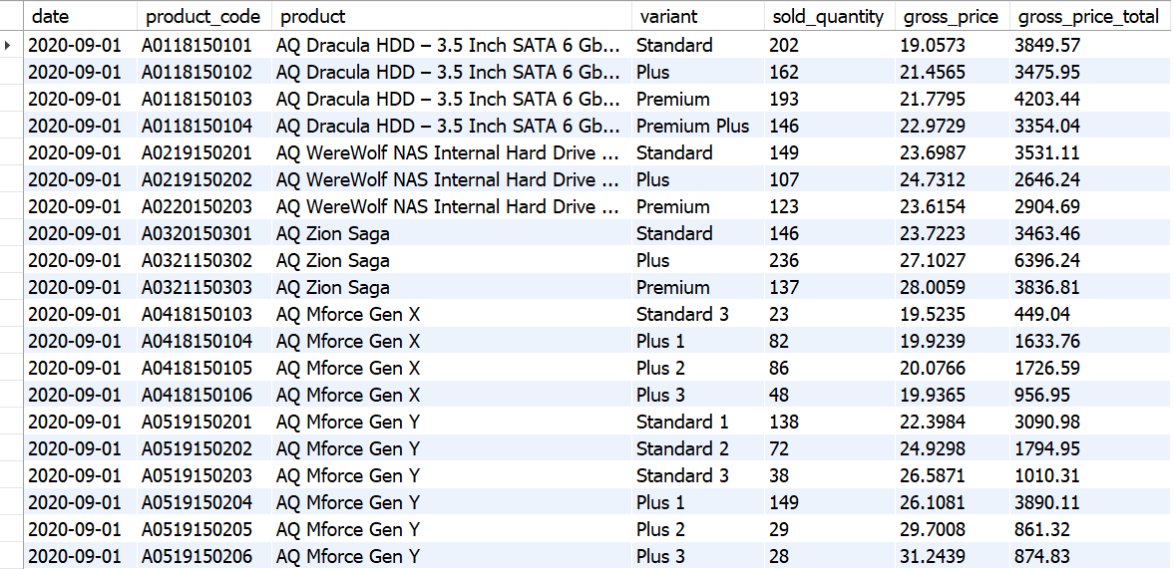
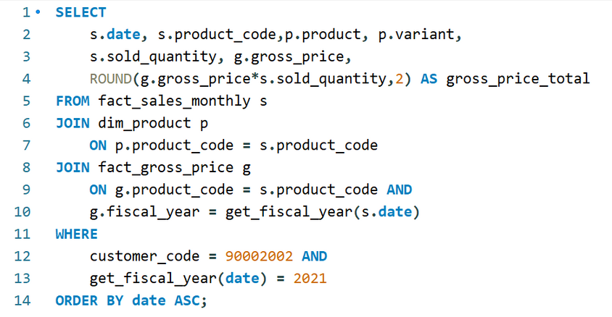
CROMA SALES REPORT
Generate a report detailing the individual product sales for Croma India customer throughout the fiscal year 2021

Slide 7
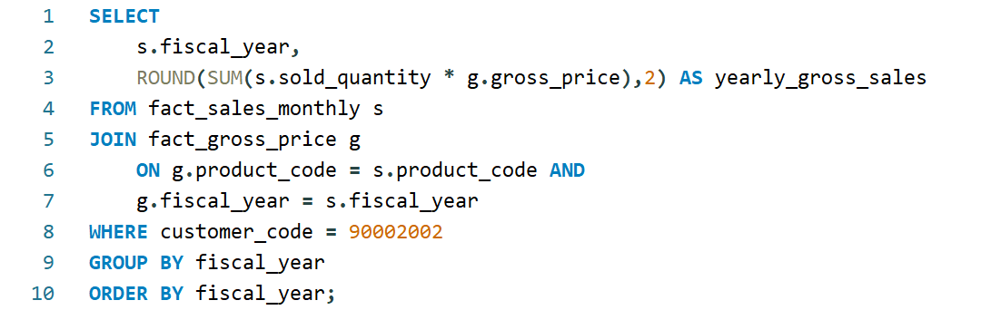
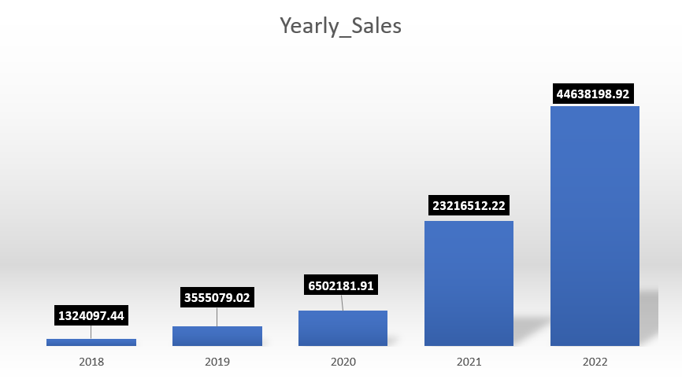
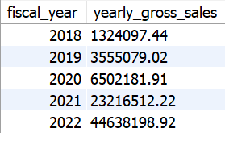
CROMA YEARLY GROSS SALES REPORT
Generate a yearly report for Croma India where there are two columns.
Fiscal Year
Total Gross Sales amount
in that year from Croma

Slide 8
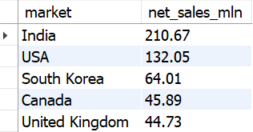
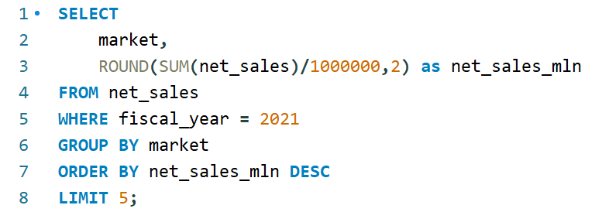
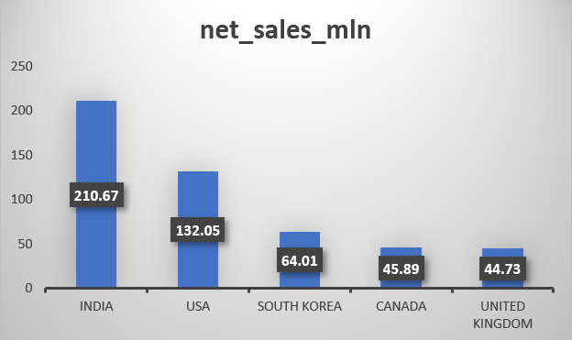
TOP 5 MARKETS
Generate a report getting Top 5 markets
by Net Sales in Fiscal Year 2021

Slide 9
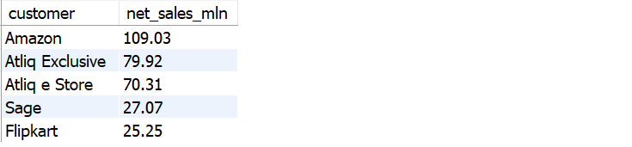
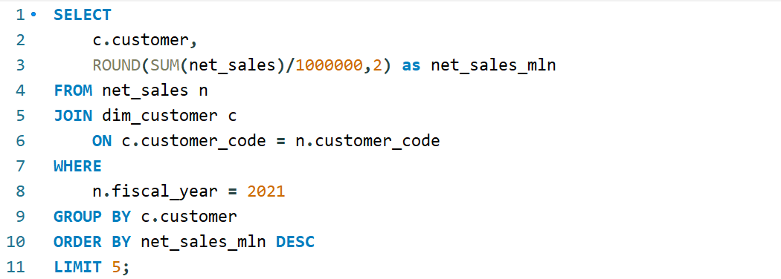
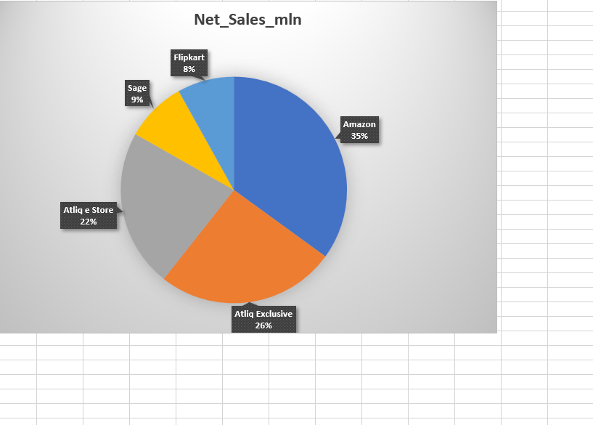
TOP 5 CUSTOMERS
Generate a report getting Top 5 Customers by Net Sales in Fiscal Year 2021

Slide 10
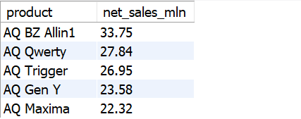
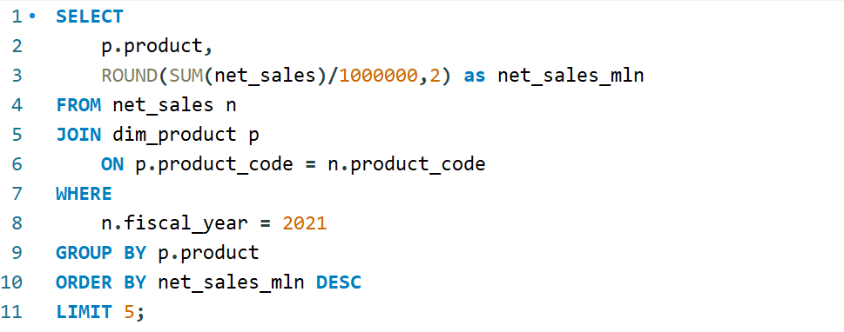
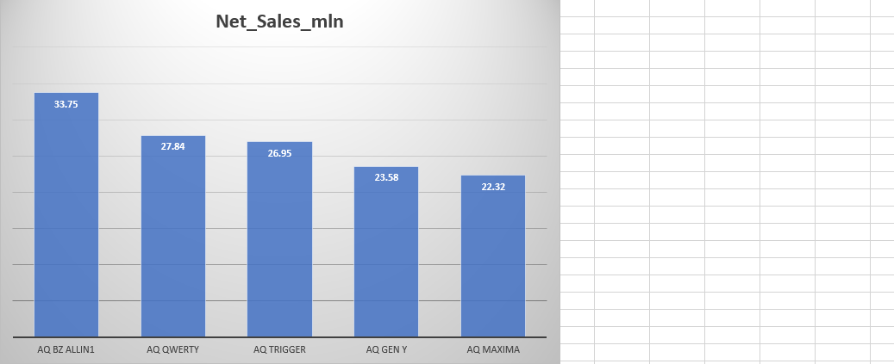
TOP 5 PRODUCTS
Generate a report getting Top 5 Products by Net Sales in Fiscal Year 2021

Slide 11
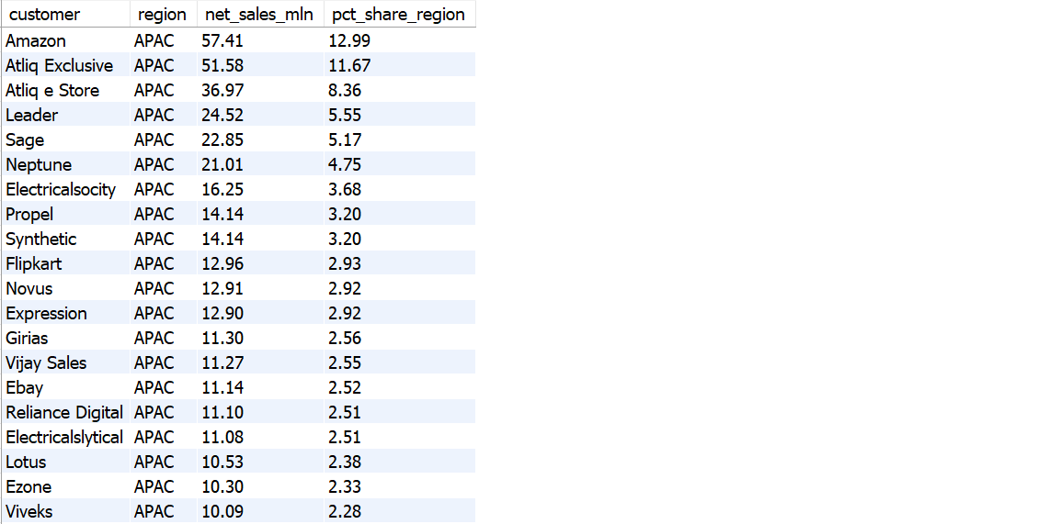
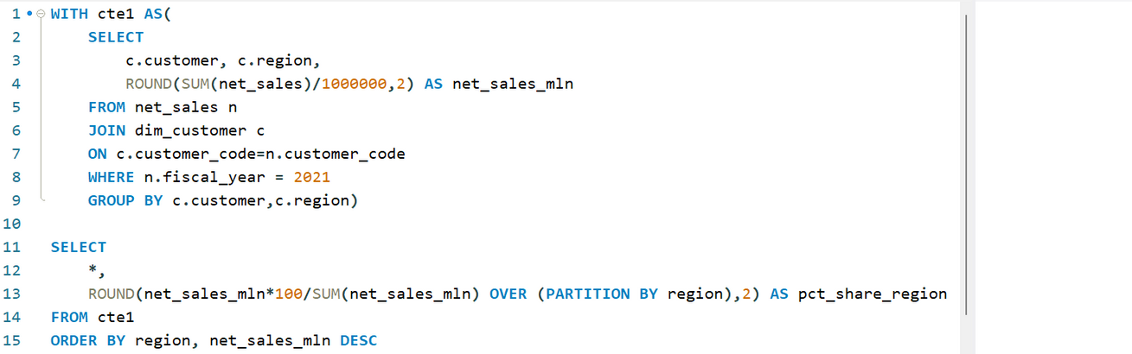
NET SALES% REPORT
Generate a Net Sales% report of Customers in different regions

Slide 12
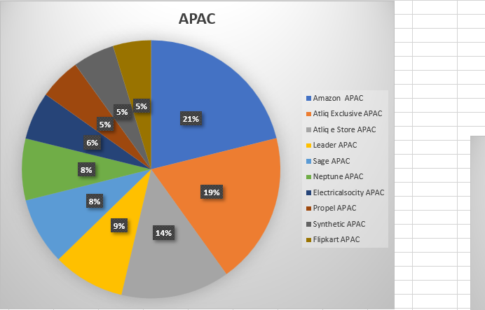
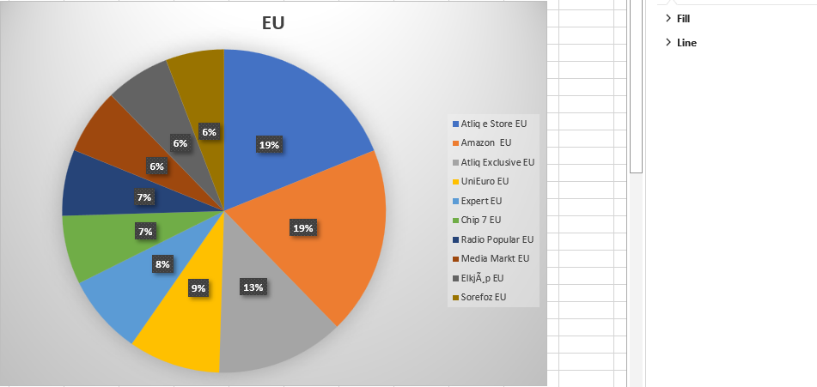
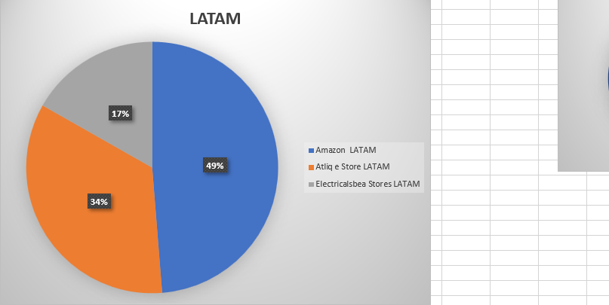
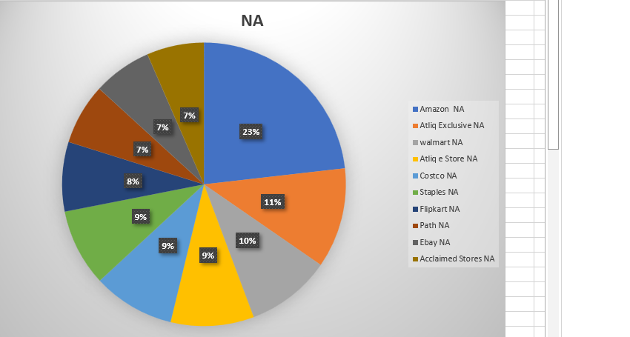
MARKET SHARE%
Top Customers in different Regions

Slide 13
CONCLUSION
AtliQ Hardware achieved record sales in 2022.
India was the largest market in 2021 with sales of $210.67M
Amazon generated the highest Net Sales in 2021 with $109.03M
The AQ BZ All-in-One was the top-selling product in 2021 with the sales of $33.75M
Amazon captures the top market share% in APAX, LATAM & NA regions.
AtliQ estore topped the chart in EU region.

Slide 14
Thank you!

