Slide 1
In-App Automation Testing Platform
Bridging the Developer–QA Gap with Interactive Test Execution, Live Evidence & Requirement Traceability
Project: ocr-processor (Full-Stack Document Intelligence with Tesseract OCR & Spring AI)
Designed, Architected & Implemented with IBM Bob
101 Automated Cases
Triple-Evidence Model
73.1% Req Coverage
Co-Piloted with IBM Bob

Slide 2
THE PROBLEM & CHALLENGE
The Core Testing Problem: Status Quo Friction
Disconnected Feedback Loop
Testing happens apart from development in separate pipelines or isolated QA sprints.
• Developers push changes without immediate verification
• Failure reports arrive days later, breaking mental context
• Engineers spend entire cycles context-switching to reproduce
• Significant delay in overall SDLC release velocity
Ambiguous Bug Reports
Bug notices routinely lack the concrete evidence needed for rapid root-cause diagnosis.
• Reports say 'Case Failed' with no runtime parameters
• Missing test data inputs, payloads, and mock configurations
• No screenshots showing what the UI actually rendered
• Heavy back-and-forth: 'Cannot reproduce on my machine'
Late Regression Discovery
New features silently compromise existing functional flows without early warning.
• Unit tests only exercise isolated, mocked layers
• End-to-end user journeys are deferred to manual QA passes
• QA team becomes the first group to discover regressions
• Costly and stressful rework right before production release
ocr-processor · In-App Automation Testing Demonstration | Slide 2 of 10

Slide 3
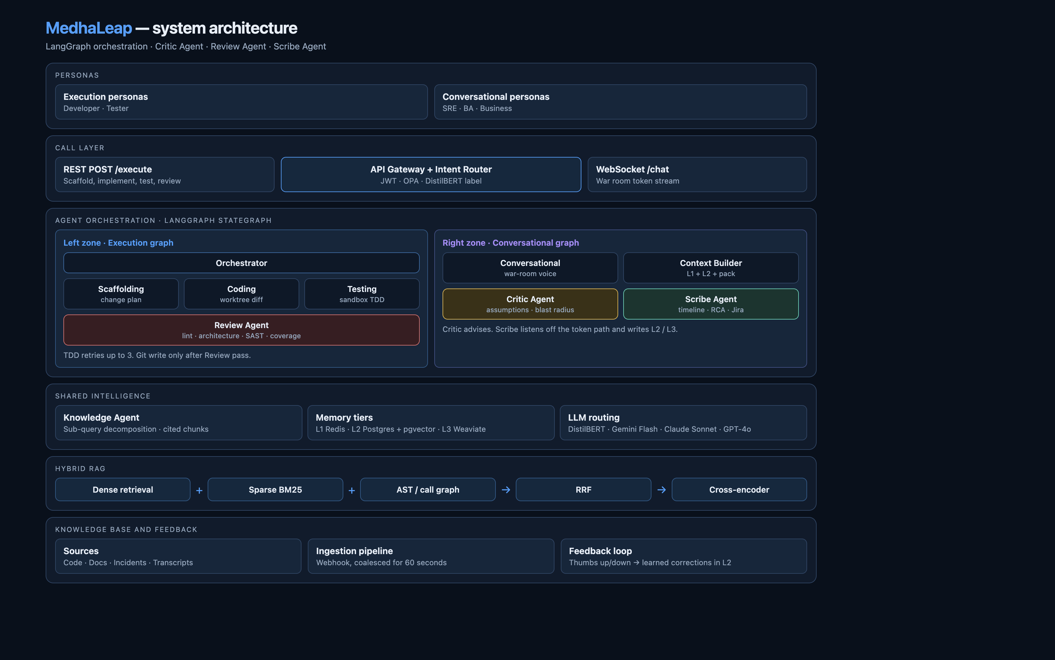
OUR INNOVATION
The Solution: In-App Automation Testing Platform
Bringing Test Automation Directly to Developers
Rather than pushing test execution off to remote CI queues, ocr-processor embeds the test harness into the running application under the dedicated Tests tab.
✔ Self-Provisioned Execution
Test cases automatically seed isolated database records, mock external APIs, and establish authenticated sessions on demand.
✔ Zero-Friction Selectivity
Developers tick specific test cases or execute complete suites with an asynchronous non-blocking queue.
✔ Triple-Fold Evidence
Every run produces an audit breakdown (Executed / Validated / Observed) paired with real browser screenshots.
✔ Requirements-Grounded Coverage
Direct visual correlation between test runs and Phase 1 functional requirements (REQ-001 through REQ-007).
Figure 1: Application Architecture & End-to-End Testing Lifecycle
ocr-processor · In-App Automation Testing Demonstration | Slide 3 of 10

Slide 4
SYSTEM ARCHITECTURE
The Product Under Test: Document Intelligence Pipeline
Multi-Format Ingestion
Upload PDF, PNG, JPG, JPEG, and TIFF documents up to 20MB with real-time UI validation and progress states.
Tesseract OCR Engine
Local optical character recognition with ImageMagick preprocessing, DPI scaling, and TSV confidence filtering.
PostgreSQL TSVECTOR Search
High-speed full-text search indexed via GIN triggers across document names, OCR text, and summaries.
Spring AI LLM Summaries
Automatic document summarisation with smart token truncation (10,000 chars) and one-click retry for failed inferences.
Hardened Security Layer
Stateless authentication via HTTP-only JWT cookies, BCrypt password hashing (factor 12), and automatic 5-attempt account lockout.
Interactive Web Interface
Lightweight Thymeleaf + CSS grid frontend featuring live Search, Create, Profile, and Test Console views.
ocr-processor · In-App Automation Testing Demonstration | Slide 4 of 10

Slide 5
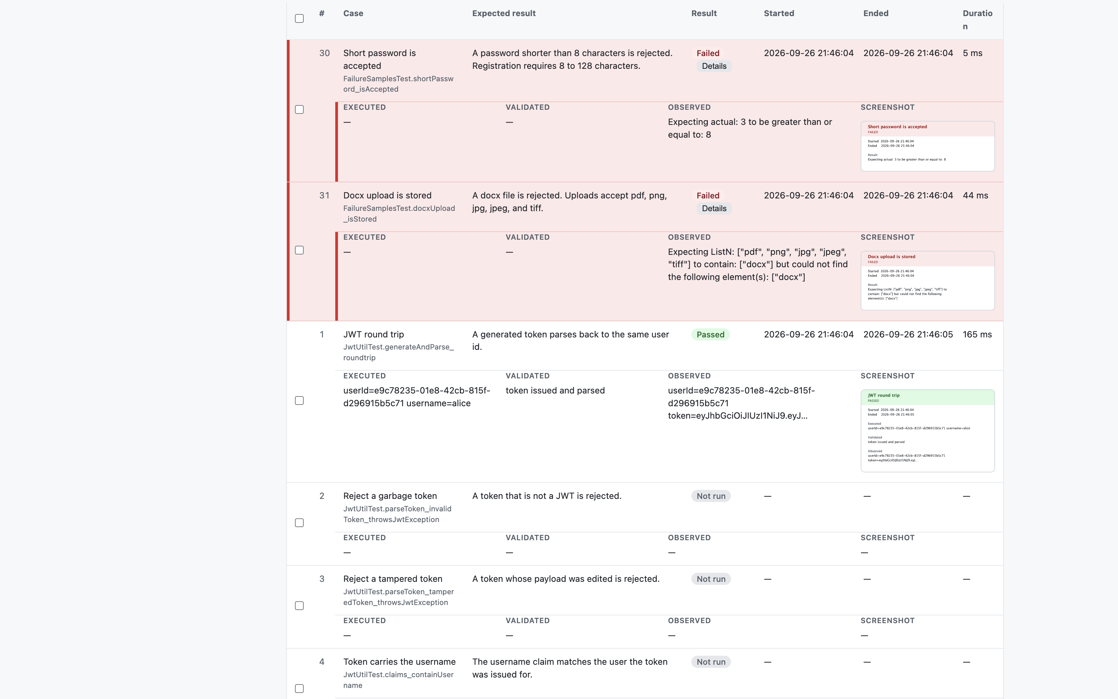
AUTOMATED TEST TIERS
The Test Console: 101 Test Cases Across 3 Tiers
Unit Tests (32 Cases)
Fast service-layer verification with faked dependencies. Validates JWT parsing & tamper rejection, lockout policies, truncation bounds, and OCR text filters.
Regression Tests (29 Cases)
Integration tests running against a real Testcontainers PostgreSQL instance. Proves full HTTP lifecycles, user isolation, cookie auth, and repository paging.
End-to-End Tests (40 Cases)
Real browser journeys driven by Selenium against the running application, combined with comprehensive API pytest scenarios testing user journeys.
Console Capabilities:
• Selective checkbox picking or full suite execution
• Non-blocking background queue for simultaneous runs
• High-density two-row layout: zero horizontal scroll
• Failed cases automatically bubble to the top of table
Figure 2: In-App Test Console showing Two-Row Case Layout & Failed-First Sorting
ocr-processor · In-App Automation Testing Demonstration | Slide 5 of 10

Slide 6
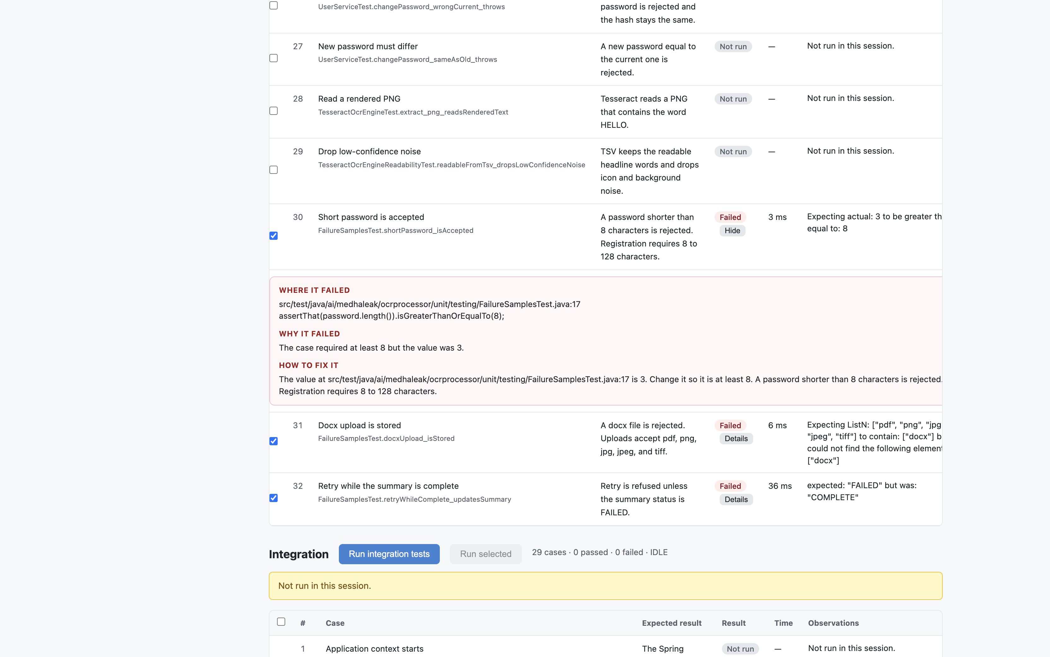
EVIDENCE & DIAGNOSTICS
Actionable Evidence & Root-Cause Failure Diagnostics
EXECUTED
Input Parameters
Records user ID, uploaded filename, MIME type, auth headers, and execution flags.
VALIDATED
Assertions & Contracts
Documents required HTTP status, database persistence, and contract preconditions.
OBSERVED
Runtime Outputs
Captures server response JSON, OCR text excerpts, and error messages.
Deliberate Failure Diagnostics (Where · Why · How to Fix)
• Where: pinpoints the exact file and line number in source code (e.g., FailureSamplesTest.java:17)
• Why: contrasts expected contract against observed reality (e.g., Expected length >= 8, but was 3)
• How to Fix: guides the developer on the exact architectural remediation required
• Evidence Card: every non-UI test auto-generates a 640px visual summary card for audits
Figure 3: Interactive Failure Explanation Breakdown & Stack Tracing
ocr-processor · In-App Automation Testing Demonstration | Slide 6 of 10

Slide 7
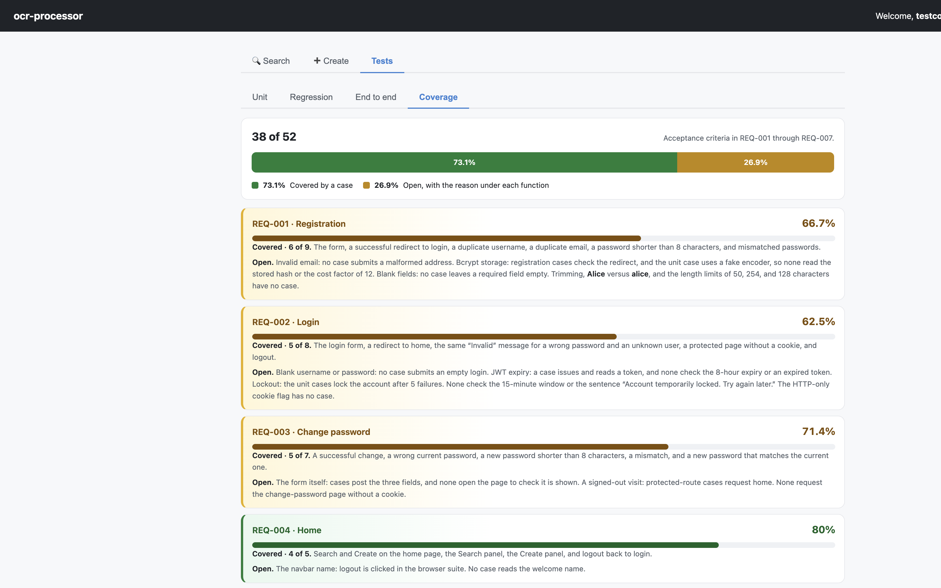
COVERAGE METRICS
Requirements-Phase Traceability: Beyond Raw Line Coverage
38 of 52 Criteria Verified (73.1%)
Traditional code coverage tools report lines executed without proving requirements. The Coverage tab maps automated cases directly to acceptance criteria defined in Phase 1:
• REQ-001 Registration (66.7%): Duplicate checks, short passwords, redirects.
• REQ-002 Login (62.5%): Valid auth, generic error messaging, protected routes.
• REQ-003 Change Password (71.4%): Validation, current password verification.
• REQ-004 Home UI (80.0%): Tabs, navigation, and seamless logout flows.
• REQ-005 OCR Search (62.5%): Queries, empty states, and tenant isolation.
• REQ-006 Upload & OCR (87.5%): Ingestion, text extraction, and status transitions.
• REQ-007 LLM Summary (85.7%): Automatic summarisation and failure retries.
Honest Accounting of Open Gaps:
Explicitly explains why remaining criteria (e.g., >20MB uploads, live external LLM billing, Tesseract 2-min timeouts) remain open.
Figure 4: Visual Breakdown of Requirements Coverage & Rationales for Open Items
ocr-processor · In-App Automation Testing Demonstration | Slide 7 of 10

Slide 8
IBM BOB METHODOLOGY
Co-Piloted with IBM Bob: From Concept to Working System
Phase 1: Requirements Engineering
Captured 7 user stories, EARS acceptance criteria, edge cases, and data models in structured documentation.
Key Deliverable: Markdown Spec & ADRs
Phase 2: Architecture & Decision Records
Authored 5 Architectural Decision Records (ADRs) evaluating Tesseract, Spring AI, PostgreSQL FTS, and JWT cookies.
Key Deliverable: Markdown Spec & ADRs
Phase 3: Design & Technical Spec
Generated end-to-end component wireframes, sequence diagrams, and REST contract schemas before writing code.
Key Deliverable: Markdown Spec & ADRs
Phase 4: Full-Stack Implementation
Implemented Spring Boot application, Testcontainers infrastructure, Pytest Selenium runners, and the interactive Test Console.
Key Deliverable: 101 Executable Cases
1
2
3
4
ocr-processor · In-App Automation Testing Demonstration | Slide 8 of 10

Slide 9
BUSINESS & TECHNICAL IMPACT
Measurable SDLC Impact: Accelerating Release Velocity
FEEDBACK LATENCY
Seconds vs. Days
Developers receive immediate failure attribution in their local browser session instead of waiting for nightlies or QA ticket cycles.
REGRESSION CONFIDENCE
Zero Silent Breaks
Executing the 29-case regression suite proves auth, search, upload, and database isolation before committing changes.
DIAGNOSTIC OVERHEAD
Eliminated Guesswork
Every failure includes source line coordinates, contract discrepancy reasons, and visual evidence cards.
HANDOFF QUALITY
Clean QA Drops
Testing teams receive verified builds where baseline functionality is proven, freeing QA for exploratory testing.
ocr-processor · In-App Automation Testing Demonstration | Slide 9 of 10

Slide 10
Summary: Testing as an Active Development Tool
• Complete Transparency: Every test is self-documenting with Executed, Validated, and Observed evidence.
• Integrated Developer Experience: Run Unit, Regression, and End-to-End suites without leaving the application.
• Requirements-Driven Quality: Continuous tracking against formal acceptance criteria (REQ-001..REQ-007).
• Accelerated SDLC: Catch defects earlier, eliminate handoff friction, and deliver faster with confidence.
Thank you! Ready for Live Demo & Q&A

