Slide 1
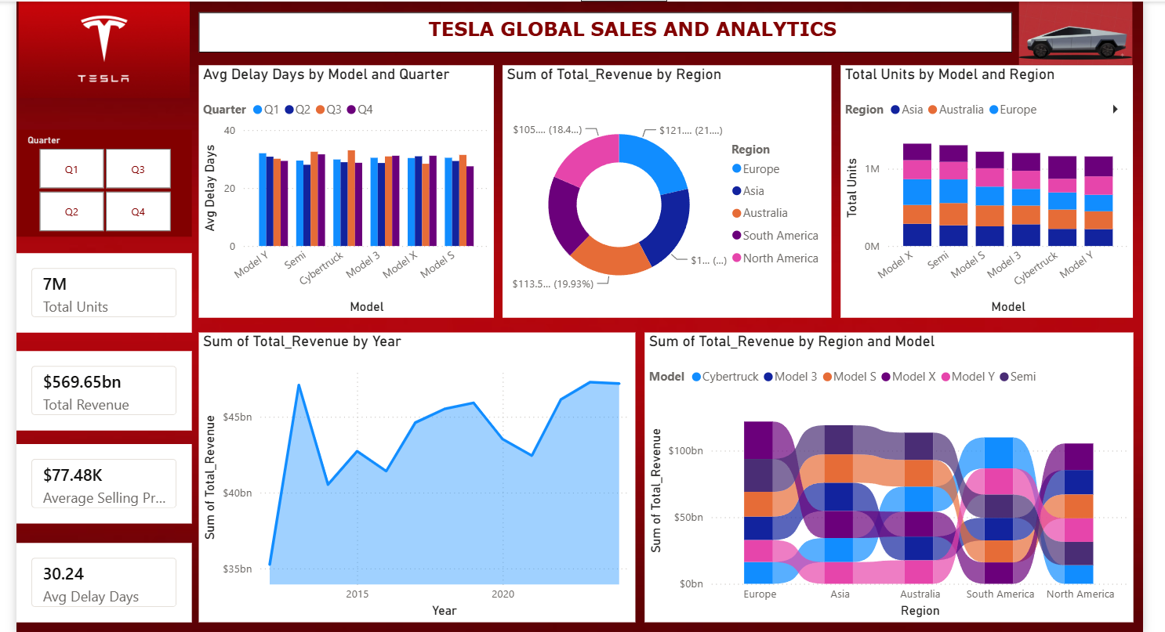
CAPSTONE PROJECT WALKTHROUGH
Tesla Global Sales
& Analytics
A guided tour of the dashboard's KPIs and six charts — what each one measures, how to read it, and why it matters for Tesla's global operations.
Presentation prepared from the Tesla Global Sales and Analytics dashboard

Slide 2
OVERVIEW
Dashboard at a Glance
This single-page dashboard tracks Tesla's global vehicle sales, revenue, and delivery performance. A quarter filter (top-left) lets viewers isolate Q1–Q4, while six visuals break performance down by model, region, and year.
1
2
3
4
7M
$569.65bn
$77.48K
30.24
Total Units Sold
Total Revenue
Average Selling Price
Avg Delay Days
Cumulative vehicles delivered across every model and region.
Combined revenue generated across all regions and years.
Blended average price per vehicle across the full lineup.
Average gap between order and delivery, across all models.
02 / 09

Slide 3
CHART 01 · CLUSTERED BAR
Average Delay Days by Model and Quarter
How to read it
Each cluster is a model; the four bars inside it are Q1–Q4. Bar height is the average number of days between order placement and delivery for that model in that quarter.
Why it matters
Delays cluster in the 22–34 day range with no single model consistently fastest or slowest — useful for spotting whether a production ramp (e.g. Cybertruck) is dragging fulfillment times in a given quarter.
03 / 09

Slide 4
CHART 02 · DONUT
Total Revenue by Region
How to read it
Each slice is one of five regions Tesla sells into. Slice size is that region's share of the $569.65bn total revenue; the dollar figure and percentage are both shown on the live dashboard.
Why it matters
Revenue is remarkably balanced — every region sits between 18% and 21% of the total. Europe leads narrowly, showing Tesla's revenue base is globally diversified rather than concentrated in one market.
04 / 09

Slide 5
CHART 03 · STACKED COLUMN
Total Units by Model and Region
How to read it
Each column is a model; the five colored segments stacked inside it show how that model's unit sales split across Asia, Australia, Europe, South America, and North America.
Why it matters
Column heights are close across all six models (~7M units total), while the internal split shows Asia and Europe consistently outselling South America — pointing to where demand, and future capacity planning, should focus.
05 / 09

Slide 6
CHART 04 · AREA TREND
Total Revenue by Year
How to read it
The line traces total revenue year over year, with the shaded area emphasizing overall volume. Peaks and dips mark strong and weak years for global sales.
Why it matters
After an early spike and a multi-year dip, revenue trends upward with visible volatility, closing near its highest point yet — the clearest single signal of Tesla's long-run growth trajectory in the dashboard.
06 / 09

Slide 7
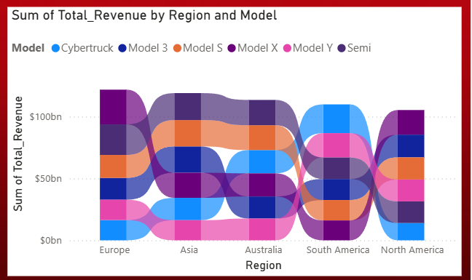
CHART 05 · SANKEY DIAGRAM
Revenue Flow: Region → Model
How to read it
Flows connect each region (left) to each model (right). Ribbon thickness represents the amount of revenue that region generated from that model — colored by model per the legend.
Why it matters
This is the most detailed view in the dashboard: it shows not just how much each region earns, but which models drive that revenue — letting analysts spot, for example, a region over-reliant on a single model.
Source: live dashboard visual (Sankey charts are rendered natively in the BI tool, shown here as captured).
07 / 09

Slide 8
FULL VIEW
The Complete Dashboard
All six charts and four KPIs together, as they appear on the live single-page dashboard — giving the full picture in one view.
08 / 09

Slide 9
Key Takeaways
Global, balanced revenue base
Delivery delays are consistent, not spiking
No single region drives more than 21% of the $569.65bn total — Tesla's revenue is spread evenly across five continents.
Avg delay sits near 30 days across every model and quarter, with no runaway outlier to flag operationally.
Unit sales are model-agnostic across regions
Revenue has grown despite volatility
All six models sell in comparable volumes (~1.1–1.25M units each), with Asia and Europe leading demand.
The yearly trend shows real dips, but the overall trajectory from ~$35bn to ~$50bn+ confirms sustained growth.
Thank you — questions welcome.
09 / 09

