Slide 1
VOCODER
Group # 23
Shaurya Bhatnagar (MT24226)
Viren Variya (MT24102)
Priyanshu (MT24130)
Chaitanya (MT24028)
Raman chola (MT24072)

Slide 2
What is a Vocoder?
(Problem Statement )
A vocoder is a tool used to synthesize audio from Mel-spectrograms.
Mel-spectrograms act as an intermediate representation in many
The vocoder serves as the final step in the audio generation process applications.
Applications:
Text-to-Speech : Generating natural-sounding speech from text
Bandwidth Compression : Efficiently transmitting audio signals with reduced data.
Audio Style Transfer : Transforming the style or tone of audio while preserving its content.

Slide 3
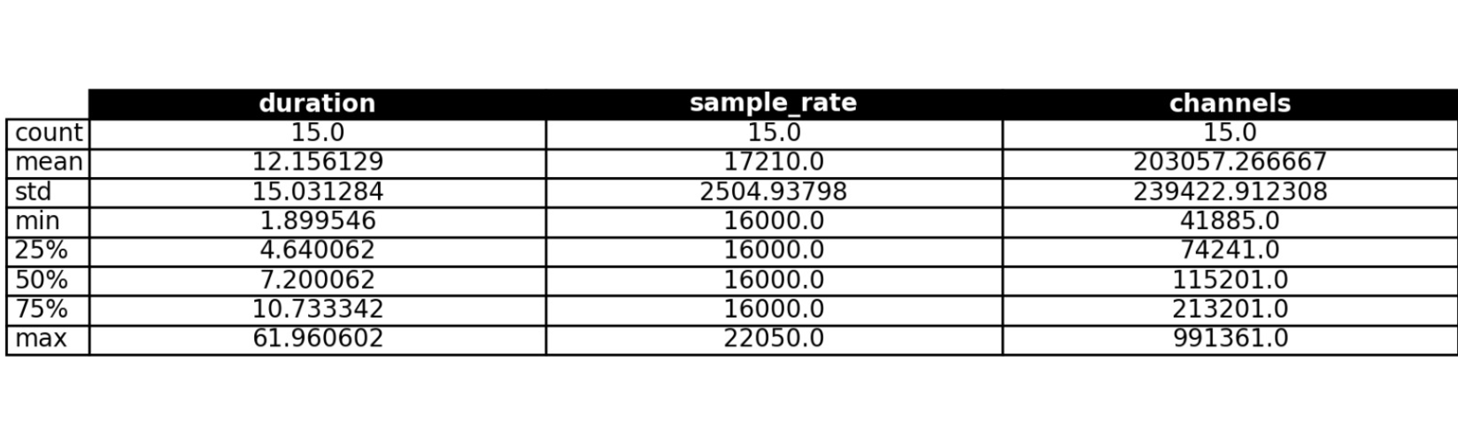
Dataset Description

Slide 4
Methodology
Steps we followed :
Data Generation
Convert Audio → Spectrogram → Mel-Spectrogram.
Mel-Spectrogram focuses on human-perceivable frequencies.
Vocoder Building
Inverse Transform: Convert Mel-Spectrogram → Spectrogram.
Phase Reconstruction: Rebuild missing phase using Griffin-Lim Algorithm.
Audio Synthesis: Use the reconstructed spectrogram to generate audio via the Inverse Short-Time Fourier Transform (ISTFT).

Slide 5
Inverse Transform: Convert Mel-Spectrogram → Spectrogram.
"Simplicity is the ultimate sophistication.“
~ Leonardo da Vinci
Step 1 : Mel Filter Matrix Construction
m = # mel filter banks , n = # Linear filter bank
Typically , m < n ( Rect. Matrix)
Create transformation matrix (let it call F)
F is Rectangular so not invertible, we must get only closest possible Solution.
Arg Max || M – F . S ||^2 ; S >= 0
S
where M is original spectrogram (Fixed)
F is Mel transformation Matrix (Fixed)
S is Spectrogram (To find out )
Step 2 : NNLS optimization

Slide 6
Phase Reconstruction & Audio Synthesis
1. Griffin-Lim Algorithm:
We used this Phase Reconstruction method
It is iterative method
After Convergence, Approximates missing phase from magnitude spectrogram.
2. Inverse FFT (iFFT):
Now we have both Frequencies from Spectrogram and phase
spectrogram (frequency-domain) to time-domain.
Combined magnitude spectrogram with reconstructed phase to generate audio.

Slide 7

Results
Original Audio Sample
Generated Audio Sample
File Sr.N0. | Euc Distance Audio | KL-Divergence Audio | Euc Distance Mel-Spectrogram | KL-Divergence Mel-Spectrogram
1 | 3.355815 | 0.701793 | 582.5747 | 0.000495
2 | 25.42285 | 0.684105 | 1059.97 | 0.000434
3 | 22.9519 | 0.752412 | 613.2822 | 0.000421
4 | 20.2562 | 0.780203 | 494.4047 | 0.000435
5 | 44.75219 | 0.663845 | 1178.469 | 0.000801
6 | 17.0293 | 0.600934 | 483.4475 | 0.000742
Average (15 Files) | 31.41 | 0.68 | 903.06 | .001

Slide 8
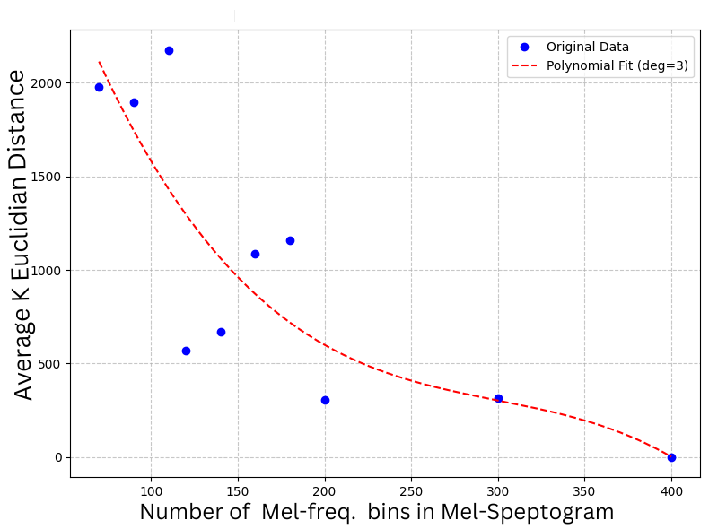
Effect of Increasing Size of Mel-Spectrogram
Comparison average Euclidian distance in Original and Generated Mel-Spectrogram (Scaled to *100 )

Slide 9
Thank you !!

