Slide 1
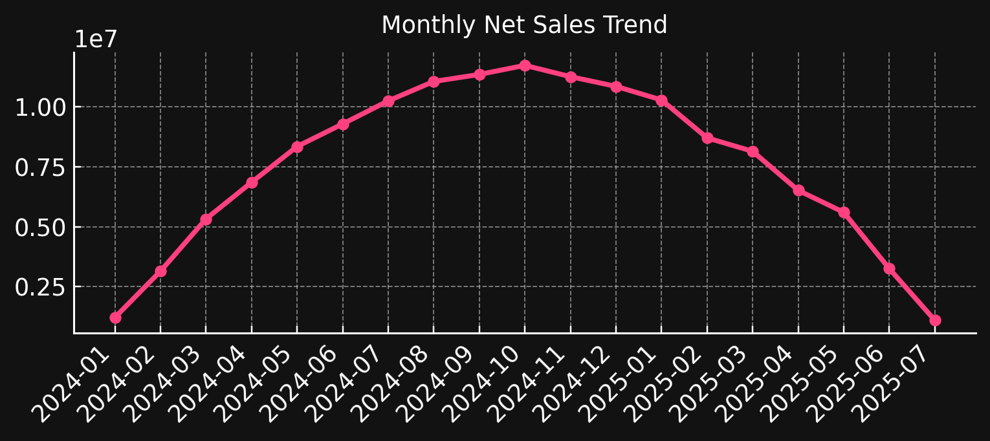
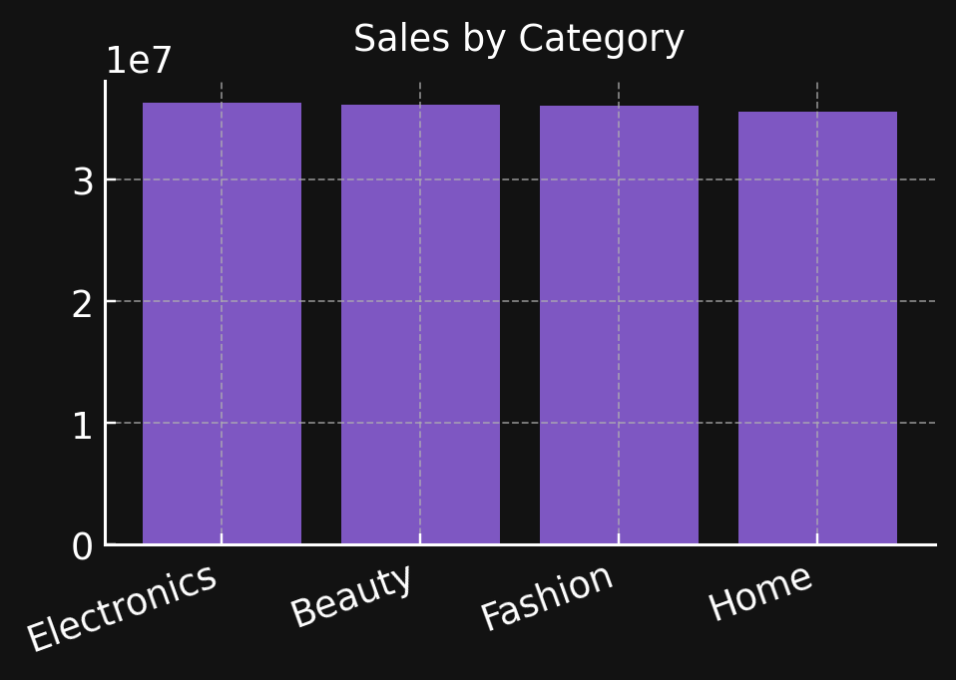
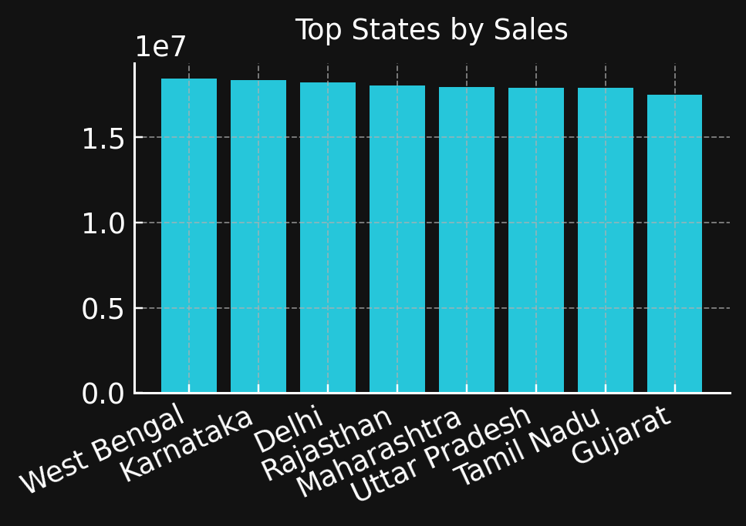
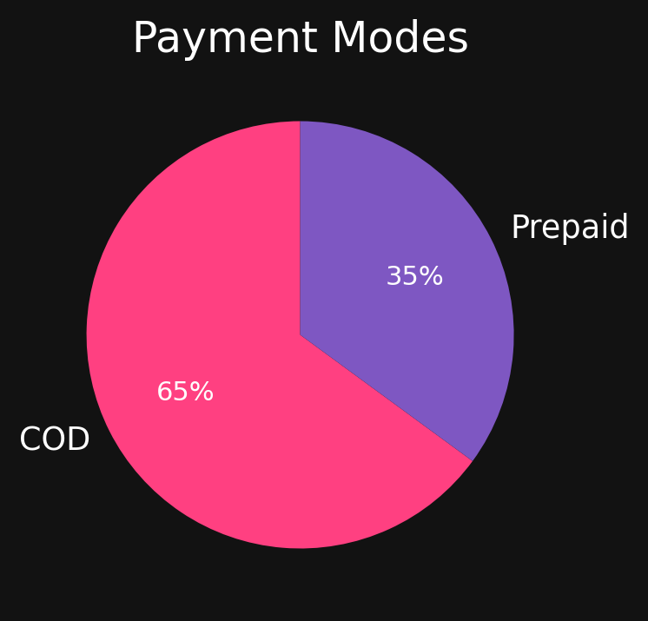
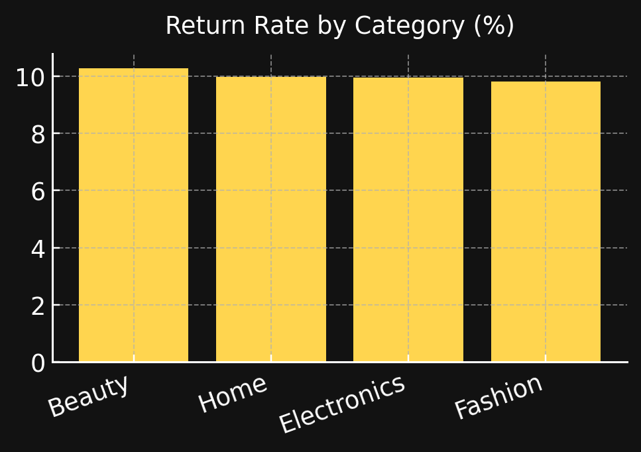
meesho
Sales Dashboard (2024–2025)
Total Orders
50,000
Total Sales
₹144,282,673
Profit
₹28,766,149
Avg Order Value
₹2,886
Returns %
10.0%

