Slide 1
Retail Sales Forecasting Dashboard
Problem → EDA → Holt-Winters Forecast → Dashboard

Slide 2
Business Problem & Approach
Problem: Forecast weekly sales to optimize inventory & staffing.
Approach:
• Synthetic multi-store, multi-category data with promos & holidays
• EDA: trend (8-week MA), category mix
• Exponential Smoothing (additive trend & seasonality, period=52)
• Excel dashboard with KPIs + charts

Slide 3
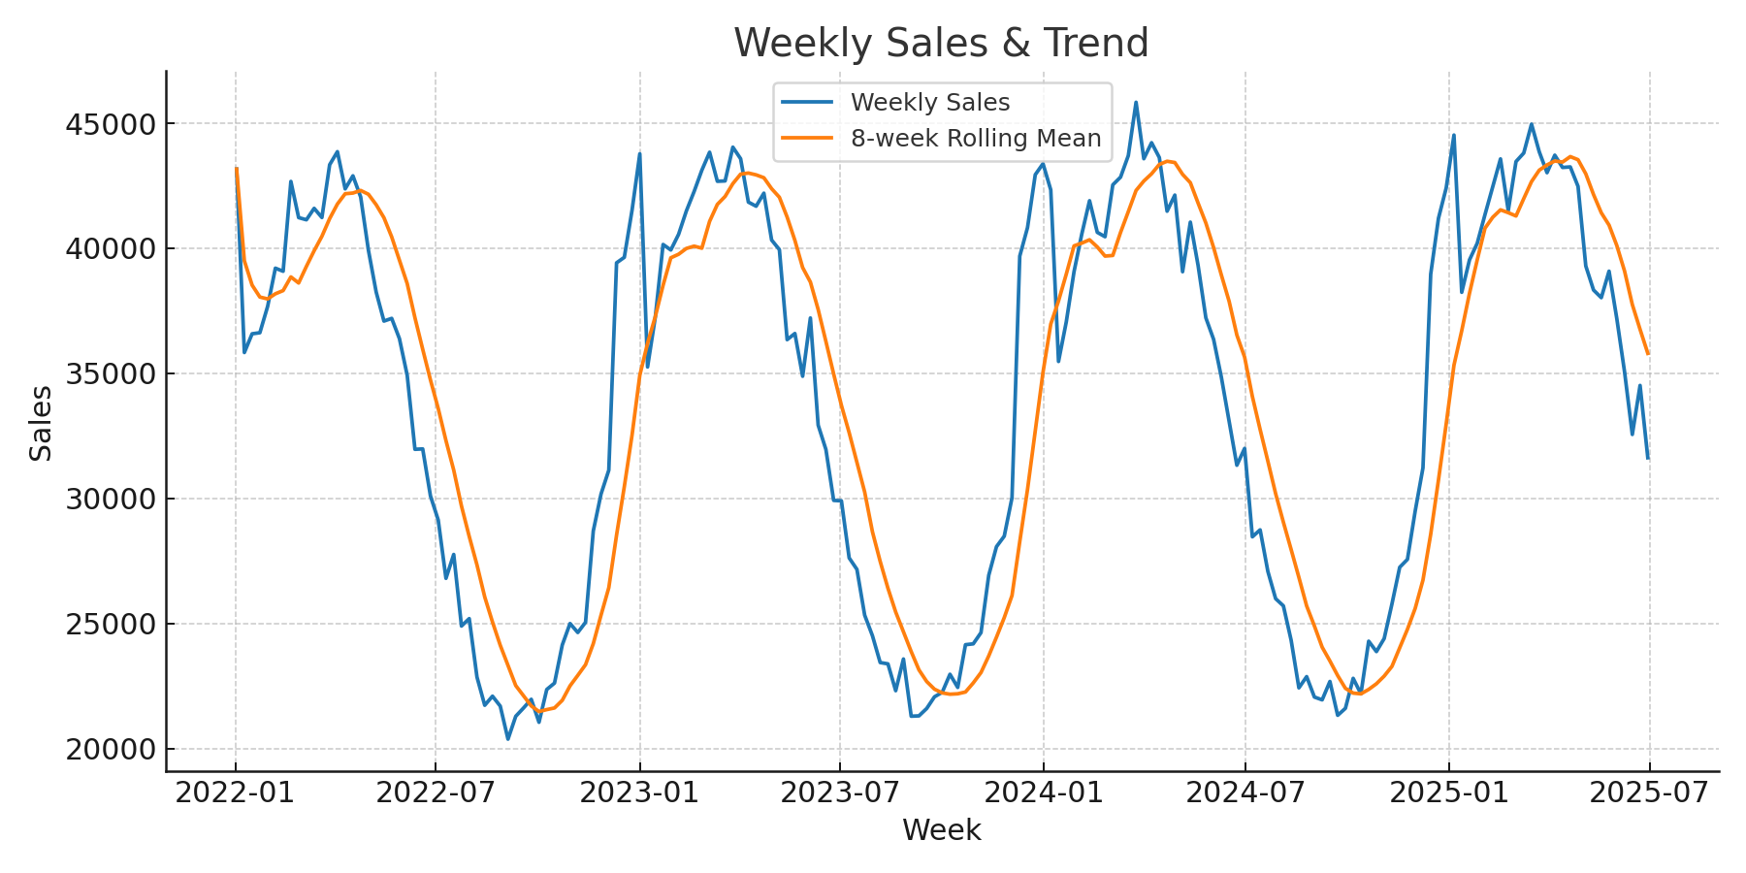
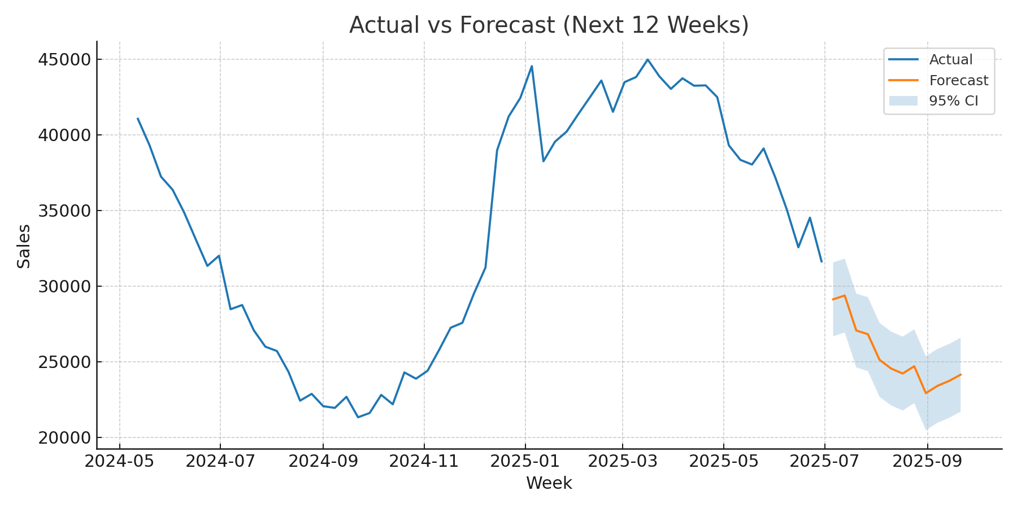
Key Visuals

Slide 4
Insights & Recommendations
Insights:
• Clear yearly seasonality with year-end peaks
• Promotions produce visible uplifts
• Next 12-week forecast above recent average
Recommendations:
• Pre-stock inventory before peaks
• Focus promos on Electronics & Home near holidays
• Monitor KPIs weekly for deviations

