Slide 1
Sales Dashboard Summary
Task 4 — Dashboard Design
Tool: Tableau
Dataset: Superstore Sales Dataset

Slide 2
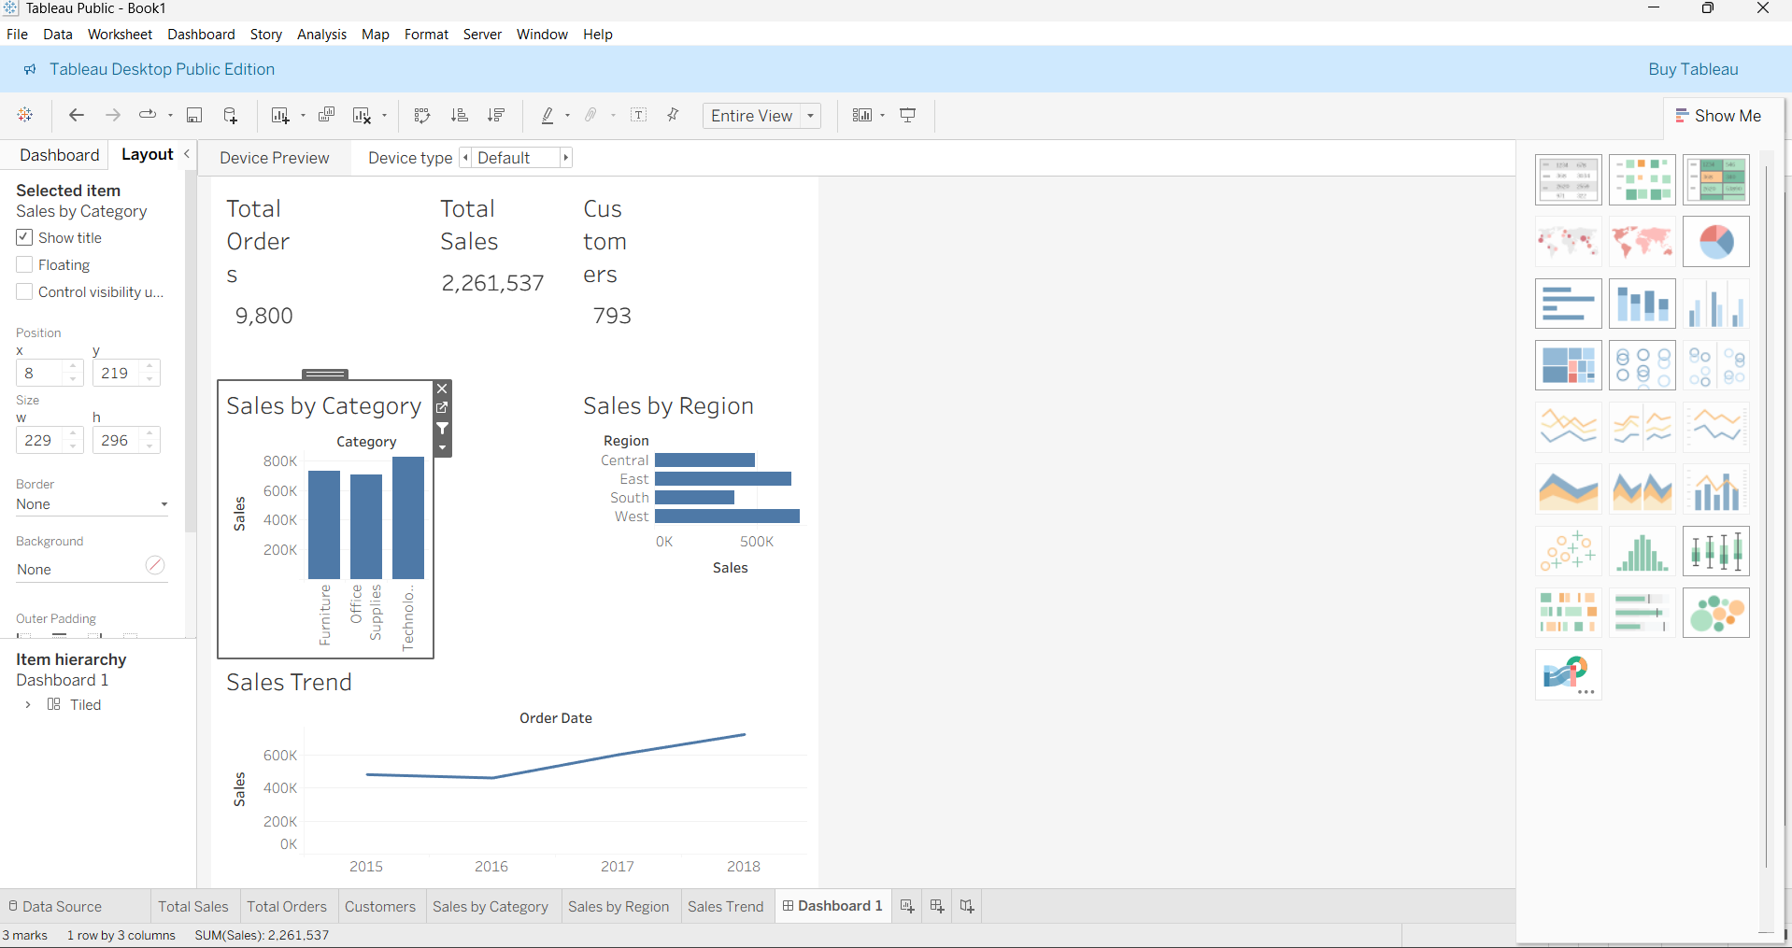
Dashboard Overview
Insert dashboard.png screenshot here.
Interactive dashboard showing sales performance by region and category.

Slide 3
Key Insights
• Technology category generates high sales
• West region shows strong performance
• Sales trend increases over time
• Dashboard filters allow interactive analysis

