Slide 1

Design and Implementation of a Zero- Trust Based Intrusion Detection and Data Protection System for Healthcare Infrastructure
Module : Cyber Security (COM771)
Presented By : Vivek Kumar Jurga magar
Student Id : b01037741
Date: 24/ 04 / 2026

Slide 2
Overview of problem area
Healthcare system store highly sensitive patient data
Increasing use of Internet Of Things (IoT) medical devices
Highly connected networks increase attack surface
Traditional systems rely on perimeter based
Major risks:
Ransomeware attacks
Unauthorized data access
IoT device exploitation
Healthcare has been the most targeted sectors.(NAO, 2017)
Example:
NHS WannaCry Attack (NAO, 2017)

Slide 3
Research Overview
Zero Trust Architecture (NIST SP 800-207)
“Never Trust, Always Verify” (NIST, 2020)
Continuous authentication of users and devices
Research shows:
Healthcare data is highly value to attackers
IoT devices have weak security controls
ENISA & NIST highlight:
Lack of monitoring in IoT environment
Increase in vulnerability to cyber threats
Zero Trust reduces risk through:
Strict access control
Identity verification
Continuous monitoring

Slide 4
Solution overview
Zero Trust-based healthcare system
Key security components:
Multi-Factor Authentication (MFA) for user verification
Trusted Device Validation
Trusted IP Verification
Role-Based Access Control
IoT Device Assignment and Permission Control
Secure PDF Download (token + password)
Anomaly Detection for IoT Data
Attack Detection (SQL Injection and XSS)
Logging and Analytics Dashboard
Every request is continuously verified before access is granted.

Slide 5
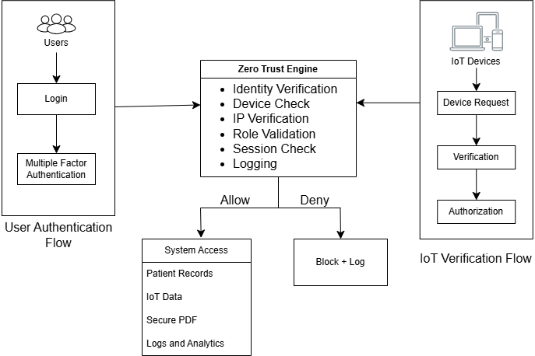
System architecture

Slide 6




Implementation
IoT Simulation using forms
PDF Generation: ReportLab + pypdf
Security Modules:
Input Validation
Token Based Authentication
Logging System

Slide 7






Zero trust engine
Identity Verification
Device Validation
IP Verification
Role Validation
Session Validation
Logging all request
Access is granted only if all condition is satisfied

Slide 8
Patient Module
Secure access to patient records
Role based access:
Admin
Doctor
Nurse
Secure search functionality
Input validation to prevent attacks

Slide 9



Attack Detection
Detects and Blocks
SQL Injection Attacks
Cross-Site Scripting (XSS)
Input Inspection before database queries
All attacks are:
Blocked
Logged for monitoring
Notes:
Block execution of malicious queries

Slide 10
IoT Security
IoT device are not trusted by default
Each device must:
Access Control
Read / Write permission enforced
Unauthorized devices are denied to access
Be Registered
Be active (not blocked)
Be assigned to a patient
Have proper permission

Slide 11
Anomaly detection
Detects Abnormal IoT Readings
High Heart Rate
Low Oxygen Level
Extreme Temperature
Suspicious Data
Flagged
Stored For Monitoring
Notes:
Helps to identify potential medical or device issues

Slide 12
Secure PDF Export
Token Based Secure download
Features:
One Time Token
Expiry Time
Password Protected PDF
Requires Zero Trust Validation
Notes:
Prevents unauthorized data export

Slide 13
Admin panel
Manage system security:
Add devices
Block/ unblock devices
Assign and remove devices to patients
Add Trusted IPs

Slide 14
Ethical and Social challenges
Key Ethical concerns include:
Unauthorised access to patient data
Misuse of data
Security breaches affecting patients safety
Incorrect medical decisions
This project addresses these above challenges by:
Strict access control
Logging of all activities
Restricting data based on user roles
Notes:
A security breach can directly impact patient safety (NAO, 2017)

Slide 15
Demo Overview

Slide 16
Performance Evaluation
System was evaluate based on its ability to prevent attacks and enforces security.
Results:
SQL Injection attacks were successfully detected and blocked via input validation
XSS attacks were prevented through pattern detection
Unauthorized IoT access were denied via device mapping
Suspicious IoT reading were Identified and Flagged
Secure PDF export protected via token and encryption
The system effectively demonstrated the application of Zero Trust Principles.
Notes:
System is effective due to multi-layer security check.

Slide 17
Limitation
Internet Of Things (IoT) devices were simulated
Multi Factor Authentication is not integrated with real services
Anomaly detection is rule based
System locally deployed

Slide 18
Future Works
Future improvements can be:
Integrating with real IoT devices
Machine learning based anomaly detection
Cloud deployment
Real OTP authentication systems
More advanced encryption for each and every stored data

Slide 19
Conclusion
This project demonstrates that how Zero Trust architecture can be used to secure healthcare systems from threats or any cyber crime activities through continuously verification of users and devices.
The system:
Protect sensitive patients data
Prevents common cyber attacks
Secure IoT Interactions
Provides activities monitoring and analytics
Overall, this shows the effectiveness of Zero Trust architecture in modern healthcare infrastructure.

Slide 20
References
"Investigation: WannaCry cyber attack and the NHS," National Audit Office (NAO), 27 Oct 2017. [Online]. Available: https://www.nao.org.uk/press-releases/investigation-wannacry-cyber-attack-and-the-nhs/.
"Baseline Security Recommendations for IoT,“ European Union Agency for Cybersecurity(ENISA), Nov 2017. [Online]. Available: https://www.enisa.europa.eu/sites/default/files/publications/WP2017%20O-1-1-2%201%20Baseline%20Security%20Recommendations%20for%20IoT%20in%20the%20context%20of%20CII_FINAL.pdf
National Institute of Standards and Technology (NIST), Aug 2020. [Online]. Available: https://nvlpubs.nist.gov/nistpubs/SpecialPublications/NIST.SP.800-207.pdf

Slide 21

Thank you

