Slide 1
253050 – stepper driver

Slide 2
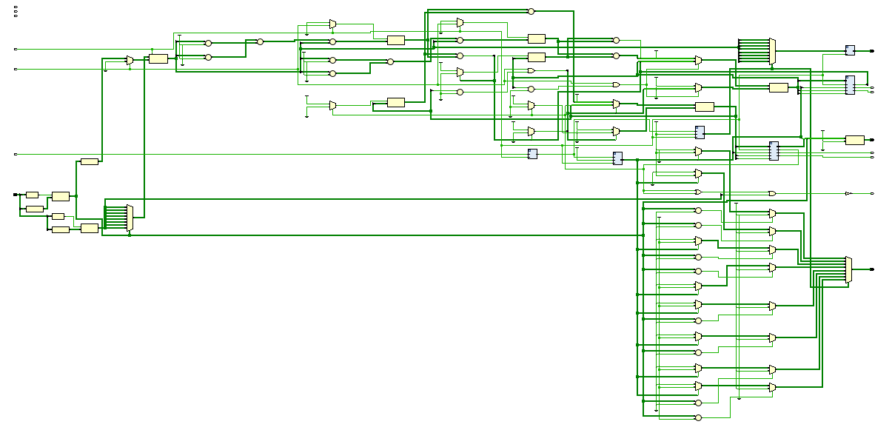
logic

Slide 3
logic
Short term memory
Step calculation
Stepper logic
Smart number display
Target (believed) position register

Slide 4
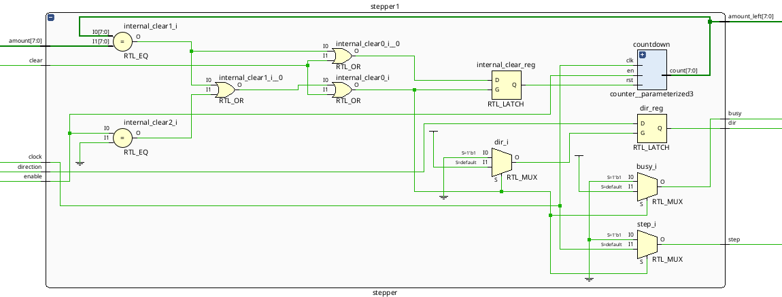
Stepper logic

Slide 5
Stepper logic

Slide 6
issues
- no auto-home function achieved
- the hardware fell apart before I could finish the software
- the number inputting system could be more intuitive
- math is done dirty-dirty

Slide 7
Dirty Math
reg1_motor1(7 downto 0) <= std_logic_vector(to_unsigned(to_integer(unsigned(reg_targetposition_motor1))-to_integer(unsigned(reg_currentposition_motor1)), 8));

Slide 8
Dirty Math
reg1_motor1(7 downto 0) <=
std_logic_vector(
to_unsigned(
to_integer(
unsigned(reg_targetposition_motor1)
)
-
to_integer(
unsigned(reg_currentposition_motor1)
),
8)
);

Slide 9
Dirty Math
reg1_motor1(7 downto 0) <=
std_logic_vector(
to_unsigned(
to_integer(
unsigned(reg_targetposition_motor1)
)
-
to_integer(
unsigned(reg_currentposition_motor1)
),
8)
);
Convert std_logic_vector binary arrays into integers

Slide 10
Dirty Math
reg1_motor1(7 downto 0) <=
std_logic_vector(
to_unsigned(
to_integer(
unsigned(reg_targetposition_motor1)
)
-
to_integer(
unsigned(reg_currentposition_motor1)
),
8)
);
Do math

Slide 11
Dirty Math
reg1_motor1(7 downto 0) <=
std_logic_vector(
to_unsigned(
to_integer(
unsigned(reg_targetposition_motor1)
)
-
to_integer(
unsigned(reg_currentposition_motor1)
),
8)
);
Convert integer back into unsigned std_logic_vector
binary array

Slide 12
End
This presentation totally was not made 1h before you saw it

