Slide 1
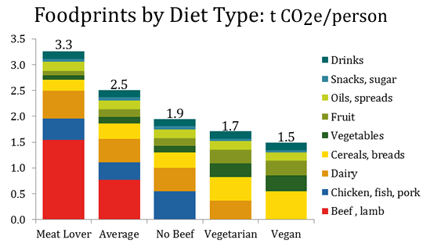

Be kind to all kinds: Go vegan!
Be kind to animals:
In today’s world, is it necessary to breed, exploit and kill animals for food, clothing and entertainment? Globally we kill over 80 billion land animals a year and trillions of marine animals. Are taste, habbit, convenience and tradition good enough reasons for you to justify doing this to living feeling conscious beings?
Every person going vegan saves about 100+ animals a year. Your choices matter.
Be kind to your planet:
What we eat is one of the biggest contributors to our individual carbon footprint. A vegan diet significantly reduces environmental impact, more than cutting flights or buying an electric car, affecting greenhouse gases, land and water.
Be kind to your health
According to the largest nutritionist associations in the world (the Academy of Nutrition and Dietetics), a well planned plant-based diet is appropriate for all stages of life. Research shows that a plant-based diet reduces the risk of chronic diseases like heart disease, diabetes, and certain cancers. Plant-based diets are rich in essential nutrients, fiber, and antioxidants, promoting better digestion and weight management. Choose plant-based foods for a healthier, longer life.
Go vegan today:
Going vegan is easy if you consider the animals’ perspective. If you would like guidance by experienced vegans and dieticians then go to challenge22.com. It’s completely free.
Find more resources at veganfuture.org

Slide 2
