Slide 1

Menu Sales Forecast
Capstone Project Summary

Slide 2

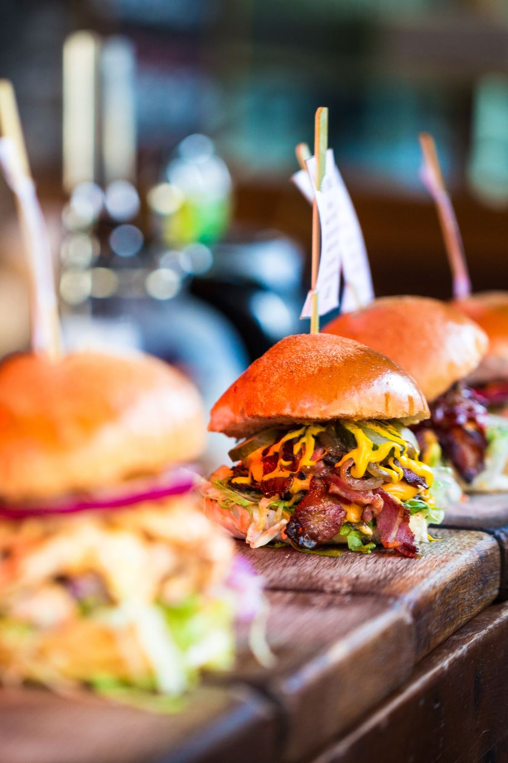
Top revenue generators for the restaurant
• Cali-Bae Rito
• Loaded Nachos
• El Classico
• Signature Fries
• Asada Taco

Slide 3
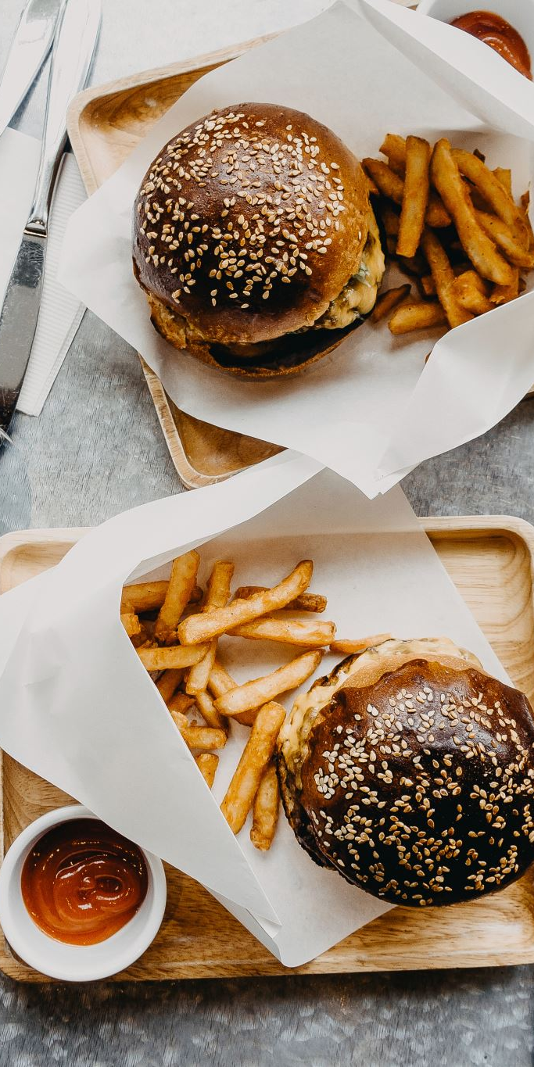
Seasonal Sales Trends
Cali-Bae Rito
El Classico
Loaded Nachos
Signature Fries
Cali Dreamin' Burger & Fries
Some menu items are more popular in certain months. By knowing when those times are, you can prepare early, stock up, advertise them more, and meet customer demand. This will help boost sales and avoid running out of your best items.

Slide 4

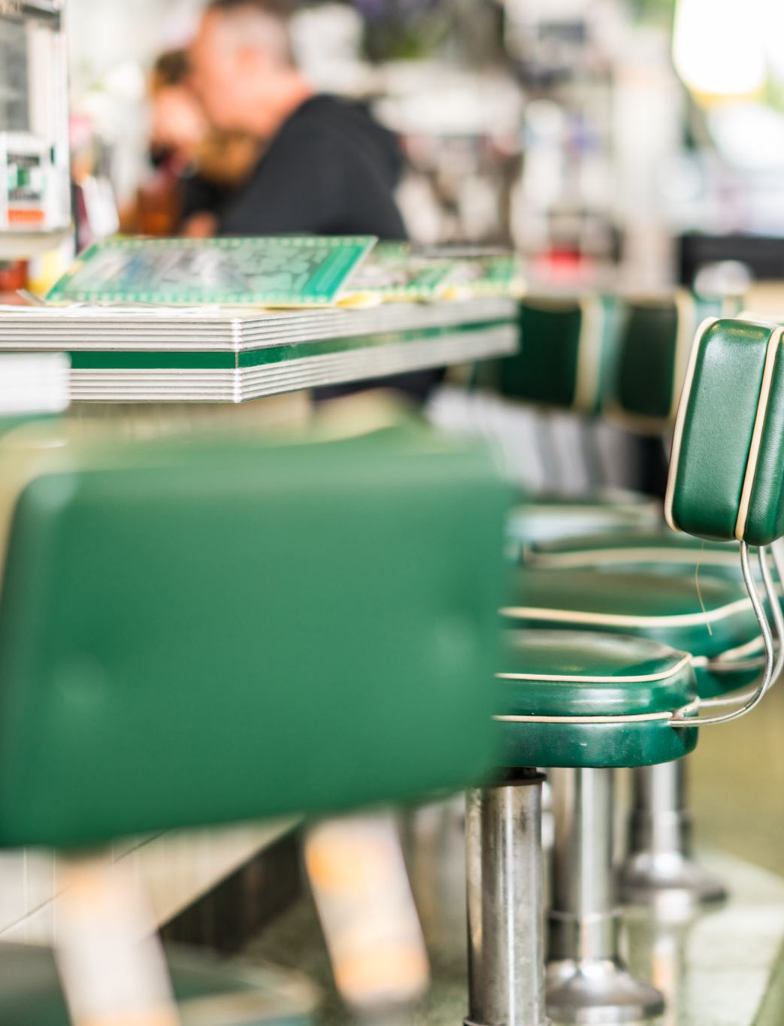
Recommendations for Action
By leveraging both trending and seasonal insights, the restaurant can make more informed decisions around stocking, staffing, and campaign timing to drive growth and reduce waste.
By focusing on what sells best and when it sells most, you can make smarter choices about what to order, when to run promotions, and how to cut back on waste.

