Slide 1

Menu Sales Forecast
Capstone Project Summary

Slide 2

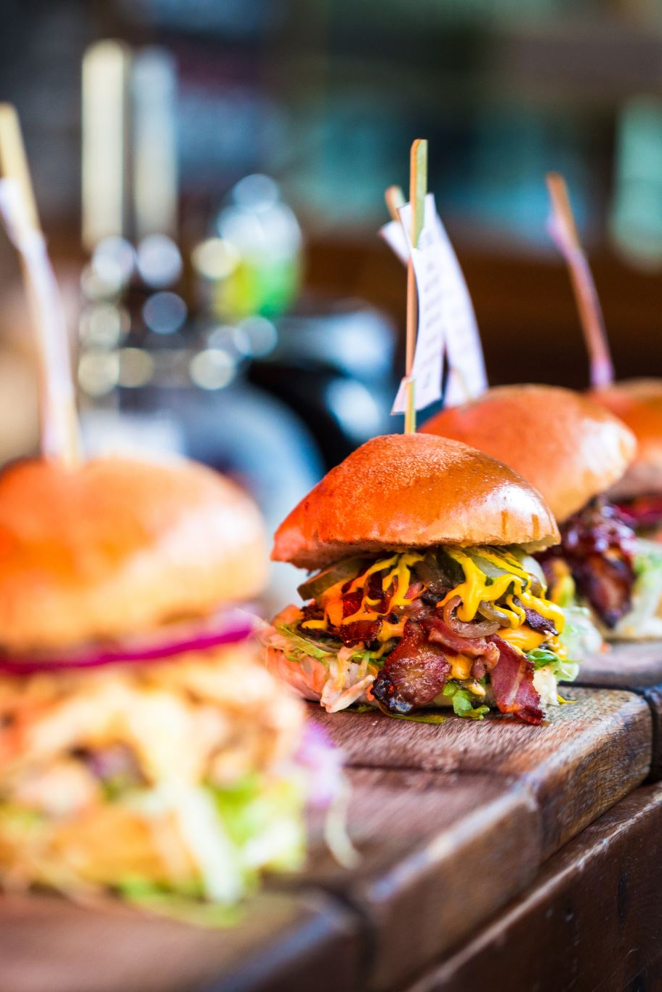
Top revenue generators for the restaurant
• Cali-Bae Rito
• Loaded Nachos
• El Classico
• Signature Fries
• Asada Taco

Slide 3
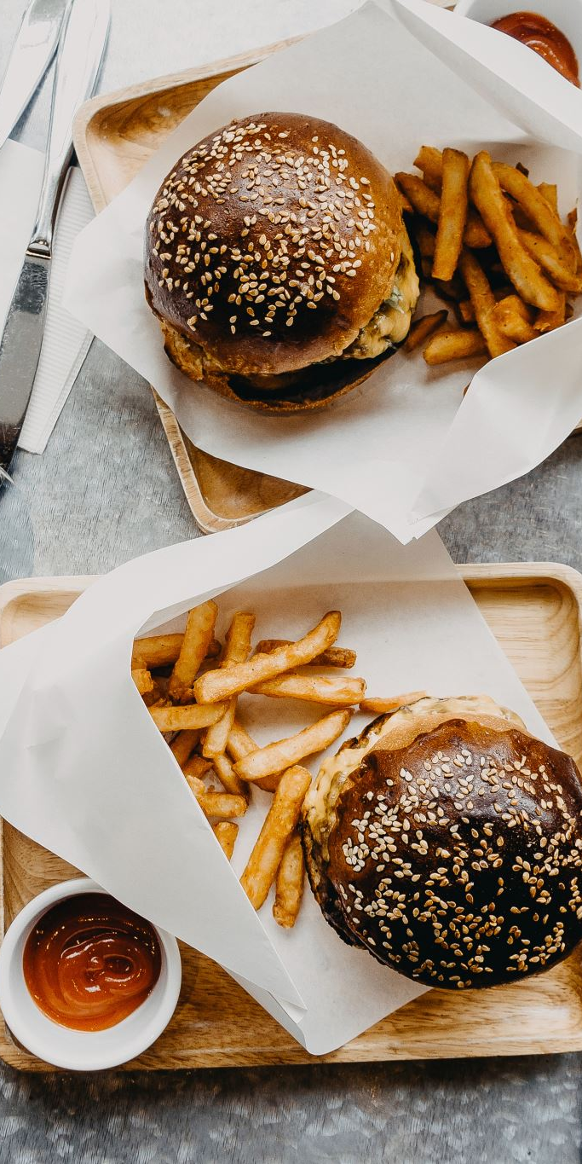
Seasonal Sales Trends
Cali-Bae Rito
El Classico
Loaded Nachos
Signature Fries
Cali Dreamin' Burger & Fries
Some menu items are more popular in certain months. By knowing when those times are, restaurant can prepare early, boosting sales and avoid running out of best menu items.

Slide 4

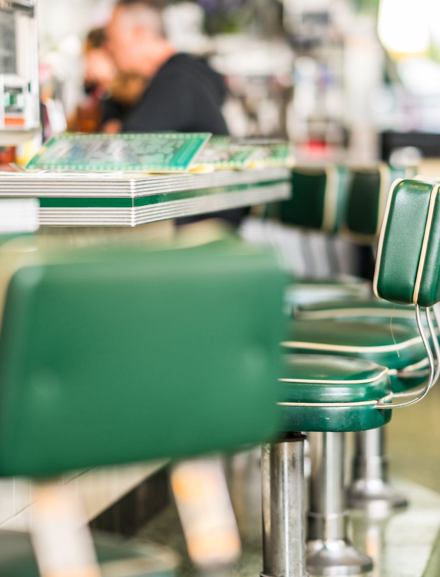
Recommendations for Action
By leveraging both trending and seasonal insights, the restaurant can make more informed decisions around stocking, staffing, and campaign timing to drive growth and reduce waste.
By focusing on what sells best and when it sells most, restaurant can make smarter choices about what to order, when to run promotions, and how to cut back on waste, and most importantly, labor cost reductions.

