Slide 1
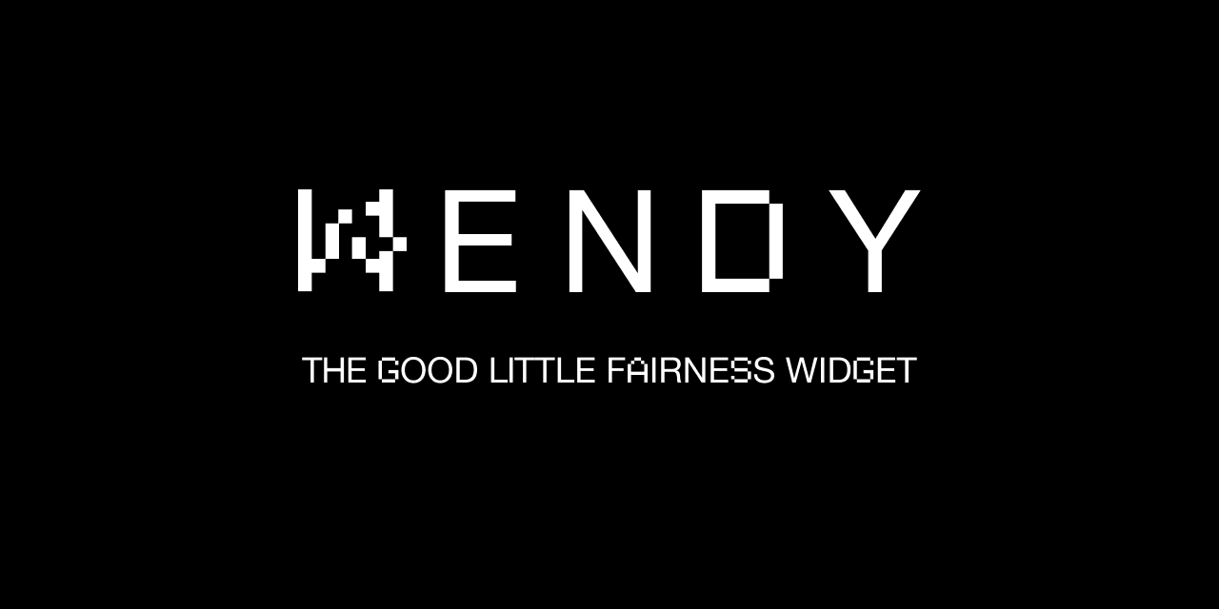

Slide 2
Fairness
If all honest validators see transaction a before transaction, then a must be in an earlier or the same block as b.
There’s some issues with that definition (e.g., we cannot guarantee termination), we’ll ignore that for the moment.
Timed Fairness: If there is a time t such that all honest parties saw a transaction tx1 before t and tx2 after t, then tx1 must be in an earlier or the same block as t2

Slide 3
Post Processing
So far, we only are concerned at getting transactions into the same block.
We can prove that this is (for some definitions) the best we can do
As all necessary information is supplied in the validation, we can do block post-processing to add inner block fairness (or a best effort thereof)

Slide 4
Market Identifiers
Not all transactions need
To be fair at all
To be fair relative to each other
The same definition of fairness
Thus, every transaction comes with a market identifier. Only transactions that have the same identifier block each other.
Special case: Transactions that need no fairness at all don’t need to wait for a vote message (might be not that special, actually. ‘None’ is just another fairness definition).

Slide 5
Basic Wendy
When a validator sees a transaction, it adds a sequence number and sends a vote for that transaction/sequence number to all validators
We call a transaction a preferred over b if, by the rules of fairness, it needs to be in an earlier or the same block
A validator collects votes and decides to delay some TXs from being passed to the blockchain. A transaction is blocked if
It is possible for a currently unknown transaction to be preferred; this is because an insufficient votes has arrived
A transaction is preferred that is already blocked.

Slide 6
Basic Wendy (2)
With more incoming votes, every transaction will get sufficient votes to not be blocked due to a possibly unknown transaction. It will then unblock itself and all other transactions blocked by it.
A transaction tx is blocked (by a so far unknown one) if it got less than t+1 votes. Once t+1 votes (in sequence) have arrived, no unseen transaction can have n-t votes preceeding tx.
A transaction tx1 is not preferred to another tx2, if at least t+1 parties reported having seen tx1 before tx2.
A vote from a validator is blocked is there is a vote with a lower sequence number missing.

Slide 7
Implementation
Wendy has two core parts:
The recompute function reevaluates which current transactions are blocked. To this end, for each active transaction, a set of transactions preferred over it (B) it is computed. If any transaction in that B is blocked due to insufficient votes, the transaction itself is blocked. Unblocked transactions are moved from the active bugger U to the blockchain buffer Q. This function calls two functions, is_blocked and is_blocked_by, which essentially define what fairness is.
The processMessage function evaluates incoming transactions and votes, cleans the buffers once a block has been delivered in the blockchain. It also makes sure that votes that come out of sequence are buffered and processed once their time has come.

Slide 8
Performance
Wendy runs parallel to the blockchain, and in that does not add latency. She does, however, delay transactions to later blocks.
Transactions that don’t need fairness can be passed through and suffer no delay
Three factors derived from the three blocking possibilities:
Insufficient votes: A transaction cannot be processed yet as there aren’t enough votes on it to know if it can be scheduled
Blocking: A transaction needs to be in the same block as one of the above category
Out of order votes: Voting messages are overtaking each other; Wendy needs to see a full sequence and thus needs to wait for the faster one

Slide 9
First Measurements
Insufficient votes depend directly on the ratio message-delivery time/block-creation time. The number of TXs delayed there is pretty much exactly that ratio
Blocked TXs added another ~15-30% of those in our simulations. This depends on several parameters:
Variation of the speed in which transactions arrive at validators
Number of TXs blocked through insufficient votes
Msg/Block-ratio as above, since many conflicts are resolved before the next block is ready
In a halfway normal network, vote overtaking had no impact. If we model erratic behavior (adding a multiple of the normal message delivery times at random), we can make this arbitrarily bad. (Factor 3 = ca 50 percent of transactions delayed).

Slide 10
Fairness Switch
As the fairness is only implemented in two functions, we can switch to a different definition with little effort
This can be done on the fly; all we need to do is recompute the blocking sets, which we do anyhow all the time.

Slide 11
Open Questions
What if the capacity of the underlying blockchain can’t keep up at all times

