Slide 1
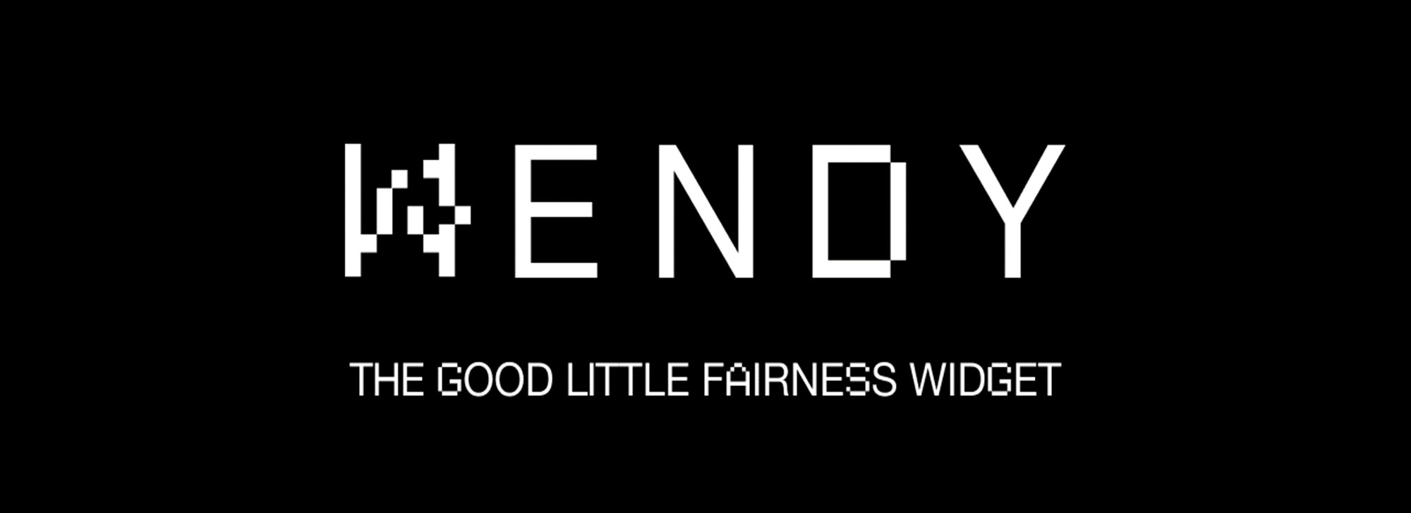

Adding order policies to the Consensus Level
Grows up
Klaus Kursawe, klaus@vega.xyz

Slide 2
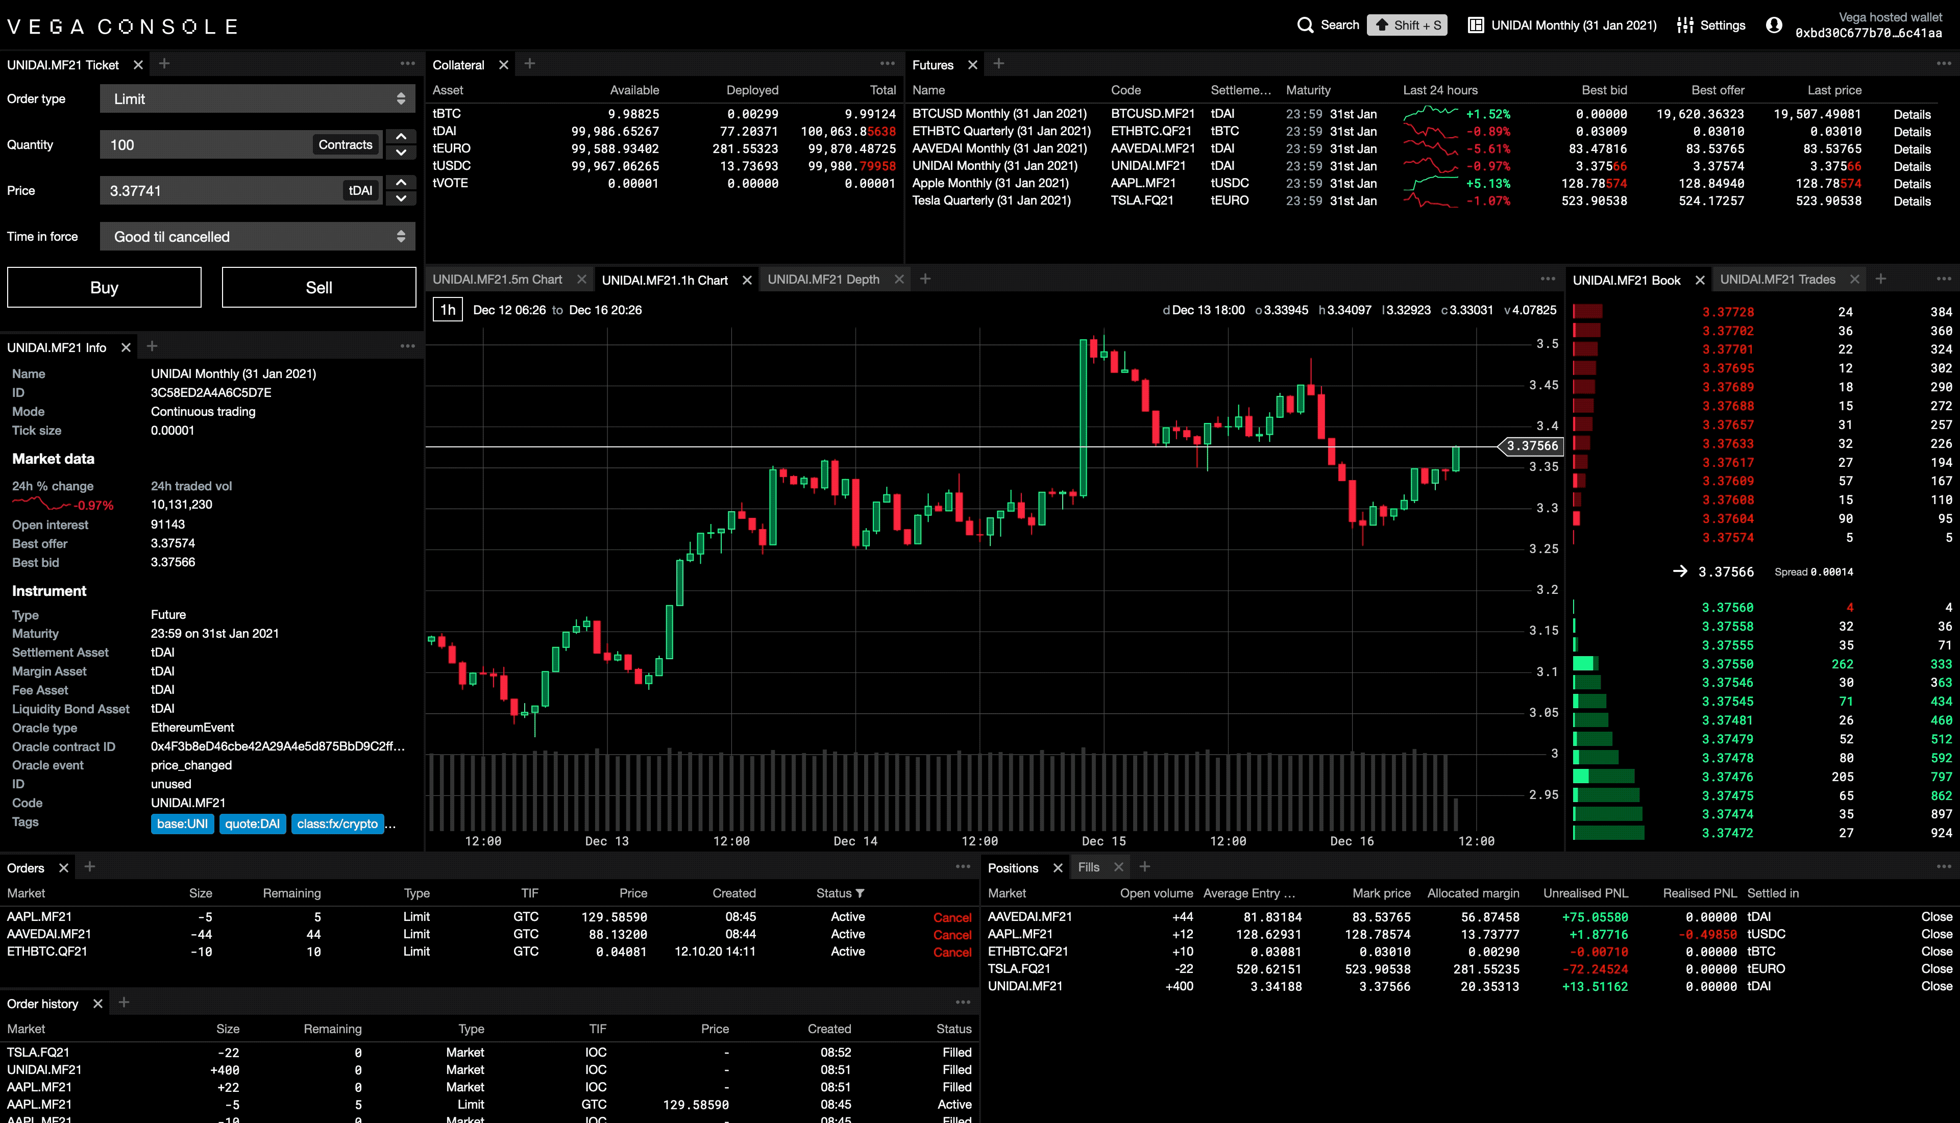

Our Motivation
Vega use case: Derivative trading
Convince traders from a Centralised exchange that DeFi is an alternative
The price of decentralisation is a larger attack surface
30+ years of work in consistent orders, much less on what’s a ‘good’ order
Less loss to flash traders than on a CEX
Minimal latency impact
Validator Policies
Allow for economic policy encouragement for validators (Diversity, performance, …)
Cost control (fees from trader revenue, not per transaction)
Goal: Integration into the consensus layer as a modular add on
Don’t want to mess with the code
Don’t want to run an external service
Original chain is a BFT style protocol
End goal: Toolset for (kind of) everyone

Slide 3
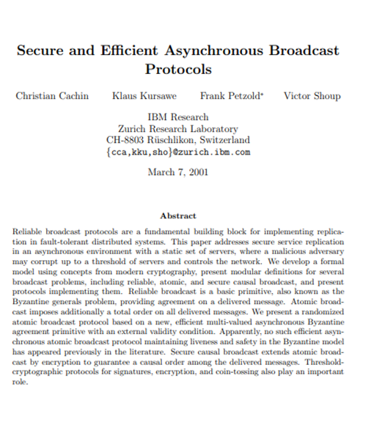
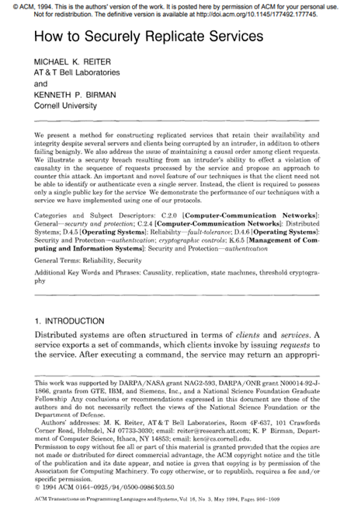
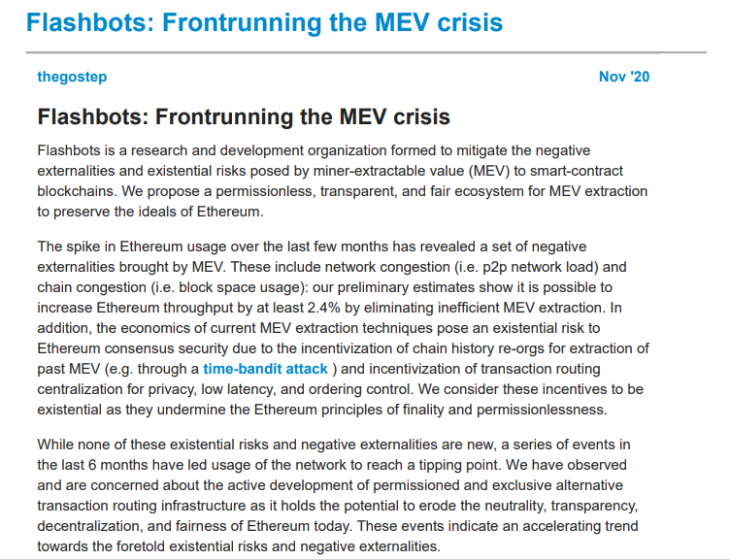
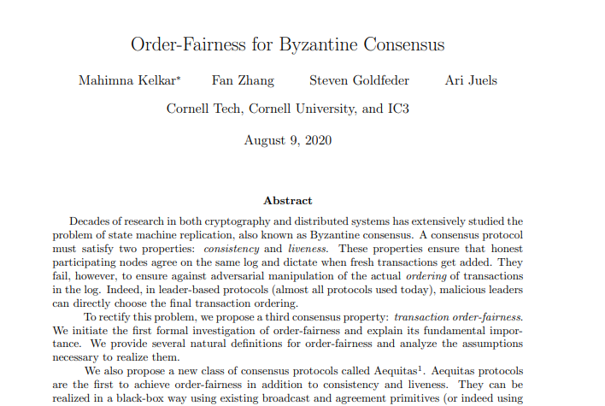
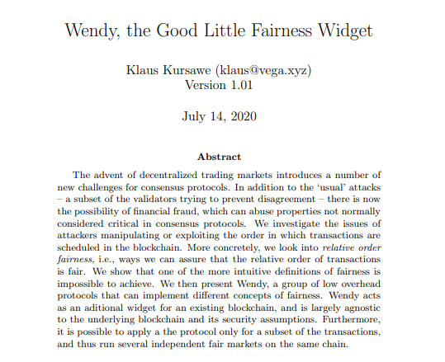
State of the Defense
Make it harder by distributing influence over validators
Leaderless Protocols [CKPS01, Honeybadger]
Fast Leader Switching [Tendermint, Hotstuff]
Control the Financial damage by spreading the MEV Proceeds
Causal Order/Commit & Reveal [RB95,CKPS01]
Block order Fairness:
Aequitas [KZGJ20]
Wendy [SFBW19,K20]
eprint.iacr.org/2020/269.pdf
youtu.be/Dd-U0ynFH14?t=1955
eprint.iacr.org/2020/885.pdf
users.ece.cmu.edu/~reiter/papers/1994/TOPLAS.pdf
eprint.iacr.org/2001/006
vega.xyz/background/
Notes:
https://youtu.be/Dd-U0ynFH14?t=1955

Slide 4
Fairness definitions & impossibilities
If all honest parties saw a before be, schedule a before b
This isn’t always decidable (there’s loops/Condorcet paradoxes)
It isn’t even always decidable if it is decidable
If all honest parties saw a before b, put a in a block no later than b
Make a best effort to sort the rest out later
Needs potential unlimited blocksize (loops/paradoxes can be of arbitrary size, even with synchronous communication)
If there’s a time t so that all honest parties saw a before b, schedule a before b
Weaker than above, but no paradox

Slide 5
State of the Defense
Wendy 2.0:
Marry Causal order with block order
Design a block order framework for different policies
Make it harder by distributing influence over validators
Leaderless Protocols [CKPS01, Honeybadger]
Fast Leader Switching [Tendermint, Hotstuff]
Control the Financial damage by spreading the MEV Proceeds
Causal Order/Commit & Reveal [RB95,CKPS01]
Block order Fairness:
Aequitas [KZGJ20]
Wendy [K20]

Slide 6
Setup & Model (Highlights)
Known set of n Validators
Validators know (and authenticate) each other
For registrationless protocols, we can use a separate/subset
A fraction of validators are corrupt, and collaborating with clients (t out of n)
We’re still thinking about a hybrid coordinated/uncoordinated selfish attack model
Fully Asynchronous Communication
We only assume that all messages arrive eventually
Individual policies may require additional assumptions
Number of corruptions, access to clocks, synchrony
We provide an add-on for an existing consensus layer
There are no hard requirements, but mempool implementation matters.
A truly non-finalizing blockchain would be memory-unfriendly
Integration with reward schemes needs to be done with care
Multi-Use Chain
We assume that transactions have labels. Only transactions with the same label need to be (relatively) fair to each other. Transactions with no label bypass the fairness protocol completely.
Notes:
I don’t want to call it permissionless, rather registrationless
Standard Asynchronous model
The corruption model needs update to include selfish validators (let me know if you have thoughts)
For some protocols, we may need a casper like approach and use different (sub) sets of validators
We support different concepts of fairness; they (and the blockchain) may bring their own assumptions

Slide 7
The Framework Protocol
Make sure all block creators have all required information
Dissemination
Every validator multicasts the order of received transactions
Simple Multicast with Sequence Numbers & Signatures
Evert transaction also gets all potentially relevant metadate (time of arrival, proposed fees, sender properties,…)
Can be reliable broadcast to trade communication for computation
Compute Blocking Sets
Transactions that by current fairness rules can’t be scheduled given current information are held back
Dependency list on what must go together
Some TXs are blocked and block every TX dependent on them
Determine which transaction needs to be delayed and which can be revealed
Reveal
Once a transaction can be revealed, multicast it’s decryption share
Interface with consensus layer
Blockchain interaction
On delivery of a block, transactions are deleted from the blocking and dissemination stage
All unblocked transactions are put in the next block together with their blocking sets (assuming sufficient capacity)
Postprocessing
All transaction in a delivered block are ordered according to fairness rules where possible
Order blocks internally
Notes:
Blocking set = what I’m blocked by or what I’m blocking ?

Slide 8

Blocking & Revealing rules (local)
Blocked
Given the current knowledge, it is possible that a currently unknown transaction gets precedent over this transaction or one it depends on
Given the current knowledge, a known and undelivered transaction could still take precedence
Depends on
Given the current knowledge, the transaction gets precedence over all newly generated transactions
Revealable
Weakly Revealable
Given the current knowledge, the transaction is not blocked and no newly generated transaction can take precedence
Notes:
Block order implementation (Timed fairness is more complicated)
t+1: low latency, potential missing information for the postprocessing
N-t: optimal postprocessing
monotone

Slide 9
Policy Examples: Fair Block Order
If all honest parties see T1 before T2, then T1 must be in the same or an earlier block than T2
(and, where possible, T1 needs to be scheduled before T2 in the postprocessing. This can sometimes be undecidable).
A transaction T is blocked, if less than t+1 valid votes are received.
At this point, one honest party has shown me all transactions they saw before T. Thus, no transaction I don’t know can get precedence over T.
A transaction T1 does not depend on T2, if t+1 valid votes have arrived that report T1 before T2.
At this point, at least one honest party has not seen T2 before T1, so its not possible that all honest parties saw T2 before T1.
A transaction T is revealable, if n valid votes for it have arrived
At this point, all honest parties have reported T and all transactions they’ve seen before, so all honest parties have seen T before any transaction that will be created now
A transaction T is weakly revealable, if n-t valid votes have arrived for T
This means that the t+1 honest parties have sent their votes for T, so all honest leaders will unblock. It’s also not possible for any new transaction to get precedence over T.

Slide 10
Policy Requirements and Caveats
Measurable
Assure a block proposer gets all required information in the chosen model (e.g., asynchronous Byzantine)
Assure the information is reliably obtainable
If all parties saw a before b… difficult in the asynchronous byzantine model
If a was send before b… requires secure, authenticated timestamping for clients
Loop-Free
Avoid a loop of transactions that all need to be scheduled before each other
If all honest parties saw a before b, … potential loops
Efficiently Terminating
Every transaction is released ‘fast’.
If a offers more gas than b, then a must be scheduled before b…. We’ll never know if there is such an a
If all honest parties saw a before b… there is no upper bound for above loops
Monotonous:
Once you’re unblocked, you stay unblocked.
If we don’t have that, there’s some limited room for a validator to cheat; if I have an unblocked transaction x, and a later transaction y that would block it, I can pretend to not have seen y until x is safely delivered.
Also, if we don’t have that we can’t help much with causal order/commit & reveal
If (known) a has paid more gas than b, then… A late transaction can block a previously unblocked one
Notes:
Terminating is very strong: As a transaction is blocked if insufficient information is present, it also requires that there is a guarantee that sufficient information will come eventually. It also covers exceeding the block capacity (essentially, if that happens, we don’t terminate).

Slide 11
Policy Examples: Fair Block Order
If all honest parties see T1 before T2, then T1 must be in the same or an earlier block than T2
(and, where possible, T1 needs to be scheduled before T2 in the postprocessing. This can sometimes be undecideable).
A transaction T is blocked, if less than t+1 valid votes are received.
At this point, one honest party has shown me all transactions they saw before T. Thus, no transaction I don’t know can get precedence over T.
A transaction T1 does not depend on T2, if t+1 valid votes have arrived that report T1 before T2.
At this point, at least one honest party has not seen T2 before T1, so its not possible that all honest parties saw T2 before T1.
A transaction T is revealable, if n valid votes for it have arrived
At this point, all honest parties have reported T and all transactions they’ve seen before, so all honest parties have seen T before any transaction that will be created now
A transaction T is weakly revealable, if n-t valid votes have arrived for T
This means that the t+1 honest parties have sent their votes for T, so all honest leaders will unblock. It’s also not possible for any new transaction to get precedence over T.
Not loop free.
Not Terminating

Slide 12
Requirements Workarounds
Adapt the system requirements. If that fails, same as effective termination.
Measurable
Assure a block proposer gets all required information in the chosen model
Assure the information is reliably obtainable
If all parties saw a before b… difficult in the asynchronous byzantine model
If a was send before b… requires secure, authenticated timestamping for clients
Loop-Free
Avoid a loop of transactions that all need to be scheduled before each other
If all honest parties saw a before b, … potential loops
Efficiently Terminating
Every transaction is released ‘fast’.
If a offers more gas than b, then a must be scheduled before b…. We’ll never know if there is such an a
If all honest parties saw a before b… there is no upper bound for above loops
Monotonous:
Once you’re unblocked, you stay unblocked.
If we don’t have that, there’s some limited room for a validator to cheat; if I have an unblocked transaction x, and a later transaction y that would block it, I can pretend to not have seen y until x is safely delivered.
Also, if we don’t have that we can’t help much with causal order/commit & reveal
If (known) a has paid more gas than b, then… A late transaction can block a previously unblocked one
Put all transactions in a loop into the same block and let the application decide on an order
Detect that we are not terminating (fast enough), and temporarily switch to weaker policy to resolve the deadlock
Accept that there is a limited way to cheat, and don’t use this with commit & reveal
Notes:
Terminating is very strong: As a transaction is blocked if insufficient information is present, it also requires that there is a guarantee that sufficient information will come eventually. It also covers exceeding the block capacity (essentially, if that happens, we don’t terminate).

Slide 13
Policy Examples: Timed Fairness
All parties have local clocks. If there is a time τ such that all honest parties see T1 before τ and T2 after τ (according to their local clocks), then T1 must be scheduled before T2
A transaction T is blocked, if less than t+1 valid votes are received.
Now one honest party has reported all transactions it saw up to T. Any unknown transaction will get a bigger timestamp from it and thus can’t have precedence.
Consider a time τ’ such that at least one honest party saw T before and one after τ’. Let’s call that tau(T)
A transaction T1 does not depend on T2, if tau(T1) < tau(T2).
If T2 had to be scheduled before T1 by above rule, then its tau value would have to be smaller .
A transaction T is revealable, if n parties have reported T as well as a transaction with a timestamp larger than the maximum of the timestamps on T.
Thus, the maximal timestamp on T is the τ w.r.t to any new transaction
A transaction T is weakly revealable, if t+1 valid votes have arrived for T
This means T is no longer blocked, and it is not possible anymore that any other vote gets precedence

Slide 14
Policy Examples: Capitalistic plus social security
For each block, schedule the highest paying known transactions at the time the block is prepared. Transactions get a bonus for waiting, so no transaction needs to wait forever.
A transaction T is blocked, if less than t+1 valid votes are received.
We want to be sure that any transaction in a block was seen by an honest party, and no transaction all honest parties have seen before it can be completely ignored.
Let f(T) be the fee paid for transaction T and w(T) be the number of blocks T waited since being unblocked. A transaction T1 depends on T2, if t+1 valid votes have arrived for T1 and T2, and f(T2) *1.1^w(T2)> f(T1) *1.1^w(T1)
Essentially, the highest non-blocked gas fee with a waiting multiplier wins.
This terminates for every transaction as long as there is a minimal fee unit and a maximal amount of money.
A transaction T is (weakly) revealable, if it is in a finalized block
We don’t have monotony, so revealability does not work here.

Slide 15
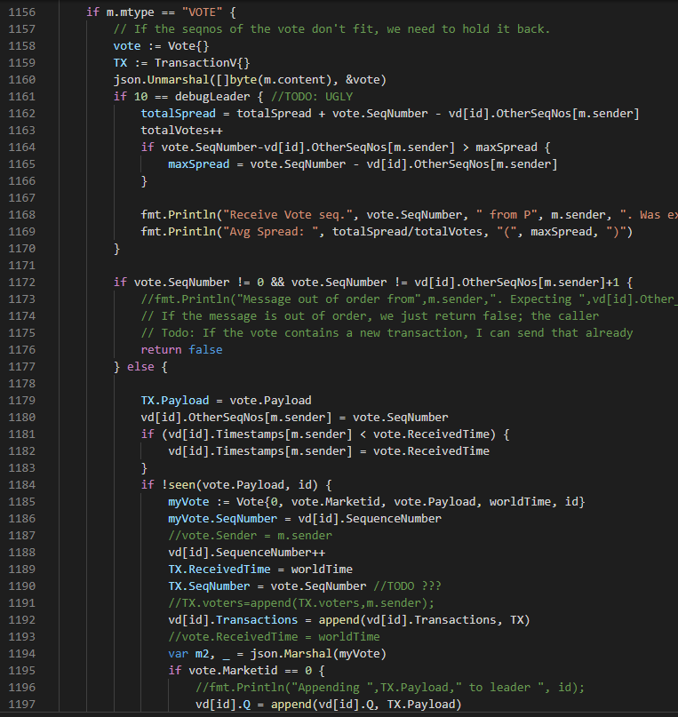
Performance Measurements & Integration
Wendy runs parallel to the blockchain, and in that does not add latency. She does, however, delay transactions to later blocks.
Transactions that don’t need fairness can be passed through and suffer no delay
The dominant latency factor is waiting for enough input to unblock a transaction Blocked Transactions: A transaction cannot be processed yet as it is blocked
The ratio of those is the ratio of message delivery time to block processing time
This is in line with expectations.
Transactions blocking each other add another 10-30 percent of the blocked transactions
Our results assume that the blockchain does not change the order of events proposed by Wendy
We can work with a non-collaborative blockchain, but it will cost a lot of performance
If a blockchain needs the ability to drop messages due to overload, this needs to be coordinated with Wendy
Fees can be an issue; on Ethereum, for example, a high priority message that doesn’t pay gas is a problem.
Wendy Prototype/Simulator: https://github.com/vegaprotocol/wendy

Slide 16

Hello, Ethereum
Wendy can work as an add-on (like Caspar)
Can make C&R more efficient, as non-finality is no longer an issue
Can be used individually for each smart contract
Performance impact very low due to slow(er) blocktimes
Needs a defined set of fairness-validators
Needs hooks into block/transaction validity verification
Needs a mechanism to resolve conflict between the native ordering mechanism (gas fees) and the Wendy policy

Slide 17
Grows up
Klaus Kursawe, klaus@vega.xyz,@chezklaus

