Slide 1
DISC DEXPI Blueprint use cases
The Blueprint files were initially created as an aid to the CAD tool DEXPI programming work. These files were then extended with ‘versions’ to include minor drafting updates so that the requirements for Persistent ID usage could be tested (Ref: Table 1)
This document gives an overview of the Blueprint use case versions:
what is changed between versions
naming convention use for Blueprint ‘sets’ and versions
DEXPI class type | Comment | Persistent ID
PlantStructureItem | All subtypes which are included in the export | Required
Note |  | Required
PipeOffPageConnector |  | Required
SignalOffPageConnector |  | Required
Equipment | All subtypes which have a representation on the P&ID | Required
Nozzle | NOT included: items without a RepresentationTypeGroup (Graphical representation) | Required
ProcessColumnComponent |  | Required
PipingNetworkSystem |  | Required
PipingComponent | All subtypes which have a representation on the P&ID. NOT included: items without a RepresentationTypeGroup (Graphical representation) | Required
ControlledActuator |  | Required
ProcessInstrumentationFunction | And subtypes. | Required
InstrumentationLoopFunction |  | Required
SignalConveyingFunction | NOT included: MeasuringLineFunction | Required
PipingNetworkSegment |  | Not Required
PipingConnection |  | Not Required
MeasuringLineFunction |  | Not Required
ActuatingElectricalFunction |  | Not Required
ActuatingSystem |  | Not Required
ActuatingFunction |  | Not Required
ProcessSignalGeneratingFunction |  | Not Required
ProcessSignalGeneratingSystem |  | Not Required
TransmissionSystem |  | Not Required
SensingLocation |  | Not Required
PropertyBreak |  | Not Required
OperatedValveReference |  | Not Required
PipingNode |  | Not Required
Pipe |  | Not Required
Table 1: Persisent ID Requirements DISC DEXPI

Slide 2
Use Cases – DEXPI 2.0
Base BluePrint File
Safety elements ESV, PSD, ESD, LST mapped as ProcessSafetyFunction
Split DEXPI PipingNetworkSegment with a piping tee. E.g. split D-20L00004A DEXPI PipingNetworkSegment by placing a piping tee between the ESV0006 actuated valve and the FE0001 element and include an unnamed valve.
Rename TI0003/TIC0003/TV0003 to TI0013/TIC0013/TV0013 and update associated loop.
Retain the original PersistentID and change the name.
Remove the note and unused nozzle from 20VA001 and update elevation to EL. 400000
Change the type of actuator for HV0001 to a PA006A actuator type
Retain PersistentID of original actuator
Add heat tracing to PipingNetworkSegment D-20L A- PL-AS200-
Modify the heat trace attribute on the segment
Modify TI0007 combination -> TW/TT combination with Special Item on PipingNetworkSegment
** Use ND0037 ‘hidden’ in-line piping component to give location of special item.
Additional property break at one of the break
Add AreaBreak AP110 / AP310 need to associate these to the PipingNetworkSystems
Scale D-20HA001 symbol y-axis scaling 1.25
Modify pipe lines: D-20L00005A-1200PL-AS200- & D-20L00015A-0800PL-AD750- to test PipingNetworkSegment export variants

Slide 3
Use Cases - continuation
Add pump driver. Add VortexBreaker internal. Change NormalPosition for valve D-VG20-0001 to ‘NC’
Add Mount-on level element (Remove N04) & Add NOA3 continuation drawing
Add CustomEquipmentPackage and add MechanicalJoint

Slide 4
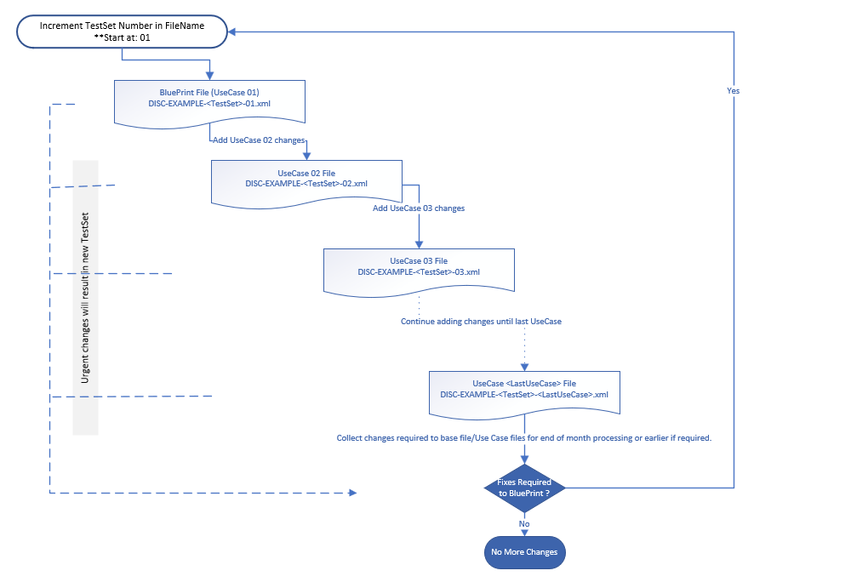
Use Case File Naming - Workflow

Slide 5
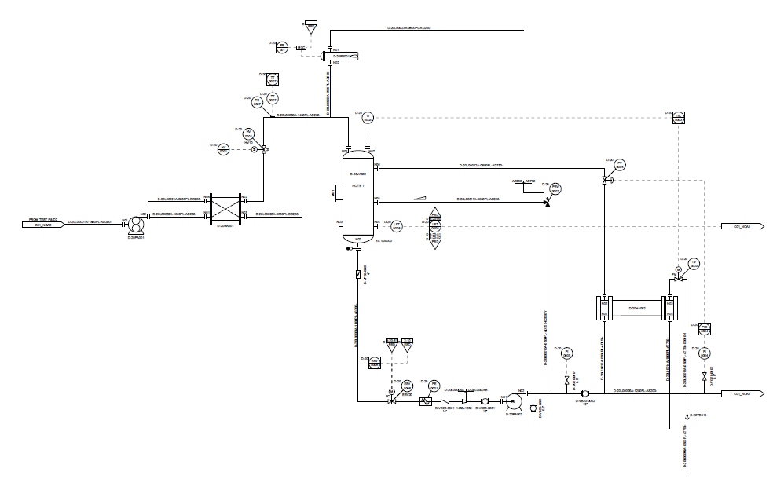
Base BluePrint File

Slide 6
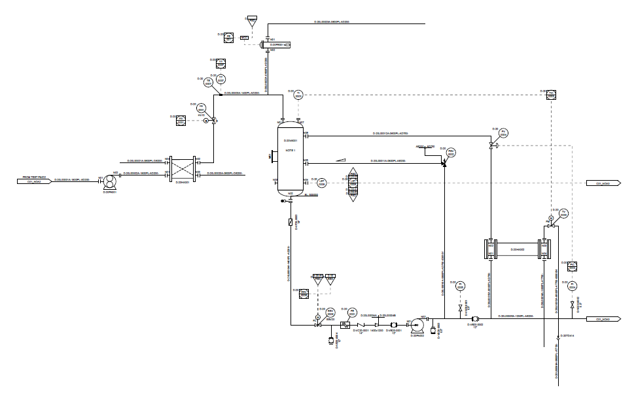
Split DEXPI PipingNetworkSegment with a piping tee. E.g. split D-20L00004A DEXPI PipingNetworkSegment by placing a piping tee between the ESV0006 actuated valve and the FE0001 element and include an unnamed valve.

Slide 7

Rename TI0003/TIC0003/TV0003 to TI0013/TIC0013/TV0013 and update associated loop.
Retain the original PersistentID and change the name.

Slide 8
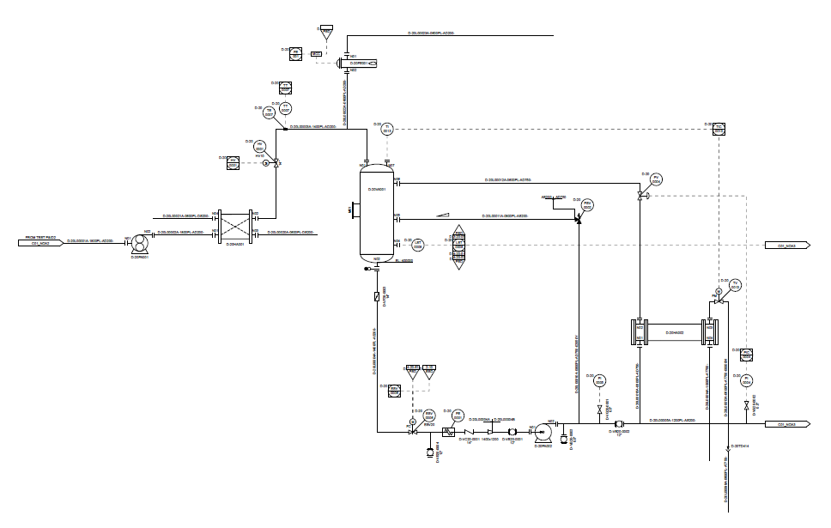
Remove the note and unused nozzle from 20VA001 and update elevation to EL. 400000

Slide 9
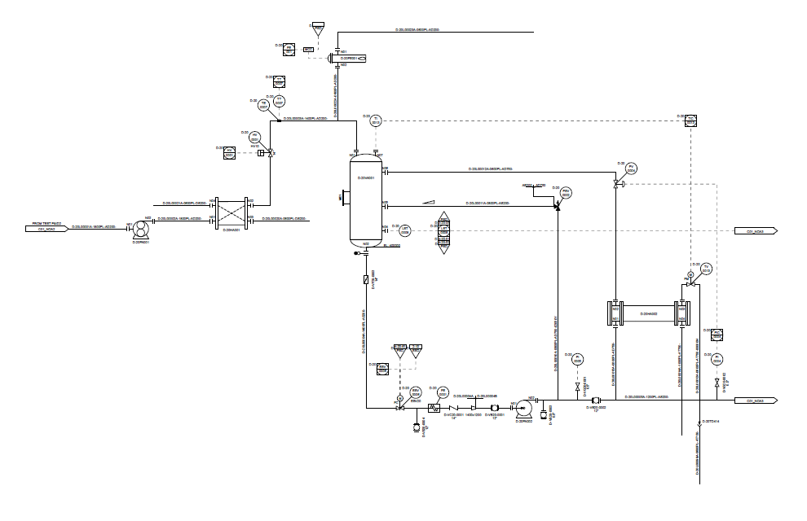
Change the type of actuator for HV0001 to a PA006A actuator type
Retain PersistentID of original actuator

Slide 10
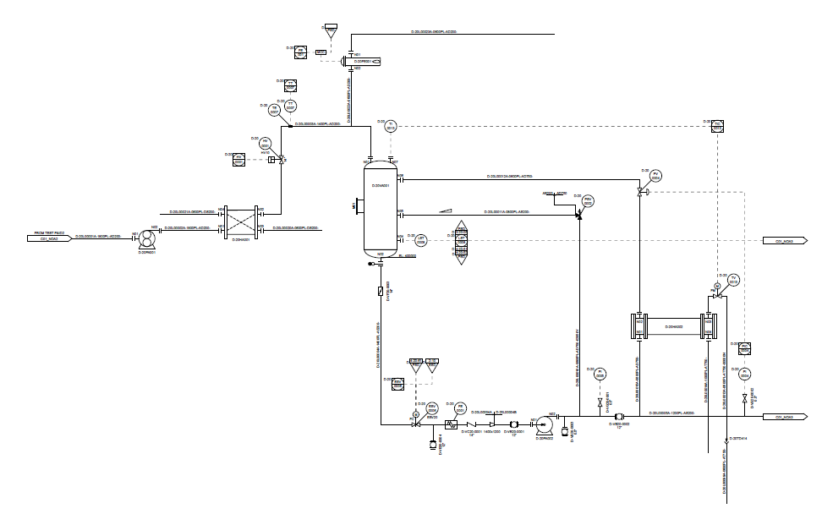
Add heat tracing to PipingNetworkSegment D-20L A- PL-AS200-
Modify the heat trace attribute on the segment

Slide 11

Modify TI0007 combination -> TW/TT combination with Special Item on PipingNetworkSegment
** Use ND0037 ‘hidden’ in-line piping component to give location of special item.

Slide 12

Additional property break to the existing breaks
Add AreaBreak AP110 / AP310 need to associate PlantArea these to the PipingNetworkSystems
** Test transfer of PropertyBreak:
Top break: use PropertyBreak class elements and separate LogicalBreak class elements for each break type.

Slide 13
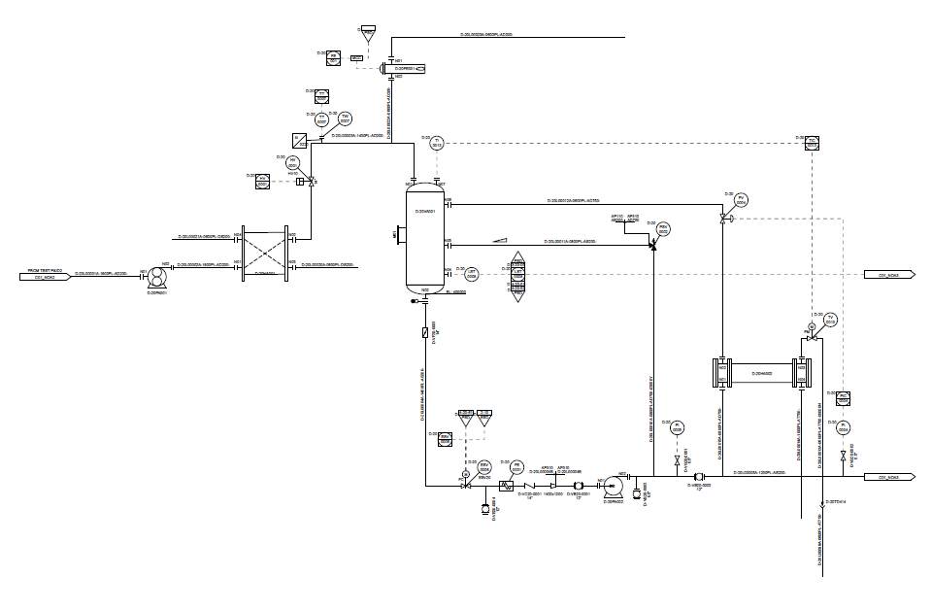
Scale D-20HA001 symbol y-axis scaling 1.25

Slide 14
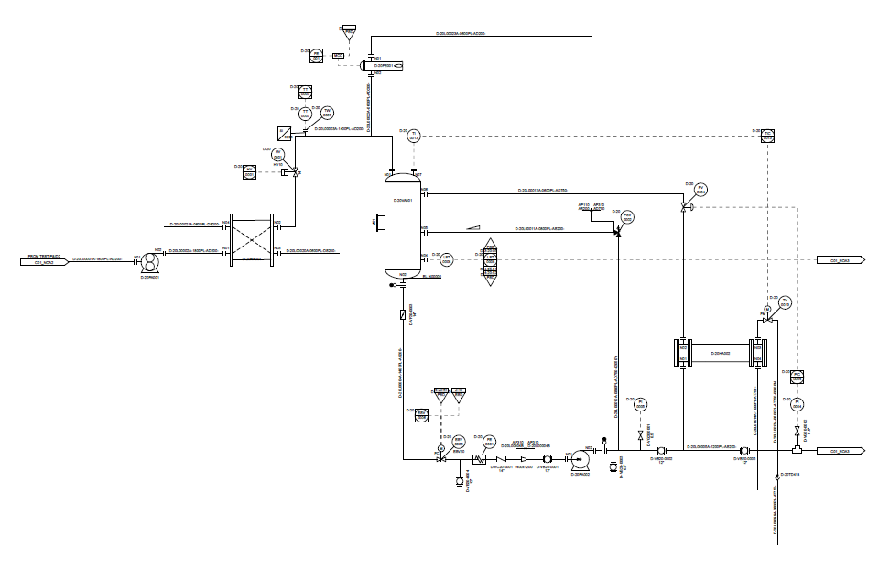
Modify pipe lines: D-20L00005A-1200PL-AS200- & D-20L00015A-0800PL-AD750- to test PipingNetworkSegment export variants
Convert D-20L00015A-0800PL-AD750- into a segment of D-20L00005A-1200PL-AS200- where all piping properties will be the same as D-20L00005A-1200PL-AS200- main pipe.
Add spectacle blind
Add physical piping tee near OPC.
Add ball valve D-VB20-0005
2 PipingNetworkSegments will be created either side of the ball valve D-VB20-0002 that is part of the main line.

Slide 15
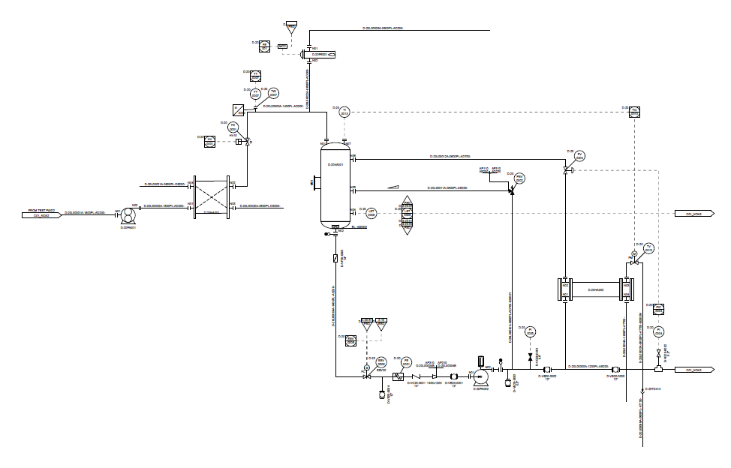
Add driver for pump. Add VortexBreaker internal.
Add pump driver.
Add VortexBreaker internal
Change NormalPosition for valve D-VG20-0001 to ‘NC’

Slide 16
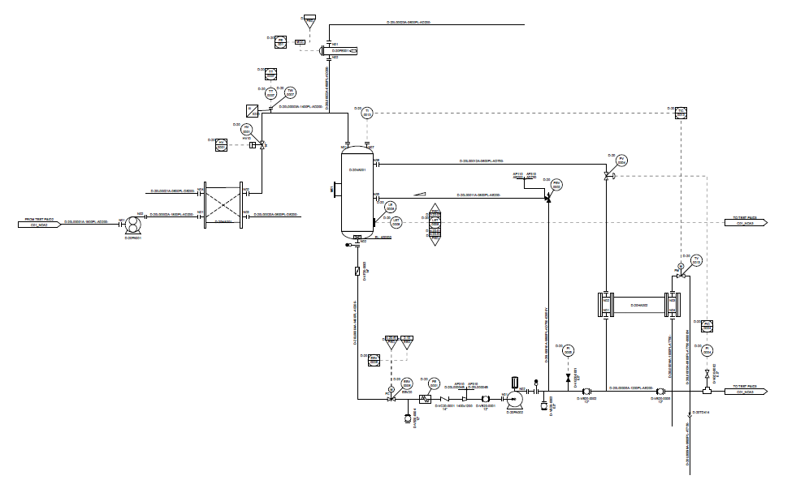
Mount-on & Off-Page Signal
Add Mount-on level element
Remove N04
Add NOA3 continuation drawing

Slide 17
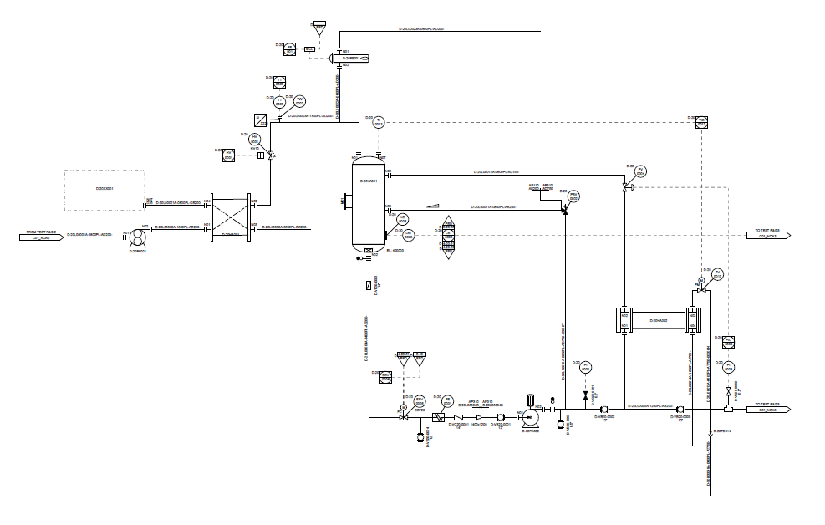
Add CustomEquipmentPackage
Add CustomEquipmentPackage
Add MechanicalJoint

