Slide 1
AI POD · AIMWG SYSTEM-WIDE
The AI POD, From the Metal Up
Why we run our own models on our own floor — the runtime, the model, the memory math, the supply chain, and what comes next.
Harsha Vegesri · Principal AI Architect, AIIM · FHLB Des Moines
Notes:
Opening. I'm not here to prove the platform is clever — I'm here to show that a regulated bank can run its own models, on its own floor, under its own governance, and that the R&D was money well spent. Everything in this talk is built so the true thing is simple to say, with a second and third layer ready if you pull the thread.

Slide 2
THE ONE-LINE THESIS
We turned a two-GPU appliance into a governed model-hosting platform — so our teams build AI the same way they build every other application, without a token leaving the building.
PART ONE
PART TWO
PART THREE
The Engine Room
What the R&D Bought Us
What's Next
Runtime, model, memory, and the scan — why each choice is what it is.
Supply chain, container expansion, infrastructure as code.
Foundation tech, admission, stateless workloads, the platform as model host.
2
Notes:
Say the thesis first, then walk the three parts. The room should leave knowing the point is not 'we ran a model' — it's 'we built a place teams can build on.'

Slide 3
PART ONE
The Engine Room
3
Notes:
The five technical topics. For each: the concept plainly, why we chose it for our box, the honest trade-off, and the answer for whoever raises a hand.

Slide 4
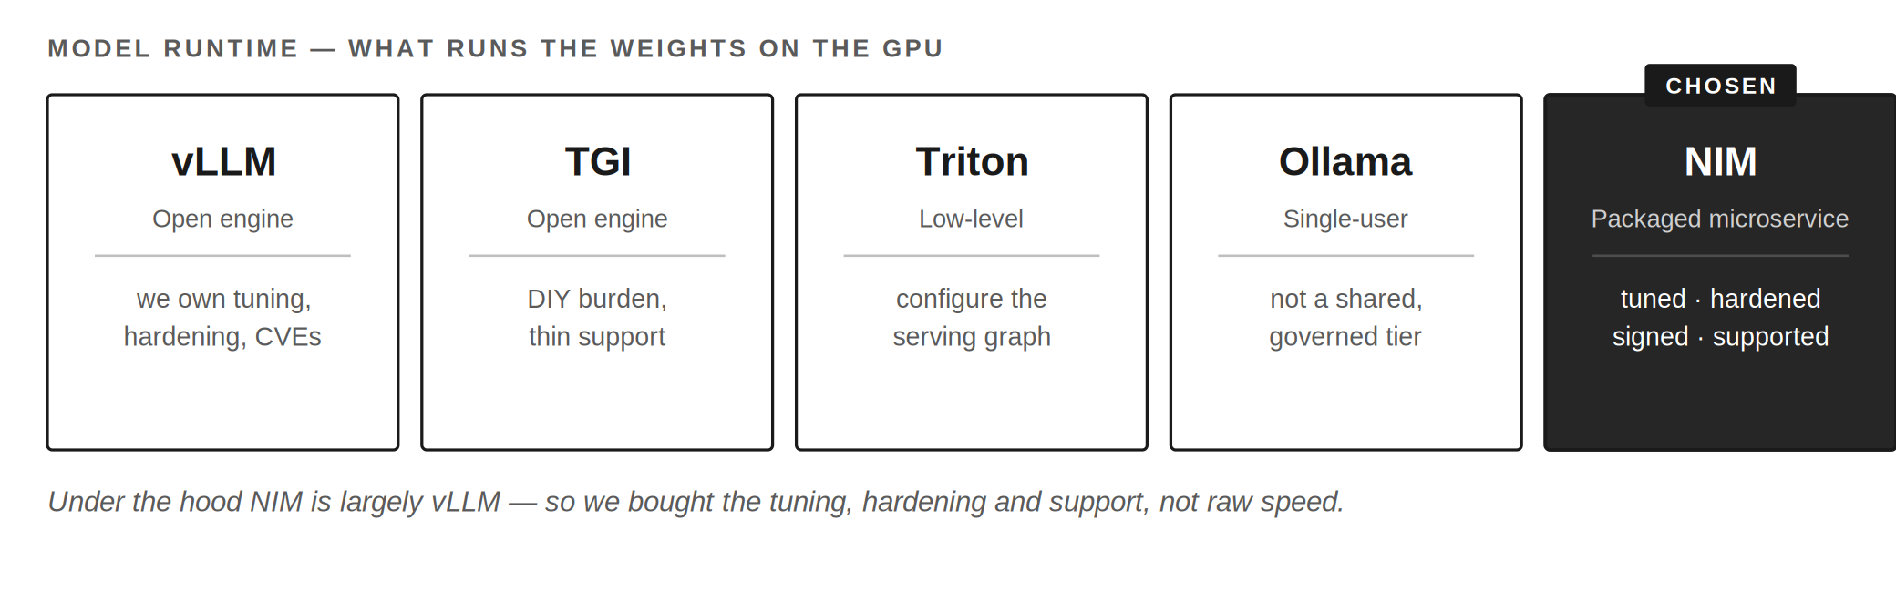
PART ONE · 01
Why NIM is our runtime
We didn't buy speed — under the hood NIM is largely vLLM. We bought the tuning, hardening, and support our small team didn't have to build.
4
Notes:
A model is just weights; the runtime loads them, batches requests, runs the math, streams tokens. NIM is a packaged, pre-tuned, vendor-supported runtime shipped as a container. Alternatives were real: raw vLLM, TGI, Triton, Ollama. The honest framing is NOT 'NIM is faster than vLLM' — under the hood it largely IS vLLM, so throughput is roughly at parity. What NIM sells is everything around the engine: hardware-aware config, a container that clears a security bar, and a vendor who owns vulnerability response. Lock-in is bounded — the API is OpenAI-compatible and the weights are open.

Slide 5
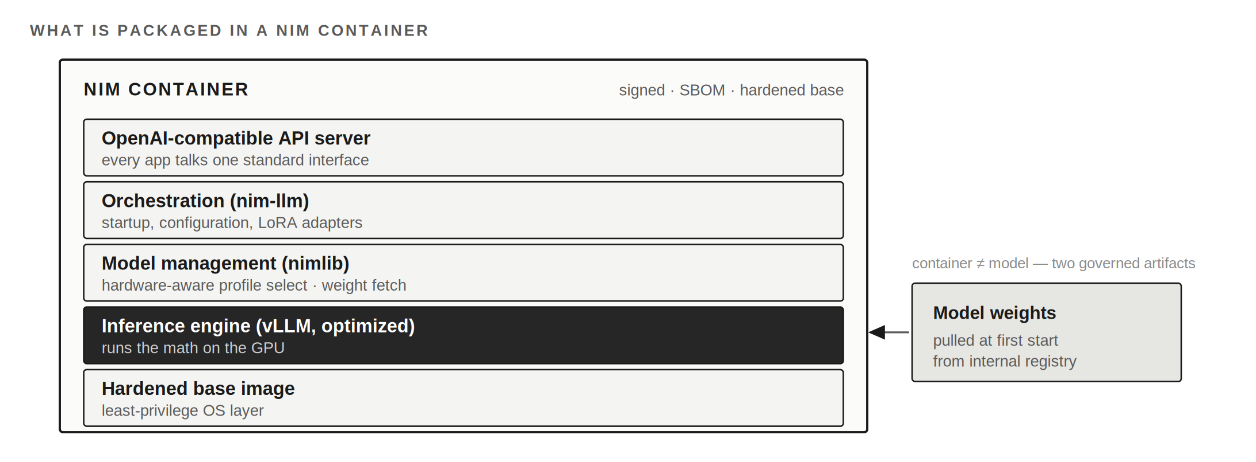
PART ONE · 04
What's inside a NIM container
It's a self-contained serving stack — and the weights are a separate governed artifact, pulled at first start from our internal registry.
5
Notes:
When people ask 'what did we deploy,' they picture a model file. It's more: an OpenAI-compatible API server, an orchestration layer, a model-management layer that picks a hardware-aware profile and fetches weights, the inference engine, all on a hardened, signed base with a bill of materials. Key nuance: the weights aren't baked in — the container and the model are two governed artifacts, which matters for how we scan, sign and admit them.

Slide 6
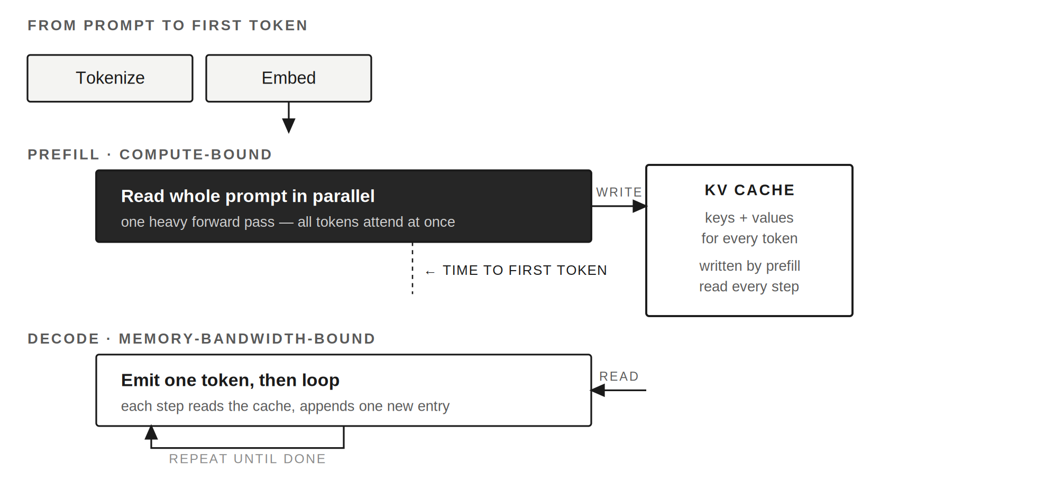
PART ONE · 04
From prompt to the first token
Prefill reads the whole prompt at once and fills the KV cache — that pause is time-to-first-token. Decode then streams, reusing the cache.
6
Notes:
This explains the 'pause, then pour.' Prefill reads the entire prompt in parallel, writing a KV cache into GPU memory — compute-bound, and its length IS your time-to-first-token. Decode then generates one token at a time, reading the cache instead of re-reading the prompt — memory-bandwidth-bound. Without the cache, cost would be quadratic; with it, roughly linear. The cache lives in the same 48 GB as the model — which is why memory is the number we design around.

Slide 7
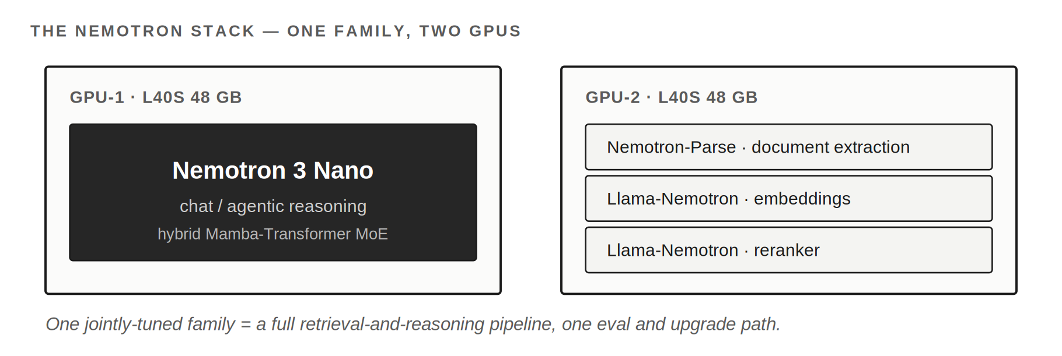
PART ONE · 02
Why the Nemotron family
Open weights we can inspect, tuned for the runtime we run, and a whole pipeline — reasoning, parsing, embedding, reranking — from one family.
7
Notes:
Choosing a family is choosing trade-offs among quality, license, size, and fit to our box. Nemotron gives us open weights and unusual data transparency (recipes and much of the pretraining data published), first-class tuning in the NIM catalog, and a full stack: a chat/agentic model on GPU-1, and parse + embed + rerank on GPU-2. One jointly-tuned family keeps evaluation and upgrades simple. Fit-to-constraint beats raw leaderboard rank on a fixed two-GPU box.

Slide 8
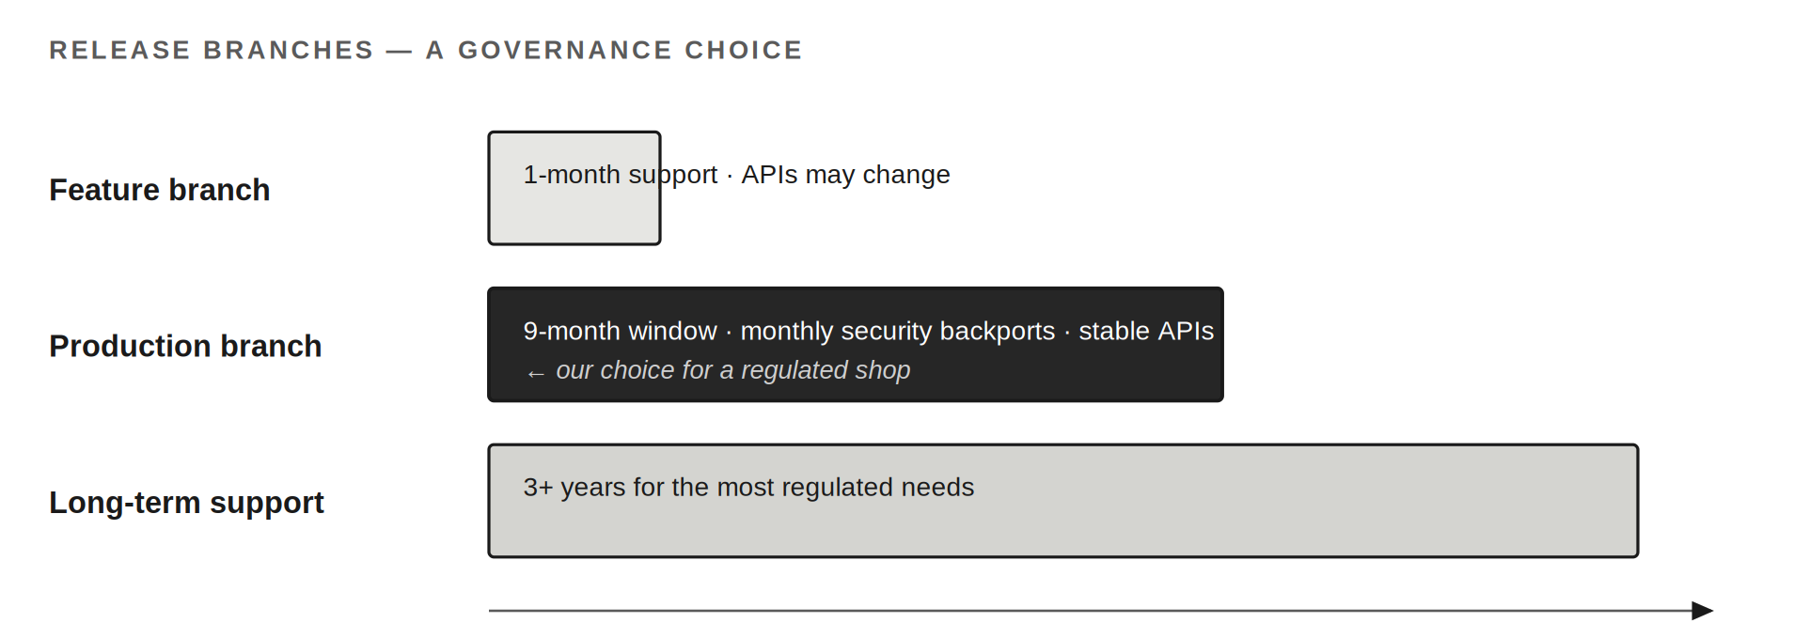
PART ONE · 02
Nemotron Nano on a production branch
The regulated-shop choice: a supported branch patched in place with stable APIs — not one we chase forward every month to stay secure.
8
Notes:
How we consume the model is itself a governance decision. A feature branch moves fast — monthly, APIs can change. A production branch gives a nine-month window with monthly security backports into that same branch and stable APIs; an LTS branch goes years. Pinning Nemotron Nano to a production branch is what lets us say we run a version that's supported and patched in place. Confirm on NGC that the specific NIM we pin carries the production-branch tag.

Slide 9
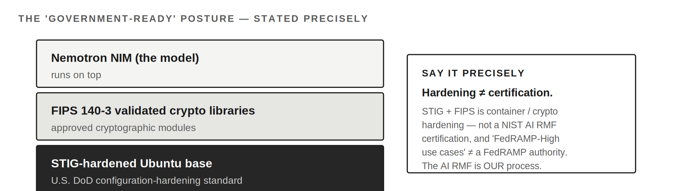
PART ONE · 02
The 'government-ready' posture — precisely
STIG-hardened base + FIPS 140-3 crypto is real, checkable hardening. It is not a NIST AI RMF certification — that framework is our process.
9
Notes:
NVIDIA offers Government Ready container variants aimed at FedRAMP-High-type sovereign use cases: a STIG-hardened Ubuntu base and FIPS 140-3 validated crypto. That's a real hardening posture. The line to hold precisely: STIG + FIPS is container/crypto hardening — NOT a NIST AI RMF certification, and 'FedRAMP-High use cases' is not a FedRAMP authorization. The AI RMF is the govern-map-measure-manage process we run around the model. Claim the hardening NVIDIA provides; claim the AI RMF work as ours. Conflating them is the one thing that could get me caught.

Slide 10
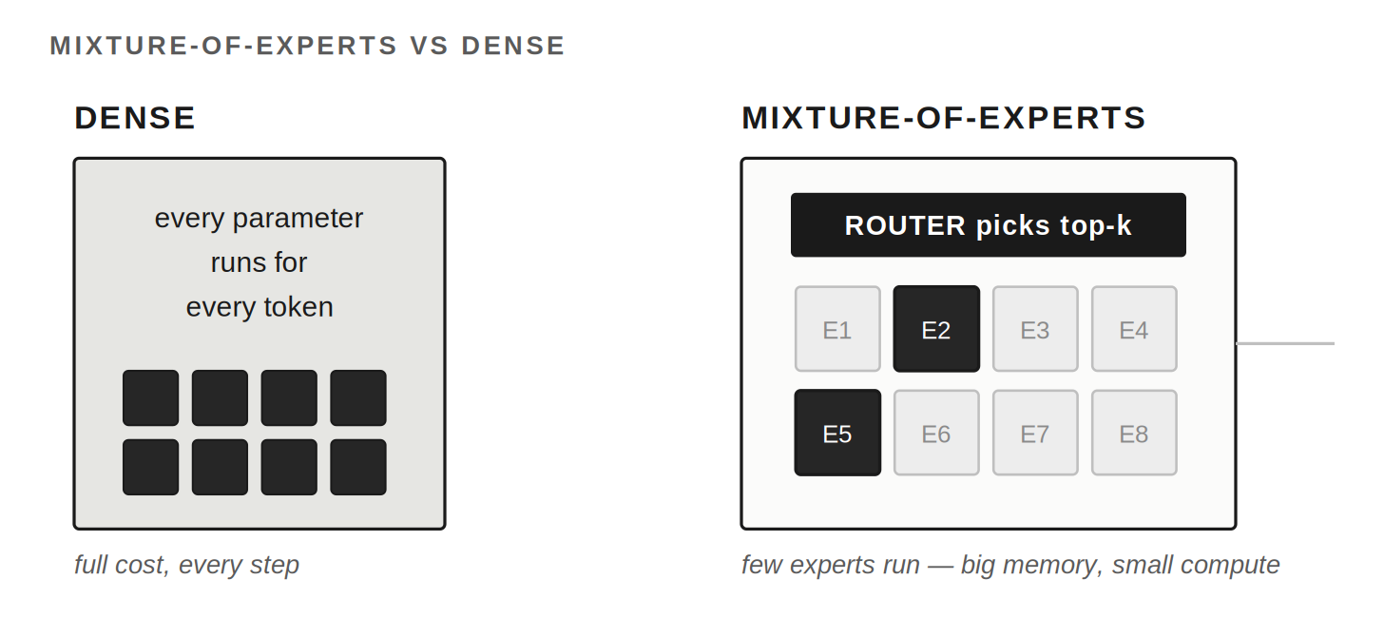
PART ONE · 03
Why mixture-of-experts over dense
A dense model runs every parameter each token. MoE routes each token to a few experts — same knowledge, far less compute per step.
10
Notes:
Dense: every parameter participates in every token. MoE splits much of the network into experts and adds a router that picks a few per token; the rest sit idle. So a model can hold 30B total but activate ~3B per token. The router is trained jointly with the model.

Slide 11
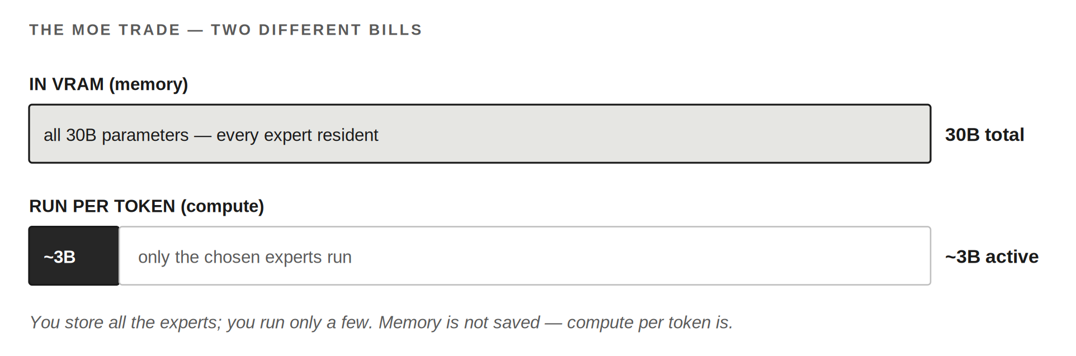
PART ONE · 03
The MoE trade — two different bills
Memory is set by TOTAL parameters; compute by ACTIVE. MoE saves compute per token — it does not save memory. Every expert stays resident.
11
Notes:
The two numbers people confuse are the whole story. Memory is set by total parameters — every expert must be resident in VRAM. Compute per token is set by active parameters. So MoE buys speed and concurrency, not a smaller footprint. Correct the common trap cleanly: MoE does NOT save memory. Its advantage shows up under concurrency — many lightweight agents — which is exactly our roadmap.

Slide 12
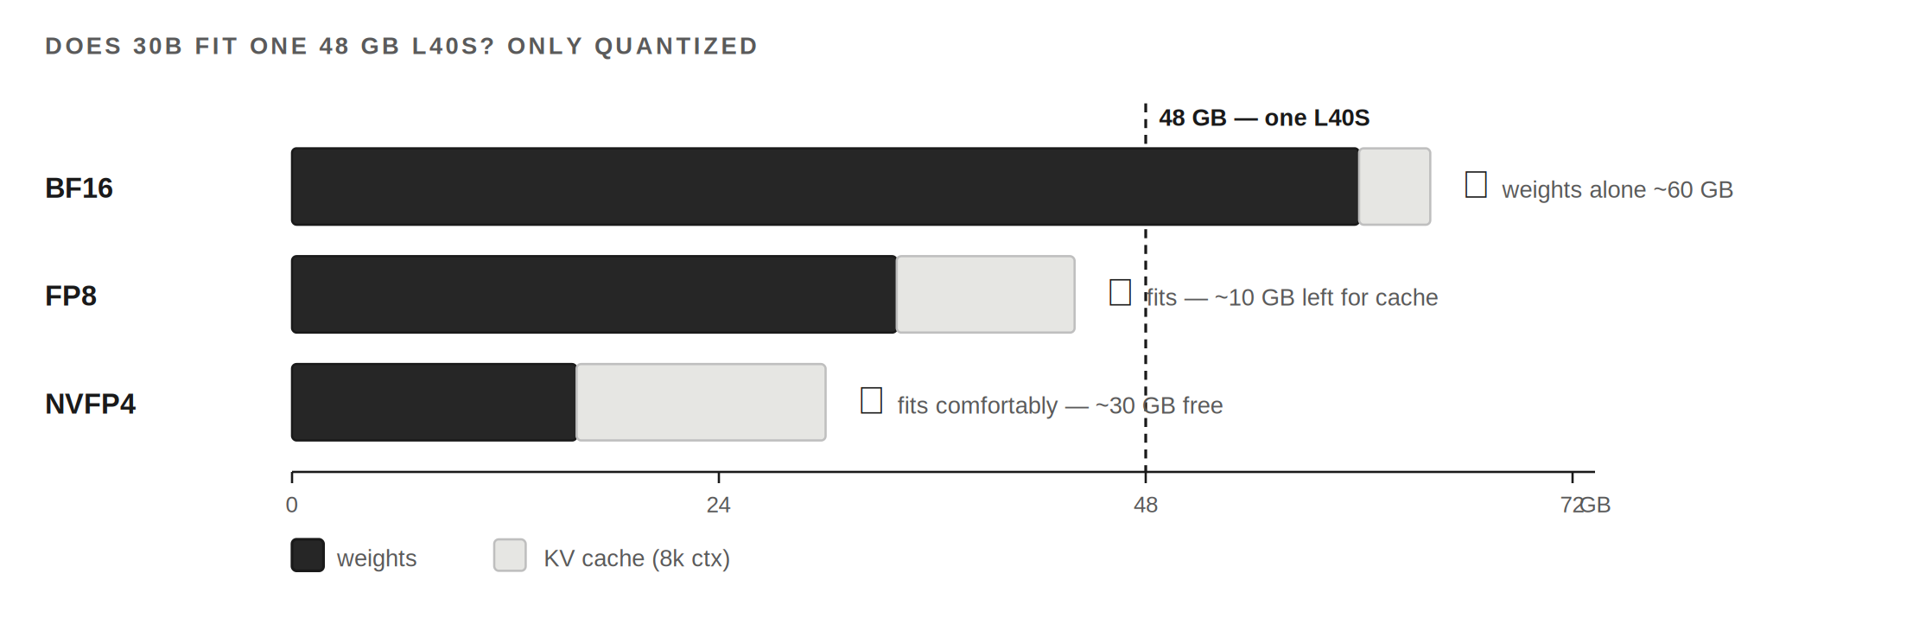
PART ONE · 03
Does 30B fit one 48 GB card?
Only quantized. At full precision the weights alone are ~60 GB. We run a quantized build — FP8 fits tightly, NVFP4 comfortably.
12
Notes:
This is a fair heckle, so have the math ready. Our chat model, Nemotron 3 Nano, is a 30B-total / ~3B-active MoE (6 of 129 experts). In full precision the weights alone are ~60 GB — would not fit. Quantized: FP8 ~34 GB (fits, ~10 GB for cache), NVFP4 ~16 GB (fits comfortably, ~30 GB free). Say 'quantized 30B on one card,' not '30B fits 48 GB' flatly — and confirm which precision we actually pinned.

Slide 13
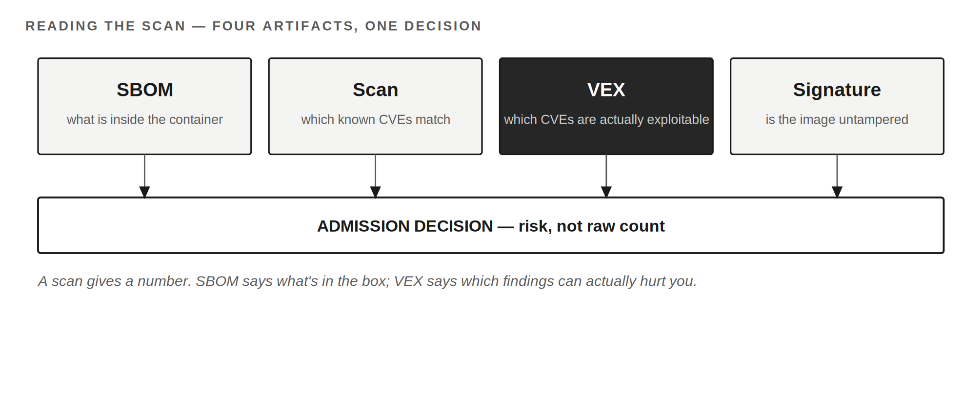
PART ONE · 05
Reading the scan — SBOM, CVEs, VEX
A scan gives a number; we govern to risk. SBOM says what's inside, VEX says which findings are actually exploitable, the signature proves provenance.
13
Notes:
Replace a raw count with an assessed risk. SBOM: what's inside. Scan: which CVEs match. VEX (Vulnerability Exploitability eXchange): a machine-readable vendor statement that a CVE is present but not exploitable here — patched, unreachable path, or false positive. Signature: proves the image is untampered. NVIDIA blocks Critical/High at publish, scans continuously, and ships all of this. VEX is an input to our own InfoSec SBOM review — not a replacement for it.

Slide 14
PART TWO
What the R&D Bought Us
14
Notes:
The 'money well spent' turn. Proving we could run this forced capabilities the whole platform now inherits. Say it as leverage, not a victory lap.

Slide 15
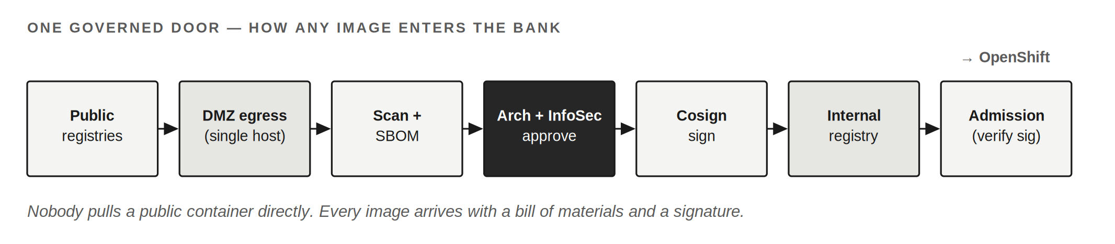
PART TWO · 06
A software supply chain we control
To run one AI container safely we had to answer how ANY container gets in. That answer is now how the whole bank sources images.
15
Notes:
Getting a vendor GPU container in safely meant answering 'how does any image enter, and who vouches for it?' The answer is now general: one controlled egress, scan + SBOM on the way in, approval requiring BOTH Architecture and InfoSec after reviewing the bill of materials, and signing every image so the cluster verifies provenance at admission. It's registry-agnostic, so it survives GitLab-to-GitHub. Nobody pulls a public container directly anymore.

Slide 16
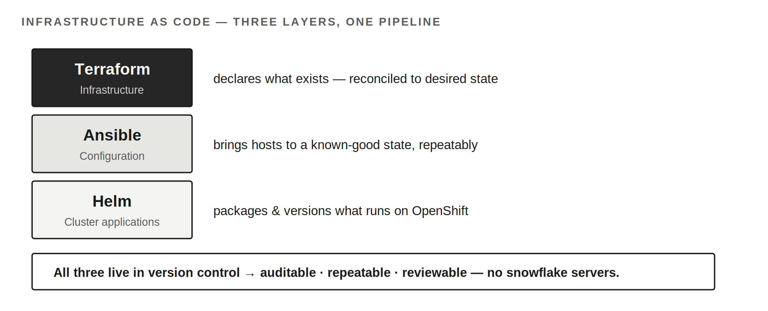
PART TWO · 08
Infrastructure as code
Terraform says what exists, Ansible how it's configured, Helm what runs on the cluster — all versioned, so the platform is provable, not remembered.
16
Notes:
A platform you can't rebuild from a file is a pet, not a platform. Three distinct layers a mixed room will conflate: Terraform (infrastructure — what exists), Ansible (configuration — how hosts are set up), Helm (cluster apps — what runs, as a versioned release). The payoff is auditability and repeatability — exactly what a regulated shop is asked to demonstrate. No snowflake servers, no click-ops.

Slide 17
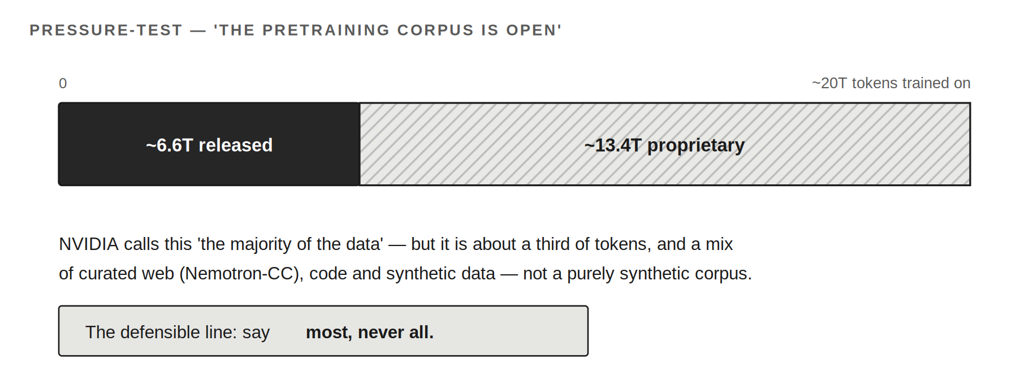
PART TWO · PRESSURE-TEST
Is the training data really open?
Most, not all. NVIDIA publishes several trillion tokens — more than any closed vendor — but a majority-by-their-accounting still leaves ~two-thirds undisclosed.
17
Notes:
This claim appears in NVIDIA's own materials and is overstated if repeated as 'the whole corpus.' For the Nano-class dataset, ~6.6T tokens released against ~20T trained on — about a third — framed as 'the majority of the data.' Roughly two-thirds proprietary, and a mix of curated web, code and synthetic — not purely synthetic. It's a genuine transparency advantage. Say most, never all.

Slide 18
PART THREE
What's Next
18
Notes:
Turn the room forward. The POD proved models can run in production; the next phase makes the platform something teams build on. Candor about what's still being designed is credibility.

Slide 19
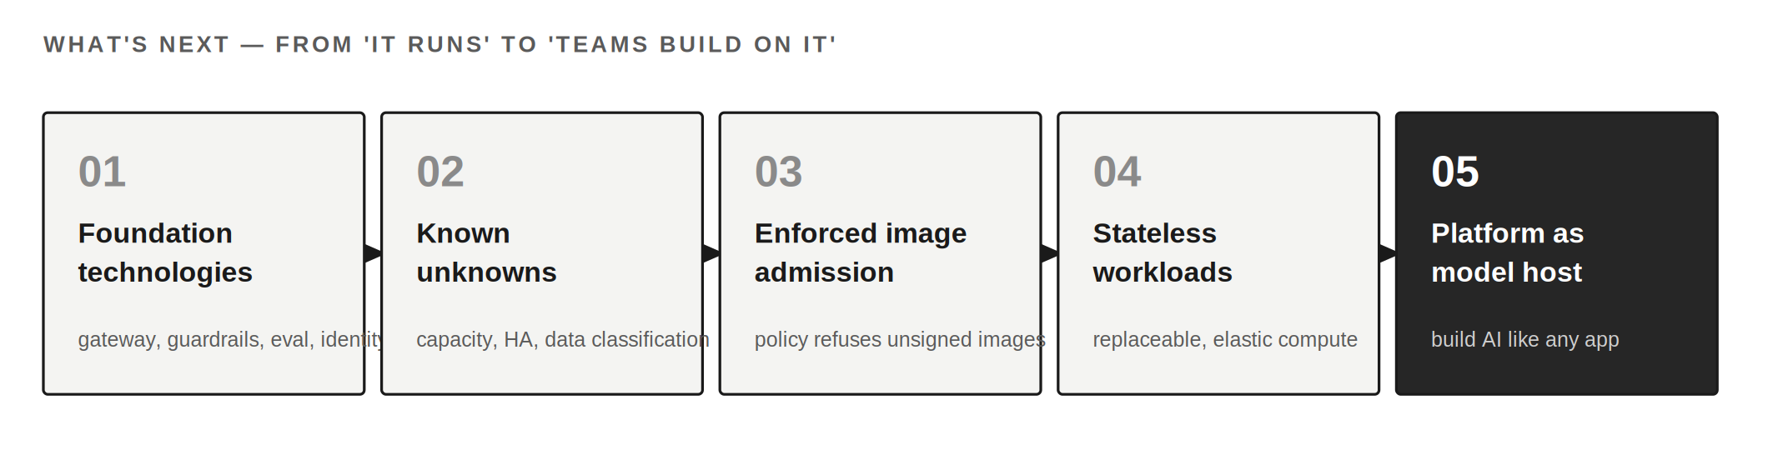
PART THREE
What's next — from 'it runs' to 'built on'
Foundation tech, the named known-unknowns, enforced admission, stateless workloads — each a deliberate step, some still in design.
19
Notes:
With 'can it run' answered, next are the load-bearing pieces: gateway, guardrails, eval, identity (foundation). The known unknowns — capacity, HA, data classification — are named and owned, not solved yet, and saying so is a strength. Enforced admission turns SBOM/scan/sign into a policy the cluster enforces. Stateless workloads make growth routine. Each is a deliberate next step.

Slide 20
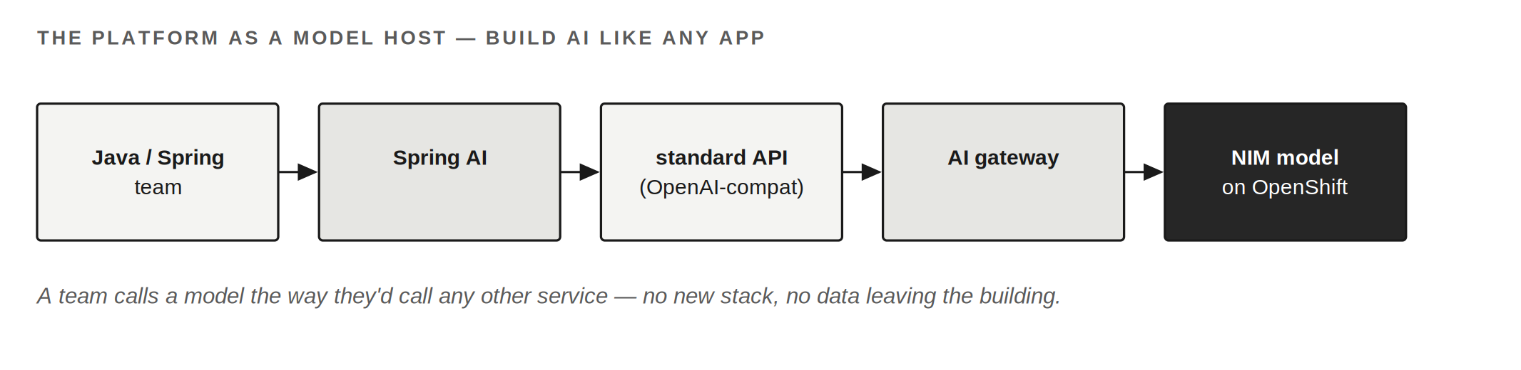
PART THREE · 13
The platform as a model host
A Java/Spring team calls a model through Spring AI like any other service — no new stack, no data leaving the building. The platform disappears.
20
Notes:
The closing idea. Everything adds up to one shift: treat the infrastructure as a model host, so teams build AI the way they already build applications — Spring AI, a standard API, on our floor, under our governance. A good platform disappears into the background. That's the sentence I want the room to leave with.

Slide 21
THE LANDING
“We set out to run a model. What we built is a place our own teams can build AI the way they build everything else — on our floor, under our governance, in the language they already speak.”
21
Notes:
Land here. Then open for questions — the appendix material (memory math, VEX, branches) is in the earlier slides if anyone pulls a thread.

