Slide 1
Benchmarking LLMs on Fast Code Homework
2025 May 07
Wenyuan Jiang

Slide 2
Outline
Technical things
Background & Related Work
Current Results
Roadmap
Possible collaboration

Slide 3
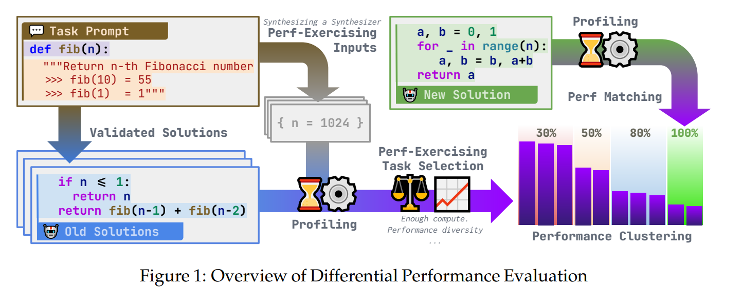
Background & Related Work
LLM for performance code
Evaluating Language Models for Efficient Code Generation
https://arxiv.org/pdf/2408.06450

Slide 4
Current Results
Benchmark data
10 manually written ASL-style problems
DSL-based problem generation for Matrix manipulation
AX + B
LLMs tested
10 SOTA ones, including GPT o4 and Claude 3.7 with thinking
Details
Best out of 3 tries
Prompts include hardware and compiler information
…

Slide 5
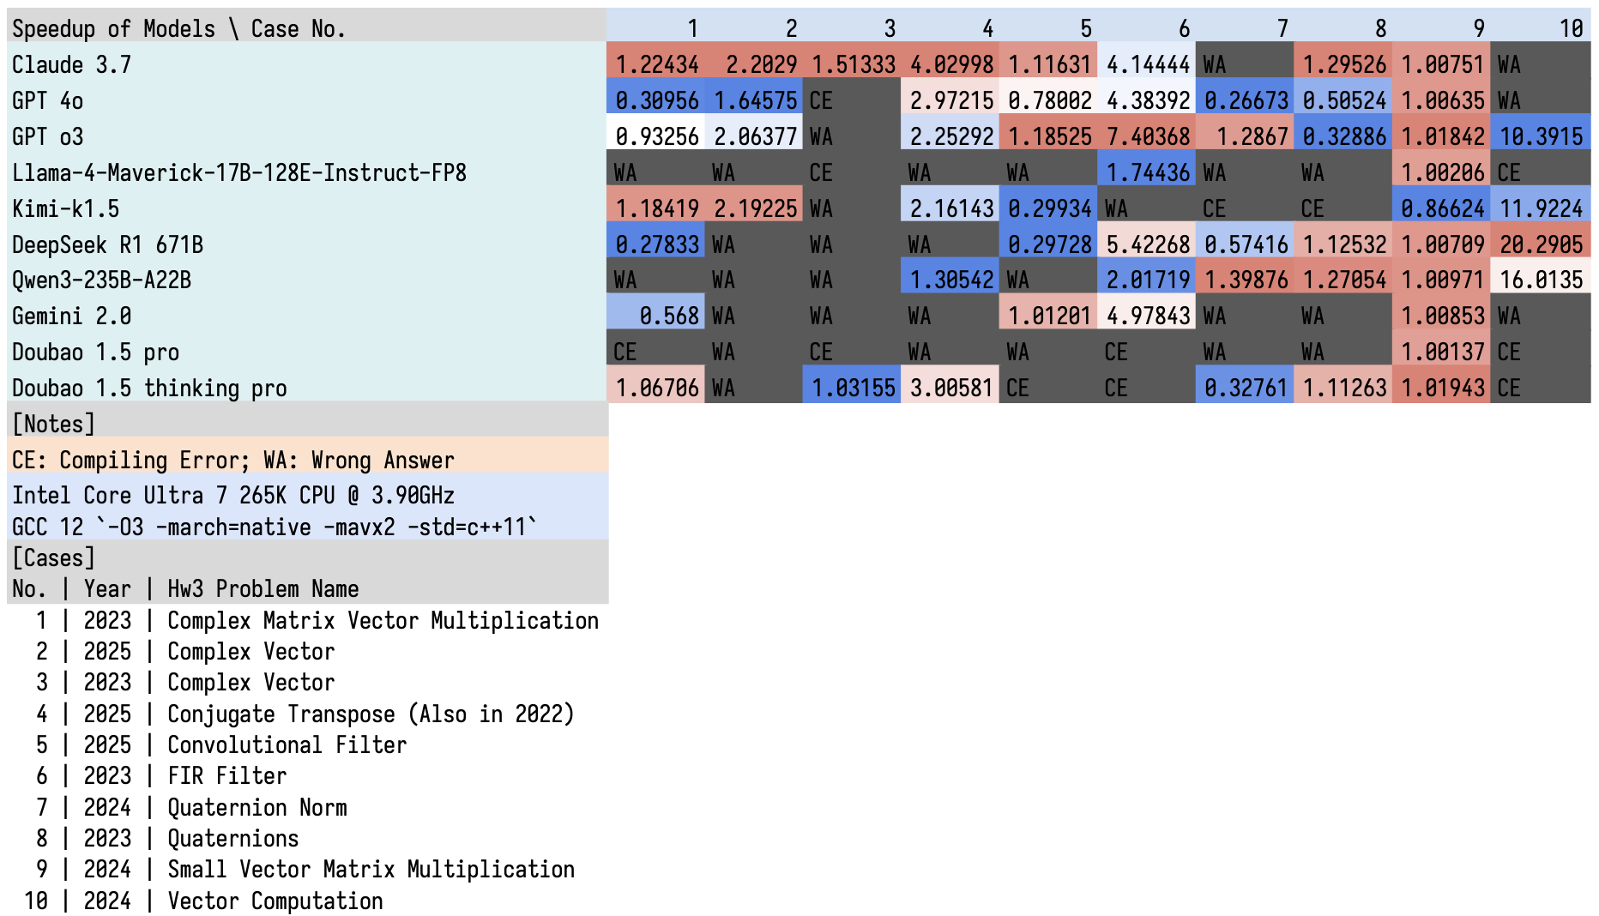
Current Results
Some Observations
Worse speed up compared with humans. (at least for 2025 hw3)
Considerable incorrect solutions.
Not hardware aware.
Hallucinations on AVX2 instructions.

Slide 6
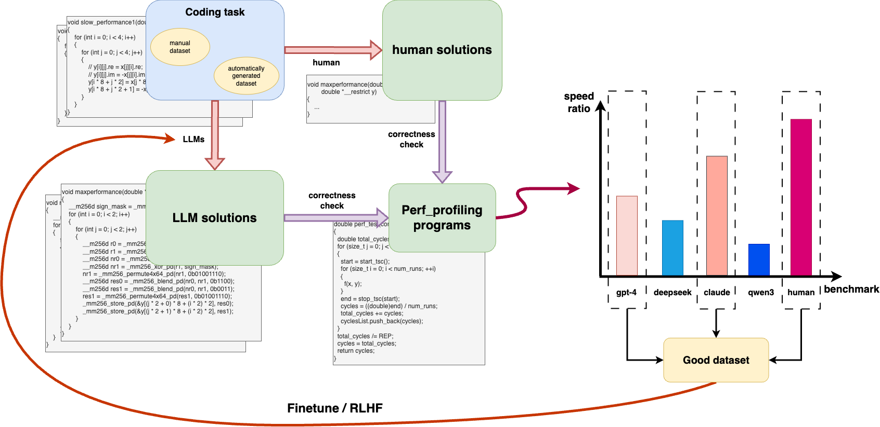
Roadmap

Slide 7
Possible collaboration
Me: ETHZ Master
Current collaborators
Zimo Ji, PhD student at HKUST
Xin Yang, Master at Zhejiang University
Yuhao Wang and Bingtao Tang, Bachelor at Tongji University
We plan
Compare with results from Fastcode course
Collaborate beyond the semester project
Publish papers (possibly)

Slide 8
Notes

