Slide 1
Version Control Systems
or: How do I git?

Slide 2
What is a Version Control System?
SCM = Source Code Management
Organizes production of large texts
Tracks changes
Helps authors collaborate
Restores previous versions if needed

Slide 3
Uses for SCM tools
Program code
Legal documents
Technical documentation

Slide 4
The Bad News: You must use SCM
Coding alone without SCM might work
Teams need source control

Slide 5
The Good News: You already do
Let‘s do an experiment
Write a text in a word processor
Make a mistake
Press the Undo button
Gratulations, you just used a version control tool

Slide 6
No, seriously. Why should I use Source Control?
See what others have changed
You can roll back mistakes
Your code is saved often
It is easy to share project files
+1 on your team‘s Joel Test score

Slide 7
Available Systems
Microsoft Team Foundation Server TFVC
BitKeeper
Git
Mercurial
Subversion, CVS, Monotone, ...

Slide 8
Jargon
Data is kept in a Repository
Repository
Data

Slide 9
Jargon
Data is kept in a Repository
Revision or Version is a single file change
Repository
Data
Version 1
Data
Version 2

Slide 10
Jargon
Data is kept in a Repository
Revision or Version is a single file change
To clone means to copy a whole repository
Old Repository
Empty Repository
clone

Slide 11
Jargon
Commit or Check-in changes or new files
Repository
commit
File
Version 2
New file

Slide 12
Jargon
Commit or Check-in changes or new files
Push or Pull all the changes from a repository to another
Repository
Repository
push

Slide 13
Jargon
Commit or Check-in changes or new files
Push or Pull all the changes from a repo to another
Branch or Fork duplicate the files in a repository
branch

Slide 14
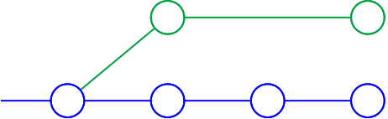
Jargon
Commit or Check-in changes or new files
Push or Pull all the changes from a repo to another
Branch or Fork duplicate the files in a repository
branch

Slide 15
Jargon - Branches
Trunk or Master is the main branch of a repository
master

Slide 16
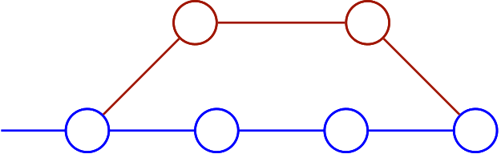
Jargon - Branches
Trunk or Master is the main branch of a repository
Add a new program component in a Feature Branch
feature branch
master

Slide 17
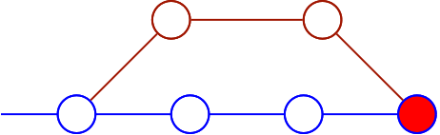
Jargon - Branches
Trunk or Master is the main branch of a repository
Add a new program component in a Feature Branch
Merge or Integration means adding branch changes back to the source
feature branch
merge
master

Slide 18
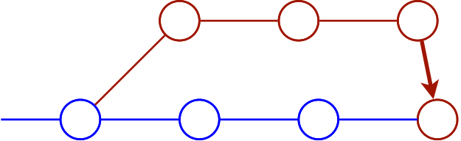
Jargon - Branches
Copying a branch to another is called a Switch
switch

Slide 19
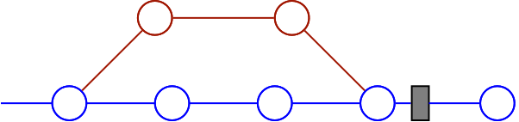
Jargon - Branches
Mark important milestones with a Tag
tag
Version 2.0

Slide 20
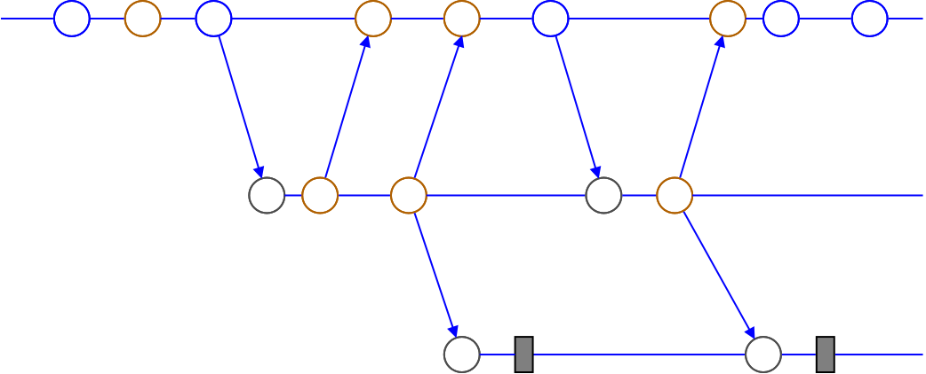
Branching Strategy Example: Testing
Dev
Test
Release
Version 1.0
Version 2.0

Slide 21
Example: Git

Slide 22
Hands-on hacking

Slide 23
Sources

Slide 24
THX & BYE

