Slide 1
Version Control Systems
or: How to git better

Slide 2
Table of Contents
Introduction
Professional use
Interactive Example
Mechanics and Jargon
Sources

Slide 3
I. Introduction
GITting started

Slide 4
What is a Version Control System?
SCM = Source Code Management
Organizes production of large texts
Tracks changes
Helps authors collaborate
Restores previous versions if needed

Slide 5
Uses for SCM tools
Program code
Legal documents
Technical documentation

Slide 6
II. Professional use
What do I git from this?

Slide 7
The Bad News: You must use SCM
Coding alone without SCM might work
Teams need source control

Slide 8
The Good News: You already do
Let‘s do an experiment
Write a text in a word processor
Make a mistake
Press the Undo button
Gratulations, you just used a version control tool

Slide 9
No, seriously. Why should I use Source Control?
See what others have changed
You can roll back mistakes
Your code is saved often
It is easy to share project files
+1 on your team‘s Joel Test score

Slide 10
Available Systems
Microsoft Team Foundation Server TFVC
BitKeeper
Git
Mercurial
Subversion, CVS, Monotone, ...

Slide 11
Interactive Example
Let‘s git it together.

Slide 12
Interactive Example
Let‘s use Microsoft PowerPoint Embedded iBash Shell

Slide 13
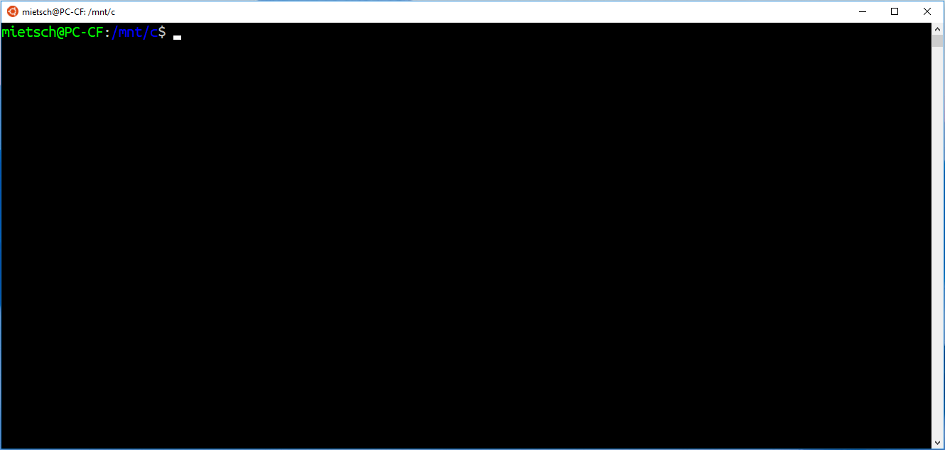

Slide 14
Mechanics and Jargon
Don‘t git confused!

Slide 15
Origin of the used imagery
fork
branch
trunk

Slide 16

Origin of the used imagery
fork
branch
tree
trunk

Slide 17
Jargon
Data is kept in a Repository
Repository
Data

Slide 18
Jargon
Data is kept in a Repository
Revision or Version is a single file change
Repository
Data
Version 1
Data
Version 2

Slide 19
Jargon
Data is kept in a Repository
Revision or Version is a single file change
To clone means to copy a whole repository
Old Repository
Empty Repository
clone

Slide 20
Jargon
Commit or Check-in changes or new files
Repository
File
Version 2
New file
commit

Slide 21
Jargon
Commit or Check-in changes or new files
Push or Pull all the changes from a repository to another
Repository
Repository
push

Slide 22
Jargon
Commit or Check-in changes or new files
Push or Pull all the changes from a repo to another
Branch or Fork duplicate the files in a repository
branch

Slide 23
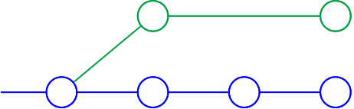
Jargon
Commit or Check-in changes or new files
Push or Pull all the changes from a repo to another
Branch or Fork duplicate the files in a repository
branch

Slide 24
Jargon - Branches
Trunk or Master is the main branch of a repository
master

Slide 25
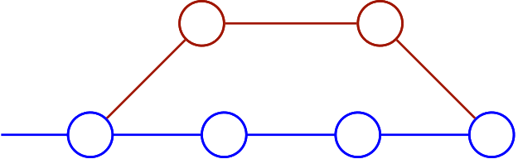
Jargon - Branches
Trunk or Master is the main branch of a repository
Add a new program component in a Feature Branch
feature branch
master

Slide 26
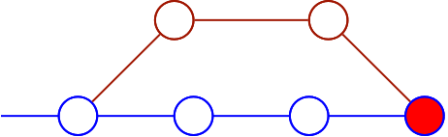
Jargon - Branches
Trunk or Master is the main branch of a repository
Add a new program component in a Feature Branch
Merge or Integration means adding branch changes back to the source
feature branch
merge
master

Slide 27
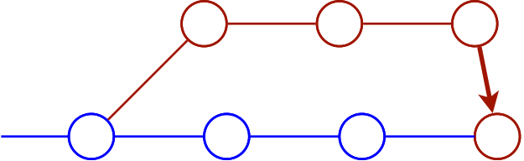
Jargon - Branches
Copying a branch to another is called a Switch
switch

Slide 28
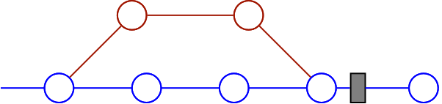
Jargon - Branches
Mark important milestones with a Tag
tag
Version 2.0

Slide 29
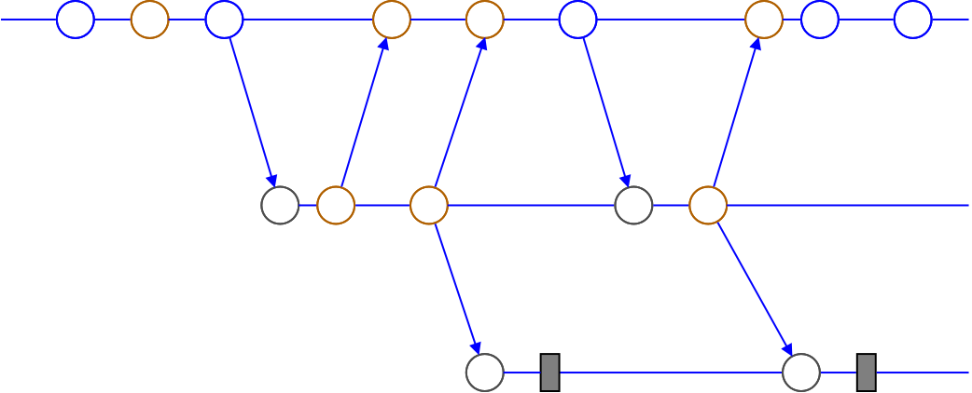
Branching Strategy Example: Testing
Dev
Test
Release
Version 1.0
Version 2.0

Slide 30
Sources
Images: Own works only
www.joelonsoftware.com/2000/08/09/the-joel-test-12-steps-to-better-code/
en.wikipedia.org/wiki/Version_control
en.wikipedia.org/wiki/Comparison_of_version_control_software
guides.github.com/introduction/git-handbook/
www.mercurial-scm.org/
www.git-scm.org/
subversion.apache.org/

Slide 31
THX & BYE

