Slide 1
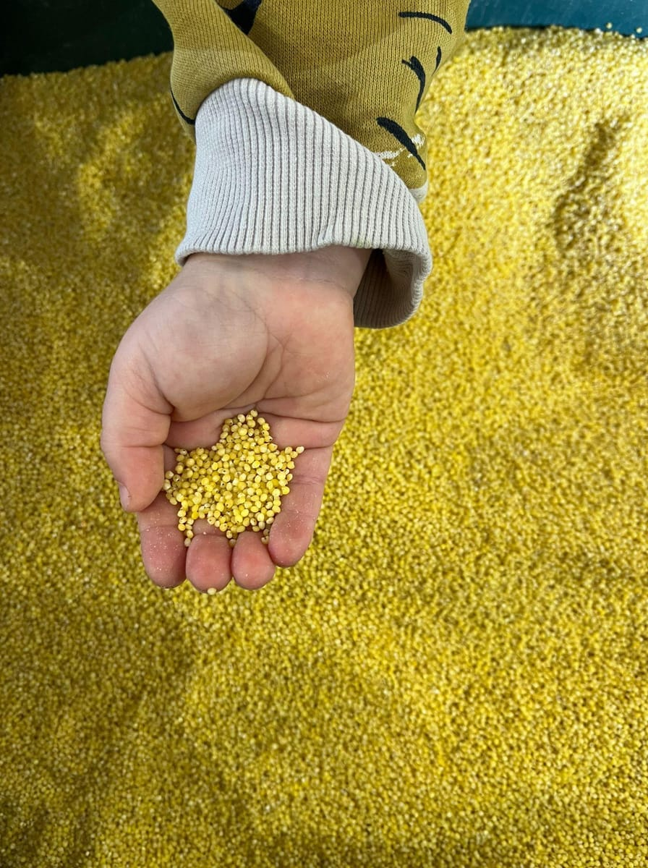

INVESTOR PRESENTATION · 2026
Naturtrade
Four generations of milling.
One gluten-free, plant-based future.
Raising HUF 400M+ to build our Röszke production plant and scale exports.
Miklós Véha
Founder & CEO, Naturtrade Hungary Kft.
Notes:
Open with the family story: the Véha mill was founded in 1931 in Endrőd. Four generations later we turn premium pseudo-cereal flours into gluten-free, plant-based foods. Today we are raising at least HUF 400M to build our Röszke plant.

Slide 2




A heritage miller building a free-from food platform
THE OPPORTUNITY AT A GLANCE
400M+
1931
250+
3–5×
HUF investment sought
Milling heritage
B2B partners
Target return
Greenfield plant in Röszke, new production technology, working capital
Four generations of millers. We make our own premium flour
Over 100 products in 10+ categories on Hungarian shelves and in export
Exit to a financial or strategic investor in 2030
Business plan: revenue from HUF 732M (2025) to HUF 2.5bn (2030), with EBITDA of about HUF 525M in 2030
Notes:
One slide that answers 'why should I listen'. The amount, the heritage, the traction and the return target.

Slide 3
What we will cover
AGENDA
1
2
3
Heritage & team
The market
Products & moat
From the 1931 Véha mill to a 27-person food company
Why free-from food is moving into the mainstream
From grain to cup, all made in-house
4
5
6
Traction
Competition
The investment
Shelves, partners, export and the Saudi deal
Positioning, SWOT and growth levers
Use of funds, capacity, plan and exit

Slide 4
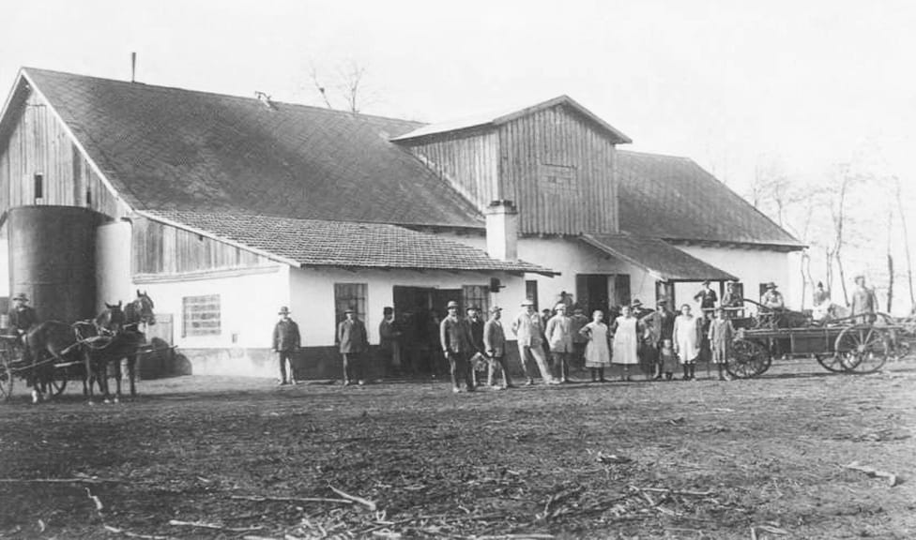
Where tradition meets innovation
01 · HERITAGE
1931
The Véha mill opens in Endrőd. Flour milling has been in the family ever since.
4 gen.
Four generations of millers, now applied to pseudo-cereals and legumes.
Today
Szeged plant: own milling, mixing, pasta and instant lines. 27 people.
2026–27
Greenfield plant in Röszke, five minutes from the current site.
The Véha mill, Endrőd, 1931
2030
International free-from food platform, ready for exit.
Notes:
Flour milling is in our genes. That heritage is our edge: we control the most important raw material, premium fine-ground flour.

Slide 5
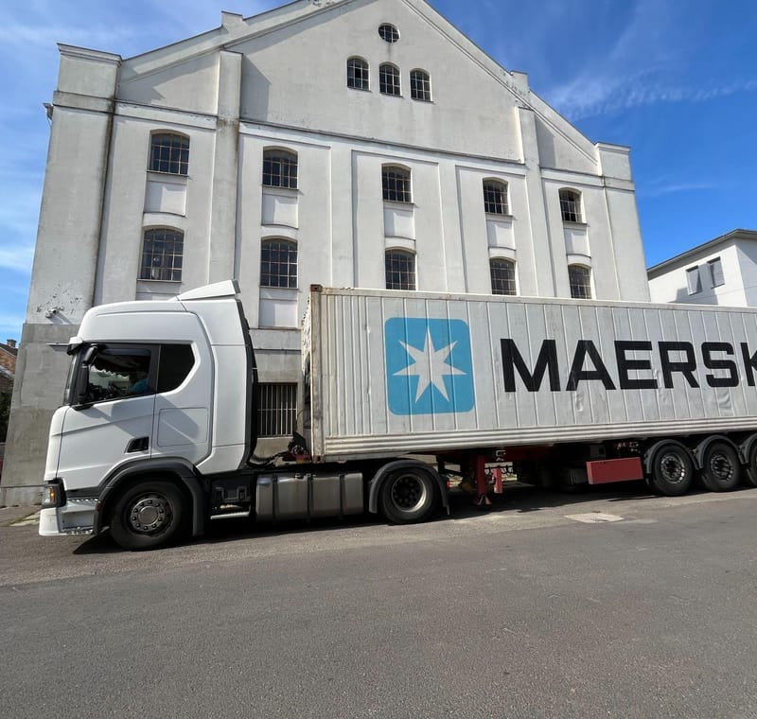
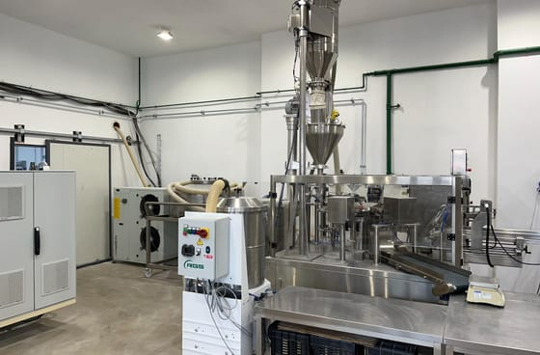
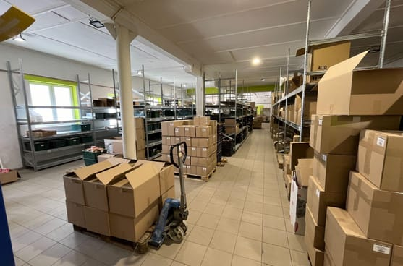
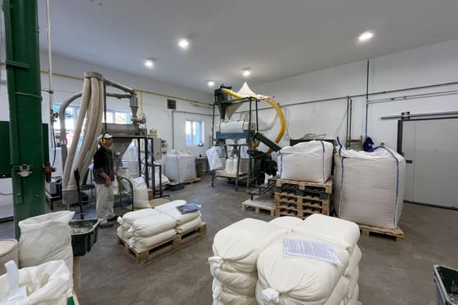
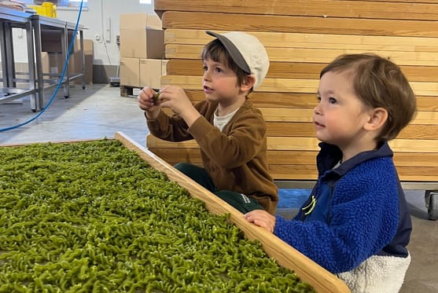
A working food plant in Szeged
01 · OUR BASE TODAY
Own milling · flour blending · pasta · instant cups · R&D test kitchen · export logistics

Slide 6
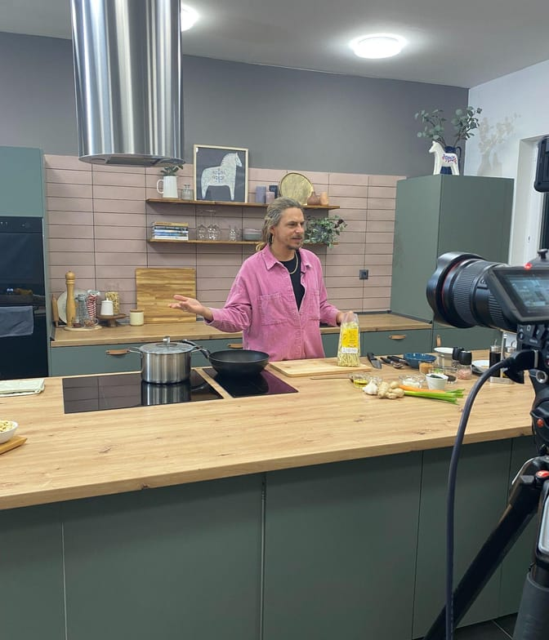


Free-from food that anyone can enjoy
01 · PURPOSE
Mission
We make gluten-free products that anyone can eat with confidence, whatever their sensitivity or diet. We combine professional experience with youthful energy to keep improving them.
Vision
We want to build a company that leads international markets, where tradition, innovation, respect for nature and a family atmosphere matter equally. Our products should set trends and lead their category.

Slide 7
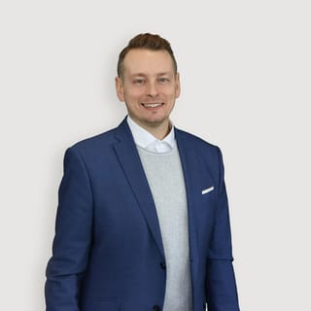
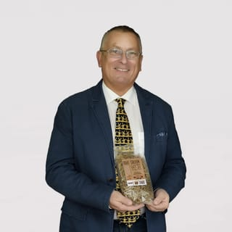
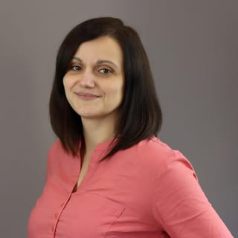
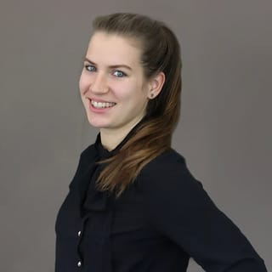
A young team with deep scientific roots
01 · TEAM
Miklós Véha
Prof. Dr. Antal Véha, PhD
Orgona Tóthné
Anita Labát
Founder-owner & CEO
Head of R&D
Chief Operating Officer
Head of Sales
Fourth-generation miller. Leads strategy, export and investor relations.
Vice-dean, Faculty of Engineering, University of Szeged. 200+ publications.
Runs production, quality and the plant floor.
Domestic retail, wholesale and key accounts.
27 people in total: production, R&D, sales, logistics and finance

Slide 8
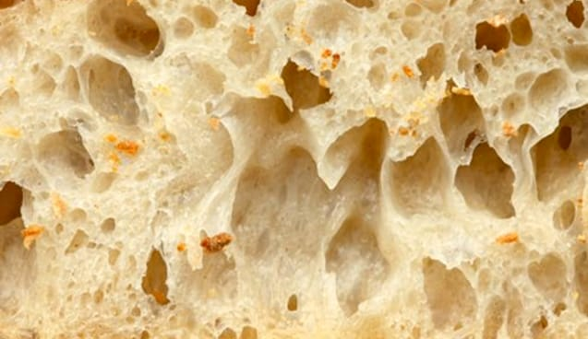
Millions need a grain-conscious diet
02 · THE NEED
Share of people on a permanent special diet that affects grain consumption
10–15%
10–15%
7–10%
IBS / non-coeliac gluten sensitivity
Diabetics
Chronic kidney disease
1–2%
~1%
0.4%
85 kg
flour per person per year in Hungary, against an EU average of 60 kg
1.2M t
of wheat milled every year in Hungary. Gliadin, about 25% of gluten protein, drives the autoimmune response.
Gluten allergy
Coeliac disease
Crohn's disease
Notes:
Coeliac disease is only the tip of the iceberg. IBS, gluten sensitivity, diabetes and kidney disease all push people towards grain-conscious diets. That is why food retail is so open to new species, new varieties and functional grain products.

Slide 9
Every market we serve is growing
02 · MARKET SIZE
+7–10%
Gluten-free CAGR to 2030
Global GF products grow 7.2%/yr and Europe 9.6%/yr. The UK is Europe's largest GF market.
+9.7%
Saudi gluten-free CAGR
The KSA market was worth $127M in 2025. It is the largest GCC market, and the GCC grows about 10%/yr.
+14.7%
Plant-based meat CAGR
Global plant-based meat grows from $9.6bn (2024) to $21.8bn (2030). This is Oosty's arena.
Sources: MarketsandMarkets (GF global, 2025–30); Ken Research (GF Europe, 2024–30); IMARC (KSA GF, 2025); TechSci (GCC GF); Arizton (plant-based meat, 2024–30).
Notes:
Third-party forecasts. Definitions differ between research houses, so treat these as directional. The point is that all of our categories grow at high single to double digits.

Slide 10




Four shifts working in our favour
02 · WHY NOW
Free-from goes mainstream
Healthy convenience gap
Gluten-free and vegan are no longer medical niches but lifestyle choices. The Hungarian GF market alone was worth over HUF 30bn in 2023.
Instant food means flavour enhancers and allergens. Clean-label instant is almost empty shelf space, which is where Cupster is the first mover.
Gen Z & flexitarians
Import-dependent markets
Millennials, Gen Z and Gen Alpha buy online, try new brands and want food with a story. That is our core consumer for instant food.
The UK, Western Europe and the GCC rely on imported free-from food. A Central European producer wins on lead time, price and flexibility.

Slide 11





From grain to cup, all in-house
03 · OUR MOAT
Raw grains
Own milling
Flour mixes
Pasta
Instant & premix
Millet, buckwheat, sorghum, quinoa, pea, lentil
Homogeneous fine flour, down to 160 µm
Bake-Free: just add water and bake
Pseudo-cereal & legume pasta
Cupster cups · Oosty plant-based premixes
Margin
We don't pay a miller's margin on our most important input
Speed
From idea to shelf without outside suppliers
Contract manufacturing
We produce for competitors too, so the margin stays with us
Notes:
This is the core of the investment case. Competitors buy flour and outsource production; we own the full chain.

Slide 12
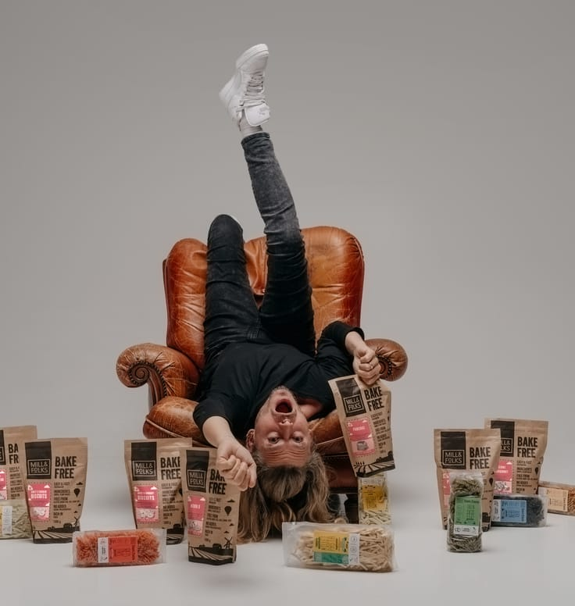
Five categories, 75+ recipes, one platform
03 · PORTFOLIO
15
Mono flours
Premium fine-ground pseudo-cereals and legumes
15
Flour mixes
Ready to bake: just add water
30
Gluten-free pastas
Millet, buckwheat, sorghum, quinoa, lentil, pea
15
Instant soups & noodles
10 soups and 5 noodle cups. A category creator
2→7
Plant-based premixes
2 'cheese' mixes now, 5 'meat' mixes coming
Target: vegans, vegetarians, the health-conscious and the gluten-sensitive. For instant: Millennials, Gen Z and Gen Alpha.

Slide 13
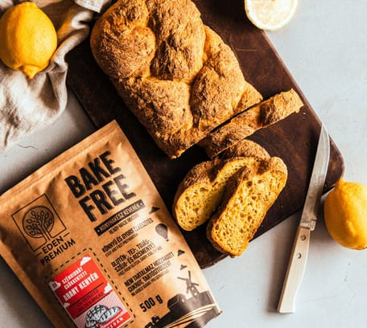
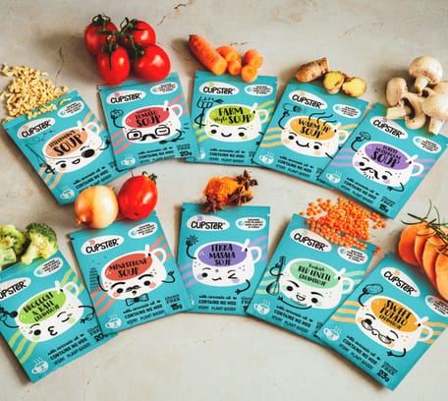
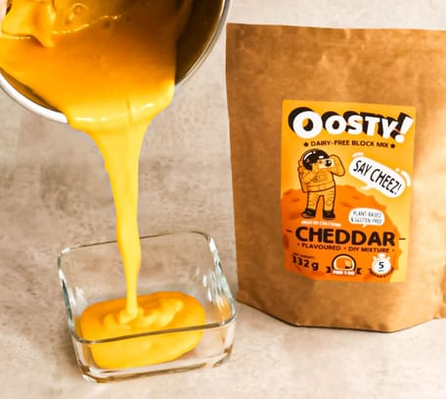
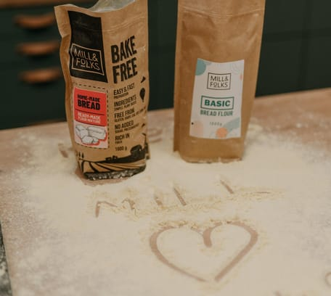
Each brand has its own consumer and message
03 · BRAND HOUSE
Bake-Free
Cupster
Oosty
Mill & Folks
Free-from, made for enjoyment
The healthy instant
Plant-based cheese & meat
Our international DTC brand
Ready-to-bake gluten-, dairy- and egg-free mixes. Strong in organic and health-food stores.
Vegan, gluten-free cups with no flavour enhancers, aimed at young urban adults.
Powdered premixes made at home. Long shelf life and affordable. Mostly sold for export.
Own webshop plus Amazon, for consumers in the UK and Western Europe.
Eden Premium is our domestic umbrella brand and multi-brand webshop, stocked by 250+ resellers.

Slide 14
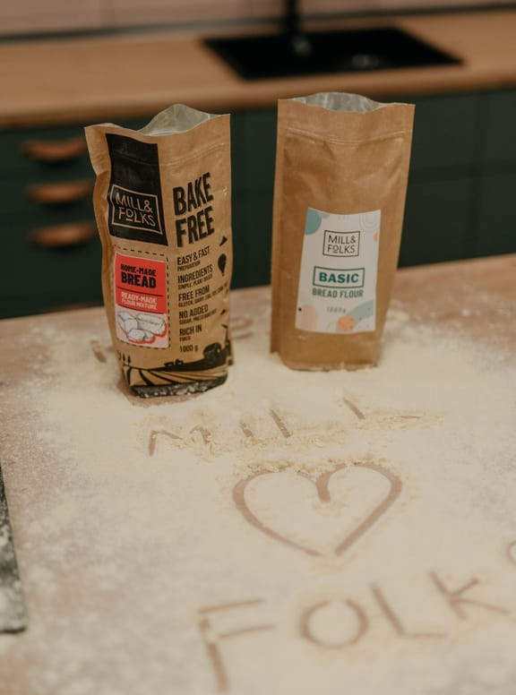
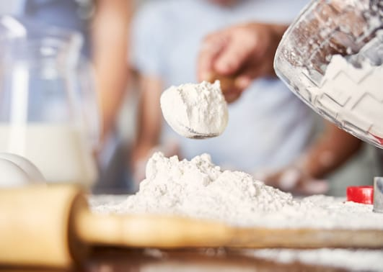

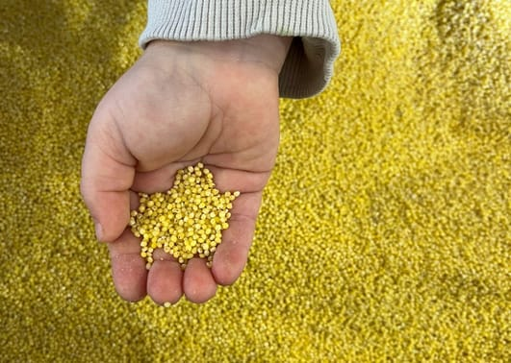
Premium flour is our foundation
03 · OWN-MILLED FLOUR
15
single-ingredient flours from pseudo-cereals and legumes
Homogeneous particle size
Ground as fine as 160 microns for better texture and baking
Our own key ingredient
Millet, buckwheat, sorghum, quinoa, green pea, red lentil
Fully traceable
Controlled sourcing and composition, in our own packaging

Slide 15
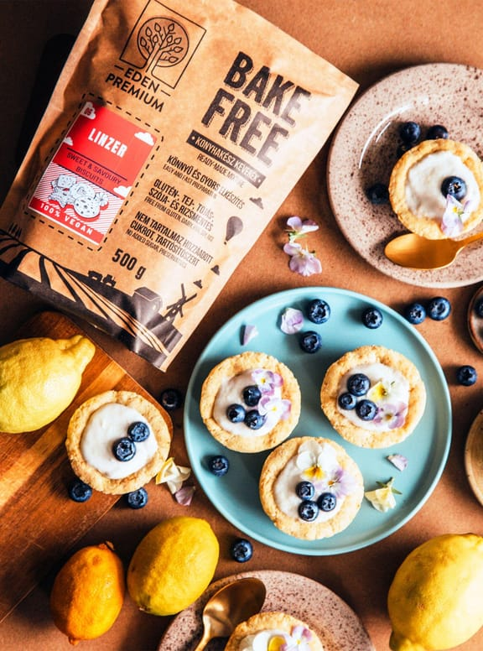
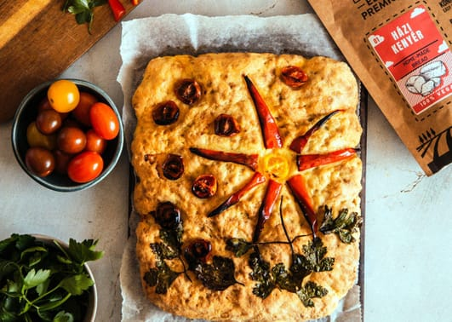
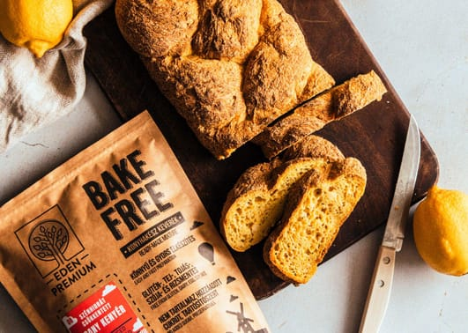
Bake-free flour mixes: just add water
03 · BAKE-FREE
15
ready-to-bake gluten-free flour mixes
Easy to make
Just add water and bake: bread, cake, pizza
Free from gluten, dairy and egg
Taste and texture that hold up against the real thing
Proven shelf presence
Stocked in organic, health-food and drugstore chains

Slide 16
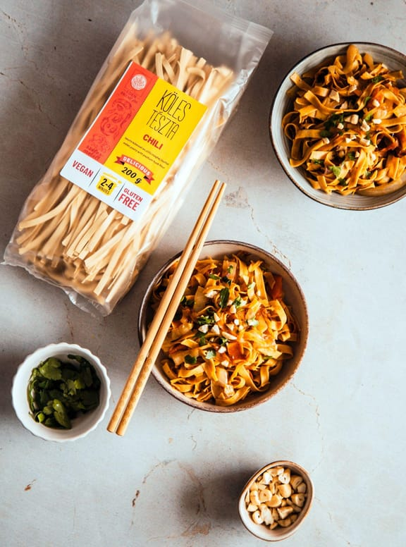
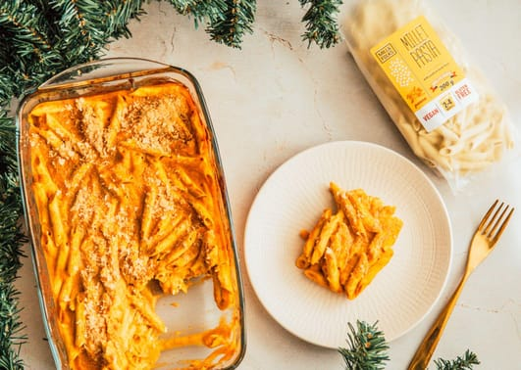
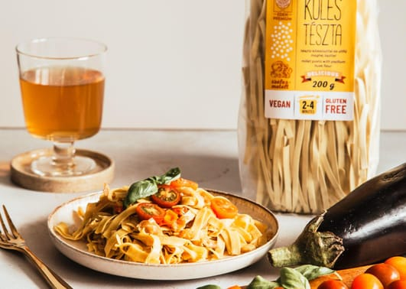
Gluten-free pasta from ancient grains
03 · PASTA
30
pasta varieties from pseudo-cereals and legumes
Pseudo-cereal pasta
Millet, buckwheat, sorghum, quinoa, lentil, pea
Made in-house from our own flour
Not contract-made, unlike the main competitor
Strong in export
Long shelf life and easy to list with retailers

Slide 17
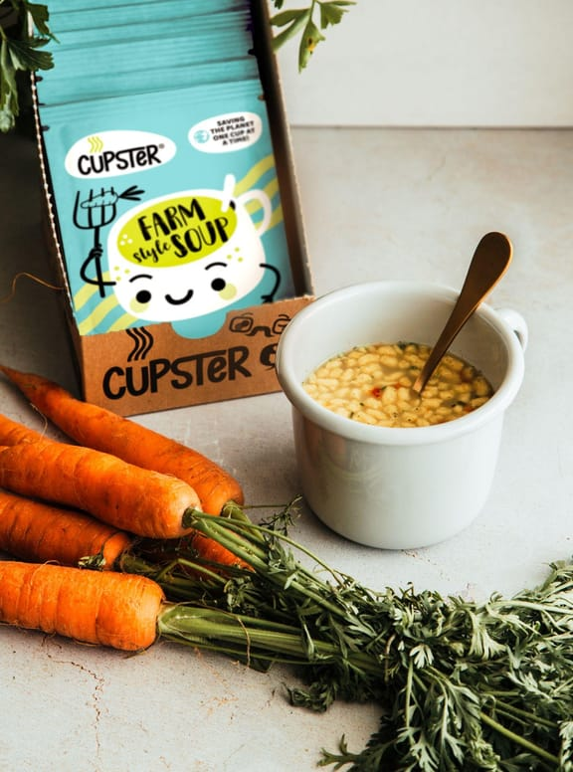
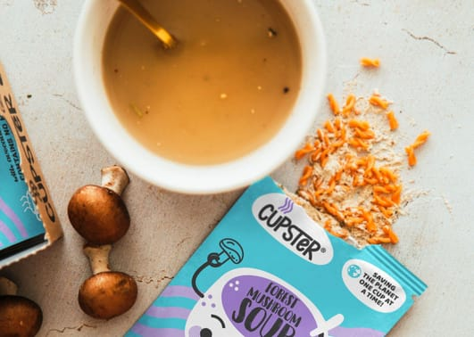
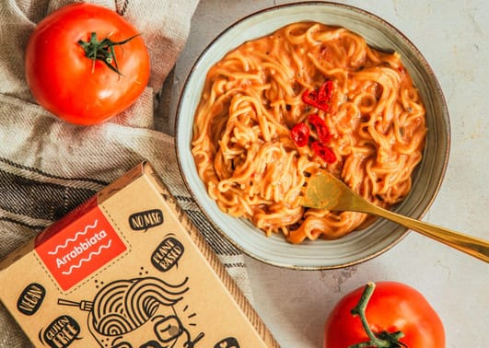
Cupster: the healthy instant category
03 · CUPSTER
15
instant soups (10) and noodle cups (5), and growing fast
Vegan, gluten-free, no flavour enhancers
A clean-label alternative to mainstream instant brands
New pack at a HUF 599 RRP
With a material cost of only ~20%
Our biggest breakout point
More sub-categories are in development
Notes:
Cupster is the category creator. There is no direct domestic competitor in healthy instant food.

Slide 18
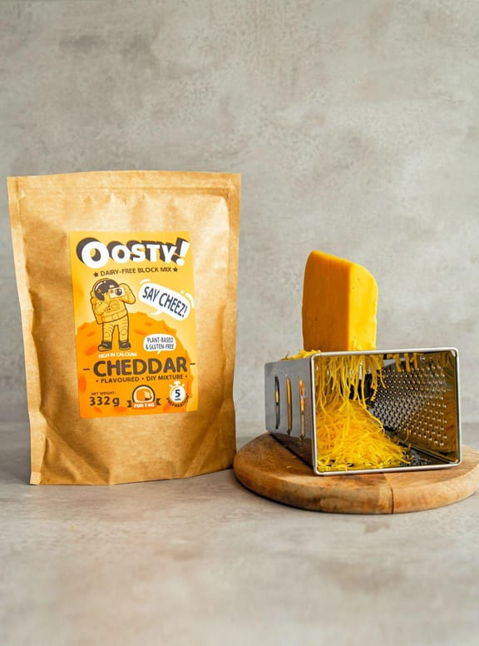
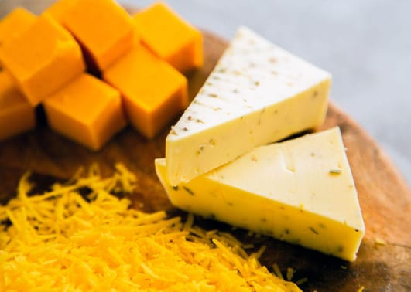
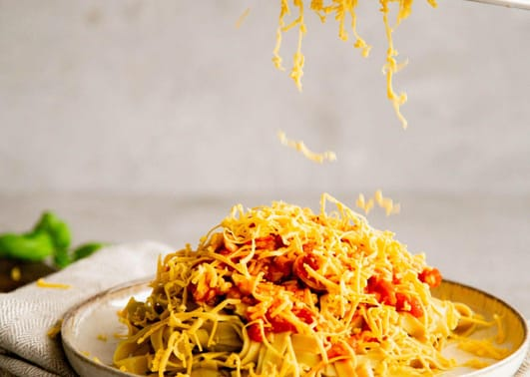
Oosty: plant-based cheese & meat at home
03 · OOSTY
2→7
'cheese' mixes today, with 5 'meat' mixes coming soon
Easy to make at home
Powder format: just mix and cook
Long shelf life, affordable
Far cheaper than ready-made vegan analogues
Built for export
Most Oosty volume goes abroad

Slide 19



On shelves at home, growing abroad
04 · TRACTION
100+
250+
10+
4
products
B2B resellers
product categories
sales channels
Hungary · B2B
Hungary · DTC
International · B2B
International · DTC
We cover the health-food wholesalers, drugstores and organic shops. Multinational and discount chains are next.
Eden Premium multi-shop. We list partner brands to raise basket value.
Distributors in the UK, Western Europe and KSA. We pivot to private label where a foreign brand doesn't fit.
Mill & Folks webshop and Amazon. Direct-to-consumer sales have started.

Slide 20


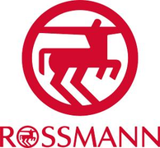












Trusted by retailers at home and abroad
04 · PARTNERS
A selection of retail, wholesale and marketplace partners carrying Naturtrade brands.

Slide 21
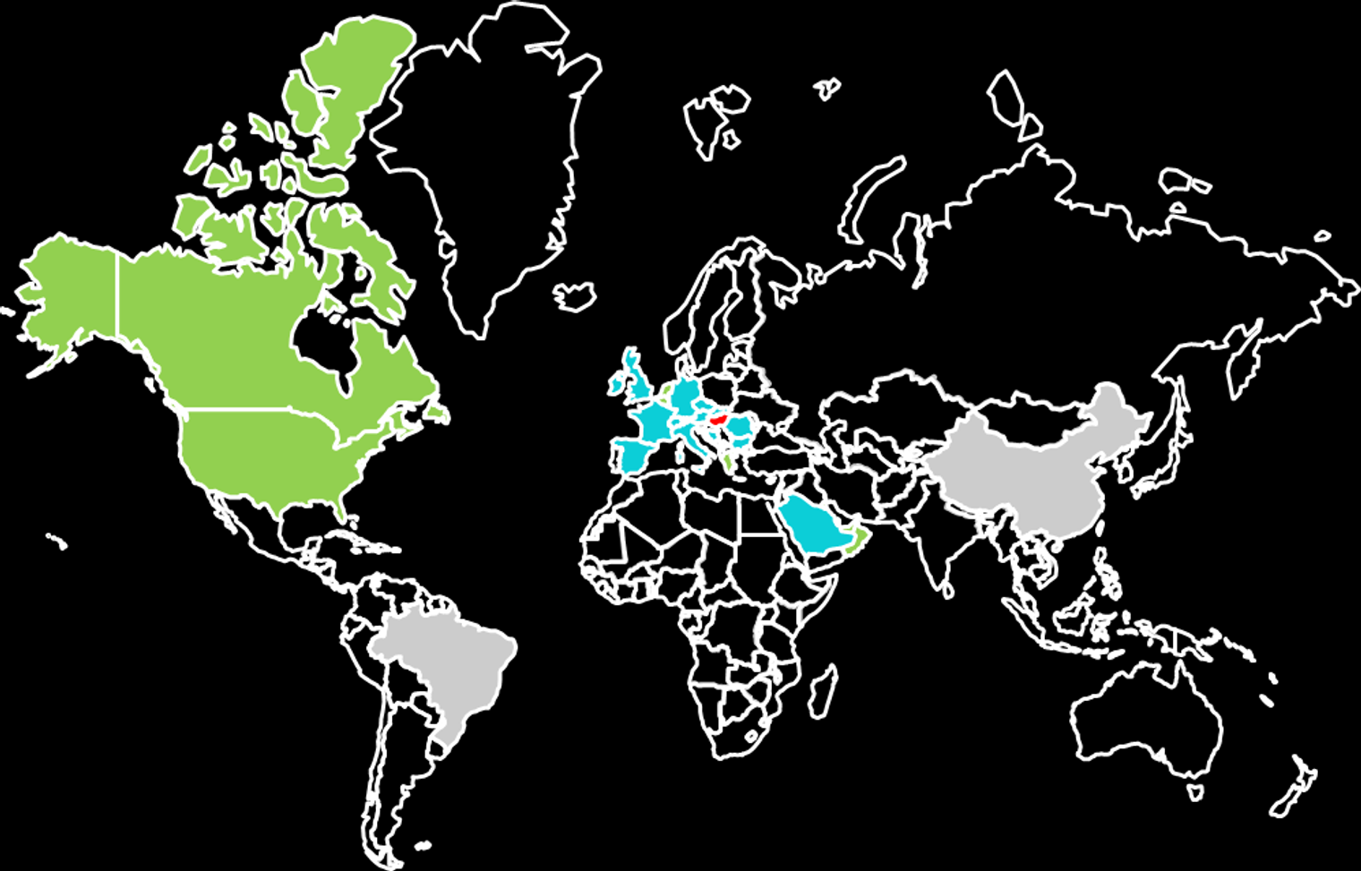



From Hungary to the world
04 · FOOTPRINT
HOME MARKET
Hungary
Our widest coverage: organic, health-food, drugstore and retail chains.
EXPORTING TODAY
UK · Western Europe · Saudi Arabia
Distributors, Amazon and a first industrial-scale GF bakery in KSA.
NEXT MARKETS
USA · Canada · GCC (MENA)
Plus deeper B2B and DTC reach in Western Europe.

Slide 22
Cupster is our fastest-growing category
04 · MOMENTUM
11.7×
Cupster growth from 2024 to the 2026 plan (HUF 30M → 350M)
16×
Oosty, our newest category, is export-led (HUF 5M → 80M)

Slide 23
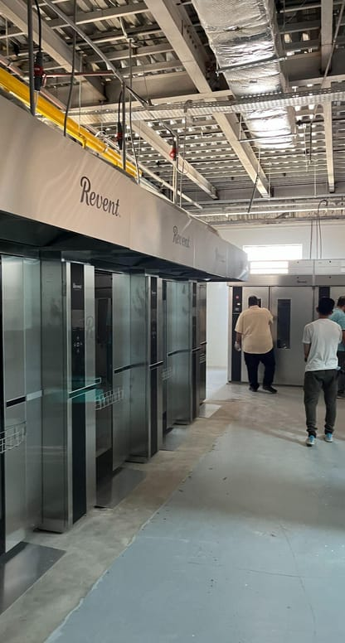
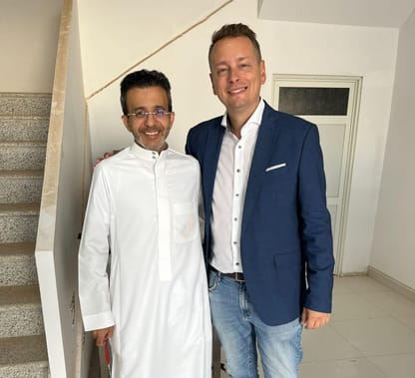
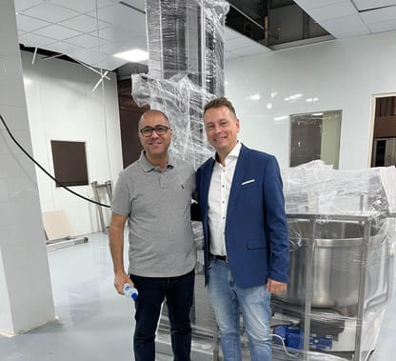
The Saudi connection
04 · SAUDI ARABIA
A first
The first Hungarian company to export to KSA's first industrial-scale gluten-free bakery.
State-backed demand
The Saudi state is the end buyer. Volumes are predictable and payment risk is low.
A gateway
We aim to bring the partnership to Europe within 2–3 years.

Slide 24
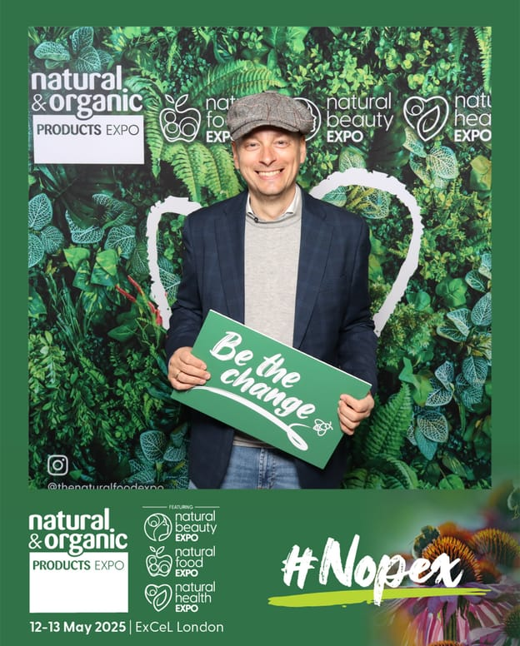
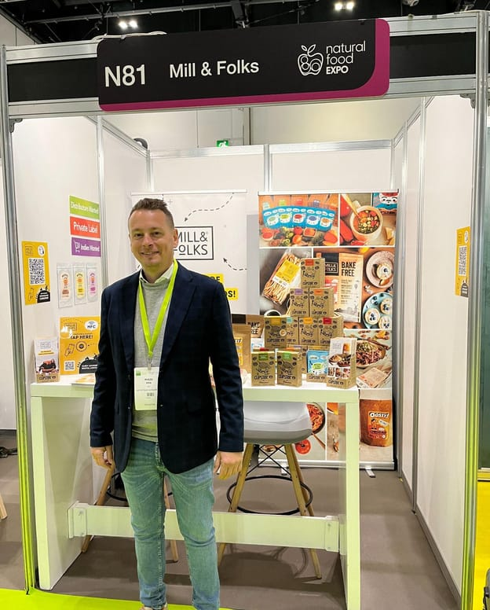
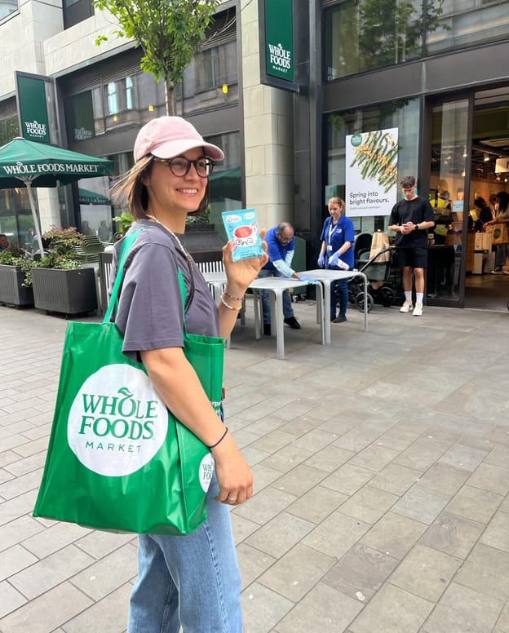
On the international stage: NOPEX London 2025
04 · VISIBILITY

Slide 25
Only one player owns the whole chain
05 · COMPETITION
 | Naturtrade | Szafi Products | Hunorganic (It's Us) | Import brands
Own flour milling | ● | ○ | ○ | ○
Own production | ● | ◐ | ◐ | ●
Healthy instant (cups) | ● | ○ | ○ | ◐
Plant-based premixes | ● | ○ | ○ | ○
Export & GCC relationships | ● | ◐ | ○ | ●
Local speed and flexibility | ● | ● | ● | ○
Szafi Products Kft.
2024 revenue HUF 1.7bn · EBIT HUF 194M
Similar portfolio. No own milling; pasta is contract-made. Ownership changed 4 years ago and growth has slowed since.
Hunorganic Kft. (It's Us)
Revenue HUF 910M · EBIT HUF 71M
Similar portfolio. An early multinational-chain listing and pioneer brand, acquired by Foodnet (Alpro).
● yes ◐ partly ○ no · Import brands: e.g. Schär, dmBio
Our edge: own milling, a constant stream of new products, strong export potential and GCC market knowledge and relationships.
Exit precedent: Hunorganic was bought by a strategic buyer.

Slide 26
Clear strengths, known risks, a plan for both
05 · SWOT
S
Strengths
W
Weaknesses
Our own premium milled flour
Constant R&D-driven product innovation
Contract manufacturing for competitors
Undercapitalised, like most Hungarian SMEs
Smaller marketing budget than Western peers
Export growth held back by capacity
O
Opportunities
T
Threats
Contract manufacturing: a HUF 1.2bn opportunity
Export: a HUF 2.1bn opportunity
Western Europe, North America, Middle East
Unpredictable regulation: special taxes, price and margin caps
Competition
Global shocks: tariffs, Covid, the war in Ukraine
How we respond: a constant flow of new products and cost advantages (wages, energy, a faster and more flexible organisation)

Slide 27


Two breakout opportunities worth HUF 3.3bn
05 · GROWTH LEVERS
HUF 1.2bn
HUF 2.1bn
Contract manufacturing
Export
We already produce for several Hungarian and international companies. The new plant lets us scale this into a stable second income stream that fills capacity.
Western Europe, North America and the Middle East are the largest expected markets. We sell in EUR, which limits currency exposure.

Slide 28
HUF 400M+ to move into a scalable plant
06 · THE ASK
Greenfield plant · HUF 200M
Relocation to Röszke (5 minutes by car): concrete base, road, fence and utilities, plus a rented production hall and offices
HUF
420M
indicative plan
Inventory & marketing · HUF 130M
Raw and packaging stock, Cupster and Oosty launch campaigns, export trade shows, webshop
Grant co-financing · HUF 90M
Own contribution to our winning ÉLIP capacity-expansion grant: new machines and accessories
Minimum raise HUF 400M. The allocation follows the company business plan.

Slide 29
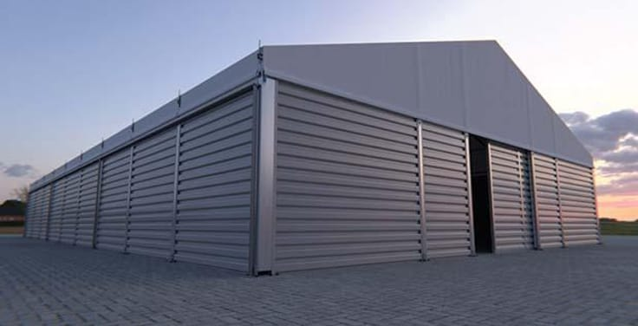
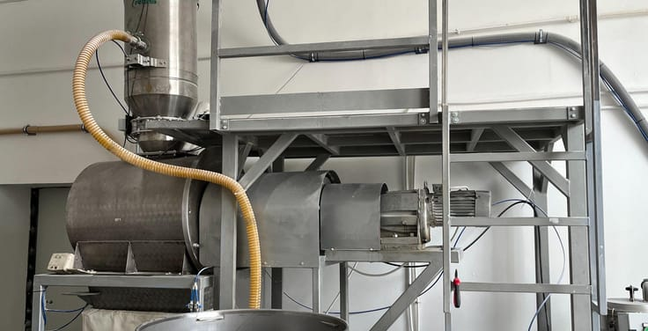
The capacity build-out multiplies output
06 · CAPACITY
Flour milling
A third, 1,000 kg/h mill joins the two existing mills
270 → 1,270
kg / hour
4.7×
Flour blending
A 550 L high-capacity mixer for Bake-Free
750 → 2,550
kg / hour
3.4×
Instant cups
A second automatic packer and an automatic cup filler
1 line → 2 lines + filler
automatic
2×+
The new plant is planned to triple production capacity within two years, towards ~10M units a year.

Slide 30
From the Szeged plant to an international exit
06 · ROADMAP
2025
2026
2027
2028–29
2030
1
2
3
4
5
Foundations
Build
Scale
Expand
Exit
First KSA exports
ÉLIP grant won
NOPEX London
Röszke greenfield works
New Cupster pack (HUF 599)
Oosty 'meat' mixes
Plant ramp-up
Multinational & discount chains
KSA up to €1.5M
Western Europe B2B + DTC
USA, Canada, GCC
Contract manufacturing at scale
Sale to a financial or strategic investor
3–5× target

Slide 31
Revenue to HUF 2.5bn by 2030, at a ~20% EBITDA margin
06 · FINANCIAL PLAN
3.4×
revenue growth, 2025 → 2030
~28%
revenue CAGR, 2025–2030
HUF 525M
planned EBITDA in 2030
Company financial plan. A = actual, P = plan. Revenue: 732 → 873 → 1,122 → 1,468 → 1,916 → 2,514. EBITDA: 182 → 201 → 208 → 320 → 377 → 525 (HUF M).
Notes:
The 2027 margin dip reflects the plant ramp-up. From 2028 operating leverage brings the margin back above 20%.

Slide 32
A clear path to a 2030 exit
06 · EXIT
3–5×
Financial investor
A sale to an international financial investor such as a PE fund or food-platform roll-up.
Target return to investors in 5 years
The value drivers are scale from the Röszke plant, export share, high-margin DTC, Cupster and Oosty growth, and contract manufacturing.
Strategic investor
Hungarian or international food groups, once we reach a larger company value. Precedent: Hunorganic was acquired by Foodnet (Alpro).

Slide 33
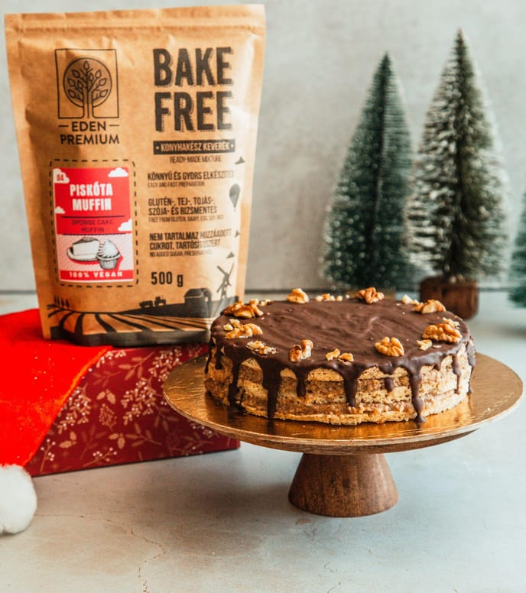


Why invest in Naturtrade
SUMMARY
Real moat
Our own milling plus full in-house production, a chain competitors can't copy quickly
Growing markets
Gluten-free +7–10% a year, plant-based meat +15%, GCC demand rising
Category creators
Cupster and Oosty open new shelf space, not just compete for it
Proven export
UK, Western Europe, Amazon and a state-backed KSA partnership
Capital-efficient plan
HUF 400M+ funds the plant, with a 3–5× target by 2030

Slide 34
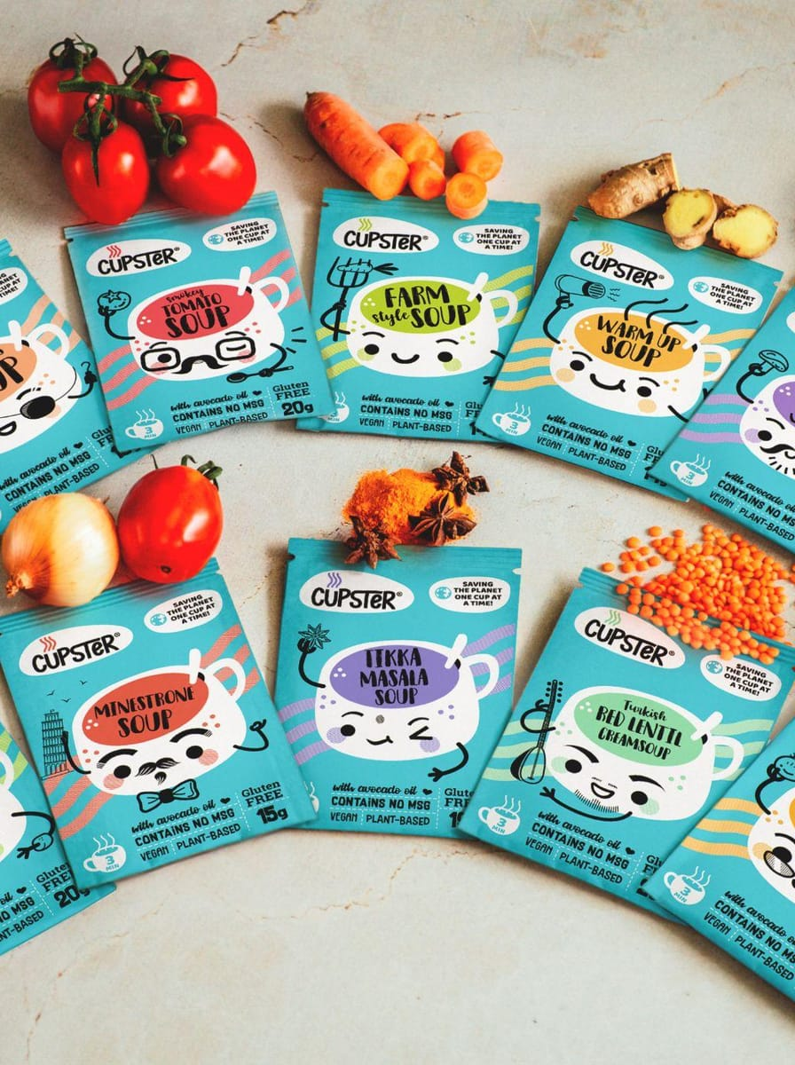

THANK YOU
Let's grow it together.
Miklós Véha
Founder & CEO, Naturtrade Hungary Kft.
miklos.veha@naturtrade.hu
+36 30 637 4535
millandfolks.com · edenpremium.hu

