Slide 1

Talksmith Style Reference
md-to-deck visual regression deck
One example of every slide template, plus layout edge cases
Autor: Talksmith
Última modificación: 2026-07-14

Slide 2
01
Frames & openers
01
02
Statement & emphasis
03
Enumerations
04
Ordered & comparison
Frames & openers
05
Visual & data
06
Interactive (quiz)
07
Closing

Slide 3
FRAMES & OPENERS
This deck renders one example of every Talksmith slide template.
Flip through it, or diff style-reference.html, and any styling regression jumps out.

Slide 4
A divider is a plain sub-opener within a section

Slide 5
01
Frames & openers
02
02
Statement & emphasis
03
Enumerations
04
Ordered & comparison
Statement & emphasis
05
Visual & data
06
Interactive (quiz)
07
Closing

Slide 6
STATEMENT & EMPHASIS
A statement slide is one dominant claim, set large.
No bullets, no cards — just the single line you want the room to remember.

Slide 7
STATEMENT & EMPHASIS
A statement title can run long, and it should still wrap gracefully across two or three lines while reading as one strong, uninterrupted assertion.

Slide 8
STATEMENT & EMPHASIS
big-number: one hero metric
1
big-number is for a single hero figure — one number set very large, one caption, nothing competing with it.

Slide 9
STATEMENT & EMPHASIS
“
A quote slide is the whole slide — one voiced line, centered, with an attribution beneath.
— the Talksmith style guide

Slide 10
STATEMENT & EMPHASIS
“
No hubo hackers. No hubo malware. Alguien pegó código en un chatbot.
Notes:
A quote with no attribution. Plenty of quoted lines have no person to name — a slogan, an anonymized line from a user interview, a sentence from a standard or a report, something said in the room. The template treats attribution as optional and renders nothing in its place: the quotation mark and the centering already say these are someone else's words, which is the only thing that distinguishes a quote from a statement. The rule this fixture guards is that the fill must not invent an attribution to satisfy the template, and must not demote the slide to statement because none exists.

Slide 11

STATEMENT & EMPHASIS
callout: an emphasized aside
Think of it this way A callout is a single rounded panel for a tip, analogy, or warning — pink for a lateral note, blue for a declarative takeaway.

Slide 12

STATEMENT & EMPHASIS
callout: the blue tone
The other tone Blue is the declarative takeaway — a conclusion the audience should carry out of the slide. Pink (previous slide) is the lateral note: an aside, analogy, or caution.

Slide 13

STATEMENT & EMPHASIS
single-point: one lead plus one point
The rule When a slide is a claim plus exactly one supporting beat, give that beat a card — never a lone bullet floating under a title.

Slide 14
01
Frames & openers
02
Statement & emphasis
03
03
Enumerations
04
Ordered & comparison
05
Visual & data
Enumerations
06
Interactive (quiz)
07
Closing

Slide 15


ENUMERATIONS
concept-breakdown: 2 cards, explicit icons, reveal together
Two is valid
Iconed
A two-item labeled set is a real concept-breakdown, not something to drop to prose.
Each card still gets its own distinct, content-matched icon beside the label.

Slide 16



ENUMERATIONS
concept-breakdown: 3 cards (2 + 1 across the width)
Unordered
Short bodies
The cards have no sequence; order carries no meaning here.
Keep each body to a line or two so the grid stays even.
No source image
Any picture would route the slide to figures instead.

Slide 17




ENUMERATIONS
concept-breakdown: 4 cards (2×2), longer bodies edge case
Capacity
Wrapping
Two through six cards fit; beyond six, split across two slides so nothing has to shrink.
Longer bodies wrap inside their card, and all four cards hold the same height as a 2×2 grid.
Distinct icons
When to switch
The renderer never repeats an icon within a slide, so four cards means four different glyphs.
If a body is too long to read comfortably here, move it to content-text, which gives each item prose room.

Slide 18






ENUMERATIONS
concept-breakdown: 6 cards (3×2), the dense edge
Default home
Grid
Icon each
The general case for any labeled set of two or more.
Six cards lay out as a 3×2 grid with uniform gutters.
Six distinct icons, one anchoring every concept.
Terse
Split point
Still cards
At six cards, keep every body to a single short line.
Need more than six? Split the set across two slides.
Even this dense, it is cards — never a bullet list.

Slide 19



ENUMERATIONS
concept-breakdown · editorial: 3 concepts, one row of three
The editorial format keeps the icon, the label and the body, and drops the panel around them:
No card
Small icon
One row
No fill, no radius, no wide padding — the concept sits on the canvas.
The glyph is a reference mark beside the label, not the anchor.
Three concepts share a single row instead of two plus one wide.

Slide 20




ENUMERATIONS
concept-breakdown · editorial: 4 concepts, a 2×2 grid
Four concepts fill two columns over two rows — the same rhythm the card grid uses, without the boxes:
Two columns
Aligned labels
Each concept takes half the useful width, so the measure stays comfortable.
Labels in a row share a baseline; bodies indent to the label's left edge.
A hairline, not a box
Opt-in
One thin rule marks the row; white space does the rest of the separating.
Set format editorial; leaving it off keeps the card grid exactly as it was.

Slide 21




ENUMERATIONS
concept-breakdown · editorial: 5 concepts, three then two centered
A short last row keeps the width of the row above and centers, instead of stretching to fill:
Three up top
Same width
Centered
The first row sets the column rhythm.
Row two keeps that item width, so every measure matches.
The leftover width splits evenly on both sides.
Never one wide
Room to breathe
No item ever spans a whole row on its own.
The unused half-columns read as white space, not as a gap.

Slide 22






ENUMERATIONS
concept-breakdown · editorial: 6 concepts, a 3×2 grid
Six concepts are the format's comfortable middle — three columns over two rows:
Three columns
Even density
Rows read across
The same span as the three-concept row, twice over.
Six flat blocks weigh less than six cards.
Reading order stays left to right, top to bottom.
Short bodies
Longer prose warns
Or use list
Around a hundred characters each at this width.
The build says so instead of shrinking the type.
The vertical format has the room prose needs.

Slide 23





ENUMERATIONS
concept-breakdown · editorial: 7 concepts, four then three centered
Seven is the count the card grid handled worst — 3+3+1 left a single item stranded on its own row:
Four up top
Type steps down
Three centered
No orphan row
Seven and eight concepts move to four columns.
Icon and text shrink one notch at four across.
The second row centers on the same grid.
Nothing is left alone across the width.
Keep bodies short
Still legible
Past that, split
The step-down is bounded, not open-ended.
Two slides beat one unreadable one.
Roughly seventy characters at this width.

Slide 24




ENUMERATIONS
concept-breakdown · editorial: 8 concepts, a 4×2 grid
Eight is the ceiling — a regular four-by-two grid, with the takeaway kept out of it:
Four by two
Equal widths
Row rules
Small glyphs
A regular grid, no partial row.
Every concept gets the same measure.
Hairlines mark the two rows.
Icons support, they do not lead.
Aligned
White space
Scans fast
The ceiling
Labels in a row share a baseline.
The row gap carries the separation.
Eight flat blocks stay readable.
A ninth concept means a second slide.
A conclusion stays a full-width band under the grid — it is a comment on the set, never a ninth cell in it.

Slide 25




ENUMERATIONS
aside: a full-bleed image column on the right
The image reinforces the point; the text carries it.
Atmosphere, not information
Default side
An aside sits on the right unless the hint says left.
The column crops to fill, so nothing in it needs to be read closely.
Any stage-based type
The stage macro adds it, so every content template supports it.
Notes:
The aside is the slide-model expression of an author's <!-- aside: ... --> hint in draft.md. It reserves roughly 37% of the slide width as a full-bleed image column and pads the stage on that side so the head and body lay out in what remains. Because the column crops to fill rather than fitting the whole image, it is only ever atmosphere: a diagram, chart, or screenshot the audience must actually read belongs in a template that owns its image, where it is contained and legible.

Slide 26



ENUMERATIONS
aside: the same column, on the left
side: left
Content reflows
The hint's optional side moves the column to the other edge.
The stage pads whichever side the image takes.
Notes:
The left variant exists for rhythm: alternating the side across a run of slides keeps a deck from feeling like a template. The choice carries no semantics — it is purely visual pacing.

Slide 27



ENUMERATIONS
concept-breakdown · format row · 3 short cards
A lead line sits above a single horizontal row of three to five short cards:
Lead
Short
One row
One framing sentence introduces the row.
Each body stays under about eighty characters.
Three to five cards share one horizontal band.

Slide 28


ENUMERATIONS
concept-breakdown · the default card grid
With no
format
, a labeled set renders as
cards
:
Parallel reads side by side
The lead survives
A labeled set is N peers. Stacking them spent the whole slide width on one item and made the set read as a sequence.
carries the lead the retired format carried, so nothing an old model wrote is dropped on the way over.
grid
Prose still fits
A card holds up to about two sentences. Past that the slide is not a labeled set — it is
content-text
, or two slides.

Slide 29



ENUMERATIONS
A bare anaphora → label-only cards
No labels are required here.
Each parallel line becomes one card.
This keeps such slides off the fallback path.

Slide 30






ENUMERATIONS
Inline styling works in every field
**bold**
,
*italic*
,
~~strike~~
,
`code`
,
[text](url)
and a naked URL are resolved in
every
text field of
every
template:
Bold a figure
Italic a term
code
inline
Entrenar un LMM puede consumir 700.000 litros de agua — the number carries the line, so it reads as the number.
The lead is the title's sub-line; the body is what follows it.
A field name like
or a flag like
slide-model.json
keeps the mono face, and
--print-pdf
file named inside a bolded phrase
a
.md
stays bold across it.
Strike a superseded value
A titled link
URLs link themselves
A figure the slide corrects reads 1.2M 4.4M — struck, not deleted, so the correction is visible.
shows the title and hides the address. Only
Raw as https://www.who.int/data, the angle form https://who.int, www.who.int/es, and even schemeless — app.sli.do/event/x — all become clickable. The trailing period stays outside.
[text](url)
http:
,
https:
and
mailto:
link —
[x](javascript:…)
stays literal text.
Fuente: WHO — Ethics and governance of AI for health (2024) — dudas a este correo.
Notes:
Inline styling is resolved once, in html_style.py _richtext/_inline_md, on the slide's prose fields — not per template — so any field of any template accepts the marks. Escaping runs first, so authored HTML in a field stays inert text; code blocks, image paths and the enum-ish fields the renderer branches on are excluded, because their bytes are the content.
Speaker notes take the same grammar (this note is proof: bold resolves here too) plus their own line breaks, because notes are prose the presenter reads rather than a schema field.
The grammar stops at inline marks on purpose: block markdown inside a field (headings, lists, tables) would let content route around the schema, which is where the template and its fields do their work.

Slide 31
01
Frames & openers
04
02
Statement & emphasis
03
Enumerations
04
Ordered & comparison
Ordered & comparison
05
Visual & data
06
Interactive (quiz)
07
Closing

Slide 32
ORDERED & COMPARISON
process: an ordered sequence of steps
Use process when order carries meaning — steps, phases, or a numbered flow:
Classify
Decompose
Render
The fill step reads final.md and picks each slide's template.
It splits the body into that template's exact required fields.
build_html.py maps those fields onto Jinja templates, mechanically.
1
2
3

Slide 33
ORDERED & COMPARISON
A plain enumeration → the numbered list
Seven unlabeled lines: no labels to card up, so they number instead of falling to bullets.
1
Uno cada dos clases, relacionado con temas vistos.
2
En grupos de 2 personas.
3
Valen 40% de la nota final.
4
Gran parte del trabajo se completa en clase.
5
Entrega: antes del viernes siguiente vía repositorio GitHub.
6
Todos los entregables son obligatorios.
7
Entregas tardías impactan la nota.
Notes:
A list whose items carry no label has nothing to build a card around, so it used to land on fallback and draw as bare bullets. It belongs on process instead: the unlabeled branch of that template is already a numbered list — an outlined number chip and the line — and the numbering is what earns the slide. It turns a loose list into a countable set the audience can hold in mind and the presenter can point at, without implying the items are steps in a sequence. The single column is deliberate here, unlike the labeled set: a numbered list is read top to bottom, and splitting it across columns breaks the count.

Slide 34
ORDERED & COMPARISON
process: plain numbered steps
When the steps are ordered but unlabeled, render them as a vertical numbered list:
1
Identify the data you are about to share and where it came from.
2
Classify its sensitivity before it leaves your workspace.
3
Choose an approved tool for that classification.
4
Record what was shared so the workflow can be audited later.

Slide 35
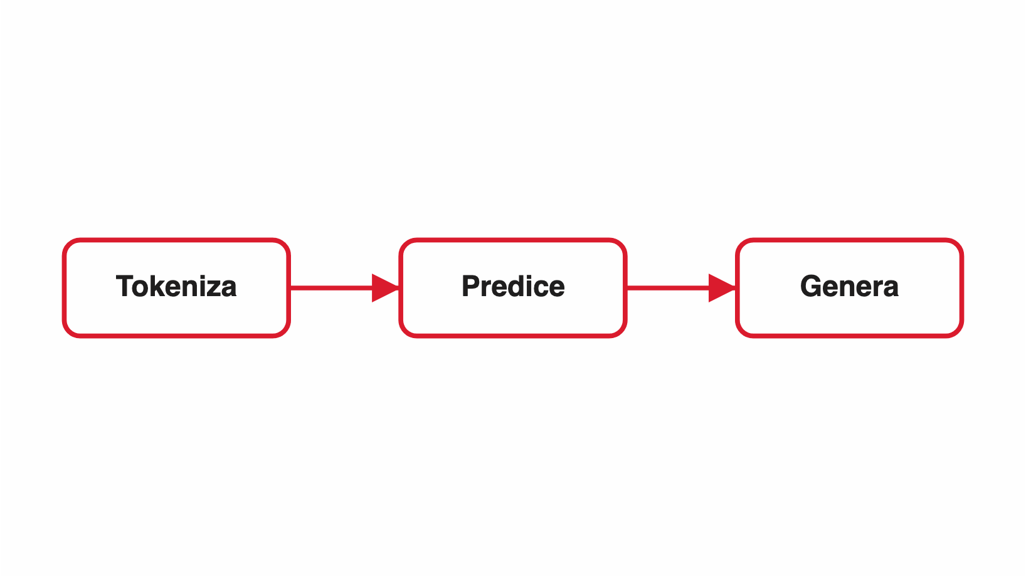
ORDERED & COMPARISON
process: steps beside a supporting diagram
With an image, the steps become a narrow column and the diagram takes the other half:
Own layout
Rows, not cards
Never cropped
An image switches process to a two-column arrangement, not the full-width numbered cards.
The supporting image is contained, so a diagram here stays readable.
Each step compresses to a numbered row so the diagram keeps its space.
1
2
3

Slide 36
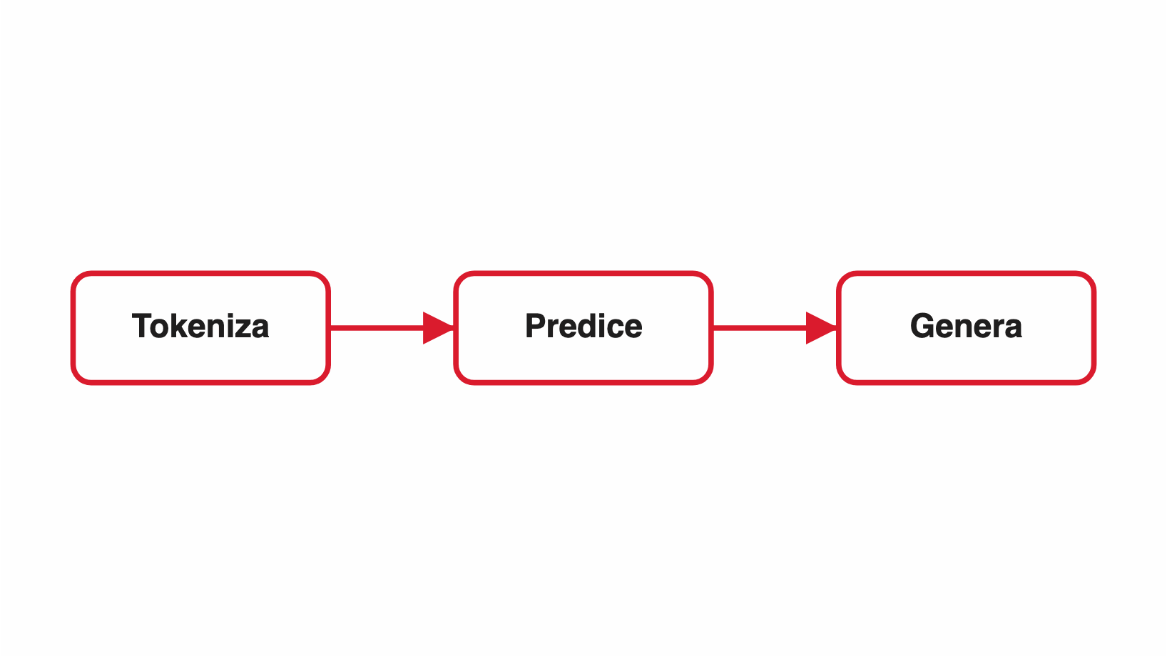
ORDERED & COMPARISON
process: diagram first, steps following (image-left)
The same steps with the diagram leading the eye:
Own layout
Rows, not cards
Never cropped
An image switches process to a two-column arrangement, not the full-width numbered cards.
The supporting image is contained, so a diagram here stays readable.
Each step compresses to a numbered row so the diagram keeps its space.
1
2
3

Slide 37
ORDERED & COMPARISON
timeline: a dated milestone sequence
An optional lead can frame the sequence before the dates begin.
Day 1
Reach for timeline when the labels read as dates or milestones.
Day 2
Time flows top to bottom along a connecting rail with a dot per entry.
Day 3
It differs from process only in that here, when matters more than the step.

Slide 38
ORDERED & COMPARISON
timeline: milestones carrying an explicit marker
The optional per-milestone marker rides inside the dot:
Day 1
1
Reach for timeline when the labels read as dates or milestones.
Day 2
2
Time flows top to bottom along a connecting rail with a dot per entry.
Day 3
3
It differs from process only in that here, when matters more than the step.

Slide 39



ORDERED & COMPARISON
concept-columns: four terms, the third emphasised
Each column explains its own term; reading across a row says nothing.
Language Model
Foundation Model
LLM
Modelo Multimodal
Asigna probabilidades a secuencias de palabras: dado un contexto, predice qué sigue.
Entrenado a escala masiva sobre datos generales, adaptable a múltiples tareas.
Un Foundation Model especializado en texto: aprende la distribución del lenguaje natural.
Un Foundation Model que procesa y genera varios tipos de dato a la vez.
CARACTERÍSTICAS
CARACTERÍSTICAS
CARACTERÍSTICAS
CARACTERÍSTICAS
Combina encoders de varias modalidades
Existen desde los años 1950
Entrenado con billones de tokens
Sólo procesa y genera tokens
Basados en P(palabra | contexto)
Generalista por naturaleza
Arquitectura Transformer
Un solo modelo para ver, oír y hablar
Primero estadísticos, luego neuronales
Base para aplicaciones específicas
Desde 7B hasta +1T parámetros
Razonamiento cruzado entre modalidades
Ejemplos: GPT-4, Gemini, Claude, LLaMA
Ejemplos: GPT-4, Claude 3, Mistral
Ejemplos: N-gramas · Shannon (1948) · RNNs
Ejemplos: GPT-4o, Gemini 1.5 Pro, LLaVA
Relación: Todo LLM es un Foundation Model, pero no todo Foundation Model es un LLM.
Notes:
Four terms explained side by side. The columns deliberately share no row structure — that is the whole discriminator against value-columns, which is a table wearing columns and whose cells align row by row against a shared factor. Here reading across a row says nothing: each column is read top to bottom on its own, and one column may carry four bullets where its neighbour carries a paragraph. The emphasised column marks the term the slide is about, the one the others define by contrast; it is not a verdict, so the older or worse option may carry it just as well.

Slide 40
ORDERED & COMPARISON
concept-columns: two terms, no shared factors
It looks adversarial, but there is no row to read across — so it is not a comparison grid.
IA Tradicional vs. Foundation Models
IA Tradicional
Foundation Models
Un modelo por tarea específica, entrenado en casa.
Modelos entrenados con datos a gran escala que adquieren una comprensión general y se adaptan después.
Requiere datos etiquetados abundantes para cada caso de uso
Se exponen como SaaS o se pueden correr localmente.
Difícil de reutilizar entre dominios distintos
No hace falta un equipo de data science para empezar a usarlos.
Ejemplo: un detector de fallos en autopartes sólo detecta eso.
Lectura recomendada: On the Opportunities and Risks of Foundation Models (Stanford HAI, 2021).
Notes:
The two-column case, and the one most likely to be misclassified. It reads adversarial — old way versus new way — but there is no shared factor and no row to read across, so it is not a value-columns grid: each side is explained in its own terms, with its own internal structure. Note also that the emphasised column here is the traditional approach, not the one the talk advocates: emphasis marks the subject under discussion, never the winner.

Slide 41
ORDERED & COMPARISON
value-columns: three columns
Layout
Rows
Rule
Two to three equal columns
Cells align across columns
A card-per-row grid
One row per comparison point
Parallel headers
Never a native table
Uniform widths
Shared gridlines
No plain bullets

Slide 42
ORDERED & COMPARISON
value-columns: two columns (myth vs reality)
Myth
Reality
A comparison needs a real HTML table
It renders as a card-per-row grid
The two columns should look different
Both columns share the same weight and width

Slide 43
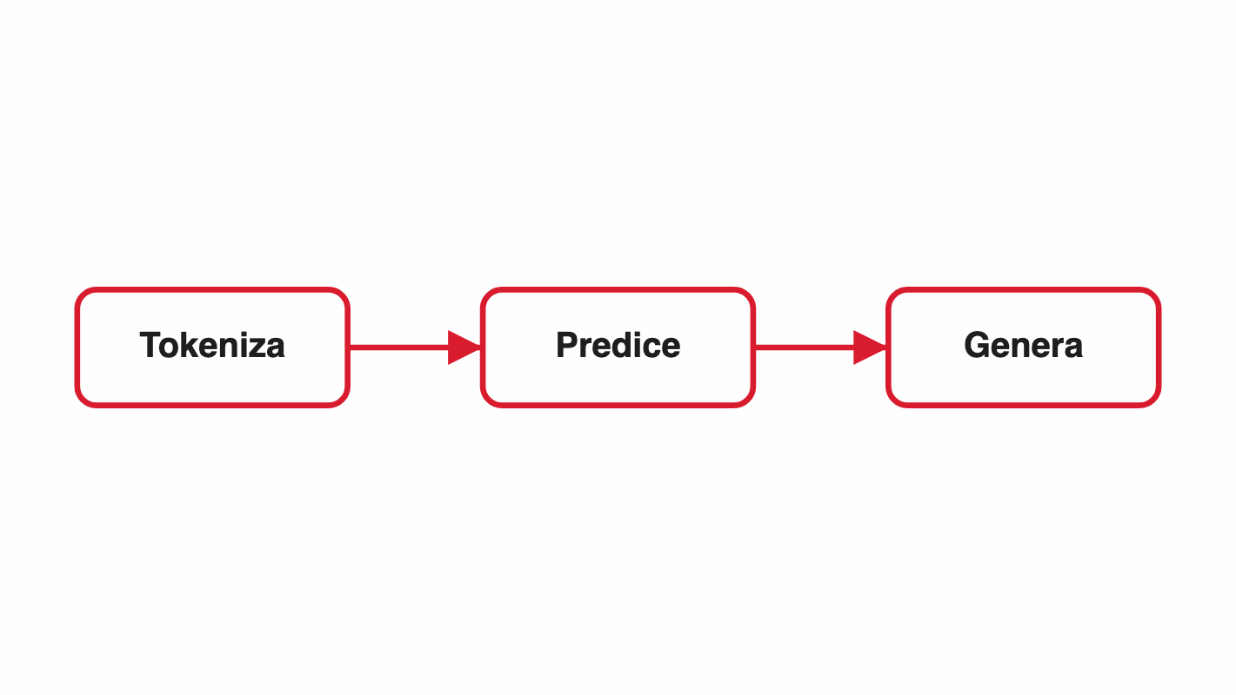
ORDERED & COMPARISON
value-columns + image: the grid keeps its columns
A table and a diagram on the same slide — neither one has to go.
What changes
Chatting
Delegating
The way of working
One question at a time
One whole assignment
The steps
You supply them
It plans and runs them
The output
Text in the window
Files on disk
The human role
You write and wait
You commission and review

Slide 44
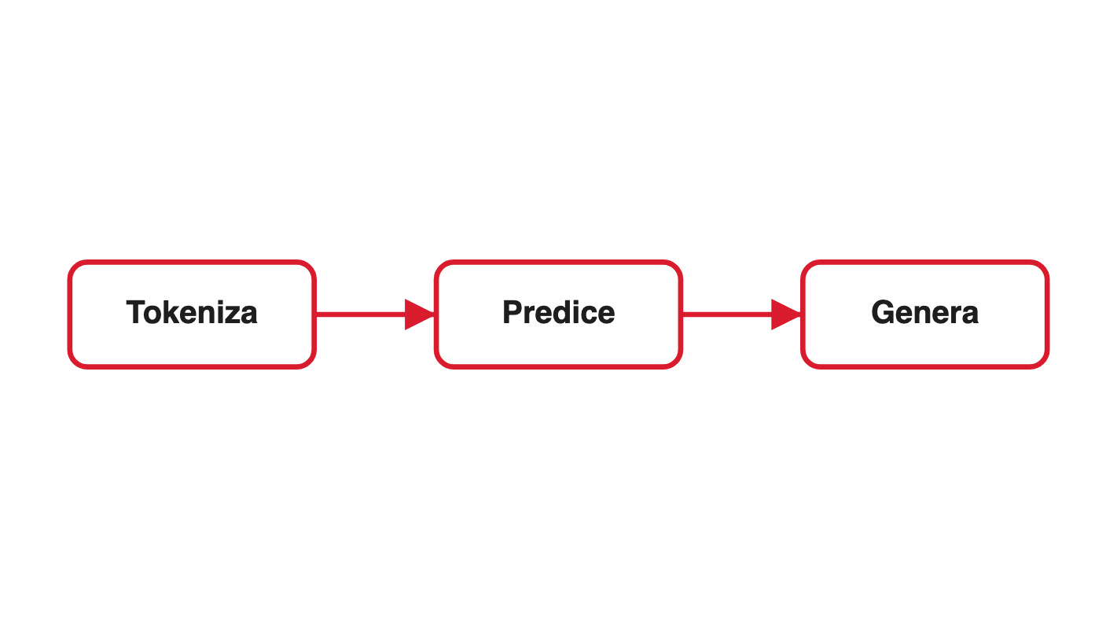
ORDERED & COMPARISON
value-columns + image: mirrored (image-left)
Factor
Mirrored
Column widths
The grid keeps the wider track
Reading order
Grid then image, unchanged
Cell alignment
Still left-aligned

Slide 45


ORDERED & COMPARISON
pros-cons: upside versus downside
Ventajas
Riesgos
The pro column uses the blue tint with a check
The con column uses the pink tint with a mark
Best for a decision framed as a trade-off
Author-directed: two labeled groups
Each line is one short point
Not for a general A-versus-B comparison

Slide 46
ORDERED & COMPARISON
pros-cons: uneven, longer lists
The count is the point of the slide, so the rules stack instead of running together.
Qué hacer
Qué no hacer
Split before you explore the data
Tune against the test set
Split by group, never by row
Re-split because the number came out wrong
Fix the seed and store the split
Augment the training set only
Trust the library's default cut
Write down what you decided and why
Notes:
Edge case for the style test: five rules against three, each a short clause. Guards the count-stepped sizing and the uneven-column layout — the shape that first showed the items had been joined into a single run-on line.

Slide 47
01
Frames & openers
02
Statement & emphasis
05
03
Enumerations
04
Ordered & comparison
05
Visual & data
Visual & data
06
Interactive (quiz)
07
Closing

Slide 48

VISUAL & DATA
stat: two to four standalone numbers
Each number is a value with a short caption beneath it:
2–4
1
0
the number of metrics a stat slide holds
caption line per value, baselines aligned across the row
bullets — the numbers themselves are the payload
A hero single metric goes on big-number instead.

Slide 49
VISUAL & DATA
stat: two numbers (the low edge)
Each number is a value with a short caption beneath it:
2–4
1
the number of metrics a stat slide holds
caption line per value, baselines aligned across the row
A hero single metric goes on big-number instead.

Slide 50
VISUAL & DATA
stat: four numbers (the high edge)
Each number is a value with a short caption beneath it:
2–4
1
0
4×
the number of metrics a stat slide holds
caption line per value, baselines aligned across the row
bullets — the numbers themselves are the payload
the fourth slot, wrapping to a second row
A hero single metric goes on big-number instead.

Slide 51
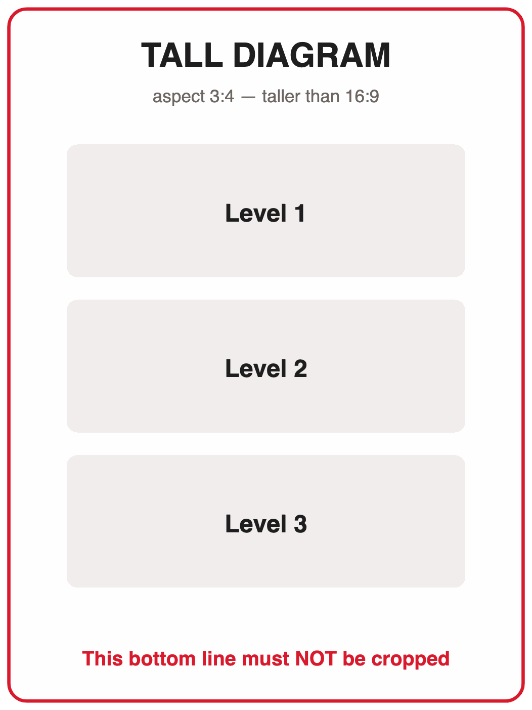

VISUAL & DATA
content-image: text beside an image
Each fact leads with a bold label the renderer bolds for you:
One image: supports one to three short facts.
Aspect preserved: the image is never cropped or forced into a box.
Three layouts: text-left, shown here, plus image-left and image-top.
Never cropped: the tall portrait must show its full height, edge to edge.

Slide 52
VISUAL & DATA
content-image: image-left mirrors the columns
Same slide, image first — the enumeration is untouched:
Columns swap: the image takes the left half, the text the right.
Enumeration unchanged: facts keep their order, left-edge dots and left alignment.
Never cropped: aspect is preserved here exactly as in text-left.

Slide 53
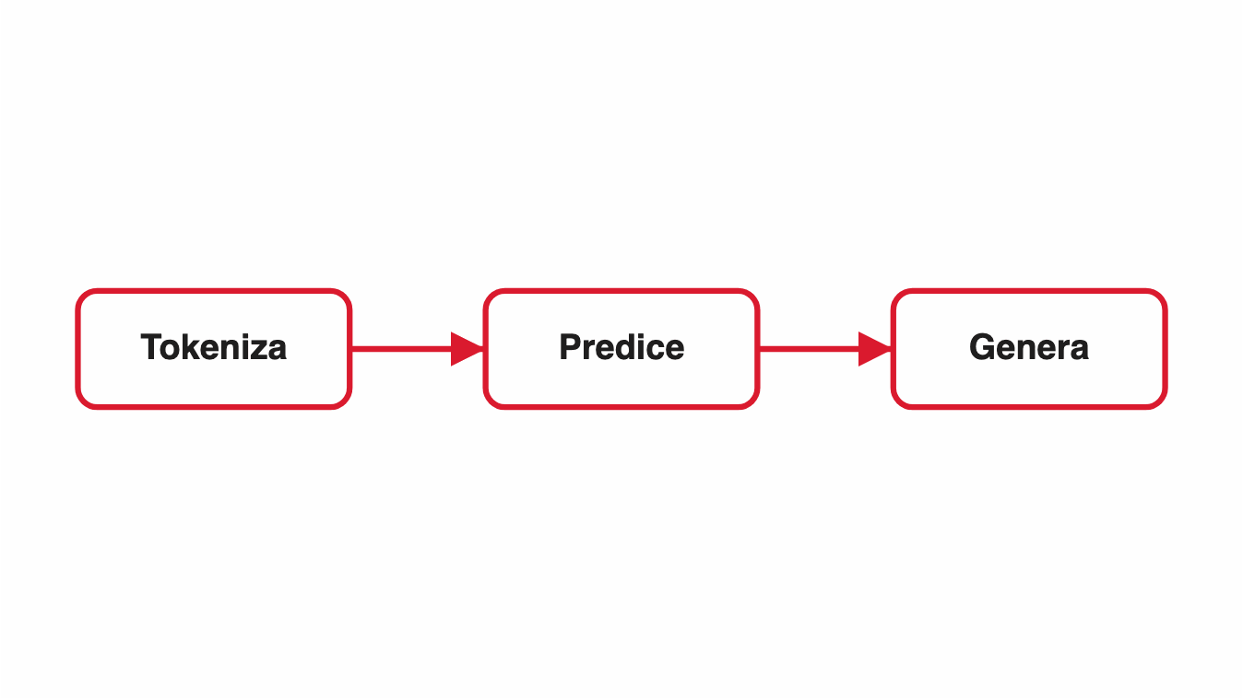
VISUAL & DATA
content-image: image-top layout for short text
When the text is just a line, the image-top layout lets the image dominate the slide.

Slide 54
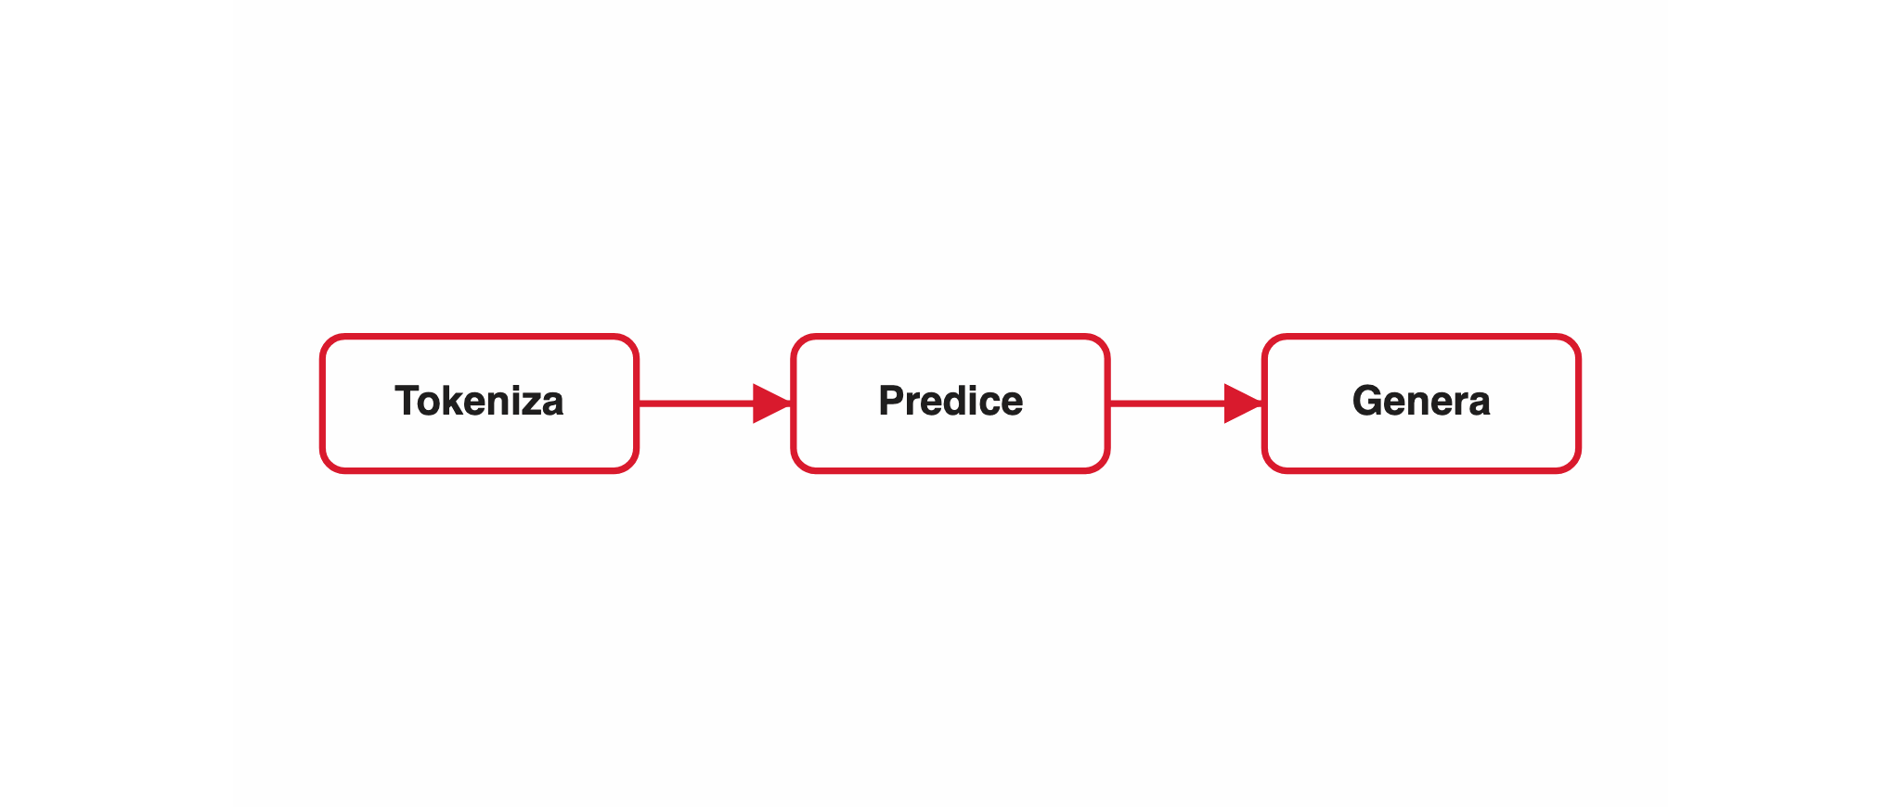
VISUAL & DATA
image-full: one image, edge to edge
Notes:
The shape a screenshot slide takes: the header stays, the image owns everything below it, and the detail the presenter narrates lives here in the notes rather than on the slide face. The image is contained, never cropped — a capture whose edges are cut stops being evidence.

Slide 55
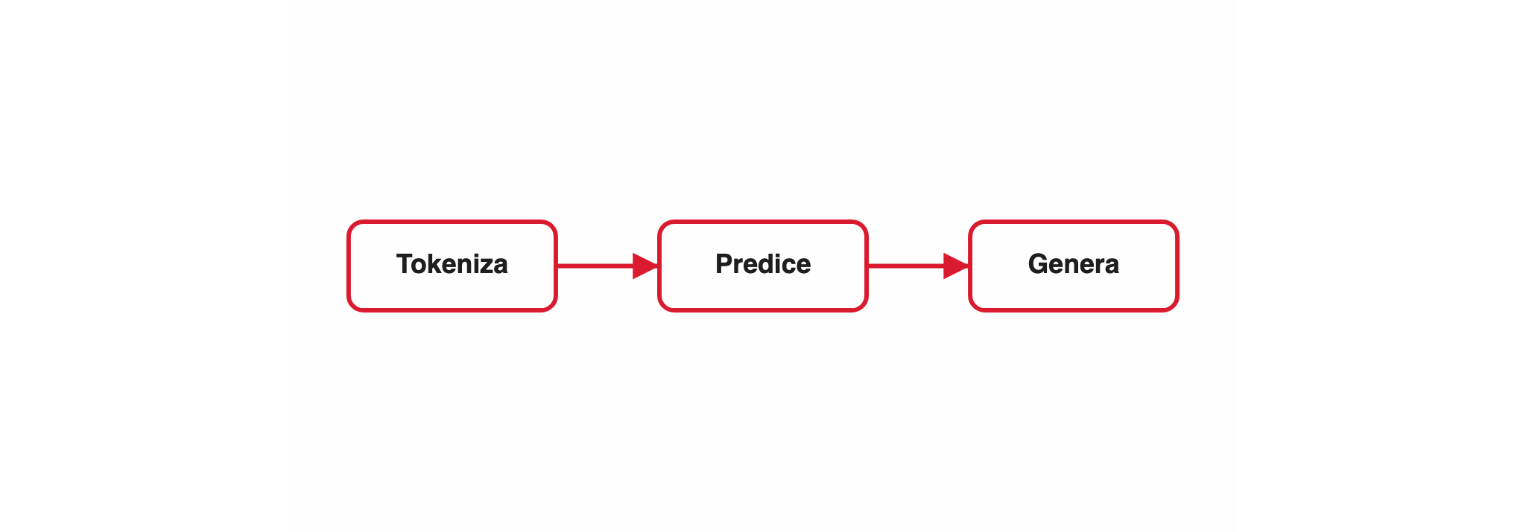
VISUAL & DATA
image-full: with a line of framing above the image
An optional lead sits under the title; the image still takes everything below it.

Slide 56
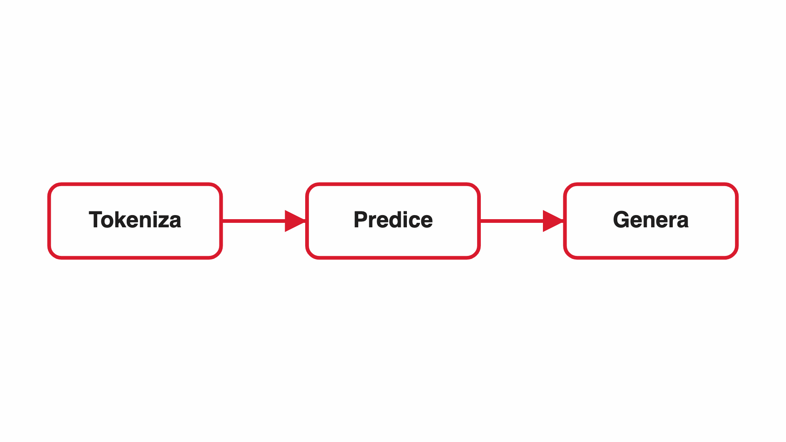
VISUAL & DATA
content-image: the empty-text-column guard
Guard, not a shape to author: a bare image here still drops the text column instead of projecting an empty one — new models use image-full.

Slide 57
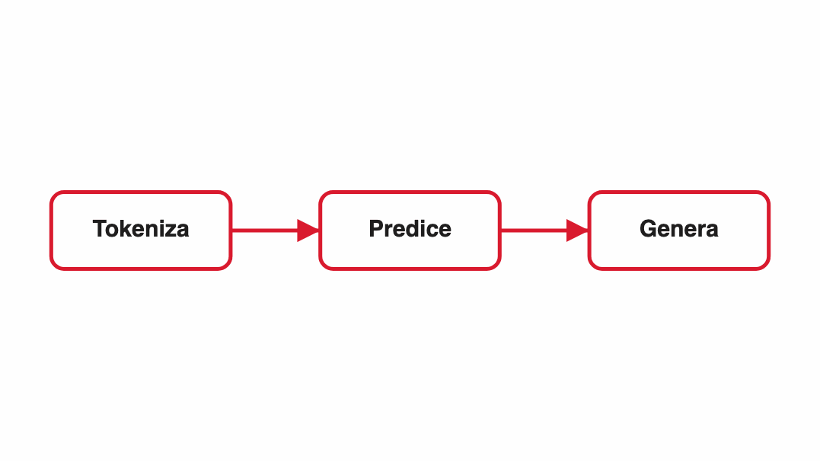
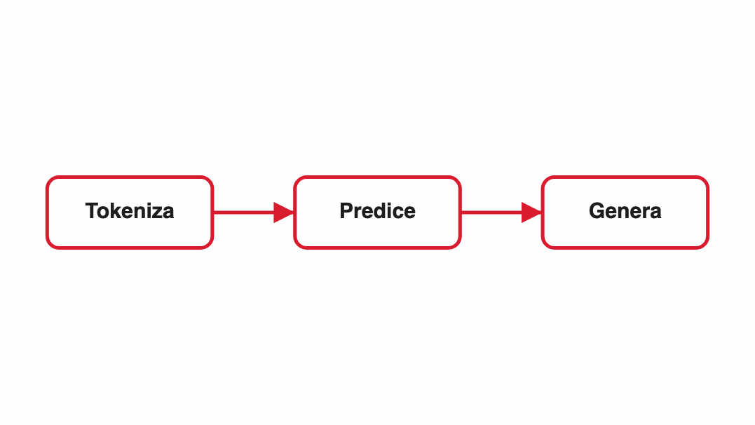
VISUAL & DATA
figures: a set where each item has its own image
Three or more figure cards, each an image with a label and a line:
Image per item
Uniform crop
Label and line
This is what separates figures from concept-breakdown.
Every figure shares the same size and alignment.
A short caption sits under each image.

Slide 58
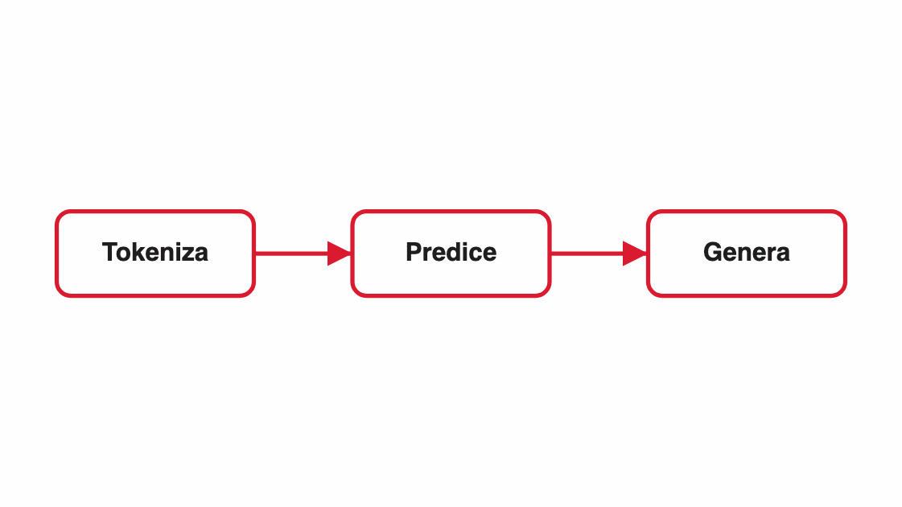
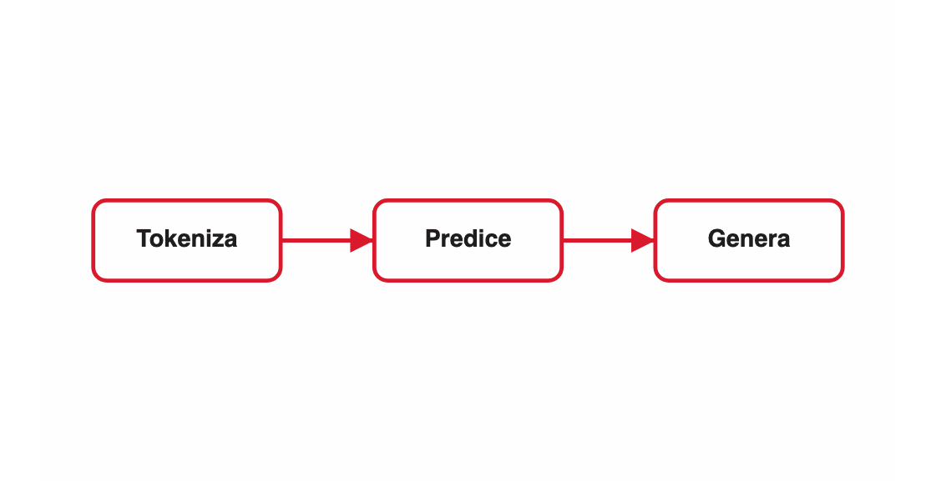
VISUAL & DATA
image-grid: four or more images as one composite

Slide 59
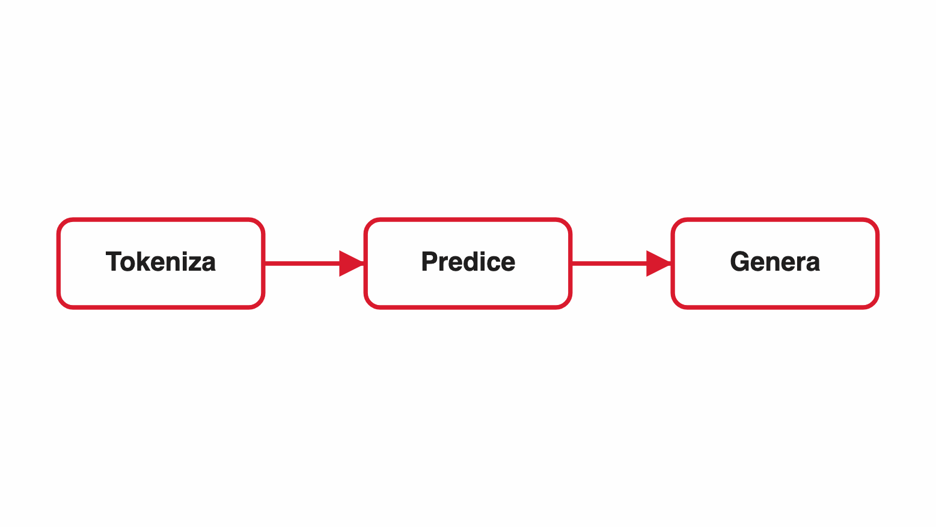
VISUAL & DATA
content+cards+image: cards beside one image
A short lead sits above the cards (regression guard for the lead field).
Cards on one side
A labeled set fills one half of the slide.
Image on the other
A single supporting visual fills the rest.

Slide 60
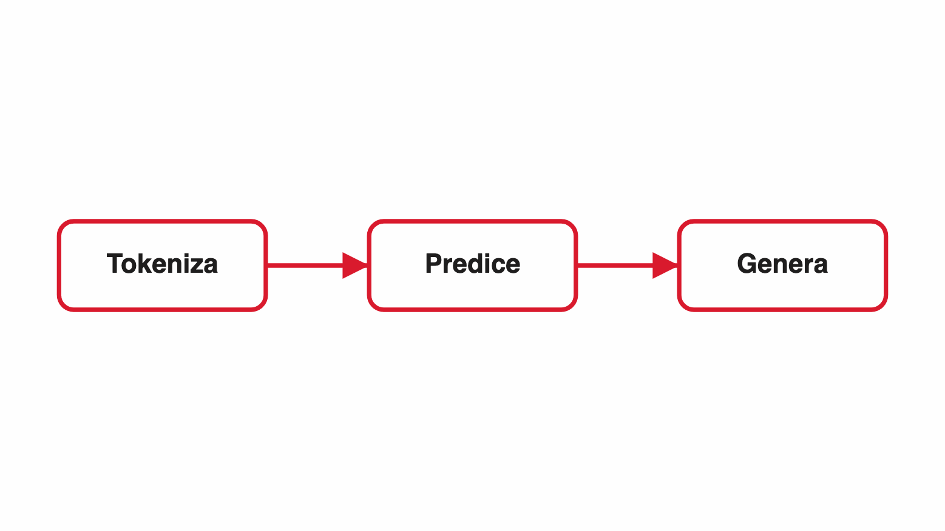

VISUAL & DATA
content+cards+image: image-left mirrors the columns
Same slide, image first — the cards are untouched:
Columns swap
the image takes the left column, the cards the right.
Cards unchanged
they keep their order, their icons and their left alignment.
Widths stay put
the wider grid track remains the cards', not the image's.

Slide 61
VISUAL & DATA
code-example: a readable code surface
PYTHON
client.messages.create(
model="claude-opus-4-8",
system=[{
"type": "text",
"text": SYSTEM_PROMPT,
"cache_control": {"type": "ephemeral"}
}],
messages=msgs,
)
The code sits on a monospace surface with syntax colors.
A short explanation column reads alongside it.

Slide 62
VISUAL & DATA
code-example: code alone, another grammar, a long snippet
TYPESCRIPT
type Cache = { key: string; ttl: number };
export async function ask(
prompt: string,
opts: Partial<Cache> = {},
): Promise<string> {
const t0 = performance.now();
// one retry: a 529 is the API saying "later", not "no"
for (let i = 0; i < 2; i++) {
const res = await client.messages.create({
model: "claude-opus-4-8",
max_tokens: 1024,
system: [{ type: "text", text: SYSTEM }],
messages: [{ role: "user", content: prompt }],
});
if (res.stop_reason !== "overloaded") {
log.info("ask", { ms: performance.now() - t0 });
return res.content[0].text;
}
await sleep(250 * (i + 1));
}
throw new Error("overloaded");
}

Slide 63
VISUAL & DATA
content-text: the prose last resort
content-text carries only prose — a definition or a framing — when nothing richer fits.
It renders as one lead line plus a few light panels, never a paragraph and never bullets.
The fill flags it as a restructure candidate: most prose slides are really cards in disguise.

Slide 64


VISUAL & DATA
Highlights: the seven kinds
Takeaway: the one idea to remember (the default kind).
Important: a risk, a limit, or a hard 'do not'.
Definition: a term being defined.
Example: a concrete case or scenario.
"A cited line — rendered in italics."
Note: an aside or minor context.
Fuente: Talksmith slide-model schema, §highlights (2026).

Slide 65
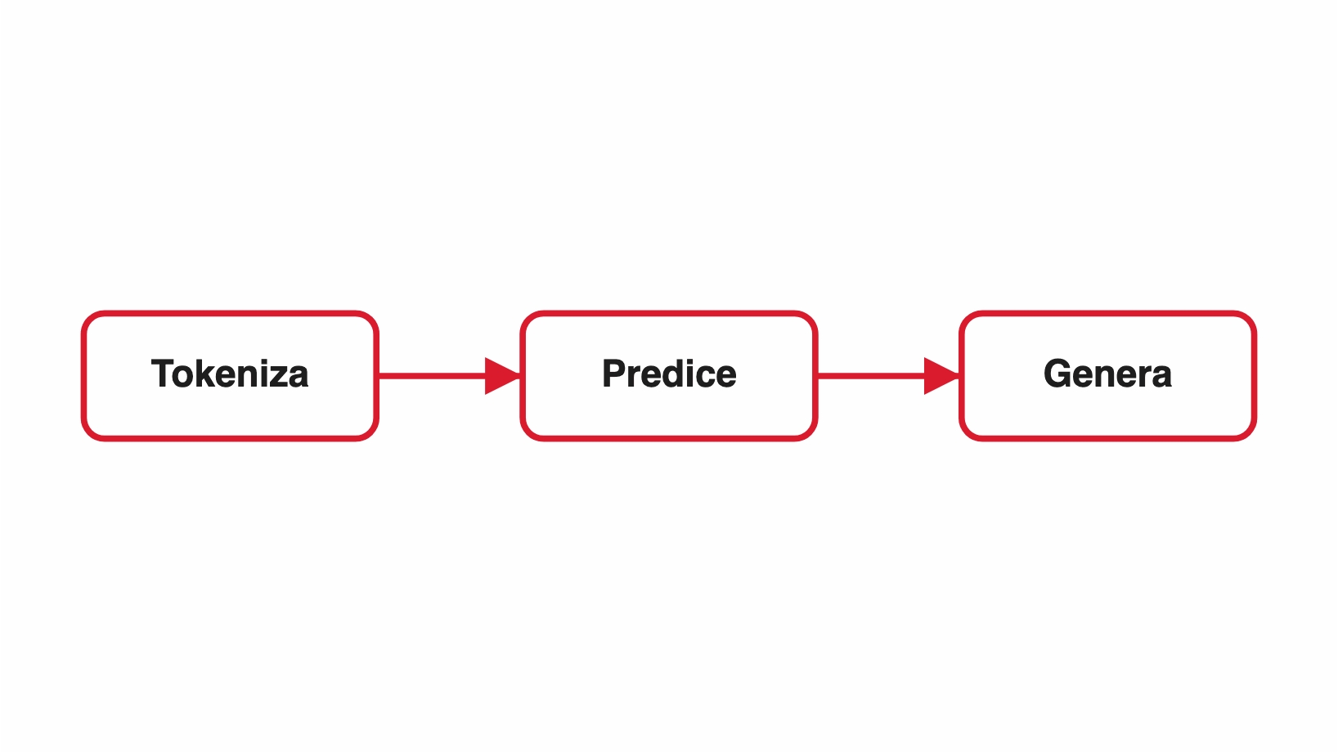


VISUAL & DATA
design: split-right — media contained on the right
A diagram the audience actually reads gets half the canvas, uncropped.
Design first
Style second
How the canvas is divided is chosen before the template.
The template only says what shape the content takes.
Fuente: WHO — Ethics and governance of AI for health (2024).
Notes:
Design and style are separate decisions, so they are separate fields. The stage places media per design; the template emits content and nothing else. That is why every content template accepts every design — the old layout field existed on five templates only, and aside was a second vocabulary for the same decision, so a template on neither list could not be composed at all. This slide is a concept-breakdown, a template that could never carry a composed image before.

Slide 66
VISUAL & DATA
design: split-left — the picture leads
Same design mirrored in CSS; the markup order (and the reading order) never changes.
Design first
Style second
How the canvas is divided is chosen before the template.
The template only says what shape the content takes.
Notes:
Design and style are separate decisions, so they are separate fields. The stage places media per design; the template emits content and nothing else. That is why every content template accepts every design — the old layout field existed on five templates only, and aside was a second vocabulary for the same decision, so a template on neither list could not be composed at all. This slide is a concept-breakdown, a template that could never carry a composed image before.

Slide 67
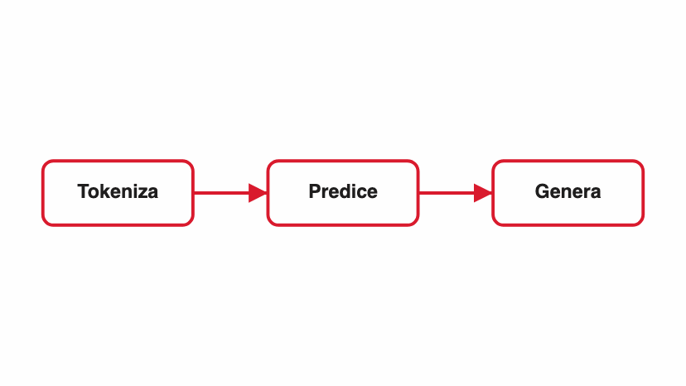
VISUAL & DATA
design: banded — media over a caption band
For text too short to hold a column.
Design first
Style second
How the canvas is divided is chosen before the template.
The template only says what shape the content takes.
Fuente: WHO — Ethics and governance of AI for health (2024).
Notes:
Design and style are separate decisions, so they are separate fields. The stage places media per design; the template emits content and nothing else. That is why every content template accepts every design — the old layout field existed on five templates only, and aside was a second vocabulary for the same decision, so a template on neither list could not be composed at all. This slide is a concept-breakdown, a template that could never carry a composed image before.

Slide 68
VISUAL & DATA
design: column-right — a cropped atmosphere strip
A narrow full-bleed column that crops to fill: tone, never information.
Design first
Style second
How the canvas is divided is chosen before the template.
The template only says what shape the content takes.
Fuente: WHO — Ethics and governance of AI for health (2024).
Notes:
Design and style are separate decisions, so they are separate fields. The stage places media per design; the template emits content and nothing else. That is why every content template accepts every design — the old layout field existed on five templates only, and aside was a second vocabulary for the same decision, so a template on neither list could not be composed at all. This slide is a concept-breakdown, a template that could never carry a composed image before.

Slide 69

VISUAL & DATA
design: bleed — the media fills the stage
The content sits over the picture.
Design first
Style second
How the canvas is divided is chosen before the template.
The template only says what shape the content takes.
Notes:
Design and style are separate decisions, so they are separate fields. The stage places media per design; the template emits content and nothing else. That is why every content template accepts every design — the old layout field existed on five templates only, and aside was a second vocabulary for the same decision, so a template on neither list could not be composed at all. This slide is a concept-breakdown, a template that could never carry a composed image before.

Slide 70

video: a clip is media — split-right, contained
Autoplays
Same frame
Reveal starts it when the slide comes up and pauses it on the way out.
A video takes the box an image would, in every design.
Notes:
A clip on a slide is a demo recording: it runs while the presenter narrates over it. Because the video carries the point and the PDF export only prints its first frame, whatever it shows has to be said here too — a reader of the deck never sees it move.

Slide 71


video: cropped to fill — column-right
Atmosphere
Looping
A column crops to fill, so nothing in the clip is meant to be read.
muted + loop is the shape ambient motion takes: it cycles, quietly.
Notes:
The column design crops media to fill its strip, which for video means the same rule as for a photo: nothing load-bearing goes in it. Ambient motion behind a text slide is what this is for — muted and looping, so it never ends mid-talk and never competes with the presenter's voice.

Slide 72

VISUAL & DATA
A source pins to the bottom edge
This slide is deliberately short.
Chrome, not a remark The citation credits the material; it does not comment on it, so it leaves the content flow entirely.
A takeaway is a remark on the body, so it stays with the body.
Fuente: OMS — Ethics and governance of AI for health (2024).
Notes:
A source highlight is emitted as a child of the stage rather than of .cfit, so it is pinned to the slide's bottom edge instead of trailing the content wherever the content happens to end. Two consequences follow from that placement, and both are the reason for it: on a short slide the citation stays on the baseline instead of floating up under a half-empty body, and the per-slide content-fit pass — which only ever scales .cfit — can neither shrink it nor move it. Every other highlight kind is a remark on the body and stays inside .cfit, where it moves and scales with what it remarks on.

Slide 73


VISUAL & DATA
Highlights: a framing band opens the slide
Anthropic: Menos una sesión de chat, más asignarle tareas a un colega.
Frames, not remarks
No fragment
The band sets up the cards instead of summarizing them.
It is on screen from the moment the slide opens.

Slide 74



VISUAL & DATA
Highlights: a slide can carry both bands
Composición: los campos que valen para cualquier template, no para uno solo.
Grouped by position
Same component
Every top entry lands above, every bottom entry below.
Identical classes, colours and icons in both bands.
Reveal differs
Only the closing band waits for the last click.
Two bands: the framing line opens the slide, the takeaway closes it — one band each.

Slide 75
01
Frames & openers
02
Statement & emphasis
06
03
Enumerations
04
Ordered & comparison
05
Visual & data
Interactive (quiz)
06
Interactive (quiz)
07
Closing

Slide 76

INTERACTIVE (QUIZ)
Quiz
In a Talksmith quiz slide, when does the answer appear?
A
Immediately, with the question
B
✓
On the next navigation (Reveal fragment)
C
Only in the PDF export
D
Never — it's decorative
ANSWER
On next-nav — the question shows first so the audience can think, then the answer fades up.
The correct choice highlights in sync; space is reserved so the question never jumps.
Notes:
Let the room commit to an answer before you advance; the reveal is one navigation step away.

Slide 77
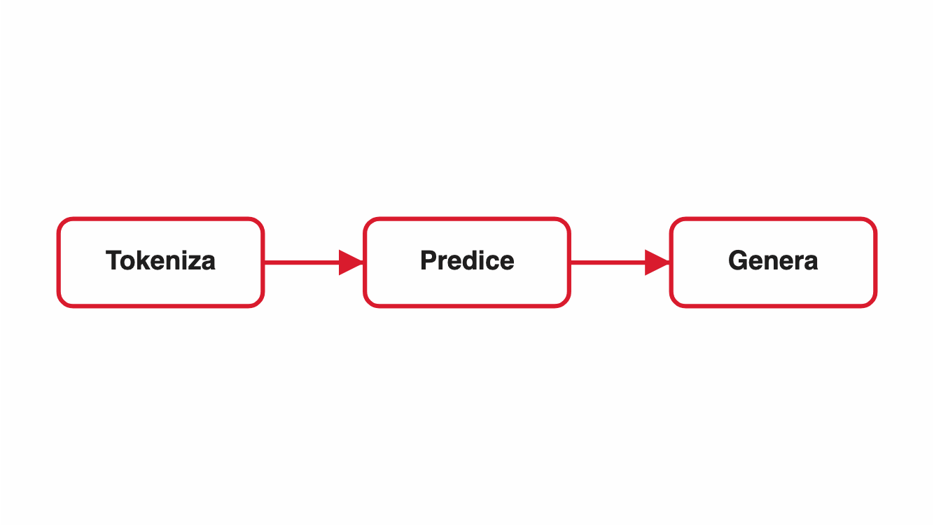
INTERACTIVE (QUIZ)
Quiz with a supporting image
Where does a quiz slide put its image?
A
Cropped as a full-bleed background
B
✓
Beside the quiz, never cropped
C
Only in the speaker notes
ANSWER
Beside the quiz — contained, sized to its own aspect.
The quiz body and the image split the slide; the image is never cropped.
Notes:
Let the room commit to an answer before you advance; the reveal is one navigation step away.

Slide 78
INTERACTIVE (QUIZ)
Quiz with the image on the left
Does image-left change which choice is correct?
A
Yes — the options mirror too
B
✓
No — only the two columns swap
ANSWER
No. The options keep their order, their letters and their alignment.
image-left is a composition choice; it never touches the enumeration.
Notes:
Let the room commit to an answer before you advance; the reveal is one navigation step away.

Slide 79
01
Frames & openers
02
Statement & emphasis
07
03
Enumerations
04
Ordered & comparison
05
Visual & data
Closing
06
Interactive (quiz)
07
Closing

Slide 80
VISUAL & DATA
fallback: the last resort when nothing matches
A slide reaching fallback means the catalog is missing an entry — the render now warns.
fallback still refuses plain bullets: its points render as accented panels.
big defaults to the title when the fill omits it.
A recurring fallback is a signal to add a real template, not to style this one.

Slide 81
FRAMES & OPENERS
matrix: cells indexed by two named axes
A quadrant is not four cards — a cell means what it means because of where it sits.
PREDICTED
Positive
Negative
True positive
False negative
Positive
Called it, and it was there.
Missed it. The expensive one in medicine.
ACTUAL
False positive
True negative
Negative
False alarm. The expensive one in spam.
Correctly left alone.
Notes:
A matrix earns its own template because the axes carry meaning. Filed as four concept cards, the labels survive and the axes vanish — and the axes were the point. The tone colours reuse the pros-cons pair rather than introducing a third palette.

Slide 82



FRAMES & OPENERS
media as a code panel — cards keep their cards
PYTHON
Learned from train
Applied to all three
scaler = StandardScaler()
scaler.fit(X_train) # train only
X_val = scaler.transform(X_val)
X_test = scaler.transform(X_test)
The statistics come from one split and one split only.
Same parameters, every time — that is what makes it a transform.
Silent when wrong
Leak the test set in and nothing raises; the score just flatters you.
Notes:
Before media could hold code, this slide had two bad options: drop the snippet to keep the cards, or become a code-example and flatten the cards into an explanation column. Both lose content. The design places the panel; the template still just emits cards.

Slide 83


FRAMES & OPENERS
media as a small aligned grid
Situation
Reach for
Early stopping
More data
Small tabular net
L2
Cheapest of the lot: stop when validation turns.
The one that always works, and the one nobody has.
Deep net
Dropout
Vision
Augmentation first
Transformers
Both, plus warmup
Notes:
A lookup table is supporting evidence here, not the slide — so it rides in media like a diagram would. Rendered with the same compare-strip classes value-columns uses, so a table beside a body and a table that is the body read as one piece.

Slide 84
FRAMES & OPENERS
a stat band under the body
Two figures that comment on the body — without making the whole slide a stat.
The hook is a contrast: A pair of numbers can carry a slide's opening without being its structure.
The pipeline
99%
0 / 100
accuracy on the imbalanced set
frauds actually caught
Notes:
The catalog always described a stat pair as the lower band of a content slide, but only the stat template had a stats field — so a slide with this hook had to become a stat and demote its cards. The band is now universal; stat is for when the numbers are the whole slide.

Slide 85
CLOSING
Questions?
Thanks for flipping through the Talksmith template catalog.

Slide 86


CLOSING
Where to go next
Schema
Catalog
schemas/slide-model.md
config/pptx-styles/slide-templates.md
Repo
github.com/austral/talksmith

