Slide 1
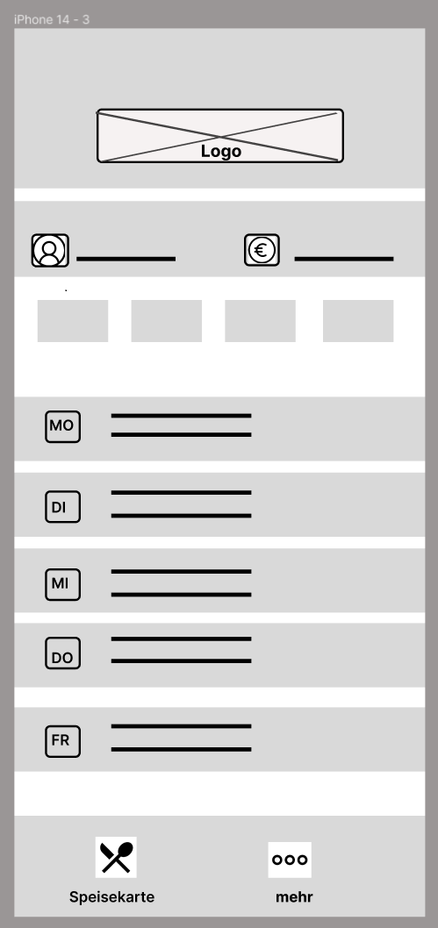
Row = 0
Row = 1
Row = 2
Vertical StackLayout
Row = 3
Grid
Col = 0
Col = 1

