Slide 1
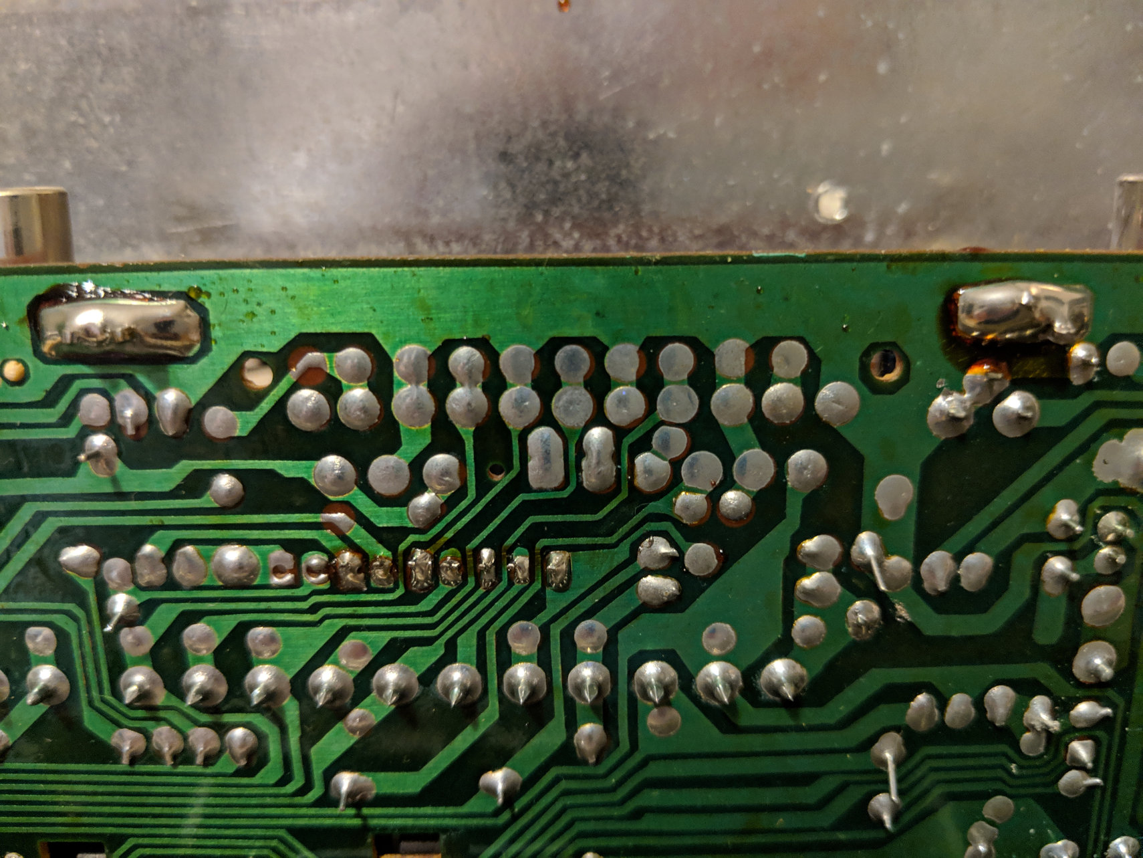
Soldering
This Photo by Unknown Author is licensed under CC BY-SA

Slide 2
Soldering
Soldering is a process in which two or more items (usually metal) are joined together by melting and putting a filler metal (solder) into the joint, the filler metal having a lower melting point than the adjoining metal. Soldering differs from welding in that soldering does not involve melting the work pieces.

Slide 3
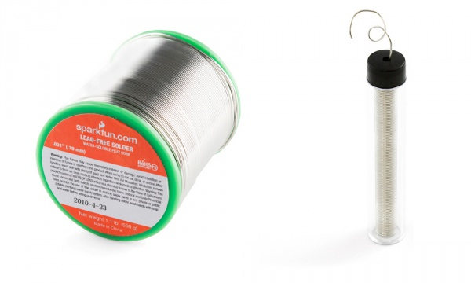
Solder
Alloy
Pb, Tin
Conducts electricity
Spools, tubes
Different gauges
2 types: leaded and Lead Free

Slide 4
Types of Solder
Leaded
Unleaded
Pb, Tin
Lower melting temperature
Sticks to itself
Does contain lead.
Tin, copper, silver
No lead = higher melting temperature
Station
More difficult to use
“rosin core” / flux
Fumes

Slide 5
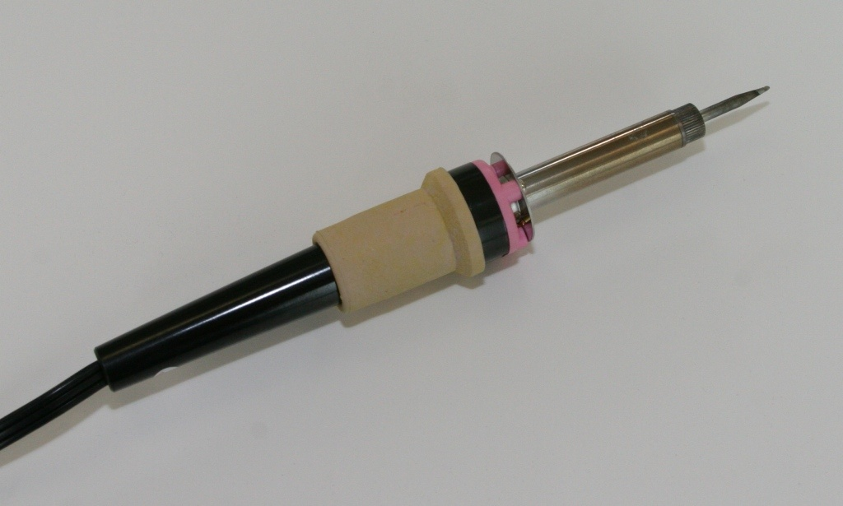
Soldering Iron
Typically 25-30 watts
Tip temperature 250°C to 280°C
Notes:
Stress the importance of safety to students, as 250-280 degrees will burn the skin INSTANTLY.
Project Lead The Way, Inc.
Copyright 2008
5

Slide 6
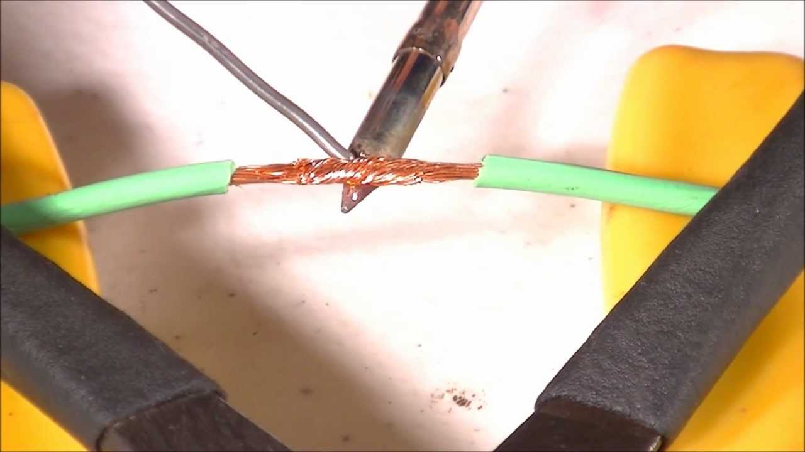
Soldering Wires

Slide 7
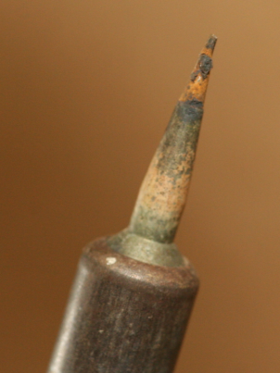
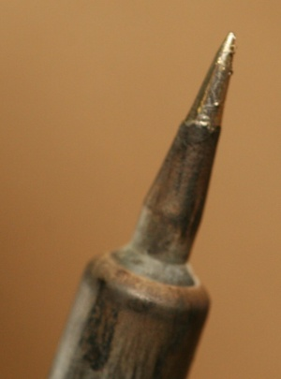
Soldering Iron Care & Maintenance
Un-Tinned
A soldering iron must be coated with a thin coat of solder. This will allow for the transfer of heat to the work piece.
This procedure is called tinning.
The tip must be kept coated with a shiny layer of solder by occasionally wiping and applying solder directly to the tip.
Tinned
Notes:
Properly tinning a soldering iron is essential for making good solder joints.
Project Lead The Way, Inc.
Copyright 2008
7

Slide 8
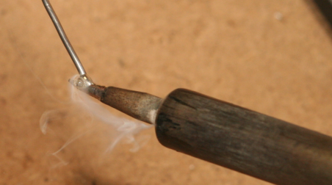
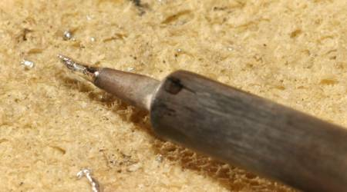
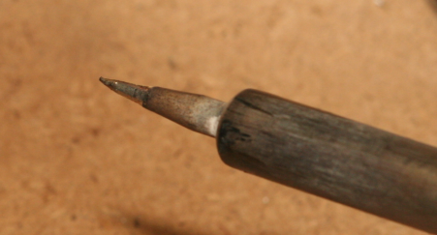
Tinning Process
Apply solder to soldering iron tip
Roll tip on damp sponge
Properly tinned soldering iron tip
Notes:
Review the steps in the tinning process.
Project Lead The Way, Inc.
Copyright 2008
8

Slide 9
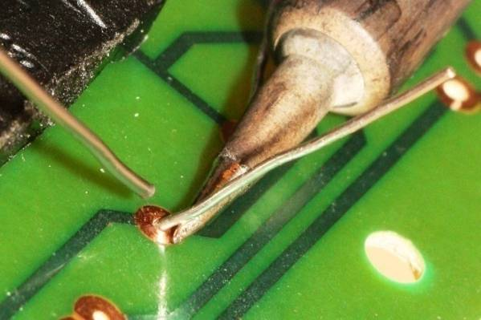
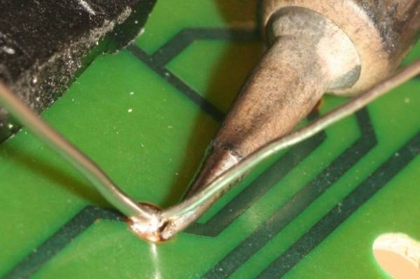
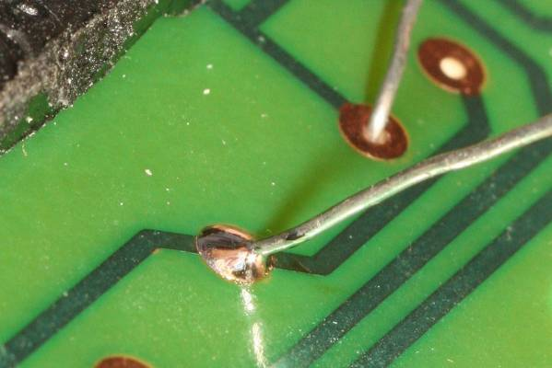
Solder Process
Heat both items at the same time by applying the soldering iron to the copper pad and the component lead.
Continue heating and apply a few millimeters of solder. Remove the iron and allow the solder joint to cool naturally.
It only takes a second or two to make the perfect joint, which should appear shiny.
Notes:
Review the steps in the soldering process.
Project Lead The Way, Inc.
Copyright 2008
9

Slide 10
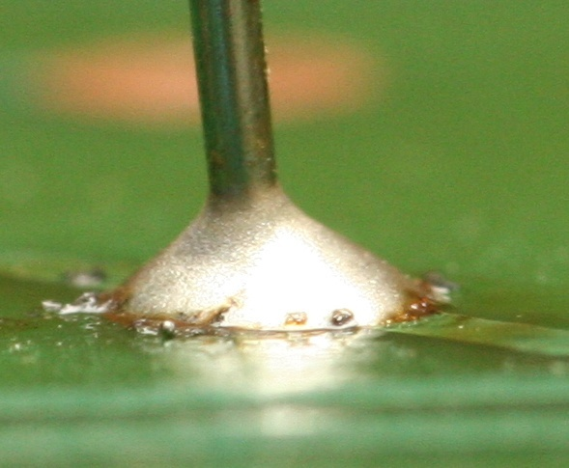
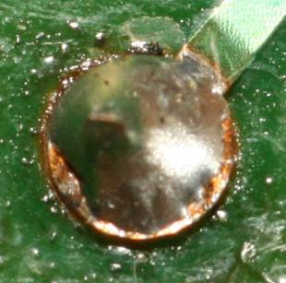
A Good Solder Connection
Smooth
Bright
Shiny
Clean
Concave fillet
Notes:
Characteristics of a good soldering joint
Project Lead The Way, Inc.
Copyright 2008
10

Slide 11
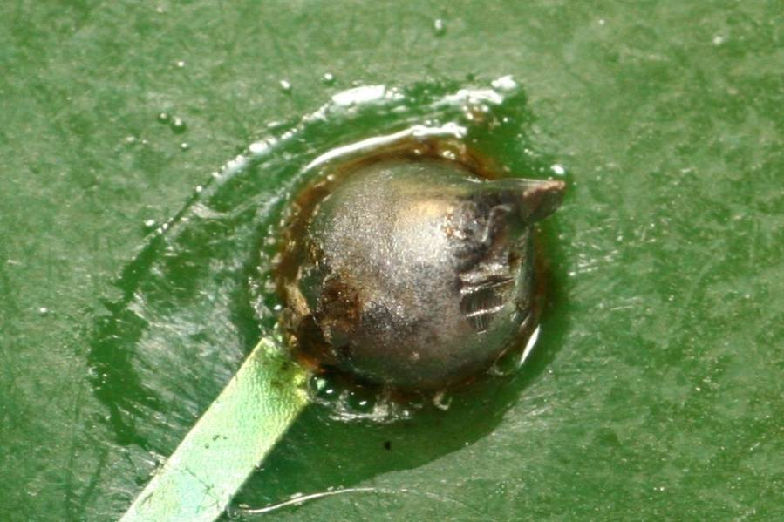
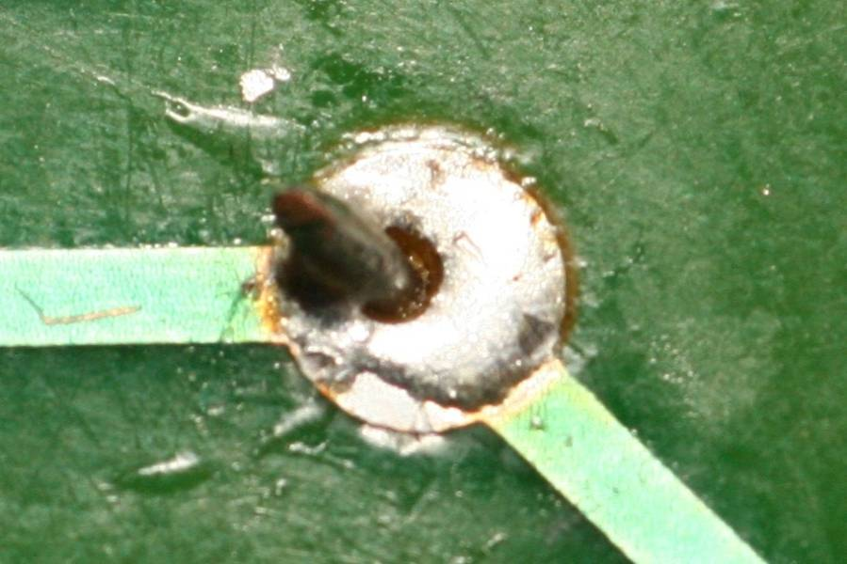
Bad Solder Connections
Too much solder
Too little solder
Notes:
Project Lead The Way, Inc.
Copyright 2008
11

Slide 12
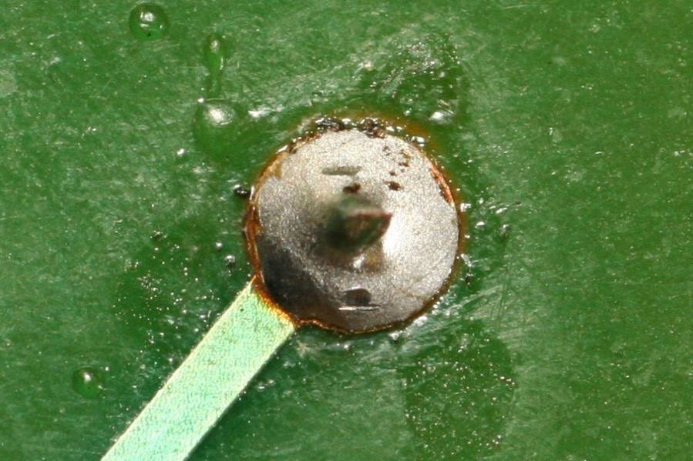
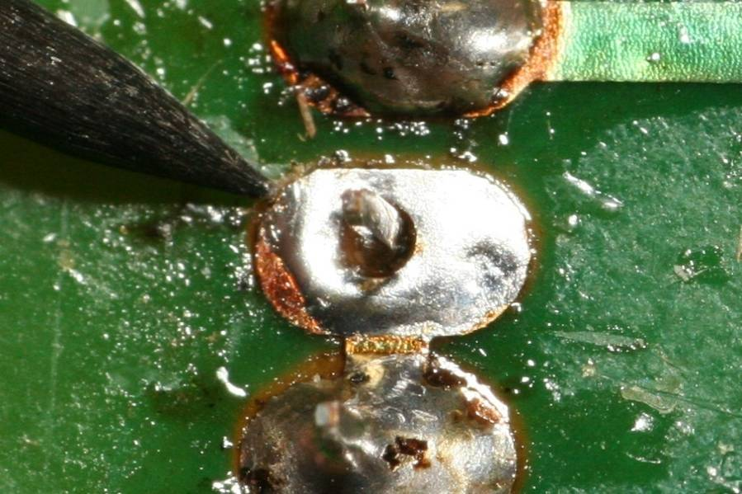
Bad Solder Connections
Cold solder joint
Not soldered
Notes:
Project Lead The Way, Inc.
Copyright 2008
12

Slide 13
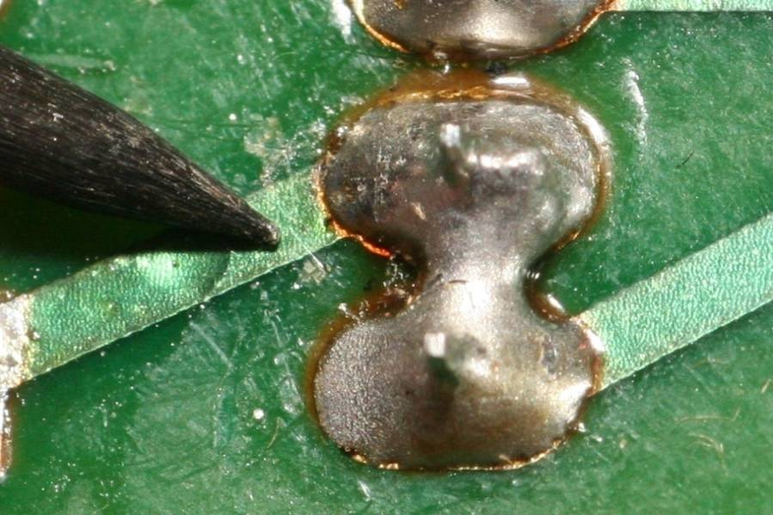
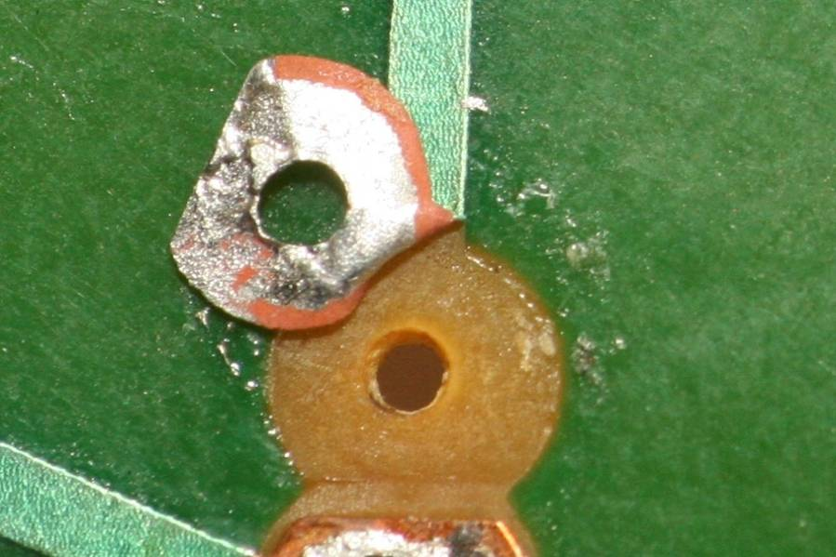
Bad Solder Connections
Solder bridge
Lifted trace/pad
Notes:
Project Lead The Way, Inc.
Copyright 2008
13

Slide 14
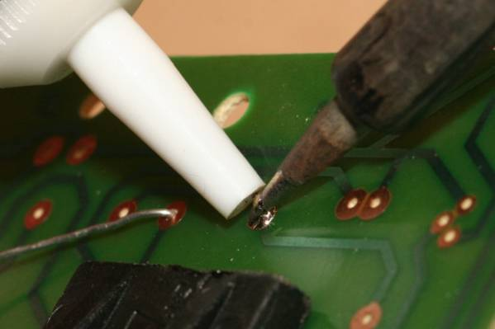
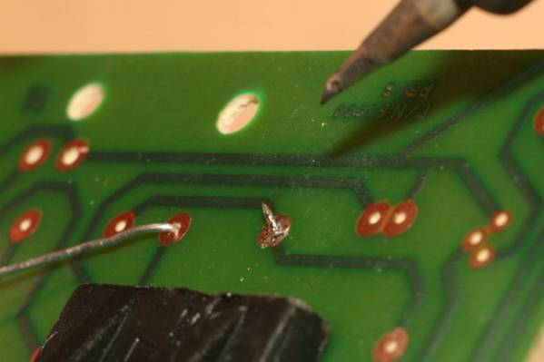
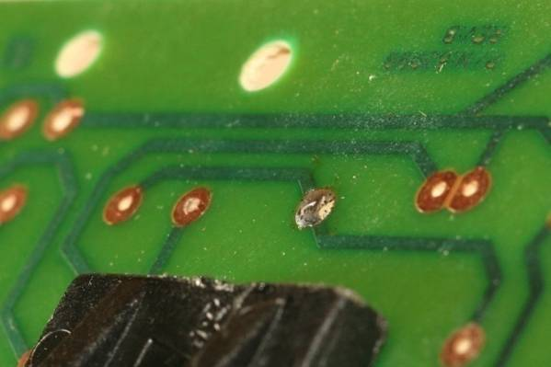
De-Solder Process: Solder Sucker
Apply heat to the connection to be de-soldered. When the solder melts, trigger the solder sucker.
Repeat de-soldering as needed until all solder is removed. Remove soldering iron & solder sucker from area.
Remove component lead.
Notes:
Review the steps in the de-soldering process using a solder sucker.
Project Lead The Way, Inc.
Copyright 2008
14

Slide 15
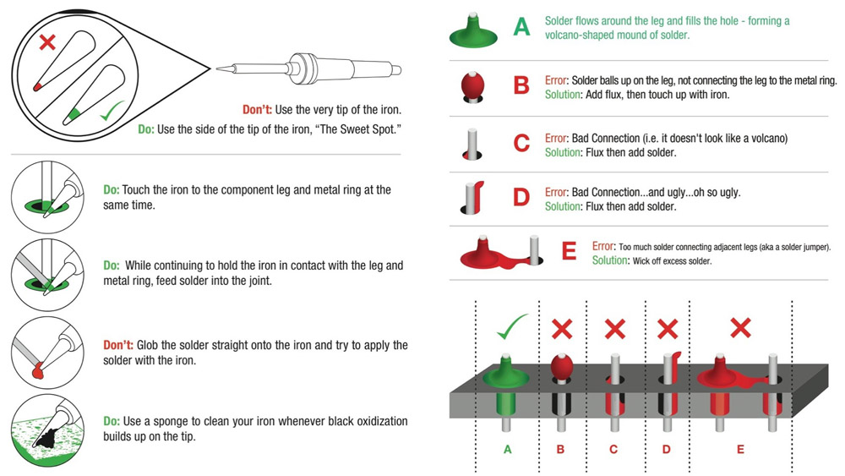
Soldering onto PCBs

Slide 16
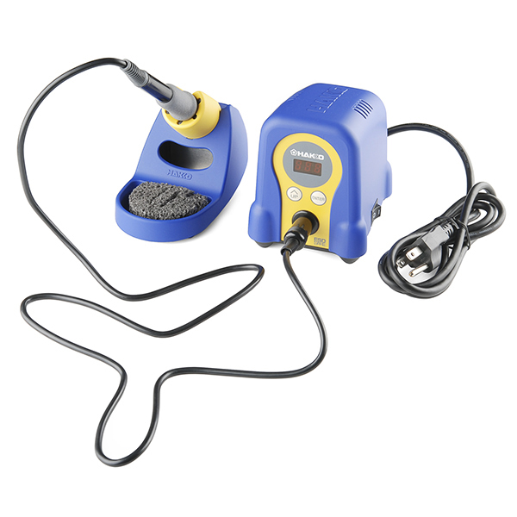
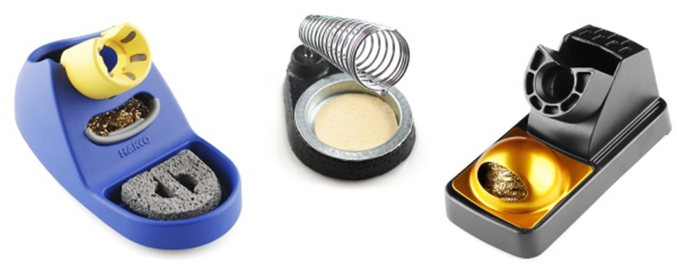
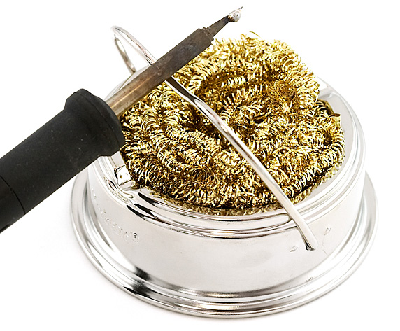
Nice to Haves:
Helping hands
Flux
Sponge/brass sponge
Solder pump/vacuum/wick
Ventilator

Slide 17
Soldering Safety
Wear safety glasses when soldering. This includes all individuals in the vicinity of someone who is soldering.
Place soldering iron in an approved holder when not in use. The iron is hot and can cause burns.
Place the soldering iron so that the cord does not get caught in your arms or on others.
Secure the components to be soldered before beginning the soldering process.
Notes:
The next few slides address safety rules related to soldering. Be sure to cover any additional safety rules that are specific to your classroom/laboratory or school.
Project Lead The Way, Inc.
Copyright 2008
17

Slide 18
Soldering Safety
Provide plenty of space to work.
Use a properly sized point for the soldering job to be completed.
Verify that the tip on the soldering iron has a sharp point and has not been damaged in any way.
Check the power cord for burned or melted sections that show bare wires. Label those cords DO NOT USE and ask the instructor to repair or replace.
Do not touch molten solder – it is hot!
Make sure that the solder strand is long enough to keep fingers away from the hot iron.
Notes:
Project Lead The Way, Inc.
Copyright 2008
18

Slide 19
Soldering Safety
Tie back long hair and remove or tuck loose clothing.
Use heat sinks for heat-sensitive parts. Provide sufficient cooling time before removing parts.
Wipe away excess solder with a wet sponge or cloth.
Hold the scrap end when cutting excess leads so that the scrap lead is not thrown into the air.
Cut leads evenly with wire cutters.
Make sure that leads do not short across other traces or leads.
Notes:
Project Lead The Way, Inc.
Copyright 2008
19

