Slide 1
SUI OVERFLOW 2026 / SPECIAL - WALRUS
01 / 06
Memory
MEMORY WILL RECEIPT
PREDECESSOR
Scoped restore ready
Will
Agent killed
WALRUS BLOB
certified pointer
Checkpoint locks.
Kill one agent. Reopen scoped
Local context drops to 0%.
REDUCTIONS
Walrus memory by receipt.
The user scopes inheritance.
private budget blocked
SUCCESSOR
First click: Kill Agent
NO HIDDEN TRANSCRIPT
cold agent output hash
Inspectable proof
The first screen is a product consequence: agent death -> scoped Walrus memory -> receipt.
Notes:
Memory Will is a working handoff surface for agent succession. The first click kills the predecessor agent, the user chooses what can survive, and the app returns a receipt instead of a generic saved chat summary.

Slide 2
SCOPE BEFORE SUCCESSION
02 / 06
The successor needs memory and restraint.
Allowed memory
Unavailable memory
Vendor shortlist with sourced findings
Private budget ceiling
Open questions for the next agent
Procurement timing notes
Next step from the locked checkpoint
Unverified vendor preference
Role-specific successor instruction
Any blocked scope the judge toggles
safe to restore after Walrus read
must be named, not leaked
The user decides what survives before any successor runs.
That is the product difference from a saved chat summary.
Notes:
The core product choice is scoped inheritance. Approved memory becomes restorable, but blocked memory stays named and unavailable. That makes the handoff useful without pretending all prior context should be inherited.

Slide 3
LIVE RUN SEQUENCE
03 / 06
The demo is one recoverable product loop.
01 ACTION
02 WALRUS WRITE
03 WALRUS READ
04 INSPECT
Kill Agent
Store will
Open successor
Read proof
The predecessor stops.
`/api/memory-wills` writes
A cold successor reads
Receipt exposes object id,
The judge chooses what
the scoped JSON before
the Walrus blob before
policy hash, and redaction
can survive.
restore is enabled.
producing output.
hash for review.
verified commands
`pnpm build` · `pnpm typecheck` · `pnpm sui:build` · `pnpm sui:test` all pass sequentially.
Notes:
The live run is a four-step loop: Kill Agent, write the scoped will to Walrus, open a cold successor through a Walrus read, and inspect the receipt. Build, typecheck, Sui build, and Sui tests have all passed sequentially.

Slide 4
LOAD-BEARING WALRUS
04 / 06
Walrus is the gate between death and succession.
Killed
Publisher
Walrus
Aggregator
agent
write
certified blob
read
Local context
POST
object id
POST
is no longer
/api/memory-wills
blob id
/api/successor
the source.
before restore
/restore
policy hash
If Walrus write or read fails, Memory Will does not fake success.
The successor is gated on a real storage pointer, not on hidden local state.
This is why the Walrus primitive changes the product behavior: it is required before restore.
Notes:
Walrus is on the restore path. The app writes the will before restore is enabled and reads the blob before successor output appears. If the Walrus write or read fails, Memory Will does not fake a successful handoff.

Slide 5
SUI PROOF BOUNDARY
05 / 06
Sui is the
inspection layer,
Receipt proof fields
not a made-up claim.
walrus_object_id
checkpoint_hash
The app reads Sui object metadata for the
policy_hash
Walrus object returned by the real write path.
redaction_hash
Real proof path
Move package included
No publish overclaim
Sui object metadata is read
`MemoryWillAnchor` builds
Registry is not called published
for the Walrus object id.
and tests locally.
without package id and signer.
docs/sui-walrus-proof.md · move/sources/memory_will_registry.move
src/lib/memory-will/sui-proof.ts
Notes:
The Sui claim is intentionally bounded. The app reads Sui object metadata for the Walrus object id, and the repo includes a Move package that builds and tests locally. We do not claim the registry is published unless package id and signer are configured.

Slide 6
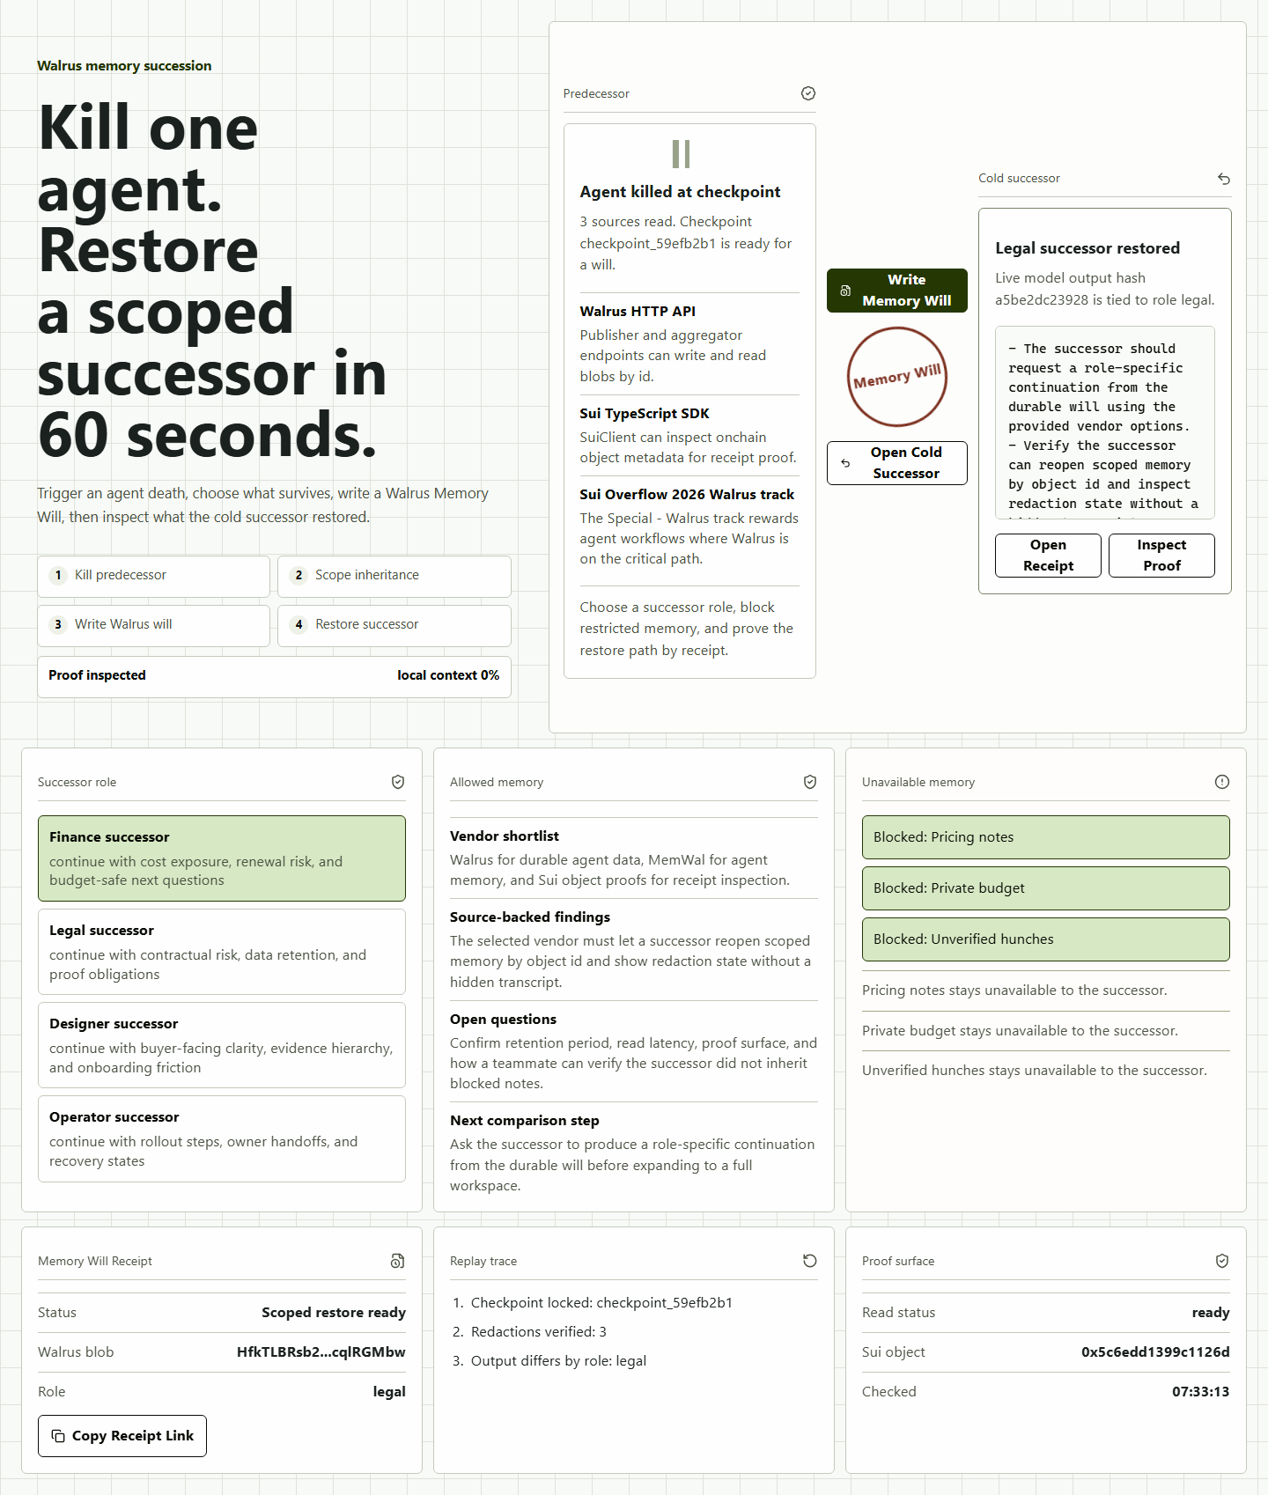
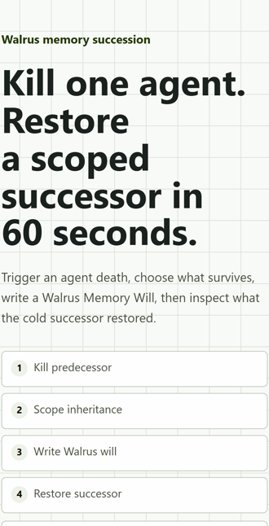
TRY IT, THEN INSPECT IT
06 / 06
Run the
Memory Will.
Start with `Kill Agent`, write to Walrus,
then open a cold successor from the receipt.
knife-marie-microwave-anthropology.trycloudflare.com
/?will=latest
real desktop smoke screenshot
Walrus blob and object id are visible.
mobile proof
Blocked memory stays named but unavailable.
Inspect receipt proof before judging the claim.
Submission hold: final hackathon form still requires explicit human approval.
Notes:
The judge path is simple: open the live URL, click Kill Agent, write the will, open the cold successor, then inspect `/?will=latest`. Final hackathon form submission still requires explicit human approval.

