Slide 1

Red Batch
Governed batch containment
A safety complaint arrives. A QA manager approves once, and the agent holds only the right orders. Red Batch runs as a governed UiPath Maestro Case agent that saves a record you can reopen.

Slide 2
Problem statement and proposed solution
Problem
Solution
Red Batch is a governed containment workspace. The Batch Containment Agent maps the bad lot to its SKU and warehouse, then fans out across every Ready-to-Ship order in scope: 37 to hold, 11 excluded with a reason each. Nothing moves until a QA manager approves the hold in a real UiPath Action Center task. On sign-off, the agent quarantines those orders (about $360,480 across 3 zones), reads the state back to confirm every one (37/37), and saves a reopenable Stop-Ship Packet. When unsure, it asks a person.
A safety complaint lands on a lot you may still be shipping, and you have minutes to act. Both usual options are bad: freeze the whole warehouse and you break shipping for everyone, or chase the affected orders by hand in a spreadsheet while defective units keep going out. Neither one holds the right orders behind a human sign-off, and neither leaves proof of what changed.

Slide 3
Benefits and technologies used
Benefits, impact and outcomes
End-user​ | Quality / Safety Ops leads, QA managers, Customer Ops, Auditors
User department​ | Product Quality & Safety, Warehouse Operations, Compliance
Industries​ | Consumer Electronics, Manufacturing, Retail & E-commerce, Supply Chain
UiPath products used​ | UiPath Automation Cloud (Orchestrator) · UiPath Action Center (Actions / OR.Tasks) · UiPath Orchestrator REST API · UiPath External Applications (OAuth)
Other - integrations / APIs / technologies used​ | Next.js (App Router) · React · TypeScript · Tailwind CSS · Node.js · node:sqlite / Cloudflare D1 · OpenAI-compatible LLM (narration)
Holds the right orders, not the whole warehouse: 37 held, 11 excluded with a reason each.
A real person signs off in a live UiPath Action Center task before any state changes.
Every run ends in a reopenable Stop-Ship Packet: before and after state, evidence, the approver's name, and the exclusions.
When the agent is not confident, a person reviews the case. Every step writes a governed run you can audit.

Slide 4
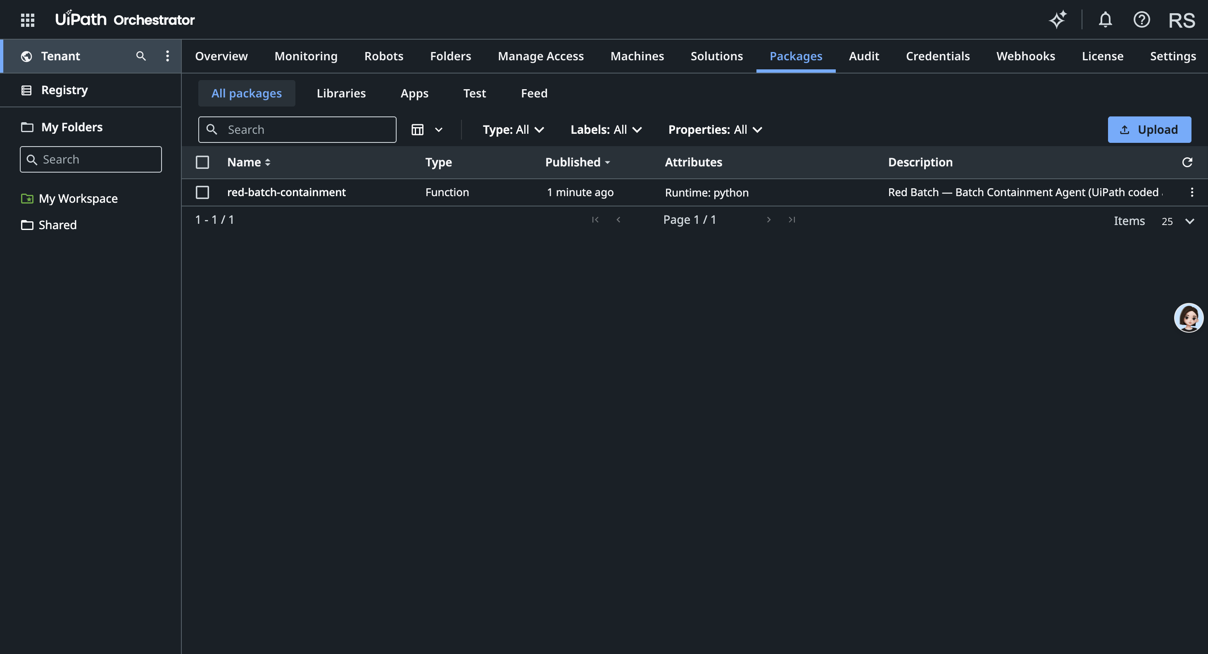
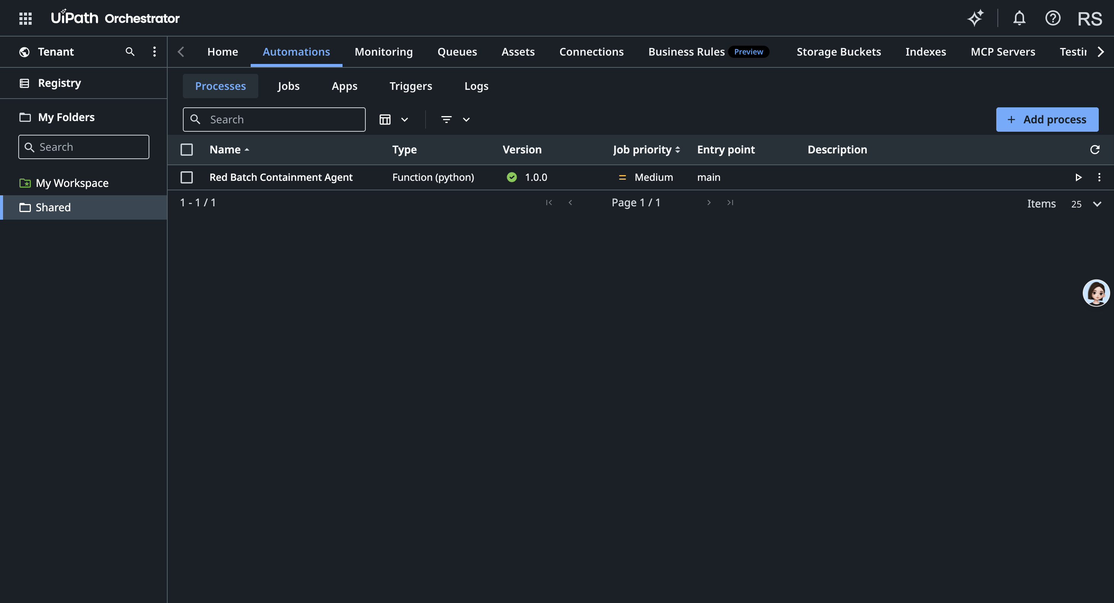
Solution architecture
How it works
Risk signal → Batch Containment Agent (observe → map lot/SKU/warehouse → fan-out orders → classify exclusions) → QA approval = live UiPath Action Center task (CreateTask / CompleteTask) → quarantine order state → verify by read-back (37/37) → saved Stop-Ship Packet. Every step writes a governed run + timeline event.
Agent type: Coded Agent (custom TypeScript), governed by UiPath Action Center. Deterministic policy; optional additive LLM narration.
UiPath: Automation Cloud (Orchestrator) · Action Center (OR.Tasks) · Orchestrator API · External Applications (OAuth). App: Next.js · React · TypeScript · D1 / node:sqlite.
Live app: https://red-batch.veithly.workers.dev · Repo: https://github.com/veithly/red-batch
Demo video: https://youtu.be/tABpObnVRIs · UiPath environment: https://cloud.uipath.com/rickopc/DefaultTenant
Live in the UiPath tenant — coded agent published (Tenant → Packages, left) and deployed as a Process (Shared → Processes, right)

