Slide 1
ABC Travel Agency
Determine the location for best coffee shops for ABC customers

Slide 2
Agenda
Overview
Business Problem
Data Selection
Methodology
Results
Conclusion

Slide 3
Overview
Quick overview of what this presentation is all about:
Emergence of location data services to various customers across globe
Start-ups like ‘ABC Travel Agency’ experiences huge competition
The evolution of new business models poses threat to the start-ups.
ABC planning to apply data science and machine learning to their models

Slide 4
Business Problem
ABC Travel Agency (a.k.a 'ABC') is a new start up company that is into the business since 2017.
ABC is effected with the huge competition that has resulted in the slow down of their business.
Their recommendations on travel itinerary to their customers has not yielded much needed growth in the business.
If this trend continues, then the company might shut down soon.

Slide 5
Data Selection
Foursquare API
Jupyter Notebook
Watson Studio
Use of Geo locations and perform GET functions to get the data wrapped into a data frame
Gather user feedback, ratings, tips etc

Slide 6
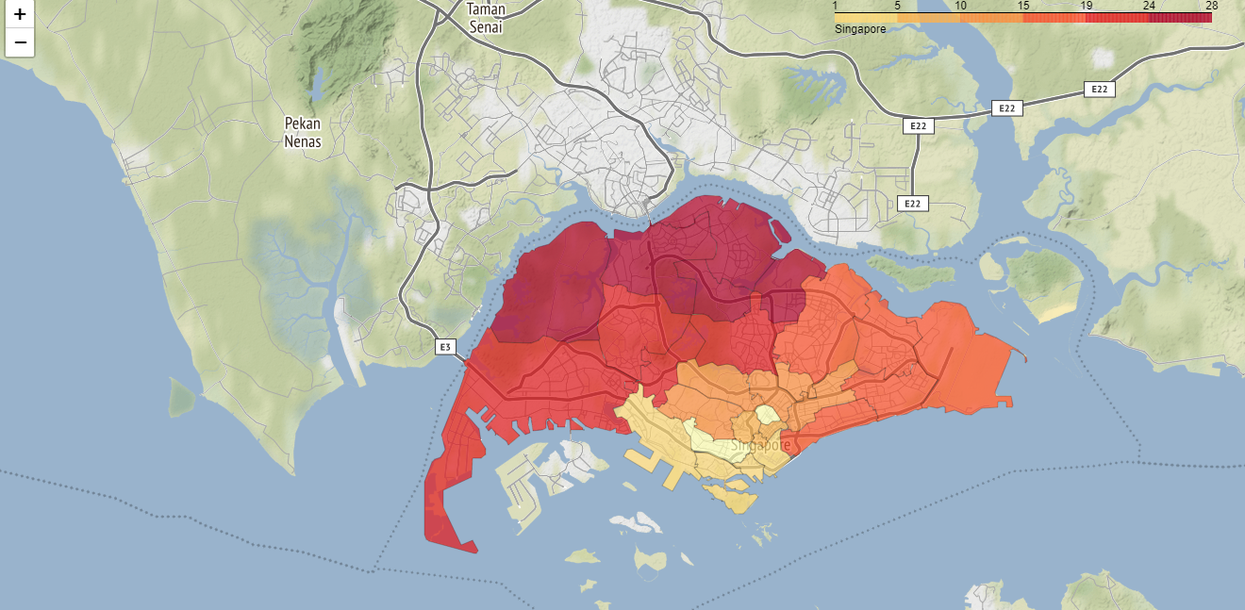
Visual Representation of data

Slide 7
Methodology
Data accessed through Foursquare API interfaces.
Use Geo location to retrieve the geographical information of locations.
Use Folium packages to visualize the data
Arrange the dataset in a data frame using numpy library
Distinguish between the two locations
Determine the best coffee shops for the customers.

Slide 8
Results
Our analysis shows that the best coffee shops ex: Starbucks located in closer proximity to the Miami beach with good rating and higher number of tips.
Based on the results, it is recommended that Miami beach should be considered as the best location for the ABC customers from the travel point of view.

Slide 9
Conclusion
Using the Foursquare APIs we have been able to determine the best geographical locations suited for the customers of ABC Travel Agency.
The changing habits of the customers and their patterns, the new business model can be developed to stand against the growing competition in the market.

