Slide 1
LSI latent semantic indexing
Nedžad Beus, Tilen Ožbot, Gašper Spagnolo

Slide 2
What is LSI
Latent semantic analysis (LSA) is a technique in natural language processing, in particular distributional semantics, of analyzing relationships between a set of documents and the terms they contain by producing a set of concepts related to the documents and terms.
  LSA assumes that words that are close in meaning will occur in similar pieces of text.
A matrix containing word counts per document (rows represent unique words and columns represent each document) is constructed from a large piece of text and singular value decomposition (SVD) is used to reduce the number of rows while preserving the similarity structure among columns.
Documents are then compared by taking the cosine of the angle between the two vectors formed by any two columns.
  Values close to 1 represent very similar documents while values close to 0 represent very dissimilar documents.

Slide 3
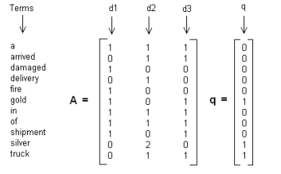
Building the matrix A

Slide 4


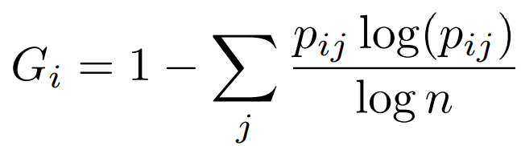
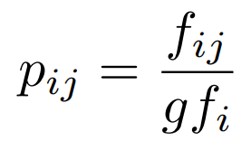
Improved matrix A

Slide 5
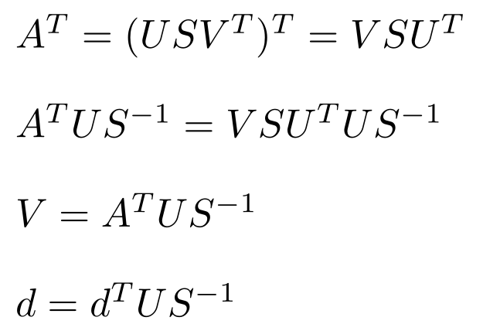
SVD DECOMPOSITION

Slide 6
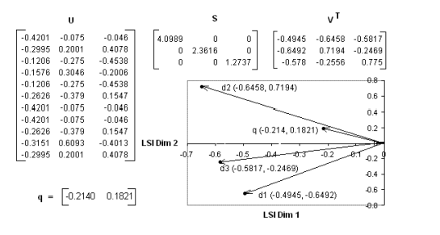
SVD decomposition and QUERY
Using cosine similarity

Slide 7
Adding new documents
Reconstructing the matrix A and recomputing the SVD
Folding-in

Slide 8
Our method in action

Slide 9
Thank you for your attention.
Questions?

