Slide 1
Medicine Reminder System
Community Based Project
Project Guide:
G. Bhagya Lakshmi
S.No | Roll Number | Name
1. | 24331A07C6 | V.DILEEP
2. | 25335A0710 | P.HEMA
3. | 24331A0776 | M.SHARIF

Slide 2
1. Abstract of Project
MediCare is a simple, smart web application designed to help elderly patients manage their daily pills without confusion. It acts as a safety companion that works offline even without internet, speaks reminders aloud, and keeps caregivers updated in real-time.
✓ No Internet? No Problem! — Updates are saved instantly in the browser cache first and sync with the database later when online.
✓ Hindi & Telugu Support — Translates instructions, logs, and buttons into local languages so seniors can easily understand them.
✓ One-Tap Doctor Dials — Direct calling actions placed directly inside the notifications to contact clinics immediately.

Slide 3
2. Problem Statement
Many people forget to take their medicines on time because of busy schedules, old age, or memory problems. Missing medicines can cause serious health issues and reduce treatment effectiveness. Patients need a simple system that reminds them about medicine timings regularly.
The Medicine Reminder App is developed to solve this problem by giving alerts and reminders to users at the correct time. This helps people take medicines properly and improve their health care management.

Slide 4
3. Existing and Proposed System
Existing Systems (The Old Way)
• Manual paper logs that are easily lost or misplaced.
• Apps freeze and block user actions when database syncing takes too long.
• No simple panic triggers or automated caregiver sync updates.
• No local translation options for rural users.
Proposed System (Medicare)
✓ Zero Database Lag: Browser cache saves inputs instantly.
✓ 0.05s button active feedback and fast modal animations.
✓ One-click SOS sirens, direct clinician dialing, and Speak Aloud helper.
✓ Fully dynamic Telugu and Hindi localizations.

Slide 5
4. Hardware and Software Requirements
Hardware Requirements
• User Devices: Smartphone, Tablet, or PC.
• Processor: Intel Core i3 or mobile SoC equivalent.
• System Memory: 2 GB RAM minimum.
• Storage: 100 MB local disk storage.
• Screen: Touch display recommended for mobile ease.
Software Requirements
• OS: Windows, macOS, Android, or iOS.
• Web Browsers: Chrome, Safari, Edge, or Firefox.
• Dev Tools: HTML5, CSS3, ES6+ Javascript.
• Database Engine: Cloud Firestore with IndexedDB.
• Deployment Host: Vercel Production Environment.

Slide 6
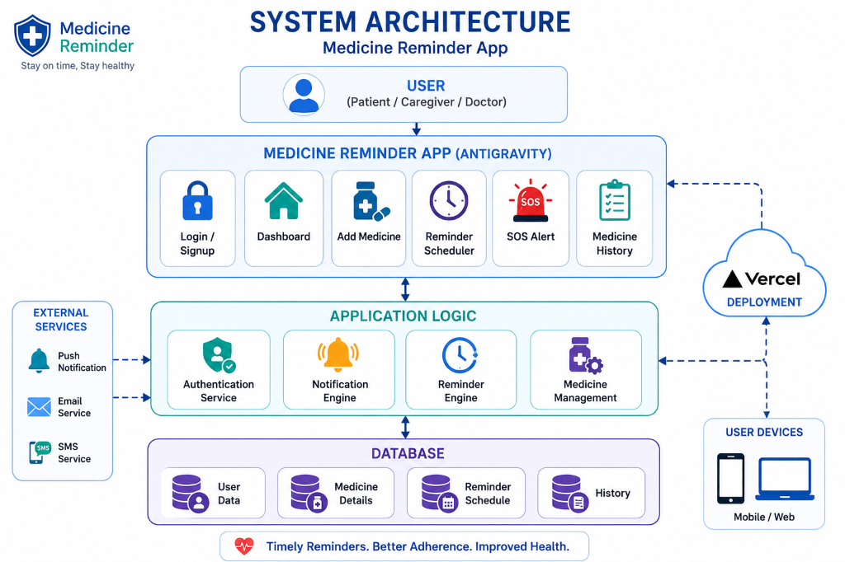
5. System Architecture
• User Interface Layer
Displays checklists, manages alerts, and executes custom Telugu/Hindi localizations.
• Application Logic
Operates authentication services, alert notifications engine, and medicine schedule check modules.
• Database & Hosting
Maintains local persistence cache and updates Firestore cloud logs, hosted live on Vercel.

Slide 7
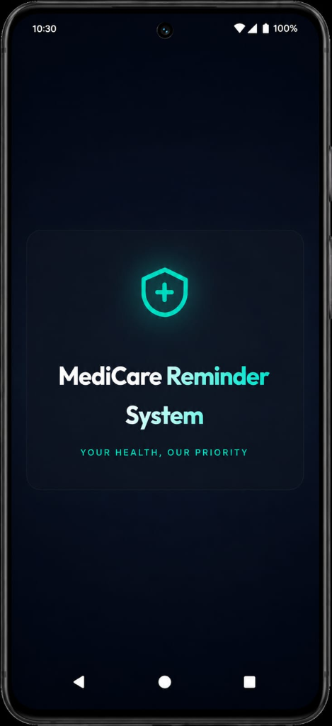
6. Front End Design - Splash Screen
• Modern App Welcome Screen
Deep charcoal theme styled to match mobile form factors natively.
• Two Access Portals
Gives simple routes for Patients to view cards and Caregivers to monitor logs.
• Bold Color Accents
Vibrant colors make text readable for senior citizens.

Slide 8
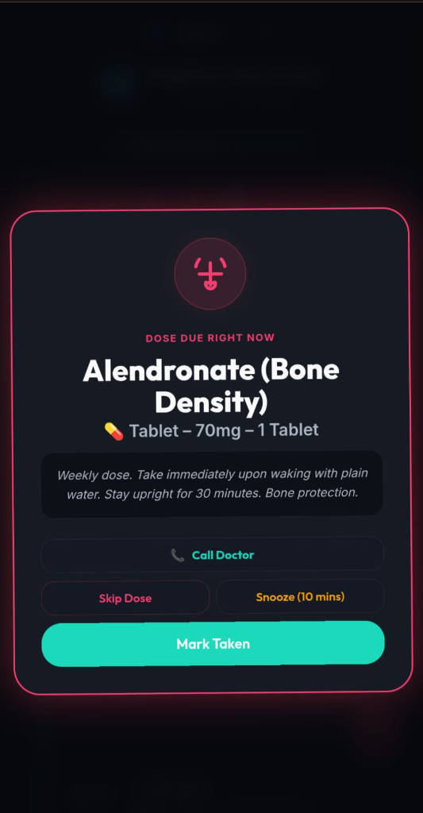
6. Front End Design - Dose Alert Modal
• Overlay Reminder Card
Alert opens immediately when a scheduled medicine is due, showing pill quantity and details.
• Instant Doctor Call Button
Let seniors click to call their primary doctor immediately during complications.
• Tactile Feedback Actions
Mark pill intake Taken or Snooze it for 10 minutes with instant tap responses.

Slide 9
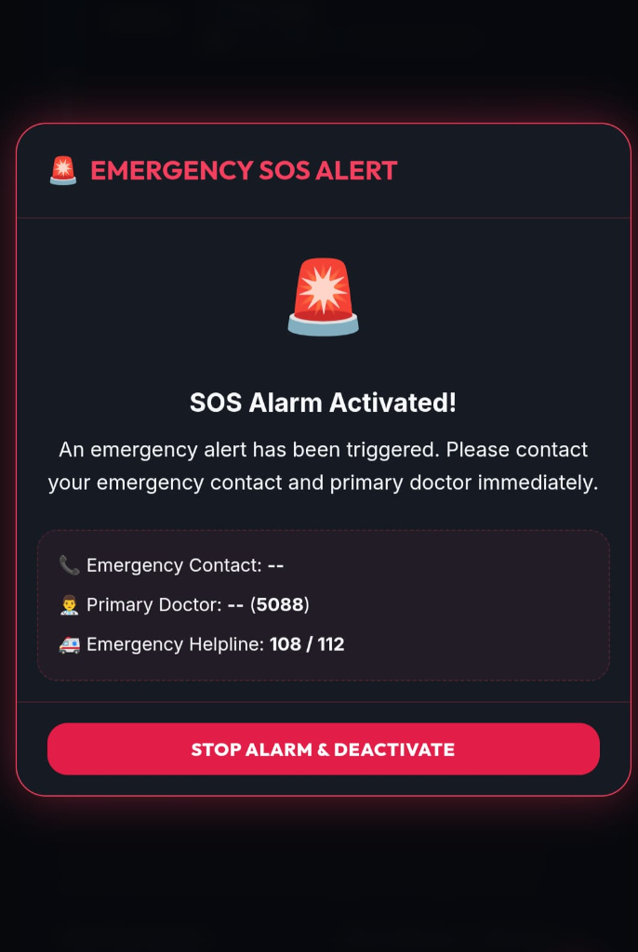
6. Front End Design - SOS Emergency Alert
• Loud Local Siren Alarms
Plays siren warnings and notifies caregiver dashboards immediately.
• Direct Calling Action List
Aggregated emergency contacts, doctor numbers, and ambulances (108 / 112).
• Quick Dismiss Trigger
High-contrast deactivate button lets the user cancel sirens as soon as they are safe.

Slide 10
Simple, Safe & Reliable
Medicare bridges the gap between patient compliance and caregiver peace-of-mind by resolving cloud delays, network timeouts, and language barriers.
Live App URL: medicine-reminder-navy-phi.vercel.app

