Slide 1
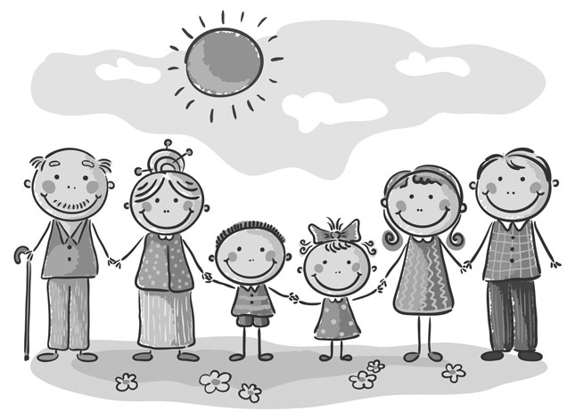
What Is Your Family Doing?
Who is he? Where is she? Let’s ask questions about family!
Exchange personal information about the home and family in communicative situations.
I can talk about current actions.
I can talk about family.
I can ask who, what, when, where questions.
How is your family?
Where are they now?
What are they doing?

Slide 2
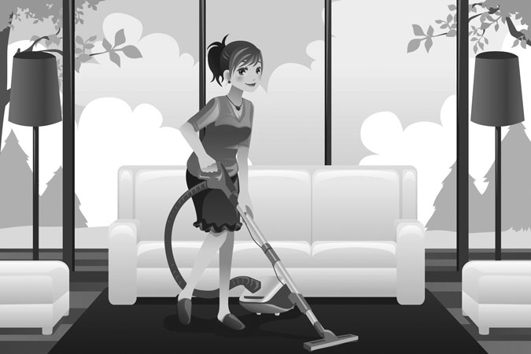
What Is Your Family Doing?
Peter and Sally talk about family. What is Sally’s mother doing?
Instructions: Read the dialogue aloud.
Peter: So, Sally, how is your family?
Sally: They are great, thanks. My mother is vacuuming today. It is so noisy, it’s quiet here. I need a quiet place to study for my Spanish class.
Peter: Where is your father?
Sally: He is at home. He is cooking dinner.
Peter: When is dinner?
Sally: It’s at 7:00. Do you want to come?
Peter: Sounds good! What are you studying?
Sally: I’m studying for my Spanish test and doing my homework.
Peter: Yeah, I’m using the internet here.
Sally: Nice computer!
Peter: Thanks! It’s from Stephen. It’s new.
Sally: Who is Stephen?
Peter: My uncle. I’m writing notes for my Business class.
Sally: Cool!

Slide 3
What Is Your Family Doing?
How is Sally's family?
Instructions: Choose the correct answer.
Peter asks Sally:
A. How is your family?
B. How are your family?
C. How do your family?
2. Sally says …
They is great.
They are great.
They be great.
3. Sally’s father is …
cooking dinner.
cooking lunch.
making breakfast.
What is your mother doing? What is your father doing?
Instructions: Find and fix the mistake. Each sentence has one mistake.
My mother are vacuuming today. _______________________
He is cook dinner. _________________
What are I studying? ____________________
I’m study for my Spanish test and doing my homework. _______
You’re writing notes for my Business class. ____________

Slide 4
What Is Your Family Doing?
Interview your partner about their family members!
Instructions: Complete the following steps. Fill in the Self Assessment.
Ask your partner 5 questions about each family member.
Examples: How is your mother? Where is your father? What is your brother doing?
Write the answers in full sentences.
Present the information to your partner.
Self Assessment
I ask 5 questions about family.
I ask about 2 family members.
I talk about what people are doing.
Yes
No
mother (noun): female parent
e.g. My mother is a teacher.
father (noun): male parent
e.g. My father is a dentist.
to vacuum (verb): to clean the floor and carpet with a machine
e.g. The floor is dirty, please vacuum it.
noisy (adjective): making a lot of noise
e.g. My house is too noisy. I study at the library.
quiet (adjective): making no noise; not noisy
e.g. The library is quiet. I like to study there.
place (noun): location; area
e.g. The library is a nice place to study. It is quiet.
homework (noun): student work to complete at home
e.g. My homework is very difficult.
internet (noun): a computer network of information
e.g. The internet is fun to use. I learn a lot.
new (adjective): not old
e.g. My computer is new.

Slide 5
What Is Your Family Doing?
Asking Wh-Questions
You use Wh-question words to get specific information.
Question word | Use | Example
What | To ask about a thing (to match the others) | Sam: What is that? Peter: It’s my computer.
Where | To ask about a place | Tim: Where is your father? Sue: He is at home.
Who | To ask about a person | Sara: Who is he? Ron: He is my brother.
When | To ask about a time | Paul: When is dinner? Sally: It's at 7:00.
The Present Continuous Tense - He, She
You use the Present Continuous tense to talk about current actions; things that are happening NOW.
Remember, to ask questions, you use the phrases:
What is he doing?
What is your mother doing?
What are you studying?
Subject | To be | Verb-ing
He | is | cooking dinner.
She | is | vacuuming.

