Slide 1
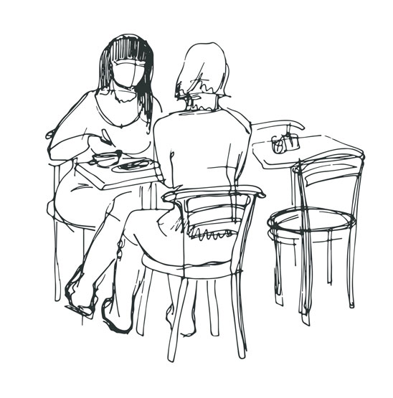
Are You Going Too? All These Choices
Pronunciation Spot: Peter and Sally talk at the coffee shop. We learn more about their families.
Exchange personal information about the home and family in communicative situations.
I can say and use words with the short u sound.
I can ask questions with a falling and rising voice.
I can say what I like or dislike.
Do you like sports?
What is your favorite sport?

Slide 2

Are You Going Too? All These Choices
Peter and Sally talk at the coffee shop about sports.
Instructions: Read the dialogue aloud.
Sally: I want a coffee, how about you? Are you hungry?
Peter: Sure! A cappuccino, please. I’m not hungry.
Sally: Do you like your cappuccino in a cup or a mug?
Peter: A mug, thanks. There is a long lineup. Wait a couple minutes.
Sally: Ok... so, does your family like sports? My family hates sports.
Peter: Yes, my dad really likes sports. He is a good football player. My mom doesn’t like it when he watches football on TV.
Sally: What about you?
Peter: I like tennis. It’s my favorite sport. I play on Thursdays. And you?
Sally: I do yoga in the park. Look, the line is short now.
Peter: Ah great, I’ll get in line.

Slide 3
Are You Going Too? All These Choices
Do you know Peter and Sally’s likes and dislikes*?
Instructions: Match the question or statement on the left with the response on
the right.
1. What about you? A. Yes, my father really likes sports.
2. Do you like your coffee in a cup or a mug? B. No, my mom doesn’t like it.
3. Does your family like sports? C. I like sports.
4. I want another coffee, how about you? D. Sure! A cappuccino please.
5. Does she like to watch football? E. A mug, thanks.
*To say no politely, you can say:
No, thank you.
No, thanks.
Can you select the words with the short u sound?
Instructions: Write each word in the correct category.
Short U Sound | NOT Short u Sound
lineup, sure, couple cute, cup, Thursday,

Slide 4
Are You Going Too? All These Choices
Taking It Further - Practicing Short Vowel Sounds
Instructions: With a partner, say these short u words and sentences aloud.
Write down 5 new short u words and use the words in a sentence.
Use a dictionary if necessary. Complete the following steps. Fill in the Self Assessment.
Short U | Sentence
cut | I cut my hand
rug | I sit on the rug.
bugs | There a lots of bugs in the garden.
jug | The jug is full of water.
Self Assessment
I say each word and sentence in the table.
I make a list of 5 new words that use this sound.
I use a dictionary to find the definitions of new vocabulary.
Yes
No
cup (noun): a container to hold liquid
e.g. Do you like your cappuccino in a cup or a mug?
mug (noun): a large cup
e.g. I use a mug for my coffee in the morning.
lineup (noun): people waiting in a line to be served
e.g. There is a long lineup.
hungry (adjective): feeling the need to eat
e.g. I’m not hungry.
dad (noun): father
e.g.My dad really likes sports.
mom (noun): mother
e.g. My mom doesn’t like it when my dad watches football on TV.
sports (noun): an organized game
e.g. Does your family like sports?
favorite (adjective): the most liked
e.g. It’s my favorite sport.

Slide 5
Are You Going Too? All These Choices
Falling and Rising Voice in Questions
Falling Intonation
When you ask a question with where, when, what, which, why, what or how, your voice falls at the end.
Rising Intonation
If the question is a yes/no question, the voice rises at the end.
The stress is usually placed on the last word in questions.
Examples;
Are you going the game?
When does it start?
Examples
Sally: What about you?
Peter: I like tennis. It’s my favorite sport.
Sally: Does your family like sports?
Peter: Yes, my father really likes sports.

