Slide 1

This One or That One?
Let’s go to to the beach, a soccer game, or a museum!
Accurately use information about free-time activities or personal likes/dislikes in communicative situations.
I can talk about likes and dislikes.
I can express how far or how near an object is using this and that.
I can talk about holidays and other sightseeing activities.
What activities do you like to do in your city?
What can you do in the evening? On the weekend? On your day off?

Slide 2
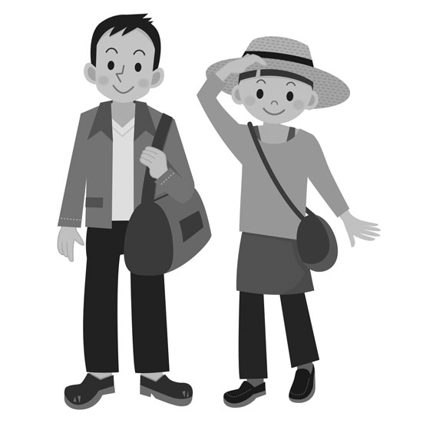
This One or That One?
Peter and Vanessa go sightseeing* on their day off**!
*”Sightseeing” is visiting interesting places in a city.
**Your ”day off” is the day you have no school or work.
Instructions: Read the dialogue aloud.
Peter: Let’s go sightseeing around town today!
Vanessa: Sure. We can start right here with ice cream!
Peter: Okay. I like chocolate. What about you?
Vanessa: I prefer fruit flavors.
Peter: This one here is strawberry mango. That one at the back is mocha crunch!
Vanessa: Hi. We want a small cup of this one here and a large cup of that one there. Mmm … this tastes wonderful.
Peter: Here’s a tourist map. We can visit a museum.
Vanessa: This boat tour looks interesting. There’s a music festival and an art show by the water too! We both like music.
Peter: Okay. We can go to the festival, then relax on the boat trip later.
Vanessa: Sounds like a plan.

Slide 3
This One or That One?
This one here and that one there!
Instructions: Draw a line from the the first part of the statement on the left to the second part on the right.
I prefer
That one at the back
We want a large cup
This boat
We both
like music.
tour looks interesting.
fruit flavors.
is mocha crunch!
of that one there.
I love sightseeing with friends in my city!
Instructions: Organize the mystery sentences. Place each word in the correct order.
festival./go/the/We/to/can
___________________________________________________________________
relax/the/later./boat/on/Let’s/tour
___________________________________________________________________
mango/like/I/cream./ice
___________________________________________________________________
small/that/at/cup/a/want/of/I/one/back./the
___________________________________________________________________
ice/wonderful!/This/tastes/cream
___________________________________________________________________

Slide 4
This One or That One?
Let’s think about sightseeing activities! Where can you go sightseeing
in your city?
Instructions: Complete the following steps. Fill in the Self Assessment.
Get a tourist map or look online.
Make a list of places to go with a friend.
Find the English words for places.
Write a short dialogue.
Invite a friend to go sightseeing.
Give 2 or 3 sightseeing activity ideas.
Practice the dialogue with a friend.
Self Assessment
I identify 3 or 4 places to go.
I identify the English words for theses place.
I use 3 target words.
I write a dialogue about sightseeing.
Yes
No
flavor (adjective): the taste of a food
e.g. My favorite flavor is strawberry.
both (pronoun): two people together
e.g. We both like coffee ice cream.
right here (expression): in this place
e.g. Stop. The restaurant is right here.
music festival (noun): an event where different bands play music
e.g. I go to the music festival in the park every year.
to visit (verb): to go to a place
e.g. Let’s visit the gallery tomorrow.
museum (noun): a building to see art or historic items
e.g. We can see the dinosaurs at the museum.
show (noun): a concert; a play; a performance; art exhibit
e.g. There is an art show in the park today.

Slide 5
This One or That One?
Demonstrative Adjectives This and That
Demonstrative adjectives point something out. You use this when something is close. You use that when something is far.
The demonstrative adjective goes in front of the noun.
this + noun (this book) or that + noun (that store)
 | Demonstrative Adjective | Example
near (here) | this (book) here | This lemon ice cream here is interesting.
far (there/over there/back there) | that (book) over there | That coffee ice cream back there looks good.
You make the negative form by adding not after the verb.
Examples
That shop over there is not expensive.
This one here does not have cheaper food.
This one here is strawberry mango.
That one at the back is mocha crunch!

