Slide 1
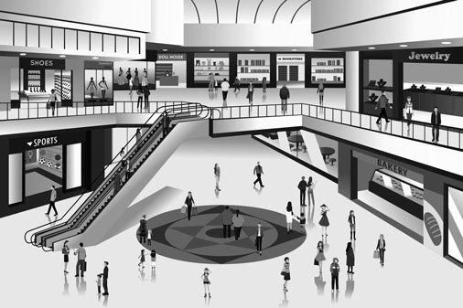
Why Don't We…
I love shopping at the mall! Do you?
Accurately use information about free-time activities or personal likes/dislikes in communicative situations.
I can talk about likes and dislikes.
I can talk about activities that I do and their frequency.
I can talk about free time activities.
How often do you go to a mall?
What do you do there?
Do you shop? See a film? Have lunch?

Slide 2
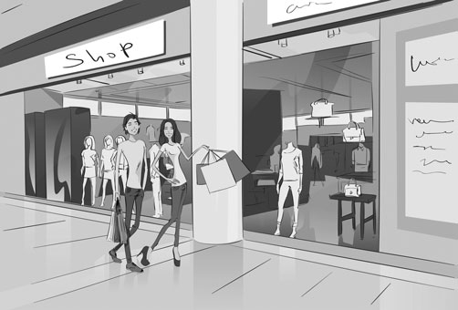
Why Don't We…
John and Sally spend* their free time** at the mall!
*”Spend” is a verb you can use with time.
**In your “free time” you can do any activity you want to do.
Instructions: Read the dialogue aloud.
John: So, Sally, do you like this coffee?
Sally: It’s a bit strong for me! I don’t like strong coffee.
John: The mall is quiet today. Do you want to text Peter to meet us?
Sally: He doesn’t go to the mall often. He’s with Vanessa all the time.
John: Text him anyway, he can bring Vanessa. She comes here a lot.
Sally. Okay. They’re busy.
John: Let’s do all of our favorite things!
Sally: Yeah, shopping for clothes, books and DVDs! This mall has great stores!
John: We can eat out - both lunch and dinner!
Sally: Then see a movie!
John: Everything I like to do in my free time!
Sally: Let’s start at that store over there!

Slide 3
Why Don't We…
What are John and Sally doing today?
Instructions: Read the dialogue again. Select the correct answer.
Sally and John like to...
go sightseeing.
go shopping.
drink strong coffee.
In their free time, Sally and John…
eat out.
have a quiet day.
walk in the park.
What do you do in your free time?
Instructions: Write the words in the correct category.
Free Time Activities | Routine Activities
shop for books go out for dinner get up at 7 a.m.
go to the gym drive to work see a movie
have lunch go the the mall

Slide 4
Why Don't We…
Let’s explore a mall or shopping area.
Instructions: Complete the following steps. Fill in the Self Assessment.
Go to your favorite shopping mall or shopping area.
Make a list of things you can do there.
Find the English words for activities.
Invite a friend to go there and do something with you.
Write two or three sentences.
Practice the sentences out loud.
Yes
No
Self Assessment
I make a list of things to do at the shopping mall.
I look for English words for the activities at the mall.
I use 3 target words.
I practice saying my sentences
strong (adjective): a powerful taste
e.g. I don’t like strong coffee.
anyway: (adverb) that doesn’t matter
e.g. He doesn’t like going to the movies, but ask him anyway.
to eat out (expression): to have a meal at a restaurant
e.g. Let’s eat dinner out at Mario’s tonight!
often (noun): many times
e.g. We often go to the mall.
a lot (expression): a large number of times.
e.g. They go to the museum a lot!
all the time (expression): regularly
e.g. I have sandwiches for lunch all the time.

Slide 5
Why Don't We…
Free Time Activities and Routine Activities
Free time activities are things you do when you have the time.
They are not routine activities.
Routine activities are things you do every day or every week.
Free Time Activities | Routine Activities
go to the movies go for a walk go to a sports game listen to music go to a museum visit an art gallery go to a music festival | study shop for food go to school take the bus go to the gym eat lunch drive to work
Examples:
They go to museums on the weekend.
They take time off to go to games in other cities.
Expressions of Frequency
To talk about how often something happens, you use an expression of frequency.
This can be an adverb like often, sometimes, never.
It can also be expression like a lot, all the time, when I can.
Examples
She goes to the mall all the time.
He doesn’t come here often.
They eat in this restaurant a lot.

