Slide 1
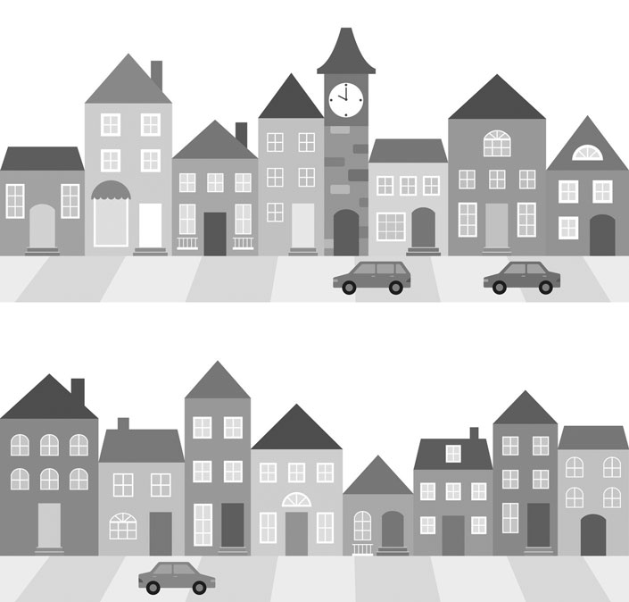
Where Is the Dry Cleaner?
Time to review some places in the neighborhood!
Describe places, neighborhoods and countries in communicative situations.
I can make suggestions.
I can ask and say where places are in a city.
I can express location.
I can talk about places in a neighborhood.
Do you know your neighborhood well?
What are your favorite places in your neighborhood?

Slide 2
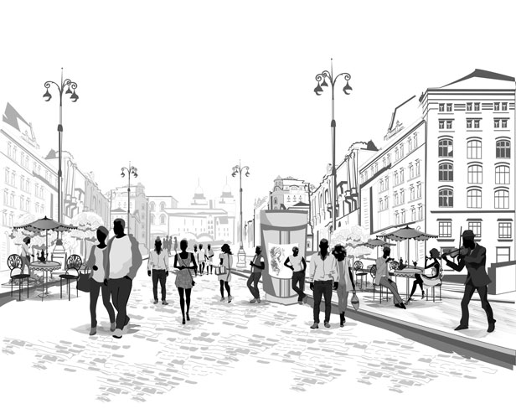
Where Is the Dry Cleaner?
Vanessa and Peter want to go to the dry cleaner. Do they know where to go? Let’s find out.
Instructions: Read the dialogue aloud.
Vanessa: Where is the dry cleaner, Peter?
Peter: Hmmm … it isn’t near the post office. I think it’s moved.
Vanessa: We should ask someone. Excuse me, can you help us?
Passerby: Huh-huh, sure...
Vanessa: Where is the dry cleaner?
Passerby: Which one? There are two in the neighborhood.
Peter: Really?
Passerby: Yes, there is one in the mall. There is another one near the drugstore.
Vanessa: How do we get to the dry cleaner near the drugstore?
Passerby: Walk straight ahead. Turn right on Main Street.
Peter: Mmmhmm.
Passerby: Then, turn right on Park Street, at the bakery. You should see the hotel.
Vanessa: Right. Okay.
Passerby: It’s across the street from the hotel. It is between the drugstore and the deli.
Peter: Thanks for your help!

Slide 3
Where Is the Dry Cleaner?
Did you understand the dialogue? Let’s find out!
Instructions: Select the correct answer.
How many dry cleaners are there in the neighborhood?
1
2
3
Where is the dry cleaner?
It is between the drugstore and the bookstore.
It is between the drugstore and the post office.
It is between the drugstore and the bakery.
Can you spot the mistakes? Let’s see!
Instructions: Find and fix the mistake. Each sentence has 1 mistake.
1. Vanessa: Where is the dry kleenex, Peter?
2. Peter: Hmmm… it isn’t near the pest office.
3. Passerby: Walk state ahead. Turn right on Main street.
4. Passerby: Then, turn right on Park Street, at the backery. You
should see the hotel.

Slide 4
Where Is the Dry Cleaner?
What does your neighborhood look like?
Instructions: Create a map of your neighborhood. Describe the location of places.
Complete the following steps. Fill in the Self Assessment.
Draw a map of your neighborhood Include 10 places.
Write 5 sentences to describe 5 places on the map.
Use 1 preposition of place for each of the sentences.
Use at least 3 Target Words.
Self Assessment
I write 5 sentences about places on the map.
I describe places in the neighborhood.
I use words like near, next to, across from, when describing a place.
Yes
No
dry cleaner (noun): a place where someone cleans your clothes and fixes them
e.g. Where is the dry cleaner? I need to fix this jacket.
post office (noun): a place where you can send letters and packages
e.g. I need to go to the post office to send a letter.
drug store (noun): a place to buy medicine
e.g. Why don’t you go to the drug store if you don’t feel good?
hotel (noun): a place where people pay to stay the night and can eat meals
e.g. The restaurant in this hotel is very good.
bakery (noun): a place to buy bread, cake
e.g. Sally always goes to the bakery to buy bread.
deli (noun): a store selling prepared foods like sandwiches, salads, and drinks
e.g. This deli has great sandwiches.

Slide 5
Where Is the Dry Cleaner?
Describing Your Neighborhood
You use Wh- questions to ask where places are in a city and to ask for directions.
You describe where places are in a city with prepositions of place like near, next to, across from, between and Imperatives.
Place | Asking for Directions | Giving Directions
Bakery Library | Where is the bakery? How do I get to the library? | The bakery is next to the library. Go straight on this street. Turn left at the lights.
Examples
Vanessa: Where is the drugstore?
Peter: The drugstore is near the post office.
Vanessa: How do we get to the dry cleaner?
Peter: Go straight ahead, and turn right at the intersection.

