Slide 1
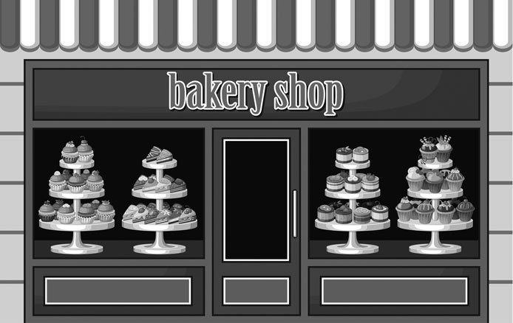
Going to the Bakery
There are so many things to do in the city! Let’s take a walk!
Describe places, neighborhoods and countries in communicative situations.
I can ask and say where places are in a city.
I can express location.
I describe places in a neighborhood.
Do you know your neighborhood?
Is there a park?
Where is it?

Slide 2
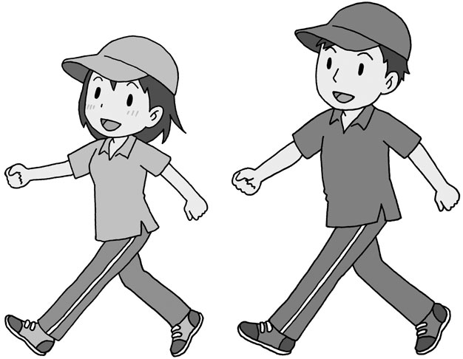
Going to the Bakery
Let’s take a walk with Peter and Vanessa around the neighborhood. Where do they want to go? Let’s find out.
Instructions: Read the dialogue aloud.
Vanessa: Hey Peter, do you know the neighborhood well?
Peter: Yeah, sure. It’s my favorite part of town. Why?
Vanessa: Oh. What is there to do around here?
Peter: Well, there is a park right here.
Vanessa: Yes, the park across from the stadium on the left.
Peter: Yes, straight ahead. Then, there is the bakery, Riviera.
Vanessa: Oohh… where is it?
Peter: It’s right there, next to the Italian restaurant, I think.
Vanessa: You think?
Peter: Well, Sally always goes to the bakery. I usually go to the park to look at the trees.
Vanessa: Ok, I see. Let’s ask someone, maybe.
Peter: Sure, there are also a few shops near the park, on the right.

Slide 3
Going to the Bakery
Peter knows the neighborhood quite well. What about Vanessa?
Instructions: Select the correct answer.
Is there a park?
Yes. The park is across from the stadium on the left.
Yes. The park is across from the stadium on the right.
Yes. The park is across from the bakery on the left.
2. Where is the bakery?
The bakery is across from the Italian restaurant.
The bakery is near the Italian restaurant.
The bakery is next to the Italian restaurant.
Let’s describe the places in a neighborhood. Do you remember the words?
Instructions: Match the word on the left with the definition on the right.
bakery
next to
tree
straight ahead
across from
right in your path
opposite
a large plant with a trunk and roots
a place to buy bread
at the side of

Slide 4
Going to the Bakery
Let’s take a walk around the neighborhood!
Instructions: Describe your neighborhood to your partner. Make a list of the places you know.
Complete the following steps. Fill in the Self Assessment.
Make a list of the places you know in your neighborhood.
Describe the places. Where are they? Are they near?
Which places do you like? Why?
Share the list with your partner.
Ask your partner to do the same. Listen to your partner’s description. Are your neighborhoods the same?
Self Assessment
I use at, by, in, to when talking about places.
I describe places in my neighborhood.
I ask and say where places are.
Yes
No
across from (preposition): opposite; on the other side of something
e.g. There is a park across from the stadium.
bakery (noun): a place to buy bread, cake
e.g. Sally always goes to the bakery to buy bread.
next to (preposition): at the side of something or someone
e.g. The bakery is next to the restaurant, I think…
right there (expression): at that exact spot
e.g. The bakery is right there, near the park.
straight ahead (expression): right in your path
e.g. The park is straight ahead. Then, there is the bakery.
tree (noun): a large plant with a trunk and roots in the ground
e.g. I like to look at the trees in the park.

Slide 5
Going to the Bakery
Asking Where Places are in the City
When you ask where places are, you can use Is there…? or Are there…? to make a question.
You use expressions like left, right, straight ahead, across from or next to to say where things are.
Question | Answer
Is there + singular noun? Are there + plural noun? | Yes, it is … / No, there isn’t. Yes, there are … / No, there aren’t.
Examples
Peter: Is there a library in the neighborhood?
Vanessa: Yes. It is straight ahead, across from the park.
John: Are there many restaurants in your neighborhood?
Sally: Yes, there are some next to the swimming pool.
Prepositions of Place
You use the following prepositions of place and expressions to talk about places in a neighborhood or city.
Preposition | Description | Example
right |  | The park is on the right.
left |  | The park is on the left.
straight ahead |  | The stadium is straight ahead.
next to |  | The bakery is net to the restaurant.
near |  | The bakery is near the restaurant.
across from |  | The restaurant is across from the park.

