Slide 1
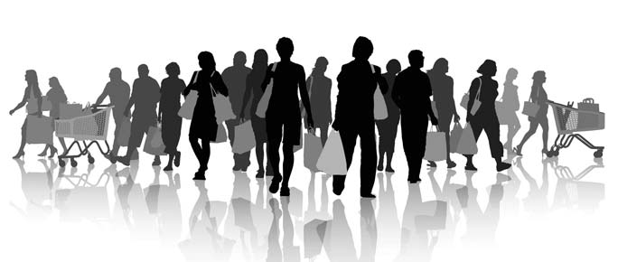
Everyone Loves Shopping
Many people love to shop in their free time. Do you?
Accurately use information about people, their likes and dislikes, homes or countries in communicative situations.
I can talk about different types of stores.
I can talk about clothing and accessories.
I can ask and say what people are doing.
Do you like shopping?
Why or why not?
Does everyone love shopping? Why or why not?

Slide 2
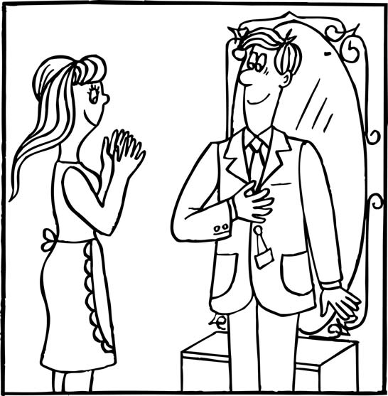
Everyone Loves Shopping
Vanessa and Peter decide to buy a new coat for Peter at a shopping center. What does the salesperson recommend?
Sally: Hi John! I’m going shopping at the new outlet mall.
John: Shopping? Again?
Sally: Yes! I love shopping. I want to get some new clothes.
John: What stores does the mall have?
Sally: Oh, there are lots of stores. Clothing and accessories, shoes, sports…
John: Is there a hardware store or a pharmacy?
Sally: No! Want to come?
John: Sure…. I guess...
John: This is a nice store. I’m finding nice things in this casual wear department.
Sally: Do you like these jeans?
John: They’re ok. Are you trying them on?
Sally: Yes. I’m trying them on with this T-shirt.
John: I’m trying on this sweatshirt.
Sally: Why don’t you try this hoodie? Excuse me, can I try these leather boots?
Clerk: Sure.

Slide 3
Everyone Loves Shopping
What can you buy in a *pharmacy? Let’s review types of stores.
*In some countries, you can buy many things in a pharmacy, like food, medication or cleaning supplies.
Instructions: Match the store on the left with the items you can buy there on the right.
Store Things you can buy
Hardware store furniture, clothes, shoes
Convenience store items from the manufacturer
Outlet store medication
Department store cleaning supplies, tools, nails
Pharmacy milk, bread, candy
John *is finding nice things in the store. Let’s practice speaking!
Instructions: Read the sentences aloud.
1. I’m going shopping at the new outlet mall.
2. I’m finding a lot of nice things in this casual wear department.
3. I’m trying them on with this T-shirt.
4. I’m trying on this sweatshirt.
*To “find” something when you are shopping
means you see something you want to buy.

Slide 4
Everyone Loves Shopping
Do you like shopping?
What are the good things about shopping? What are the bad things?
Instructions: Complete the following steps. Fill in the Self Assessment.
With a partner, talk about shopping.
Think of 3 good things. Examples: new clothes and fun.
Think of 3 bad things. Examples: noisy and crowded.
Complete the table.
Compare your answers.
Self Assessment
I talk about shopping.
I write 3 good things.
I write 3 bad things.
I share with a partner.
Yes
No
Good Things | Bad Things
jeans (noun): very popular pants made of denim
e.g. Do you like these jeans?
t-shirt (noun): a shirt shaped like a T, with short sleeves
e.g. I’m going to try on this T-shirt with those jeans.
casual wear (noun): clothing for sports or recreation, not for work
e.g. This store has a good casual wear department.
boots (noun): protection for the feet for outdoor use
e.g. Do you like these boots?
leather (noun): material originally from animals, used to make boots and coats
e.g. These boots are made of leather.
sweatshirt (noun): clothing for the upper body, often for sports
e.g. I’m going to try on this sweatshirt.
hoodie (noun): a sweatshirt with a hood to cover the head
e.g. Try this hoodie. It has a hood.
outlet (noun): a store that sells goods directly from the manufacturer
e.g. I’m going shopping at the new outlet store this afternoon.
mall (noun): a building with many stores
e.g. I love the new mall!
store (noun): a place you buy things
e.g. There are many stores in this mall.

Slide 5
Everyone Loves Shopping
Types of Stores
Stores are places you buy things. There are many different types of stores. Different countries have different types of stores.
In Europe, many stores are often specialized -- they sell a small number of things:
bakery - bread
pastry shop - pastries
pharmacy (drugstore) - medication
perfumery - perfume
butcher shop - meat
In North America, stores are more generalized - they sell many things:
grocery store - fruits, vegetables, meat, bread, etc.
supermarket - a large grocery store
convenience store (corner store) - milk, bread, candy, newspapers, etc.
hardware store - nails, tools, cleaning supplies, etc.
department store - clothing, furniture, shoes, perfume, etc.
outlet stores - large stores that get items directly from the company that makes them.

