Slide 1
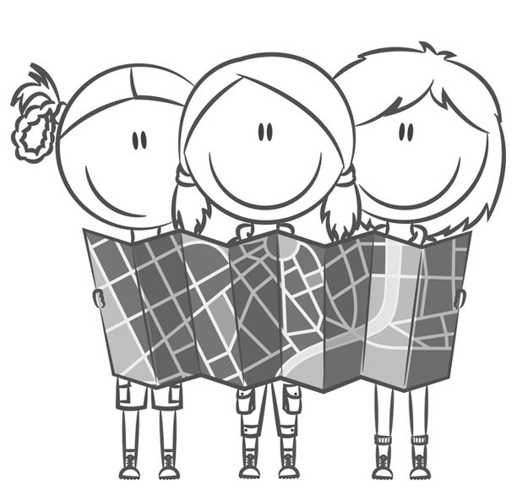
You Are Going the Wrong Way!
Do you get lost in new cities? Who do you ask for help?
Describe places, neighborhoods and countries in communicative situations.
I can give directions.
I can talk about places and attractions in a city.
I can ask and say where places are.
Do you ask for help in new places?
Who do you ask?
Are the directions usually good? Do you understand them?

Slide 2
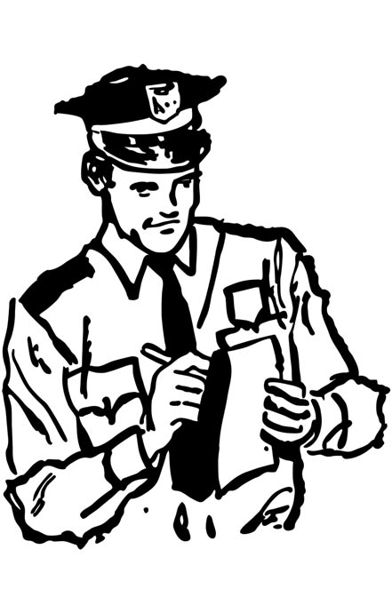
You Are Going the Wrong Way!
You Are Going the Wrong Way!
*When you are “still lost”, you continue to be lost.
Sally and John are still lost*. The need a better map!
Instructions: Read the dialogue aloud.
Sally: See John, asking for help isn’t a bad idea.
John: I guess so. I don’t see Exhibition Place.
Sally: Sure this is it!
John: No, this says Convention Place.
Sally: Oh! Turn here!
John: No, go this way!
Sally: Ask the police officer.
John: Alright. Excuse me officer, we are very lost.
Police Officer: How can I help?
John: We’re looking for the county fair at Exhibition Place.
Police Officer: You’re walking the wrong way.
John: Again!
Police Officer: You have to go back along this street. There is a bank at the intersection. Turn right. Walk straight ahead. You can’t miss it!
John: Thank you.
Sally: Look! It’s there!
John: Finally!

Slide 3
You Are Going the Wrong Way!
We use the Imperative* to give directions.
You do not use the subject with “the Imperative”. The Imperative stresses the verb.
Instructions: Select all the correct answers.
Which sentences use the Imperative to give directions?
No, go this way!
You can’t miss it!
Walk straight ahead.
Turn right at the next corner.
You’re walking the wrong way.
I can help you find the bank!
Instructions: Organize the mystery sentence. Move each word to place it in the correct order.
? / can / How / help / I
______________________________________________
2. Exhibition / looking / fair / Place / We’re / county / the / at /. / for
______________________________________________
3. street / You / back / to / along/ have / this /. / go
______________________________________________
4. is / intersection / a / There / the /. / bank / at
______________________________________________
5. then / this / to / bank, / street / turn. /take / We / the / we
______________________________________________

Slide 4
You Are Going the Wrong Way!
Help a person with directions!
You meet a person on the street. Write a short dialogue. Complete the
following steps. Fill in the Self Assessment.
The person asks you about a place in your area.
You say they are not going in the right direction.
Tell them where to go.
Say street names and use prepositions to help the person find their way.
Practice your dialogue.
Self Assessment
I use use Imperatives to give directions.
I use street names.
I say where places are.
I write 20-30 words in my dialogue.
Yes
No
not a bad idea (expression): it’s a good plan or thought
e.g. Go to the film festival? That’s not a bad idea!
I guess so (expression): maybe; I’m not sure
e.g. Do you think this is the right direction? I guess so.
wrong way (expression): not the correct direction
e.g. We are going the wrong way. The store is in the opposite direction.
bank (noun): the building where you put your money
e.g. Let’s go to the bank and get some cash for our trip.
police officer (noun): a person who enforces the law
e.g. Police officers help stop crime.
you can’t miss it (expression): it is easy to see
e.g. The park is on this street. You can’t miss it!
intersection (noun): the place where two streets meet
e.g. Meet me at the intersection of Main and Front streets.
to have to (verb): to be necessary
e.g. We have to leave before 10 p.m.

Slide 5
You Are Going the Wrong Way!
The Imperative to Give Directions
Use the Imperative to give a person directions and to repeat them. You do not use the subject, so the verb is stressed.
Examples
Walk down this street to Exhibition Place.
Go back along this street to the intersection.
Turn right at the corner.
Giving Directions
You use a preposition or an expression when you give directions.
Expression | Preposition
straight ahead | to the intersection
go back along | at the intersection
the wrong way | along the street
turn right
Examples
Walk along Liberty street to the intersection.
The park is at the intersection of Main and Liberty.

