Slide 1
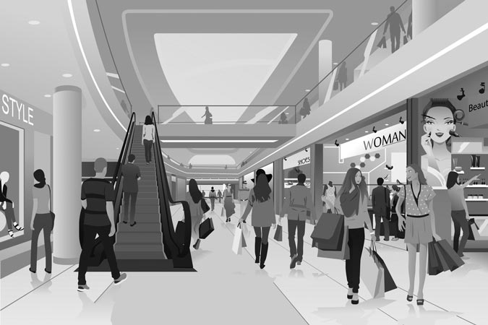
The Tall Glass Building
Shopping malls can be interesting and exciting places. Let’s go to one!
Describe places, neighborhoods and countries in communicative situations.
I can describe places in the city.
I can describe buildings.
I can ask and say where places are.
What shopping mall do you go to?
What shops are inside?
Are there plants or places to sit?

Slide 2
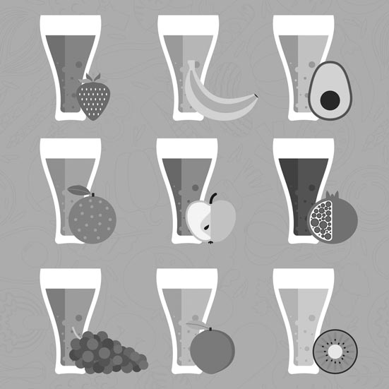
The Tall Glass Building
*“Step into” means to walk through the entrance or go inside.
John and Sally step into* a modern shopping mall.
Instructions: Read the dialogue aloud.
John: There’s a food shop over there. It’s in that concrete building across the
street.
Sally: Is it in the shopping center?
John: The shop is here.
Sally: Is there a juice bar down there? I want a kiwi and lemon drink first!
John: There’s a lot of space in here. I like the plants and small trees.
Sally: The shops are so modern. They’re all steel and glass.
John: Stop at the bar and get your juice. Sit and drink it. We can leave later.
Sally: Yes! I love it here! Sit next to me and relax!
John: Look up. There are colored glass windows in the ceiling!
Sally: Wow!

Slide 3
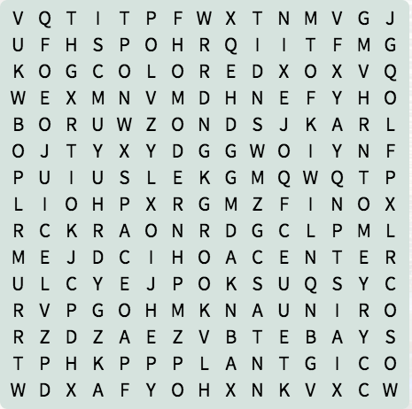
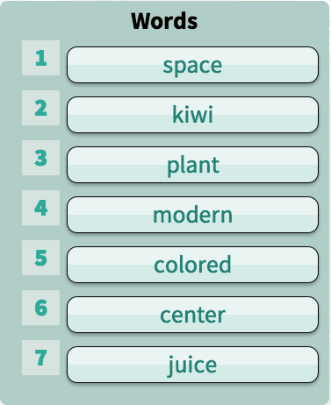
The Tall Glass Building
The tall glass building!
Instructions: Find the words in the word search below.
What does the shopping center look like?
The question “What does it look like”? asks a person to describe a place.
Instructions: Choose the correct answer to complete the sentence.
1. Sally says...
They’re all steel/seal and glass.
The shops are so modem/modern.
2. John says...
There are colored glass windows on the sealing/ in the ceiling!
There’s a lot of spice/space in here.
I like the plants around/ground the escalators.

Slide 4
The Tall Glass Building
Let’s describe a place. Choose a place you like to visit. Complete the
following steps. Fill in the Self Assessment.
Self Assessment
I describe a place using adjectives.
I say where places are using prepositions.
I write 20-30 words about a place.
I read my sentences aloud.
Yes
No
Talk about what is there.
Use adjectives to say what the place looks like.
Use prepositions to say where things are.
Read your sentences to a friend or classmate.
down (preposition): along
e.g. The bank is down this street.
juice bar (noun): a place to buy fruit drinks
e.g. I want a kiwi and lemon drink from the juice bar.
shopping center (noun): a group of stores built together
e.g. We go to the shopping center to shop every week.
kiwi (noun): a green fruit with a fuzzy skin
e.g. Kiwis come from New Zealand.
space (noun): open area
e.g. There is a lot of space in this room.
steel (noun): a very strong gray metal
e.g. The building is made of glass and steel.
plant (noun): small vegetation you can bring inside
e.g. There are plants in the shopping mall.
modern (adjective): from now; from the current period
e.g. The bank building is so modern!
colored (adjective): having many colors
e.g. There are colored windows in the ceiling!

Slide 5
The Tall Glass Building
Describing Things
When you describe a thing, you use adjectives.
Adjectives tell you what a thing looks like.
Adjective(s) | Example
modern | a modern building
colored | colored windows
concrete | a concrete building
shopping | a shopping mall
shopping | a shopping area
steel and glass | a steel and glass building
Examples
This is our new modern shopping center.
It is a concrete tower.
The steel and glass shop is interesting.
Prepositions of Place
You use prepositions of place to say where things are in a place.
Preposition | Example
in | in the building
 | in the ceiling
at | at the juice bar
down | down the hall
next to | next to Tom
across | across the street
Examples
There are colored windows in the ceiling.
Sit next to Tom.
The shop is down the hall.
He’s at the juice bar.
The building is across the street.

