Slide 1
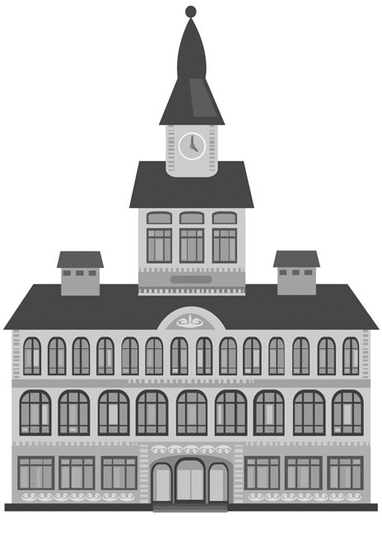
Which Line Goes to City Hall?
I’m new to Cambridge. Can you help me find the city hall?
Describe places, neighborhoods and countries in communicative situations.
I can talk about places and attractions in a city.
I can talk about travel and transportation.
I can ask and say where places are.
I can talk about colors and materials.
What places do tourists ask about in your city?
How can you help them?
What do you say?

Slide 2

Which Line Goes to City Hall?
*A “city hall” is a building for city government. You use capital letters (City Hall) to talk about one specific city government.
How do I get to the city hall*?
Instructions: Read the dialogue aloud.
John: It’s nice in the park square at night.
Sally: We should walk to the pizzeria.
John: There are lots of flowers here.
Sally: They’re colorful, like the sign on that shop in Boston!
John: What kind of pizza should we try this time?
Sally: Any kind is fine.
Tourist: Excuse me. How do I get to the city hall building?
John: Catch the green bus line. It stops here on this corner. Get off at King Street.
Tourist: It’s on King Street?
Sally: No. Walk down King to the intersection. Then, turn right. It’s next to the red
brick art gallery.
Tourist: Maybe I should take a taxi.
Sally: You can get a taxi down this way, on Elm Street.
Tourist: Thank you.

Slide 3
Which Line Goes to City Hall?
What should John and Sally do?
Instructions: Draw a line from the first part of the statement on the left to the second part on the right.
We should walk a) take a taxi.
How do b) the intersection.
It’s nice in the park c) square at night.
Walk down King Street to d) I get to the city hall building?
Maybe I should e) to the pizzeria.
Is the city hall building next to the park?
Instructions: Select all the correct answers.
Which are places in a city?
A flower
An art gallery
A city hall
A red brick
A pizzeria
A taxi
A square
A bus

Slide 4
Which Line Goes to City Hall?
Let’s talk about buildings. Talk about buildings in your city. Click on the
play button to listen to the audio.
Look at the chart.
Choose 3 buildings in your city.
Look online or go to the building.
Write the colors and the material the building is made of.
Look up new words in English.
Write 2 sentences about each building.
Self Assessment
I write about 3 buildings.
I describe a building’s color and material.
I describe materials.
I describe the color of things.
Yes
No
Building Name | Color(s) | Material(s)
city hall (noun): the building for a city government
e.g. The city hall building is on the next street.
art gallery (noun): a building that shows paintings and sculpture
e.g. The art gallery is showing paintings by Picasso.
intersection (noun): the place where two streets meet
e.g. Meet me at the intersection of Main and Front streets.
colorful (adjective): with lots of color
e.g. It’s a colorful sign with red, orange and yellow letters.
to catch (verb): to use; to take
e.g. Where do we catch the bus?
down (preposition): along
e.g. The bank is down this street.
brick (noun): A hard, heavy, rectangular block used to build walls and buildings.
e.g. It’s a beautiful old red brick house.
to get off (verb): leave a bus or train
e.g. Get off the bus at the next stop.
square (noun): an open area in a city with four equal sides
e.g. They sit in the square in the evening and watch people walk by.
pizzeria (noun): a restaurant that makes pizza
e.g. That pizzeria makes real Italian style pizza!

Slide 5
Which Line Goes to City Hall?
Prepositions of Place and Expressions of Place
You use prepositions of place to say where you are or where you want to go.
They help you say the place more clearly.
Preposition/ Expression of Place | Meaning | Examples
on the corner | where 2 streets meet | The museum is on the corner of Liberty and Main Streets.
along | forward | Walk along Main Street.
at | a specific place | He’s at Paul Revere’s house.
by | near; beside | There are restaurants by the harbor.
toward | in the direction of | Walk toward the water.
Travel and Transportation
You can travel to places and travel around places in different ways.
Transportation | Examples
car | by car in a car
train | by train on a train take a train
bus boat | by bus on a bus take a bus by boat on a boat on board a boat
taxi | by taxi in a taxi
Examples
They prefer to travel by car.
We can spend the day on board a boat in the harbor.
Let’s take a taxi.
Get on the bus!

