Slide 1
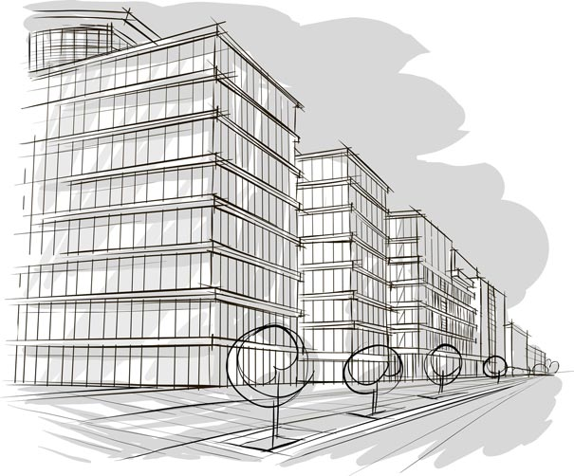
How Do I Get Back to…?
Look at that building! It’s amazing! Is that wall made of glass?
Describe places, neighborhoods and countries in communicative situations.
I can describe places in the city.
I can describe buildings with colors and materials.
I can express how far or how near objects are using this, that, these, those.
What buildings are interesting in your city?
Why do you like them?
What are they made of?

Slide 2
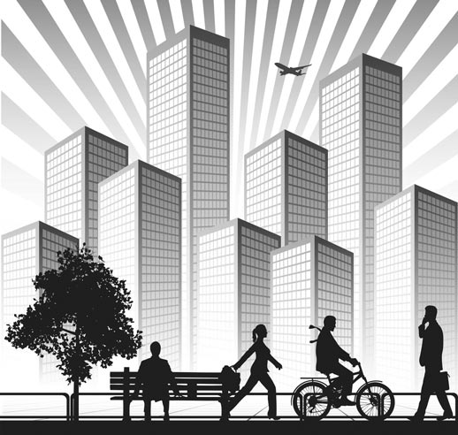
How Do I Get Back to…?
*“Buildings” can be houses, towers or office blocks.
Sally and John think the buildings* in Boston are beautiful!
Instructions: Read the dialogue aloud.
Sally: I don’t think this is the right way.
John: Why do you say that?
Sally: Look at that big red building.
John: Which one? That brick building?
Sally: Yeah… that building is not near the bus station. We should go this way.
John: This way? Ok.
Sally: Look over there.
John: There’s the city hall. I love that huge glass wall!
Sally: That’s my favorite building here in Boston.
John: It’s beautiful, not like those grey towers in Cambridge!
Sally: Are we getting close to the art gallery?
John: I think so. This building is the bank.
Sally: There’s that cool flower shop!
John: Where?
Sally: Over there. It’s the yellow shop with the colorful wood sign.
John: There’s the bus station!
Sally: Yesssss!

Slide 3
How Do I Get Back to…?
John and Sally talk about the buildings in Boston!
Instructions: Practice reading aloud the sentences.
Look at that big red building.
That building is not near the bus station.
That’s my favorite building here in Boston.
It’s not like those gray towers in Cambridge!
It’s the yellow shop with the colorful wood sign.
This building here is nice. Oh! Look at that one there!
Instructions: Read the dialogue again. Write the missing phrases. Use: this way, glass wall, This, the station, flower shop.
I don’t think this is the right way to get back to _____________.
We should go ______________.
I love that huge _______________!
There’s that cool _______________!
___________building is the bank.

Slide 4
How Do I Get Back to…?
Let’s talk about buildings where you live. Make a list of the buildings
you like or see every day. Complete the following steps. Fill in the Self
Assessment.
Fill in the chart.
Write the names of the buildings - or what you call them.
Write the colors and materials.
Write a sentence about 2 of the buildings.
Building Name | Color | Materials
Self Assessment
I use color and material to describe places.
I use street names.
I complete the chart.
I write 2 sentences about buildings.
Yes
No
to get back to (verb): return to a place again
e.g. How do we get back to the bus station?
brick (noun): a hard, heavy, rectangular block used to build walls and buildings.
e.g. It’s a beautiful old red brick house.
wall (noun): the vertical structure that is part of a room
e.g. She likes to paint the walls in her bedroom a light color.
this way (expression): this direction
e.g. We have to go this way for the bus station.
tower (noun): a very tall building
e.g. The office tower is all glass and metal.
close (adjective): near
e.g. The station is close to the mall.
colorful (adjective): with lots of color
e.g. It’s a colorful sign with red, orange and yellow letters.
cement (noun): a material for building that is mixed with water and dries hard
e.g. The cement on the sidewalk is not hard yet.

Slide 5
How Do I Get Back to…?
Colors and Materials in Buildings
Here are some colors and materials used to make buildings.
When you use a color and a material to talk about a building, you say the color first.
A blue glass wall.
color + material
Examples
It’s a red brick house.
I don’t like that grey steel tower!
Look at that beautiful blue glass wall!
Colors | Materials
red | glass
grey | metal
blue | steel
brown | wood
yellow | cement
Demonstrative Adjectives This and That
A demonstrative adjective points out the noun it talks about. It goes before the noun.
that book this car
You use this for something that is near.
You us that for something that is far.
Examples
This street is not the right one.
That building over there is the city hall.

