Slide 1

Take the Green Line
It’s time to get the bus home. Let’s buy the tickets!
Describe places, neighborhoods and countries in communicative situations.
I can describe places in the city.
I can ask and say where places are.
I can talk about travel and transportation.
How do people move around in your city?
Do they drive a car? Take the bus? Take a train?
How do you prefer to travel?

Slide 2
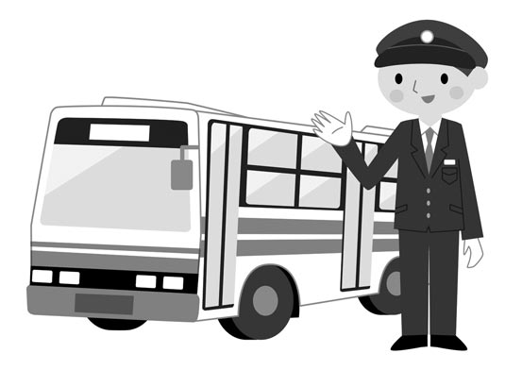
Take the Green Line
Is the bus on time*?
*”On time” means on schedule; arriving at the correct time.
Instructions: Read the dialogue aloud.
Sally: This is a nice old bus station! We can get our tickets at the counter!
John: Two tickets to Cambridge, please.
Clerk: That’s $14.
John: Where do we catch the bus?
Clerk: Wait on platform 12. Take the Green Line. Give your tickets to the conductor.
John: When does the bus leave?
Clerk: Buses leave every hour. Get the next bus at 6 o’clock.
John: Thanks. The bus leaves in 55 minutes.
Sally: Ask the clerk where to get some food.
John: Excuse me. Is there a good place to buy food nearby?
Clerk: Look across the street. There’s a cafe in the large concrete building.
John: Thanks! We have time to get food. We can ride the bus and eat.

Slide 3
Take the Green Line
In the bus station…. but where?
Instructions: Complete the sentences. Write the missing word. Use words from the word bank on the right.
_________ a good place to buy food nearby?
There’s a cafe ______ the large concrete building there.
Where do we __________the bus?
I can buy the bus tickets ________________!
Wait for your bus _________ platform 10.
WORD BANK
at the counter
in
into
catch
Is there
in the counter
on
by
What’s in the bus station?
Instructions: Complete the sentences. Write the missing word. Use platform, leave, at, Get, ride the bus, tickets.
Two __________ to Cambridge, please.
When does the bus __________?
Wait on _____________ 12.
_________ the next bus ________ 6 o’clock.
We can ____________ and eat.

Slide 4
Take the Green Line
Let’s go to a station!
Look at a bus or train schedule online.
Instructions: Complete the following steps. Fill in the Self Assessment.
Research for a bus or train schedule online.
Find out where you can go from your city.
Find out when the buses leave.
Find out how long does the trip take.
Complete the table below.
Write a sentence about each trip.
Self Assessment
I write about 3 places.
I use words for travel and transportation.
I write complete statements about places to go and state travel times.
Yes
No
 | Place | Time Leaves | Time to Travel There
Trip 1
Trip 2
Trip 3
to catch (verb): to get on
e.g. Where do we catch the bus?
ticket (noun): a small card that you use to get on the bus
e.g. The bus ticket is not expensive.
platform (noun): an area where a bus or train arrives
e.g. Catch the bus on platform 12.
to ride (noun): to be on
e.g. We ride the bus to school every day.
have time (expression): not have to hurry
e.g. We have time to go and eat before the movie starts.
on time (expression): at the correct time
e.g. This bus is always on time. It is never late.
line (noun): a bus or train route or circuit
e.g. The Green Line travels from Boston to Cambridge.
conductor (noun): a person who works on a bus or train
e.g. The bus conductor collects the tickets.
concrete (noun): a grey building material
e.g. The station is in that concrete building.

Slide 5
Take the Green Line
Prepositions
You use the prepositions in, at and on to talk about where places are.
Preposition | Example
in | in the building
on | on the platform on the bus
at | at the ticket counter
Examples
There’s a cafe in that concrete building.
Wait on the platform for the bus.
Get your ticket at the counter.
Taking the Bus
You use special words when you take the bus. You use specific nouns and verbs.
Nouns | Verbs
bus | ride
station | catch
ticket | wait for
conductor | take
platform | get
line | leave
Examples
The bus leaves the station every hour.
The bus gets here in 10 minutes.
You catch the bus on platform 12.
Wait for the Green Line here.
Ask the conductor for help.
Buy your tickets over there.
I take the bus every day.

