Slide 1


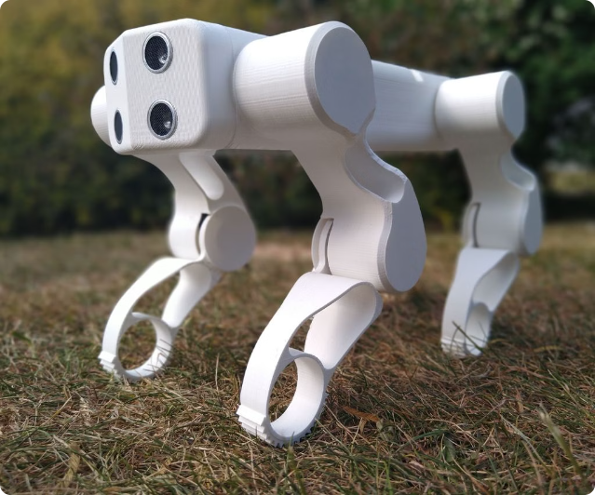


3D Printing in IoT Prototyping
3D printing is an invaluable tool for building IoT prototypes. It allows you to quickly iterate on your designs and create complex geometries that might be impossible to manufacture using traditional methods.
by Velan

Slide 2
Benefits of 3D Printing for IoT Physical Design
Rapid Prototyping
Cost-Effective
Design Flexibility
3D printing lets you create physical prototypes in hours, speeding up the development process. This allows you to test your designs quickly and iterate on them efficiently.
3D printing eliminates the need for expensive tooling and molds. You can print smaller batches, minimizing upfront costs and making it suitable for early stage prototyping.
3D printing allows you to create intricate and complex designs that would be challenging or impossible to produce with traditional manufacturing methods. This opens up new possibilities for IoT devices.

Slide 3

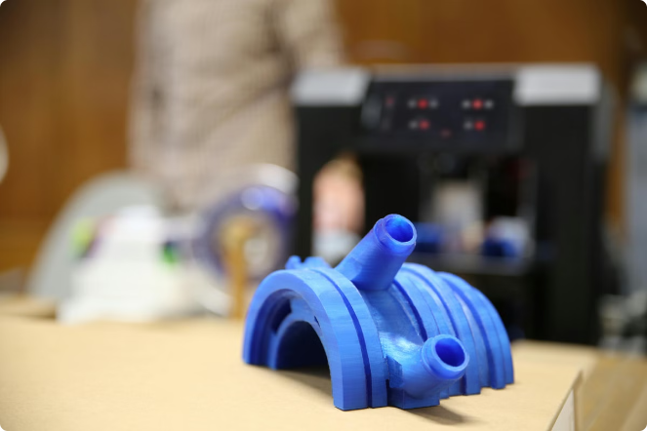
Workflow and Considerations for 3D Printed IoT Prototypes
1
Design Concept
Start with a clear concept of your IoT device. Sketch out your ideas and define the functions of your prototype.
2
3D Modeling
Create a 3D model of your device using CAD software. Ensure it is printable and optimized for 3D printing.
3
3D Printing
Print your prototype using a 3D printer. Experiment with different materials and printing settings to achieve the desired properties.
4
Testing and Refinement
Thoroughly test the functionality and ergonomics of your prototype. Identify areas for improvement and iterate on your design.

