Slide 1
TITLE
Ben Fraud, Pedro Vasquez, Gloria Velasquez, Olivia Perez

Slide 2
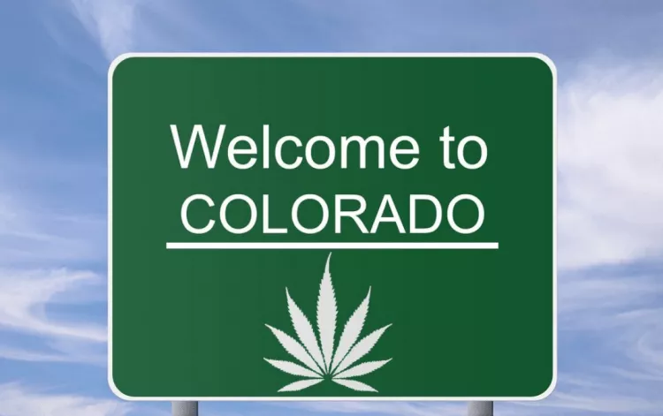
INITIAL QUERY: Colorado tourism + cannabis impact on Emergency room Visits

Slide 3
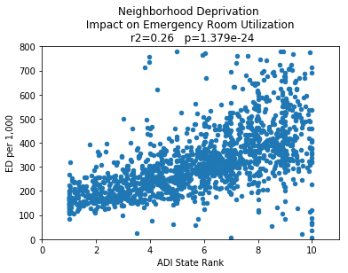
Neighborhood Deprivation Impact on ER Visits

Slide 4
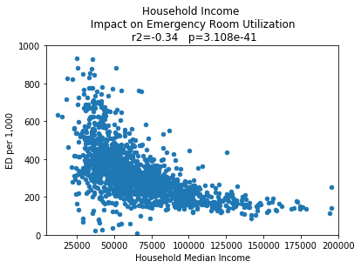
Household Income Impact on Emergency Room Utilization

Slide 5
OPIOID PRESCRIPTIONS

Slide 6
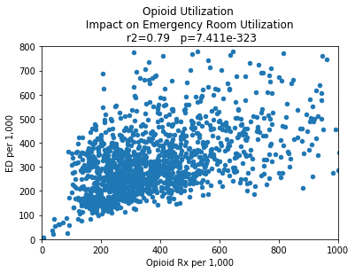
Opioid Prescription IMPACT ON ER VISITS

