Slide 1
Pain, Drugs, Emergency Rooms and Mortality
Ben Fraund, Pedro Vasquez, Gloria Velasquez, Olivia Perez

Slide 2


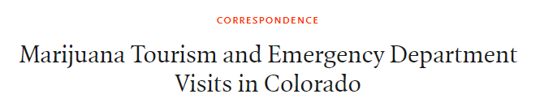
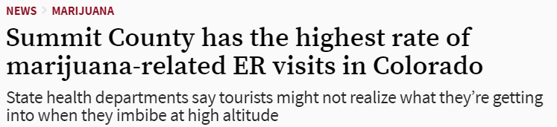

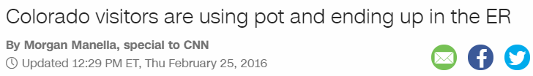

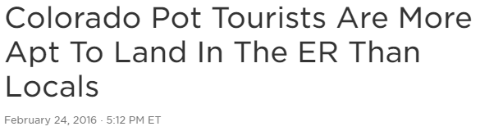

Marijuana Tourism Impacting Colorado Emergency Room Volumes
Is California is experiencing a similar effect?

Slide 3
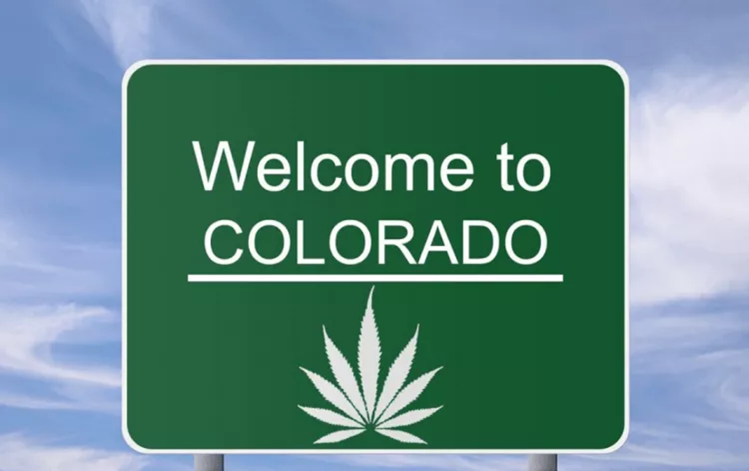
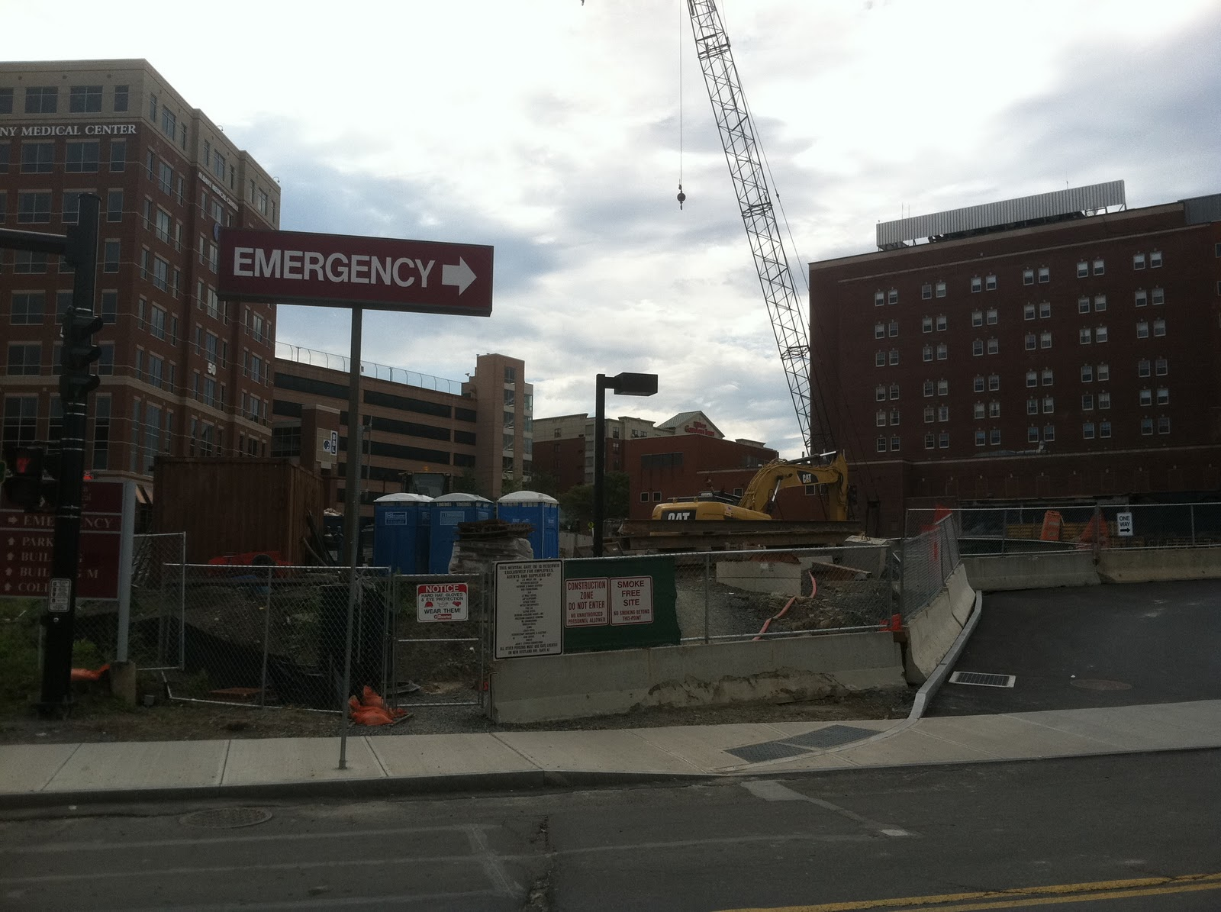
Hypothesis I
CA is experiencing increased emergency room visits due to cannabis tourism
Hypothesis II
Socioeconomic deprivation drives higher emergency room utilization

Slide 4
Data Sources (zip code level, most for 2016)
CA Office of Statewide Health Planning and Development (OSHPD)
Emergency Department Visits
Inpatient Discharges
US Census American Community Survey
Population demographics
Employment Rates
Median Household Income
Insured Rates
Area Deprivation Index (Socioeconomic Measure)
ESRI Tapestry Consumer Segmentation Data
CA Controlled Substance Utilization Review and Evaluation System (CURES)
Opioid Prescription Volumes
Number of Unique Patients with Opioid Prescriptions
Schedule II – IV Controlled Substance Prescription Volumes
US Centers for Disease Control (CDC)
Overall Death Counts
Deaths by Leading Causes of Death

Slide 5
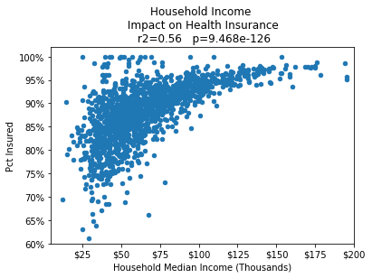
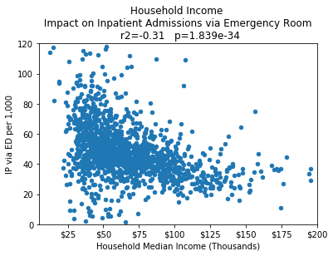
Socioeconomic Impact on Insured Rates and Emergency Room Visits

Slide 6
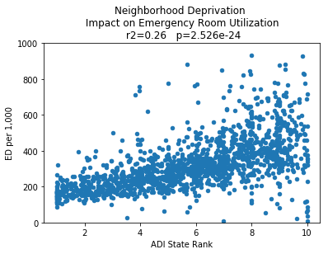
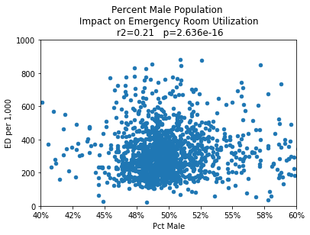
What other factors could be driving Emergency Room Visits?

Slide 7
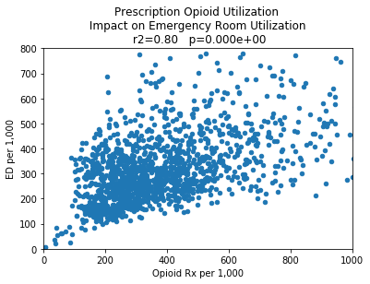
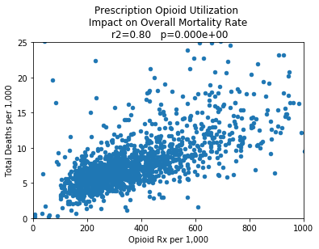
Impact of High Opioid Prescription Use

Slide 8
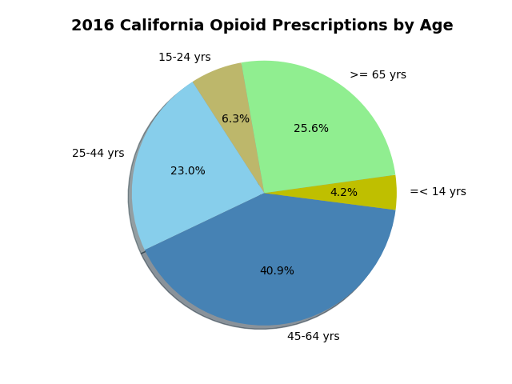

Slide 9
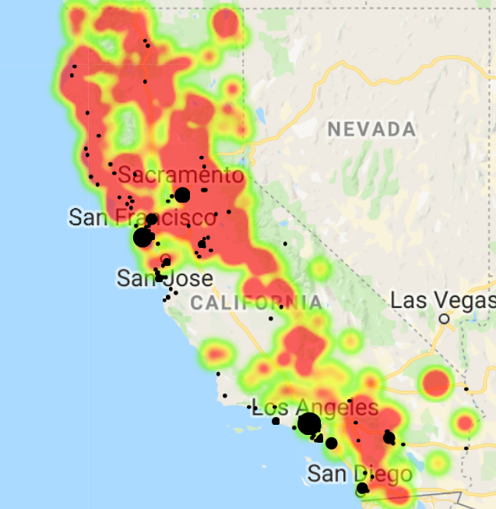




Back to the impact of Cannabis deregulation in CA.
Cannabis is already being taken seriously as a substitute for prescription opioids…
CA Prescription Opioid Utilization
vs. Licensed Cannabis Retail Locations
High Opioid Rx Utilization
Licensed Cannabis Retailers

Slide 10
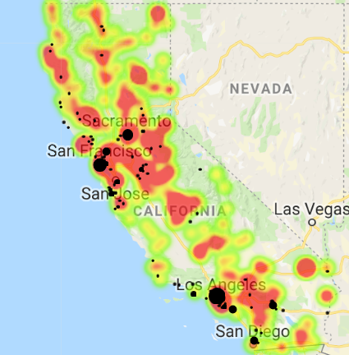
CA Emergency Room Utilization
vs. Licensed Cannabis Retail Locations
Keep an eye out for those headlines on the impact of Cannabis tourism in CA…
High Emergency Room Utilization
Licensed Cannabis Retailers

