Slide 1
PYTHON DATA ANALYSIS PROJECT • SPRINT 1
ScamPulse AI
Telecom Scam & Spam Pattern Intelligence
Industry: Telecommunications • call-protection & spam/scam monitoring context
VELAVAN P D
Student ID • AF05320062
Course • AIML
Batch Code • ANP - D7444
Industry reference: Truecaller (inspiration only; not an official project)
Data source: FTC Do Not Call consumer complaint records used in the project
01

Slide 2
Industry Overview
02
Selected industry: Telecommunications • focus on complaint intelligence for call-protection analysis
Why data analysis matters in this project
SELECTED INDUSTRY
Telecommunications
1
2
3
ScamPulse AI examines consumer-reported unwanted-call complaints as an analytical signal for telecom call-protection and spam/scam monitoring.
PATTERN DISCOVERY
MONITORING
PRIORITIZATION
Turn high-volume complaint rows into recurring patterns that are easier to monitor.
Compare dates, subjects, geography and robocall status to spot shifts in complaint activity.
Use recurrence and emerging-pattern signals to focus deeper review on the most relevant records.
Project context
PROJECT VIEW
Time • Subject • Robocall • Geography • Originating number
The analysis layer converts complaint records into structured intelligence that can support monitoring, prioritization and future detection work.
These signals are analyzed together rather than interpreted as isolated fields.
Source: project-provided notebook and dataset

Slide 3
Problem Statement
03
Why ScamPulse AI is needed
THE INDUSTRY PROBLEM
Large-scale consumer complaint records contain important patterns that are difficult to identify manually.
WHY IT MATTERS
WHO IS AFFECTED
WHAT IS MISSING
Raw complaint records need structure before they can support consistent monitoring and analytical decisions.
Telecom users experience unwanted calls; analysts and call-protection workflows need usable pattern intelligence.
A repeatable analysis layer that connects temporal, subject, robocall, geographic and originating-number signals.
INDUSTRY QUESTION
How can a telecom call-protection platform convert complaint data into actionable pattern intelligence?
Interpretation rule: complaint frequency is a monitoring signal, not confirmation of fraud.
Source: project problem statement and supplied notebook analysis

Slide 4
Project Objective
04
Five clear objectives for Sprint 1
1
Transform consumer-reported complaint records into structured analytical intelligence.
2
Identify recurring and emerging patterns across time, subject, robocall status, geography and originating number.
3
Measure complaint concentration and recurrence to support monitoring priorities.
4
Build an interactive Plotly dashboard for fast exploration and decision support.
5
Create a clean analytical foundation for future anomaly detection, risk scoring and machine-learning work.
Data Quality
Cleaning
EDA
Dashboard
Future ML
Source: project-provided notebook and dataset

Slide 5
Proposed Solution & Analysis Questions
05
Use Python to turn raw complaint records into a structured analytical workflow
PROPOSED SOLUTION
Raw FTC CSVs
Data Quality
Cleaning
EDA
Plotly Dashboard
How Python helps
Pandas
clean, group, count, cross-tab and compare
ANALYSIS QUESTIONS
NumPy
support numerical transformations and analysis
How does complaint volume vary by Created_Date?
Which states, cities and area codes have the highest complaint volume?
Matplotlib
validate EDA patterns with static charts
Plotly
present an interactive dashboard with hover/zoom
Which complaint subjects dominate the dataset?
Which originating numbers recur most often?
How much activity is marked as a robocall / recorded message?
Which subjects, states and phone numbers are emerging in the recent period?
Source: project-provided notebook and dataset

Slide 6
Dataset Information
06
FTC Do Not Call complaint records used for the project
DATASET NAME
RAW DATASET
FINAL PROCESSED
UNIQUE SUBJECTS
FTC Do Not Call complaint records
84,686 × 8
84,678 × 10
15
Source
Selected daily FTC complaint CSV files loaded by the project notebook
Schema at a glance
Coverage
31 Aug 2026 → 09 Sep 2026
•
Company_Phone_Number
•
Consumer_State
Format
CSV
•
Created_Date
•
Consumer_Area_Code
Selected files
8 daily CSV files: sep1, sep2, sep3, sep4, sep7, sep8, sep9, sep10
•
Violation_Date
•
Subject
•
Consumer_City
•
Recorded_Message_Or_Robocall
Important features
Company_Phone_Number • Created_Date • Violation_Date • Consumer_City • Consumer_State • Consumer_Area_Code • Subject • Recorded_Message_Or_Robocall
Dataset description
Complaint records capture report timing, reported number, consumer geography, subject and robocall status.
Source: FTC Do Not Call complaint CSVs selected and combined in the project notebook

Slide 7
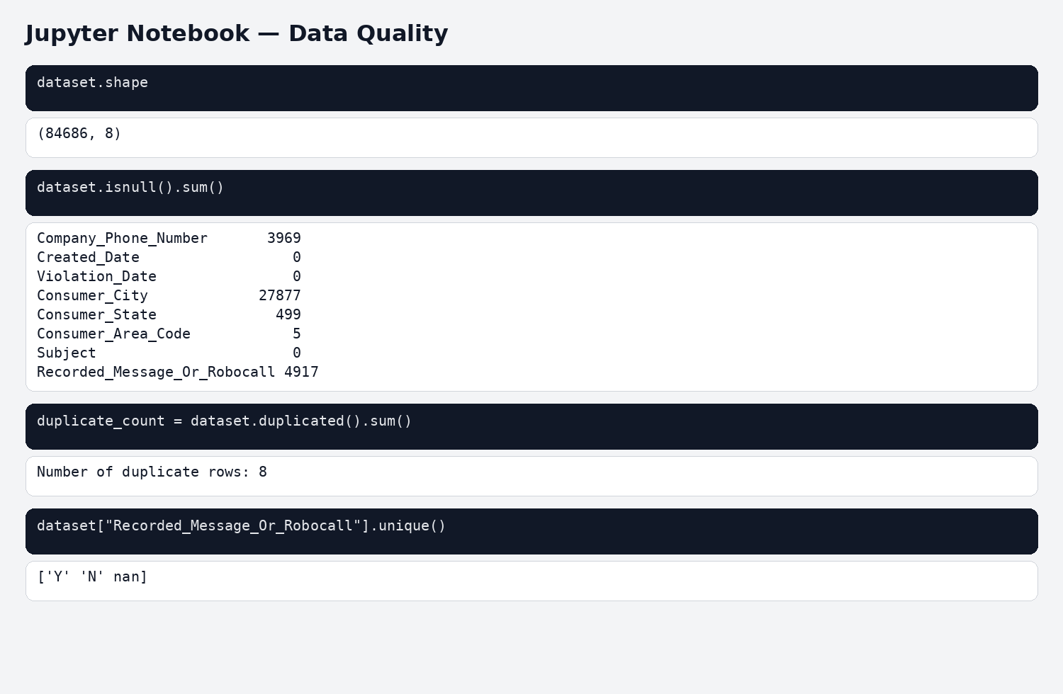
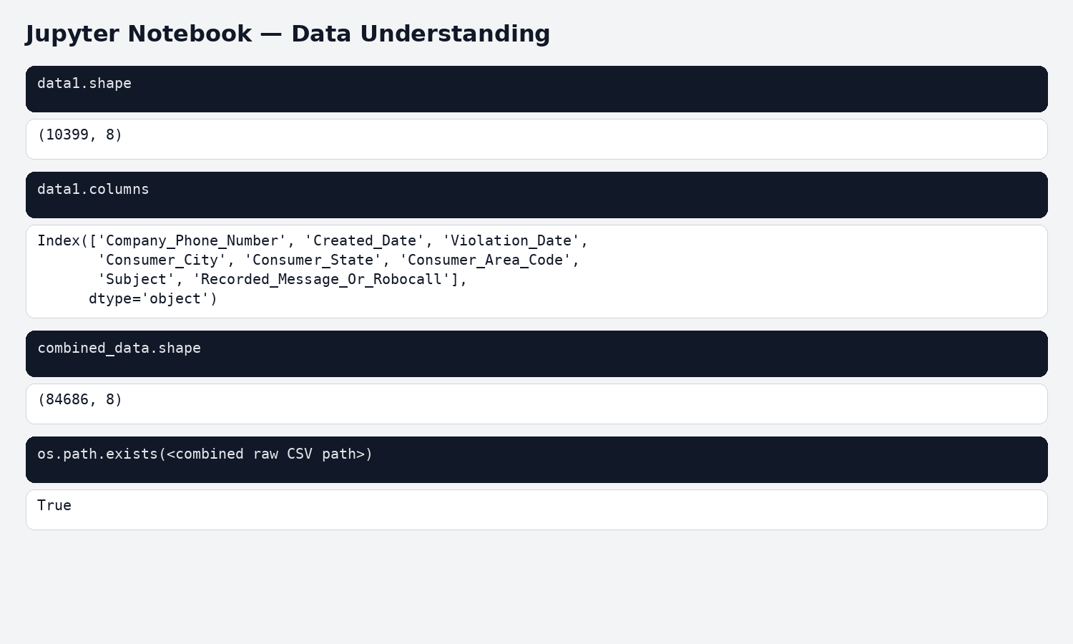
Data Collection & Understanding
07
Notebook evidence from the supplied, executed Jupyter files
8 raw CSV files
Vertical concat
84,686 rows × 8
Collection step: data1 … data8 loaded from the raw folder and combined row-wise.
Quality checks observed in the notebook: missing-value counts, exact duplicates and robocall values Y / N / missing.
Notebook evidence: 1) Data Understanding.ipynb + 2) Data Quality.ipynb

Slide 8
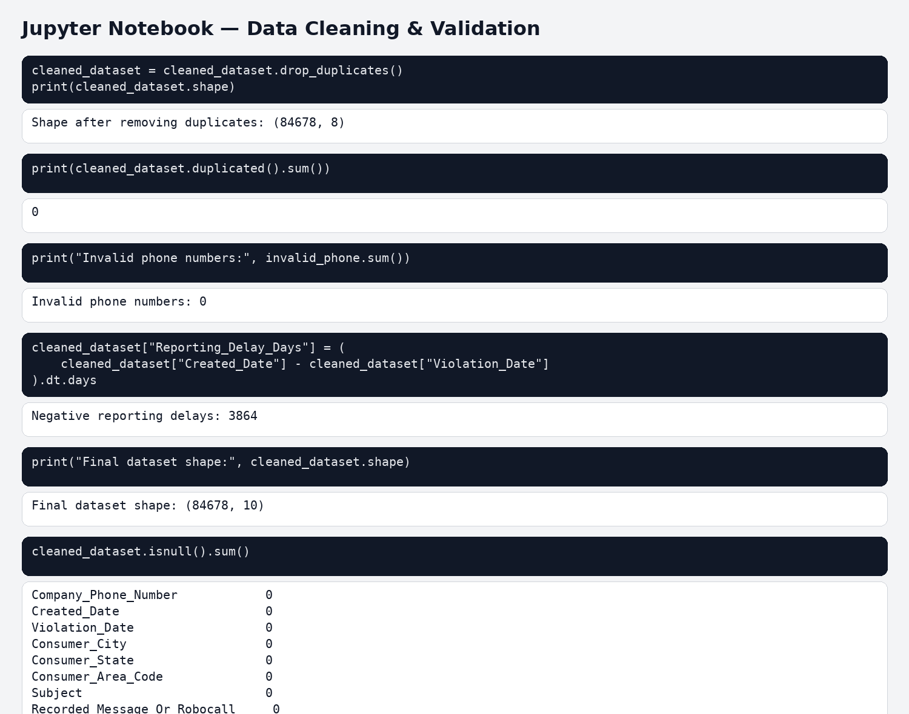
Data Cleaning & Transformation
08
Actual cleaning decisions and final validation from the executed notebook
ACTUAL STEPS PERFORMED
1
Remove duplicates
8 exact duplicates removed; index reset.
2
Handle missing values
Missing analytical fields represented as Not_Reported where appropriate.
3
Normalize identifiers
Phone numbers validated as 10-digit strings; invalid/missing → Not_Reported.
4
Standardize categories
City/state/text formatting standardized; robocall normalized to Y / N / Not_Reported.
5
Prepare dates
Created_Date and Violation_Date converted to datetime; Invalid_Date_Order and Reporting_Delay_Days created.
3,864 negative reporting delays retained for traceability and flagged through the date-quality field.
FINAL DATASET
NULLS REMAINING
DUPLICATES
84,678 × 10
0
0
Notebook evidence: 3) Data Cleaning(1).ipynb

Slide 9
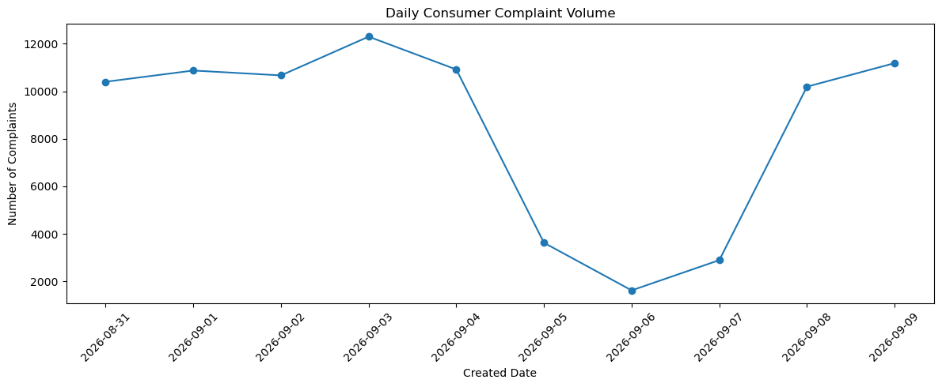
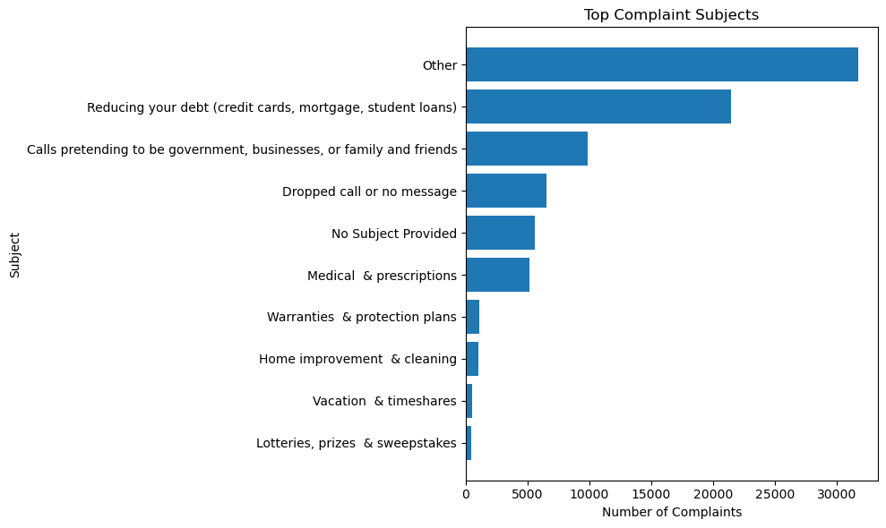
Exploratory Data Analysis (EDA)
09
Pandas + NumPy aggregations with Matplotlib outputs from the notebook
Temporal
Subjects
Robocall
Geography
Numbers
Emerging
Important findings
PEAK DAY
03 Sep 2026 • 12,296
LOWEST DAY
06 Sep 2026 • 1,628
LEADING SUBJECT
Other • 31,724 • 37.46%
DEBT-RELATED SUBJECT
21,465 • 25.35%
The EDA also covered time-of-day, day-of-week, subject × robocall, state/city/area-code concentration, originating-number recurrence, reporting delay and emerging-pattern comparisons.
Matplotlib outputs: daily complaint volume + top complaint subjects
Actual notebook outputs: 4) EDA.ipynb

Slide 10
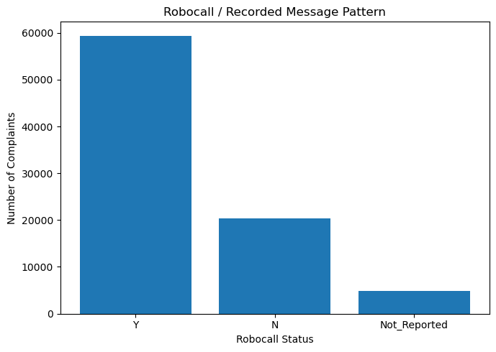
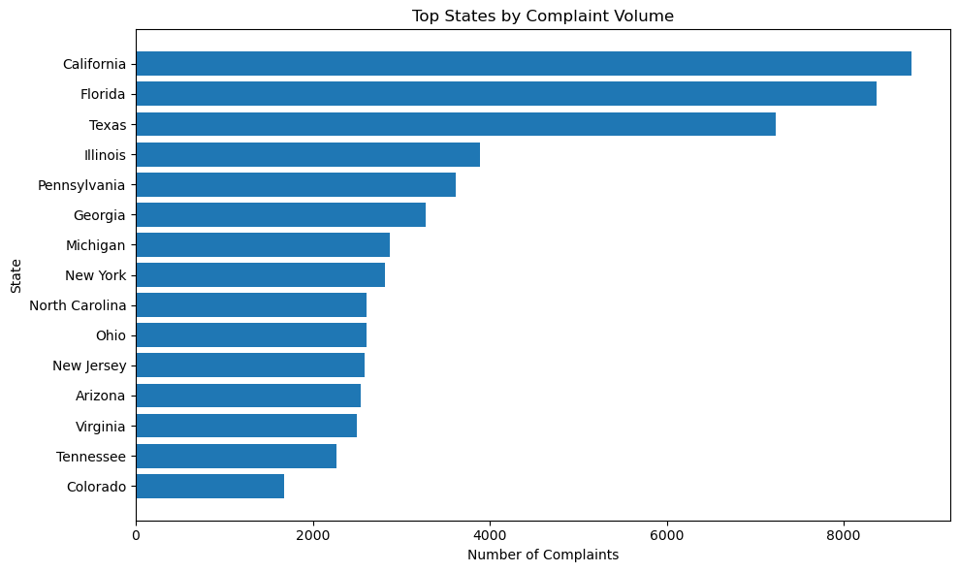
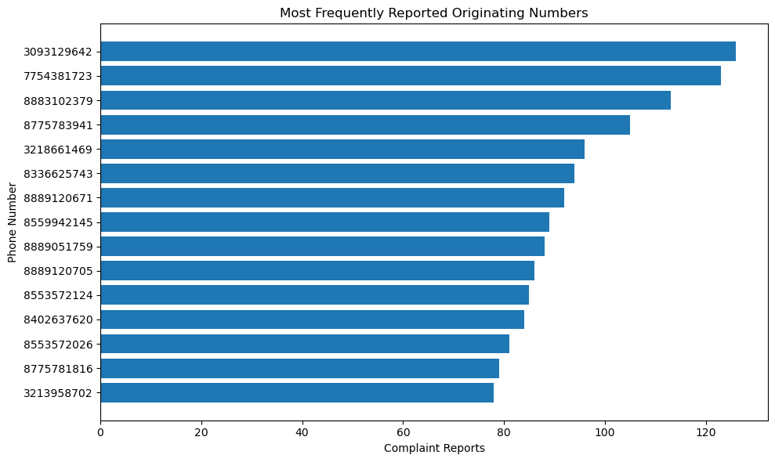
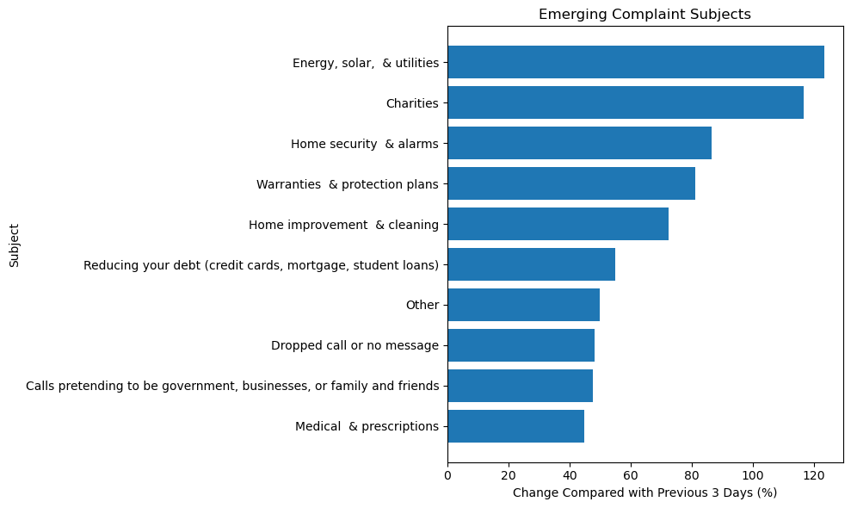
Data Visualization
10
Actual chart outputs from the project notebook — Chart → Purpose → What it shows → Key insight
Robocall / Recorded Message Pattern
Top States by Complaint Volume
Purpose: compare Y / N / Not_Reported status.
Purpose: identify geographic concentration.
Shows: 59,405 Y • 20,357 N • 4,916 Not_Reported.
Shows: top states ranked by complaint volume.
Key insight: 70.2% of complaint records are marked Y.
Key insight: California is the top state in the analyzed records.
Most Frequently Reported Originating Numbers
Emerging Complaint Subjects
Purpose: detect recurrence among reported numbers.
Purpose: compare recent 3 available dates vs previous 3.
Shows: the most frequently reported originating numbers.
Shows: subjects with increasing recent-period counts.
Key insight: 70,265 distinct reported numbers; 4,767 were reported more than once.
Key insight: “Other” increased by +3,053 reports.
Static charts are exact notebook outputs; dashboard adds Plotly interactivity for the same analysis.

Slide 11
Key Insights & Recommendations
11
What the actual dataset analysis supports
KEY INSIGHTS
RECOMMENDATIONS
01
Complaint activity varies sharply by date: 12,296 on 03 Sep vs 1,628 on 06 Sep.
01
Monitor daily volume with a trend/rolling-average view to surface spikes and drops.
02
“Other” is the largest subject: 31,724 reports (37.46%).
02
Prioritize high-volume subjects for deeper pattern review.
03
Debt-related complaints contribute 21,465 reports (25.35%).
03
Use robocall status as one monitoring dimension alongside subject and time.
04
70.2% of records are marked as recorded-message / robocall (Y).
04
Prioritize repeated and emerging numbers for review — do not label them as confirmed fraud from complaint frequency alone.
05
California is the top state; 4,767 originating numbers recur in the dataset.
05
Retain date-quality flags and use valid reporting delays for delay-specific analysis.
Interpretation rule: consumer complaint frequency is a monitoring signal, not confirmation of fraud.
Source: project-provided notebook and dataset

Slide 12
Conclusion
12
Sprint 1 turns raw complaint data into a reusable analytical foundation
FUTURE SCOPE
WHAT WAS ACHIEVED
From analytics to intelligent detection
A reproducible path from raw complaint records to cleaned data, deep EDA and an interactive Plotly dashboard.
1
2
3
4
5
Raw complaint records
Feature engineering
Anomaly detection
Risk scoring
ML classifier
Deployment
Cleaned dataset
EDA
The Sprint 1 output creates a structured base for future anomaly detection, risk scoring and machine-learning-based spam/scam monitoring.
BOTTOM LINE
Interactive dashboard
Major findings
84,678 processed rows • 70.2% robocall-marked • 4,767 repeated numbers
THANK YOU
ScamPulse AI • Telecom Scam & Spam Pattern Intelligence
Source: project-provided notebook and dataset

