Slide 1
Agilité par le code grâce à CQRS et EventSourcing
Workshop
Florent @florentpellet
Clément @clem_bouiller
Jean @jeanhelou
Emilien @ouarzy

Slide 2
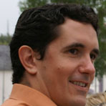

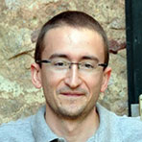
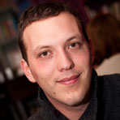
Who are we ?
4 passionate guys initiated this workshop in 2015
Feel free to give some feedback on GitHub
Clément
@clem_bouiller
Emilien
@ouarzy
Florent
@florentpellet
Jean
@jeanhelou

Slide 3
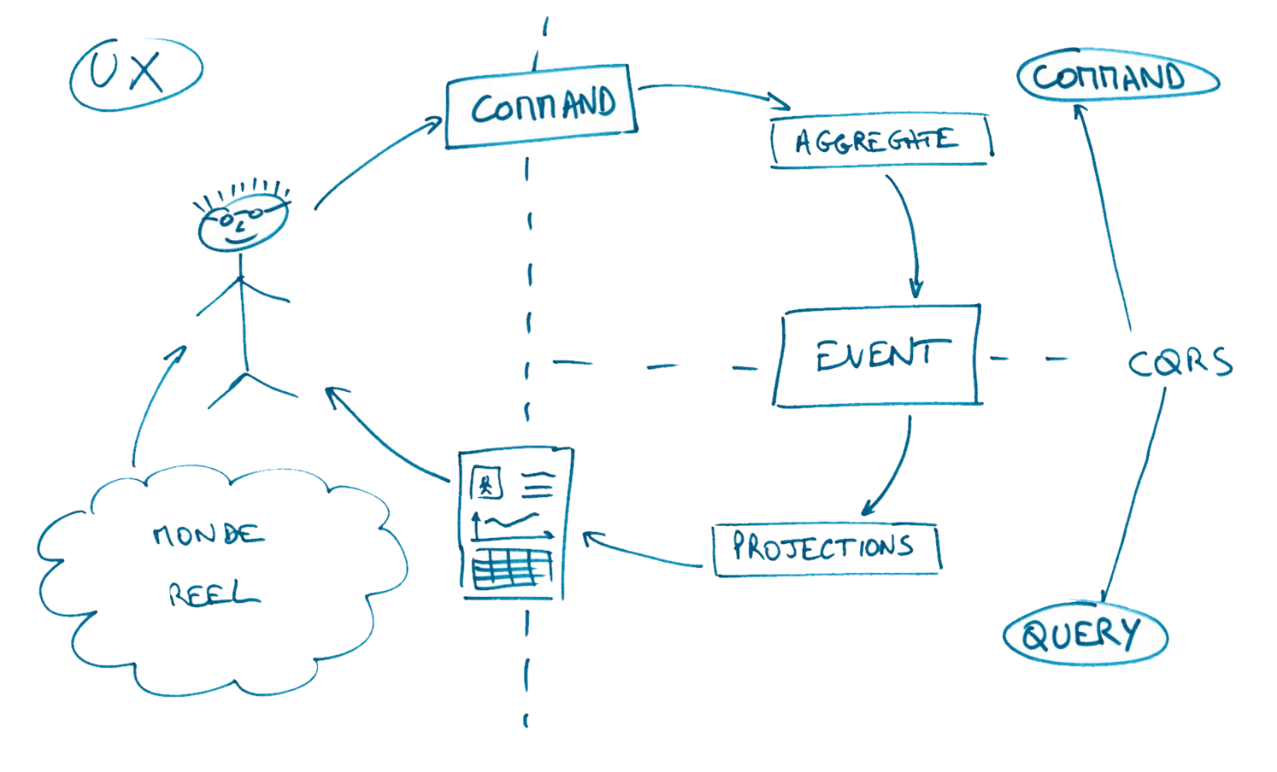
CQRS Concept
Ref. "Conceptual CQRS" - Alberto Brandolini

Slide 4
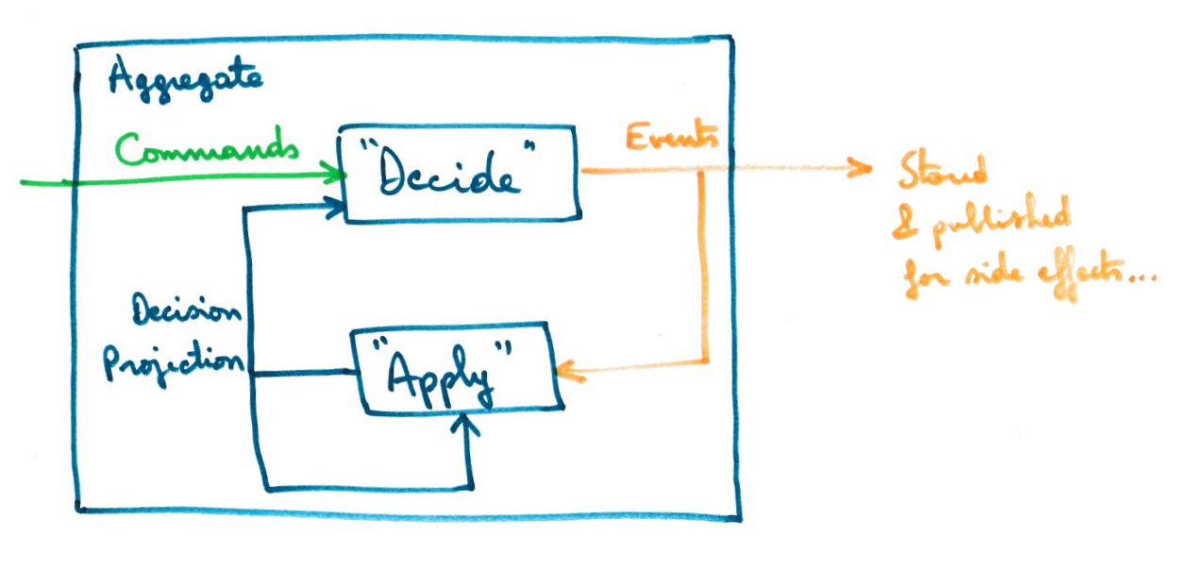
Event Sourcing Concept
NB : DecisionProjection is also called State
Ref. Jérémie Chassaing

Slide 5

The New unicorn!
We’ll revolutionize the web!
We’ll create a product like Twitter but better ...
A revolution!

Slide 6
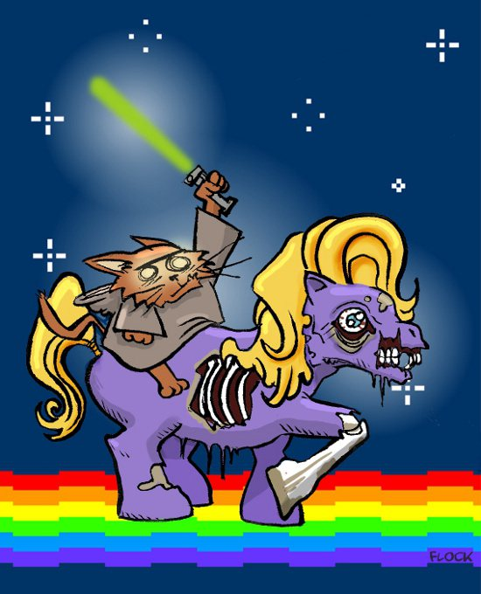
MIXTER
Instead tweet…
we'll quack!

Slide 7
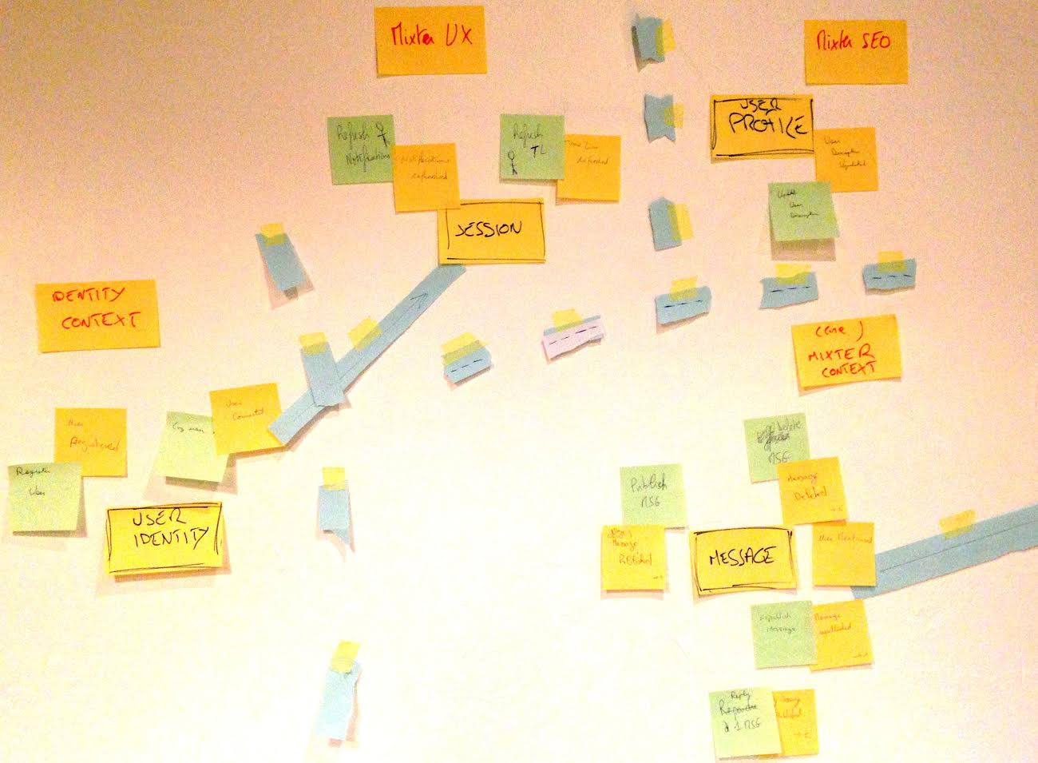
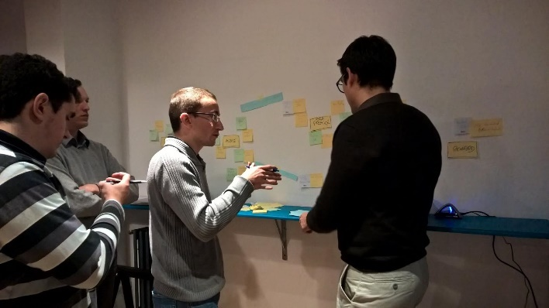
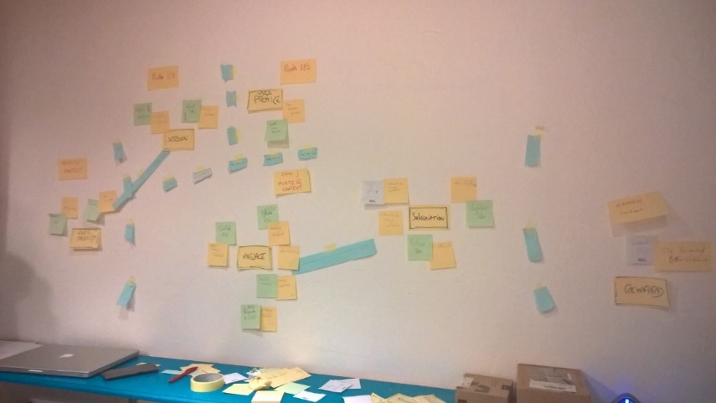
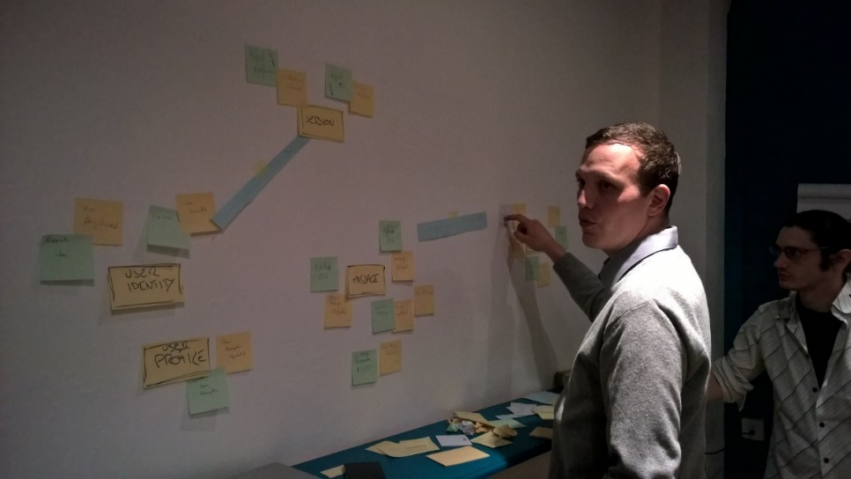
Event Storming Mixter
Ref. "Event Storming" - Alberto Brandolini

Slide 8

Identity context
User description updated
Mixter SEO
Log user
User Connected
Session
Update user description
User Profile
Logout user
User Disconnected
User Identity
Register User
User registered
Followee Message Quacked
Timeline messages
Notify follower
User unfollowed
Unfollow user
Subscription
Message deleted
Message quacked
Follow user
Followers
Delete message
Quack message
User followed
Message
User mentionned
(core)
Mixter context
Reply message
Requack message
Gaming context
Reply Message Quacked
Message requacked
Message rewarded
(>500 republished)
Reward
Reward message

Slide 9
Identity context
User description updated
Mixter SEO
Log user
User Connected
Session
Update user description
User Profile
Logout user
User Disconnected
User Identity
Register User
User registered
Followee Message Quacked
Timeline messages
Notify follower
User unfollowed
Unfollow user
Subscription
Message deleted
Message quacked
Follow user
Followers
Delete message
User followed
Quack message
Message
User mentionned
(core)
Mixter context
Reply message
Requack
message
Gaming context
Reply Message Quacked
Message requacked
Message rewarded
(>500 republished)
Reward
Reward message

Slide 10
Test Driven Workshop
Working in pairs
Execute run script and read instructions
Red test => Green test
3 steps (+2 bonus)
Command DeleteMessage
Query Timeline Message
Events in aggregate

Slide 11
FOCUS ON core Domain
Do not change
Tests code
Infrastructure code
You can see Identity context implementation as example

Slide 12
Repository git
git clone https://github.com/DevLyon/mixter.git
./run
Slide : https://github.com/devlyon/mixter/raw/master/slide.pdf

Slide 13
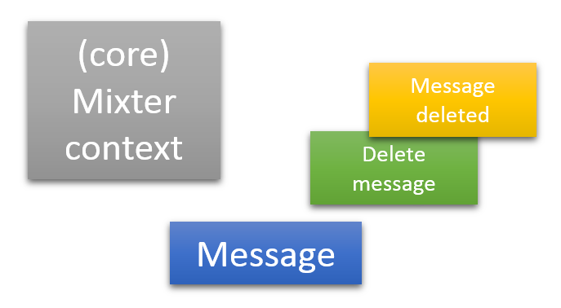

1. Delete Command
What we will learn
publish events from aggregate,
use projection for decision inside aggregate (contains only "state" for future decision, DO NOT keep all state like in an entity)
Implement "business rules" that insure aggregate consistency (based on decision projection and command=method parameters)
In brief : the C of CQRS
Notes:
Additional messages:
Avoid primitive obsession with UserId, MessageId...
A decision leads to events raised => "state" is maintained in DecisionProjection, but just when needed (i.e for future decisions)
For error cases, we can have several strategies : 1) ignore/do nothing, 2) raise an event, 3) throw an exception (not really the best choice)
Tests (and associated tags)
[1.1] message can be deleted​
[1.2] message cannot be deleted by someone else​
[1.3] cannot delete a deleted message​
[1.4] cannot reply to a deleted message​
[1.5] cannot republish a deleted message

Slide 14
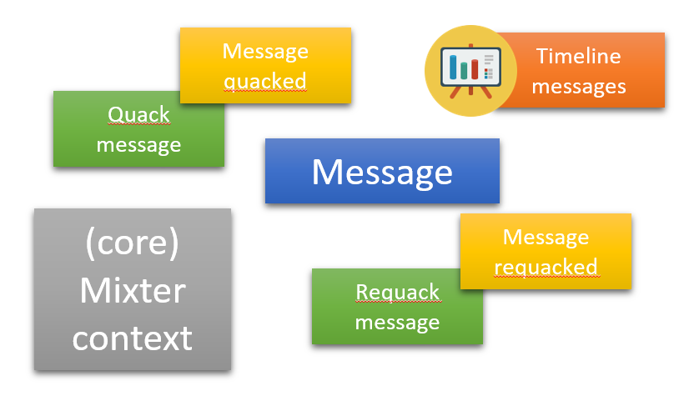

2. Timeline messages Projection
What we will learn
Create another model for Query (Projection, TimelineMessageProjection)
Transform events in a projection model through an EventHandler
A projection repository (in-memory) with its interface is given
In brief : Q of CQRS
Notes:
Additional messages :
develop against interfaces (repository interface)
emergent design & options delaying implementation details to later, like storage (event store & projection store)
projection repositories are more or less like a query side cache, as a side effect (i.e not a justification for CQRS!), it could lead to far more better performance
Tests (and tags):
[2.1] on MessagePublished, add message in author timeline
[2.2] on ReplyMessagePublished, add message in replier timeline
[2.3] on MessageRepublished, increment NbRepublish of message

Slide 15
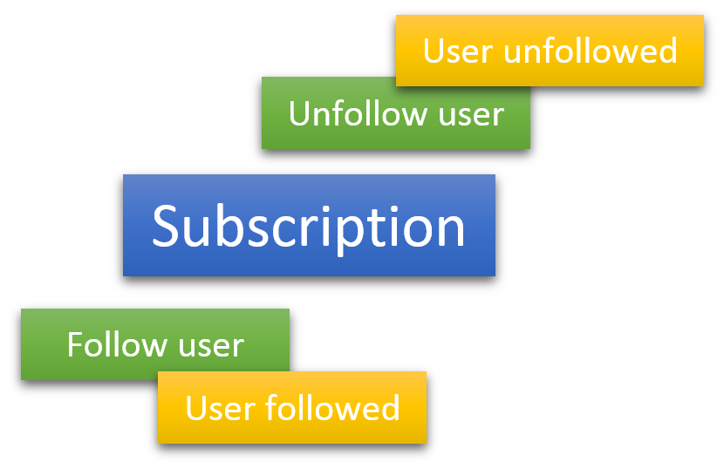
3. Subscription Aggregate
What we will learn
Create a new aggregate (Subscription)
Raise events from it : UserFollowed and UserUnfollowed
Create a decision projection for it
Implement replay of events (event sourced aggregate)
In brief : C of CQRS + Event Sourcing
Notes:
Tests/tags:
[3.1] Follow a user=> Subscription aggregate & UserFollowed
[3.2] Unfollow a user => UserUnfollowed+ DecisionProjection + replay event (used in test for initial UserFollowed)
[3.3] NotifyFollower
[3.4] Cannot NotifyFollower when user have been unfollowed

Slide 16
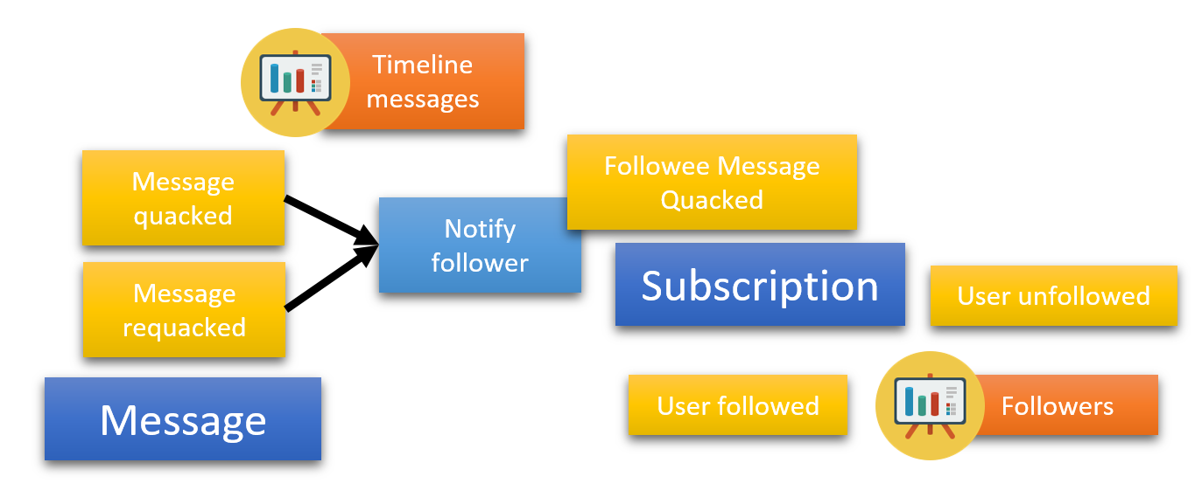
4. Aggregates interaction
What we will learn
Coordinate several aggregates to limit coupling
Concept of " Eventual consistency"

Slide 17

5. Command Handler
What we will learn
Integrate previous code from Message & Identity contexts in a command
Write some web infrastructure code executing the command
Request Rest to execute delete Message command, with session validity verification
NB : no tests for this step for now…

Slide 18
Agilité par le code grâce à CQRS et EventSourcing
THANKS!
Florent @florentpellet
Clément @clem_bouiller
Jean @jeanhelou
Emilien @ouarzy

