Slide 1
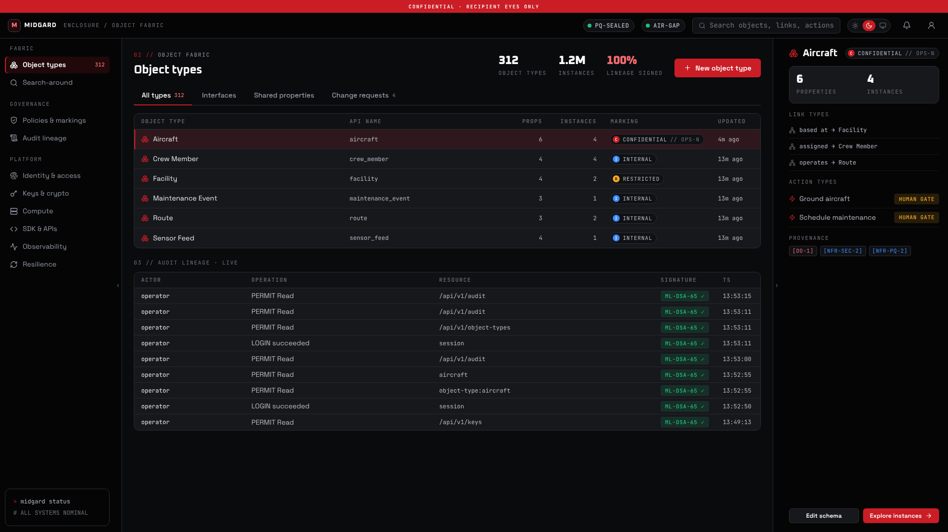
00 // VELDRIS LTD · PRODUCT LAUNCH · SEPTEMBER 2026
MIDGARD.
The sovereign enclosure.
A post-quantum, air-gap-capable platform for your data, your models and your operations. One core, four products, one trust boundary.
PQ-SEALED · ML-KEM-1024
NO EGRESS
AIR-GAP READY
MIDGARD CONSOLE · RECORDED AGAINST THE REAL ENCLOSURE EDGE
Notes:
Welcome. Midgard is a Veldris Ltd product: a sovereign, open-source, post-quantum data and decision platform, built against a complete specification: five services run today and the rest is tested as libraries. Over the next twenty minutes I will show you what it is, watch it run end to end, and be precise about what is proven today and what still stands between this release candidate and general availability. (≈1 min)

Slide 2
01 // AGENDA
Twenty minutes, five parts
01
02
03
04
05
The problem
The platform
Live demo
Proof
Where we are
Why sovereign data platforms are overdue
One enclosure, four products, one trust boundary
The real edge, the consoles, a human-gated action
Post-quantum by default, and the verification record
Release status, blockers and the next 90 days
2 MIN
6 MIN
5 MIN
4 MIN
3 MIN
MIDGARD · VELDRIS LTD · LAUNCH 2026
02
Notes:
Five parts. The problem we are solving, the platform itself, a recorded live demo of the software running, the security and verification evidence, and an honest statement of where the release stands. Questions are welcome at the end. (≈0.5 min)

Slide 3



02 // THE PROBLEM
Three pressures on every serious data platform
Platforms that phone home
Harvest now, decrypt later
Lock-in without visibility
Analytics, AI and delivery tooling assume an always-on cloud and a vendor in the loop. For regulated, defence and critical-infrastructure work, that is disqualifying.
Traffic and archives captured today will be readable once large quantum computers exist. NIST finalised FIPS 203, 204 and 205 in 2024. Migration is a multi-year programme, and it has to start with the platform.
The incumbent is closed, hosted and expensive. You cannot audit what it does with your data, reproduce its builds, or take your ontology with you when you leave.
MIDGARD ANSWERS WITH · SOVEREIGNTY
MIDGARD ANSWERS WITH · POST-QUANTUM
MIDGARD ANSWERS WITH · OPEN CORE
Midgard was built to answer all three at once: no outbound dependency, post-quantum cryptography applied by default, and an Apache-2.0 core with reproducible builds.
MIDGARD · VELDRIS LTD · LAUNCH 2026
03
Notes:
Three pressures. First, the tooling organisations use for analytics, AI and software delivery assumes an always-on cloud; for regulated, defence and critical-infrastructure work that is disqualifying. Second, harvest-now-decrypt-later: traffic and archives captured today become readable once quantum computers mature, and NIST has already finalised the replacement algorithms, so migration is now a programme, not a research topic. Third, the incumbent platform is closed, hosted and opaque. You cannot audit what it does with your data and you cannot leave easily. Midgard was designed to answer all three at once. (≈2 min)

Slide 4
03 // THE PLATFORM
One core platform, four composable products
FORGE
MIMIR
BIFROST
HEIMDALL
Data operations
Local agentic AI
Continuous delivery
Operational fusion
Ingest, transform, version, project to the fabric
In-enclosure inference, grounding, agents, evals
PQ-signed artefacts, rings, fleet, offline bundles
Feeds, one common picture, decision workflows
MIDGARD
The enclosure: identity, object/ontology fabric, storage, compute, governance, PQ crypto substrate
Admin Control Panel
Client platforms
Role-separated RBAC and no super-admin. Dual control is live for enrolment; break-glass and the rest are tested libraries
One shared Rust core, tested as a library: offline-first sync, tiered inference. Six shells are specified, not built
MIDGARD · VELDRIS LTD · LAUNCH 2026
04
Notes:
Midgard is the core platform: the enclosure. Identity, the object and ontology fabric, storage, compute, governance and post-quantum cryptography by default. It is the foundation every product builds on. On top sit four independently useful products, each with its own domain: Forge for data operations, Mimir for local agentic AI, Bifrost for continuous delivery, and Heimdall for operational fusion. Two cross-cutting layers complete it: a self-governing admin control panel with no super-admin, and native mobile, desktop and web clients. (≈1.5 min)

Slide 5






04 // DESIGN PRINCIPLES
Enforced by construction, not by policy document
Sovereign by construction
Post-quantum by default
Object fabric at the centre
No core function makes an outbound call. The full acceptance gate runs under --network none and passes.
Hybrid X25519 + ML-KEM-768 in transit; AES-256-GCM under ML-KEM-1024-wrapped keys at rest; ML-DSA and SLH-DSA signatures.
Objects, properties, links, actions and dynamic security: a decision-centric semantic layer, the answer to Ontology.
Local AI native
Provenance everywhere
Open-source core
Mimir serves every model in-enclosure. Products call Mimir, never a hosted LLM. Signed model manifests, verified before serving.
Every claim has a source, every action has lineage. Append-only signed audit and human gates are first-class.
Apache-2.0. Reproducible builds, a CycloneDX SBOM per release, every binary signed and attested.
MIDGARD · VELDRIS LTD · LAUNCH 2026
05
Notes:
Six principles, and each one is enforced by construction rather than by policy document. Sovereign: no core function requires an outbound call, and the build and the test suite run under docker network none. Post-quantum by default: hybrid ML-KEM in transit, ML-KEM-wrapped keys at rest, ML-DSA signatures everywhere. The object fabric is the centre, not a bolt-on. Every product calls Mimir for AI, never a hosted model. Every claim has a source and every action has lineage. And the core is open: Apache-2.0, reproducible builds, a CycloneDX SBOM with every release. (≈1 min)

Slide 6
05 // ARCHITECTURE
One boundary. Everything inside it.
THE ENCLOSURE · AIR-GAP BOUNDARY · NO OUTBOUND CALL REQUIRED
Operators & clients
Edge · http-gateway
Enclosure core
Forge worker
Console · API · client core
Shells specified, not built
TLS 1.3 / PQ-mTLS to the edge
Policy decision point
ML-DSA-signed session tokens
Uniform 401, per-object filtering
IAM · Object fabric · KMS
Governance: one PQ-signed ledger
Sealed, append-only journals
connectors · datasets · projection
Mimir server
signed models · guardrails · agents
PQ-mTLS SERVICE MESH · HYBRID X25519 + ML-KEM-768
Admin Control Panel
Bifrost fleet
External sources
EGRESS
artefacts · rings · bundles
PostgreSQL · S3 · Kafka
via the egress broker: TLS 1.3, pinned CA
Dual control on enrolment today · no super-admin · break-glass and signed configuration are tested libraries, not yet served
Heimdall feed
Deployment
signed observations · fused picture
Air-gapped sites
BUNDLE
Laptop (dev mode) · docker compose (5 services) · Kubernetes via Helm (hardened pods, default-deny network) · signed air-gap bundle for disconnected sites
Signed .mgbundle on media; every artefact is verified offline before install
Every hop audited
one ledger, ML-DSA-65, re-verified on start
MIDGARD · VELDRIS LTD · LAUNCH 2026
06
Notes:
The shape of a deployment. Operators reach the enclosure through one edge, the HTTP gateway, which terminates TLS and issues ML-DSA-signed session tokens. Behind it the core composes identity, the object fabric, key management and the governance ledger in one process, so edge admission and every fabric call land in a single PQ-signed ledger. The four product services talk to the core and to each other only over PQ-mTLS, each with a certified mesh identity. The only things that cross the boundary are deliberate: Forge reaches external sources through an egress broker with a pinned CA per route, and Bifrost carries releases into air-gapped sites as signed bundles that verify themselves offline. (≈1.5 min)

Slide 7
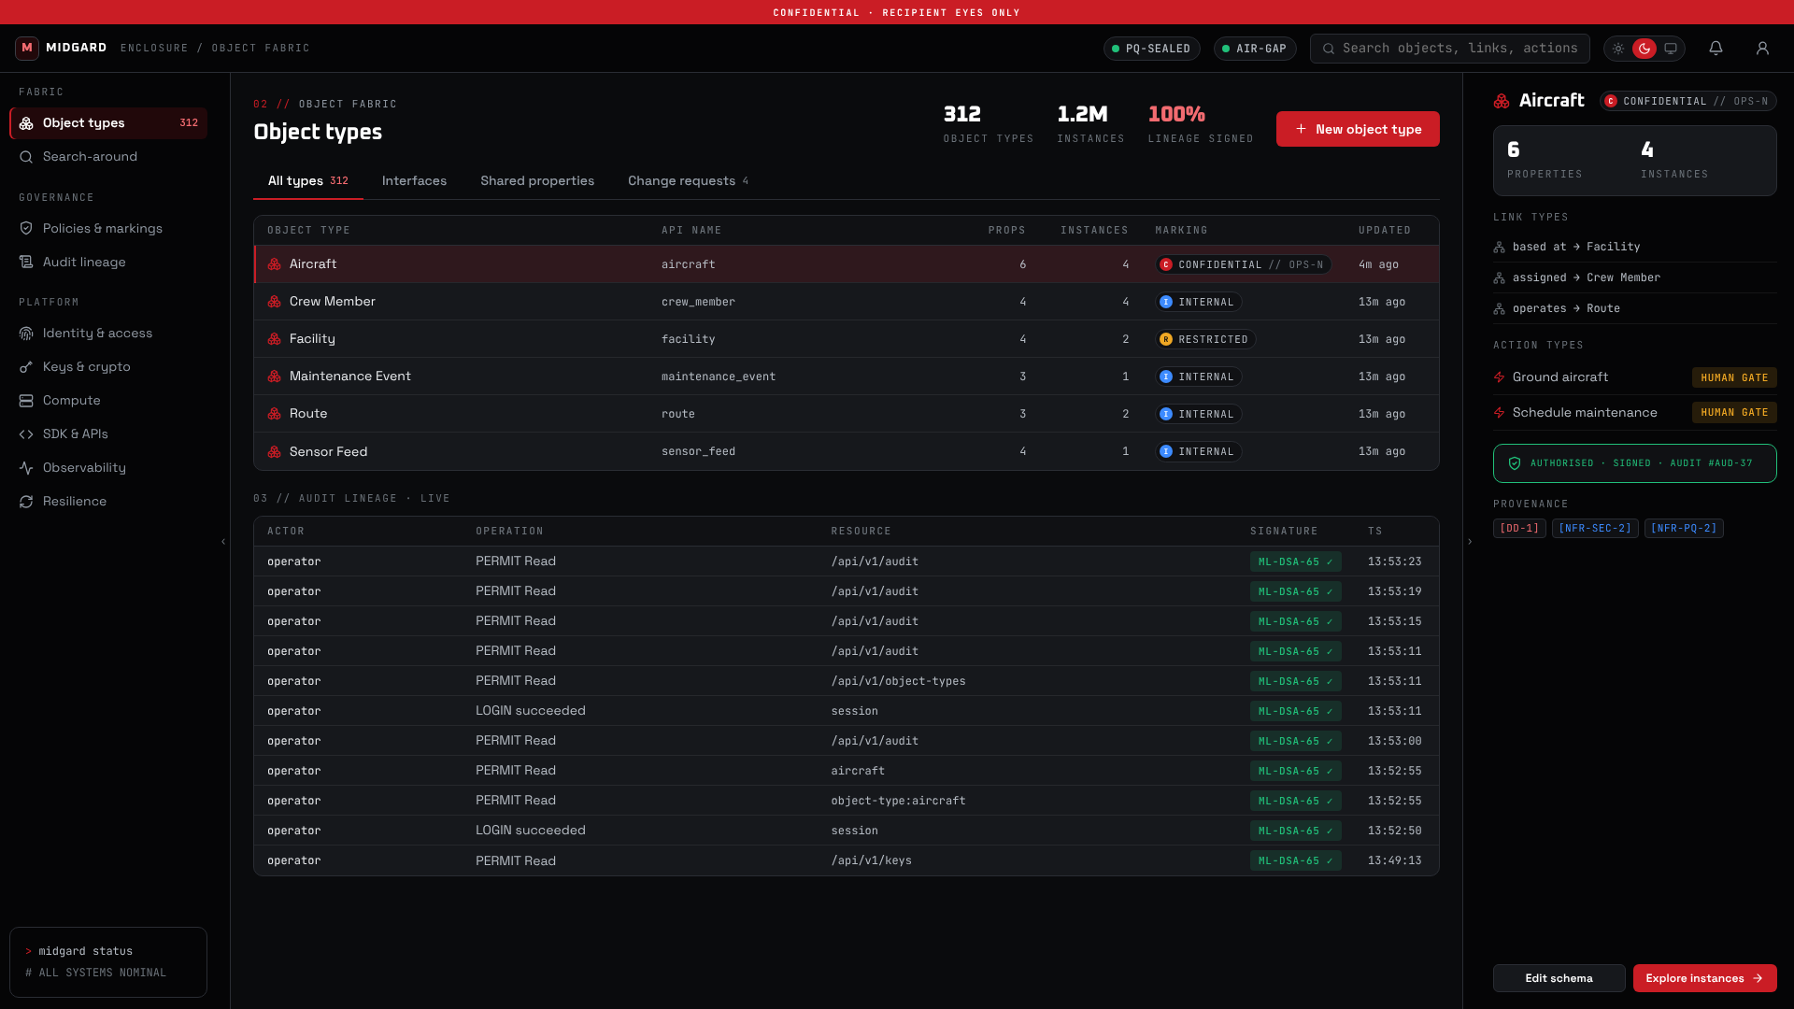
06 // THE ENCLOSURE · OBJECT FABRIC
Your organisation, described once
Objects, properties and links: aircraft, facilities, crew, sensor feeds as real things, not rows in a table.
Markings (clearance band plus compartment) and purposes are enforced per object at query time. What you cannot read never appears.
Actions are typed and policy-authorised, and gated by default: refused without a human-gate token. Tying that token to a named person is still to do.
Every response carries the audit id of the signed ledger entry that authorised it.
Schema comes from an ontology file; data is imported offline and validated against it, all or nothing.
MIDGARD CONSOLE · HUMAN-GATED ACTION AUTHORISED AGAINST THE REAL EDGE
MIDGARD · VELDRIS LTD · LAUNCH 2026
07
Notes:
This is the Midgard console against the real edge. The left panel is the object-type registry; the inspector on the right shows an object type, its links and the actions a person may take. Ground aircraft is human-gated: the first attempt is refused with a human-gate-required error, an operator authorises it, and the authorisation comes back with the audit id that recorded it. The same flow works from the API with curl. (≈1 min)

Slide 8
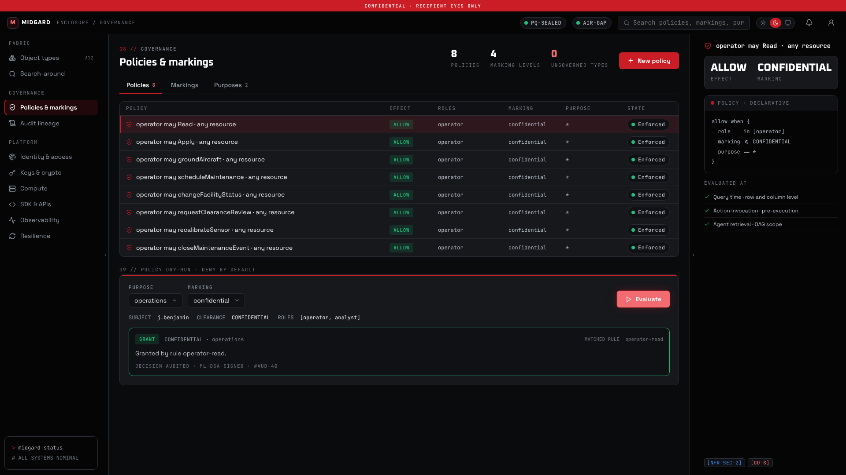
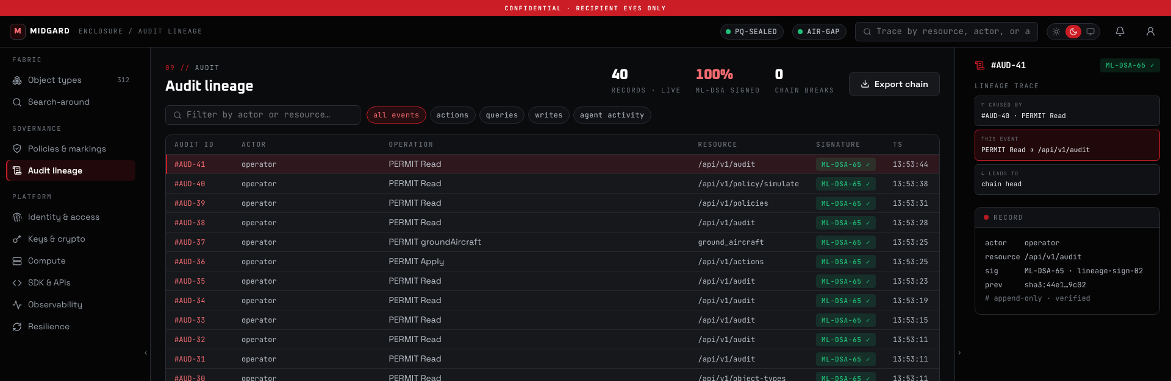
07 // THE ENCLOSURE · GOVERNANCE
Access is proven, not assumed
Deny by default. Role, marking and purpose must all match a written rule; mandatory access control runs first.
Dry-run any decision before it goes live. The decision is ML-DSA-signed and audited like everything else.
One append-only ledger for reads, writes and actions at the edge, re-verified on every start.
Fail closed. A tampered ledger, keystore or policy file stops the service from starting.
POLICY DRY-RUN AND AUDIT LINEAGE · EVERY ENTRY RE-VERIFIED · ML-DSA-65
MIDGARD · VELDRIS LTD · LAUNCH 2026
08
Notes:
Governance is the spine, not a report. Policy is deny by default: role, marking and purpose must all match a written rule, mandatory access control runs first, and anything not granted is denied. You can dry-run a decision for a subject, clearance and purpose before it goes live, and the decision itself is ML-DSA-signed. Every read, write and action at the edge lands in one append-only ledger, and the service re-verifies that ledger on every start: a tampered ledger, keystore or policy file stops it from starting. (≈1 min)

Slide 9
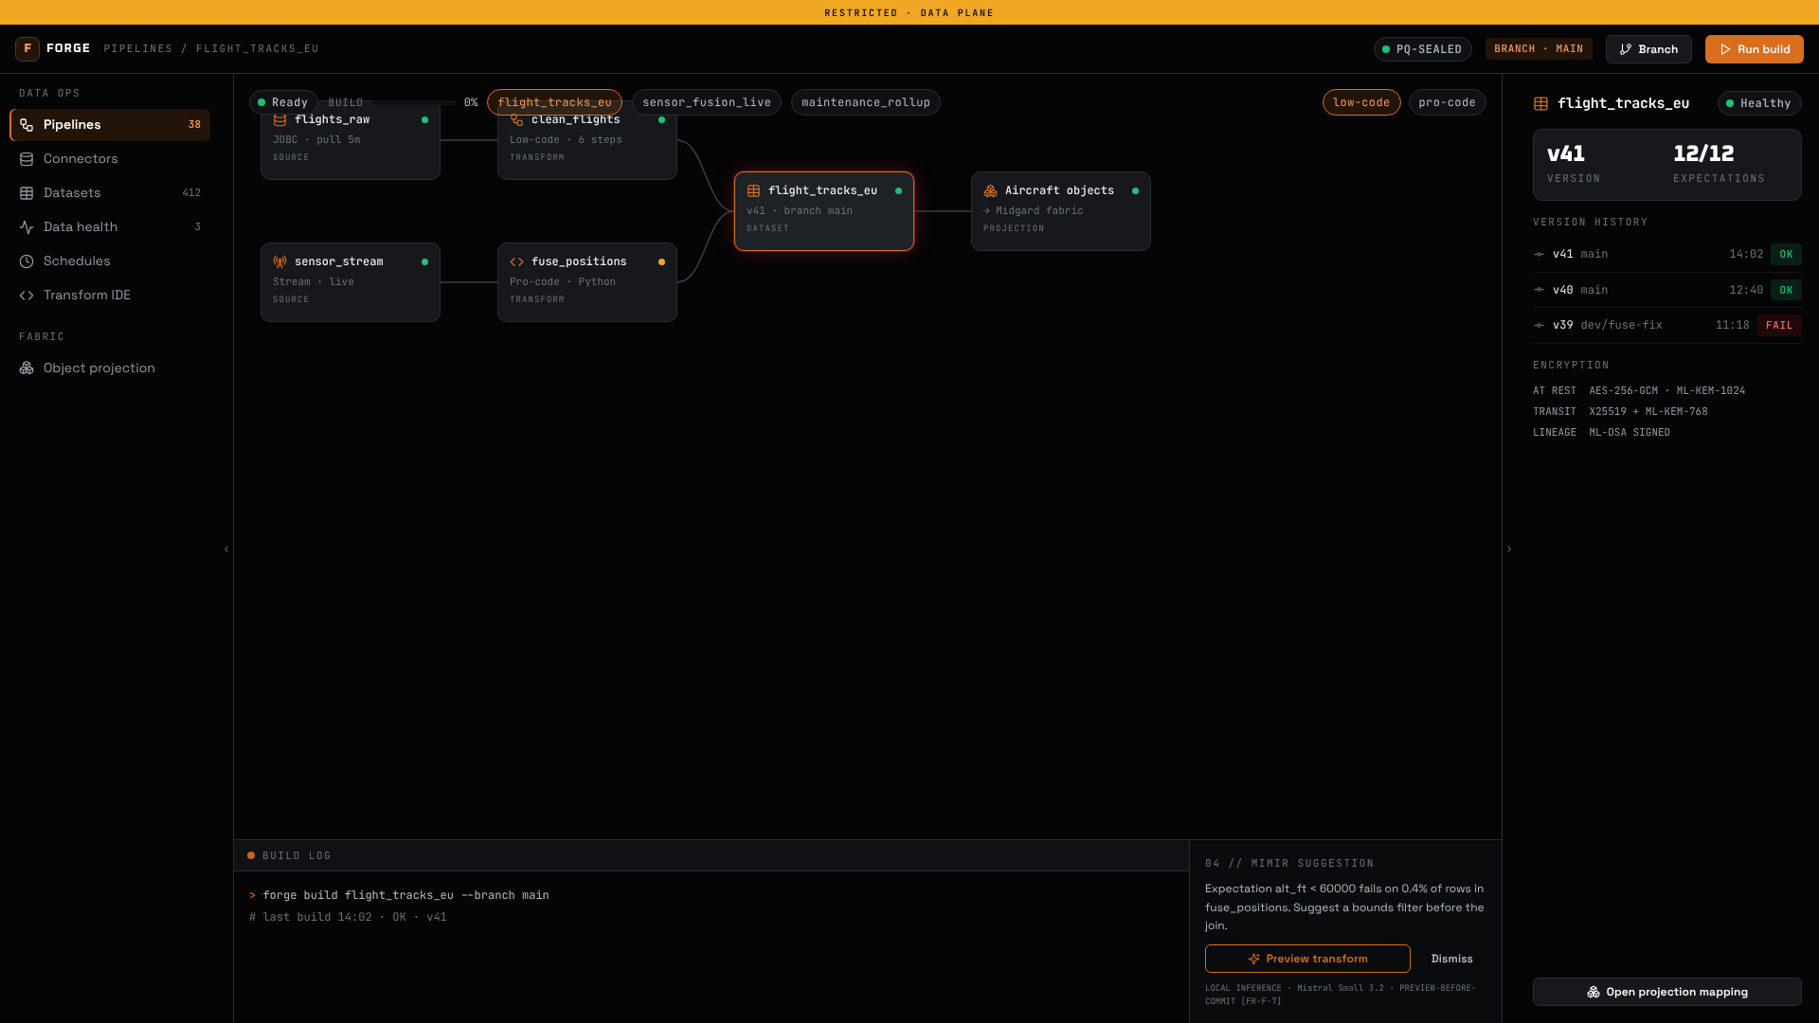

08 // FORGE · DATA OPERATIONS
Getting data in, without losing track of it
Connectors for PostgreSQL, S3 and Kafka, syncing incrementally from checkpoints inside an air-gapped sandbox.
Sources outside the enclosure are reached only through the egress broker: TLS 1.3, one pinned CA per route.
Datasets are content-addressed and versioned with ingest lineage; an unchanged source is the same version.
Expectation checks that block promotion are a tested library; the running worker does not apply them yet.
A pure-Rust partitioned compute engine: join, aggregate, sort and window, with spill to disk.
FORGE CONSOLE · PIPELINE BUILDER · BUILT-IN SAMPLE DATA
MIDGARD · VELDRIS LTD · LAUNCH 2026
09
Notes:
Forge is the data-operations product. Draw a pipeline or write it in code; either way every build is repeatable and versioned like source control. The worker service already runs: it reads a source, commits rows to a sealed dataset store, projects them onto the ontology and syncs them into the fabric through the gateway's PQ-mTLS door. Connectors have been tested against real PostgreSQL 16 and MinIO. (≈1 min)

Slide 10
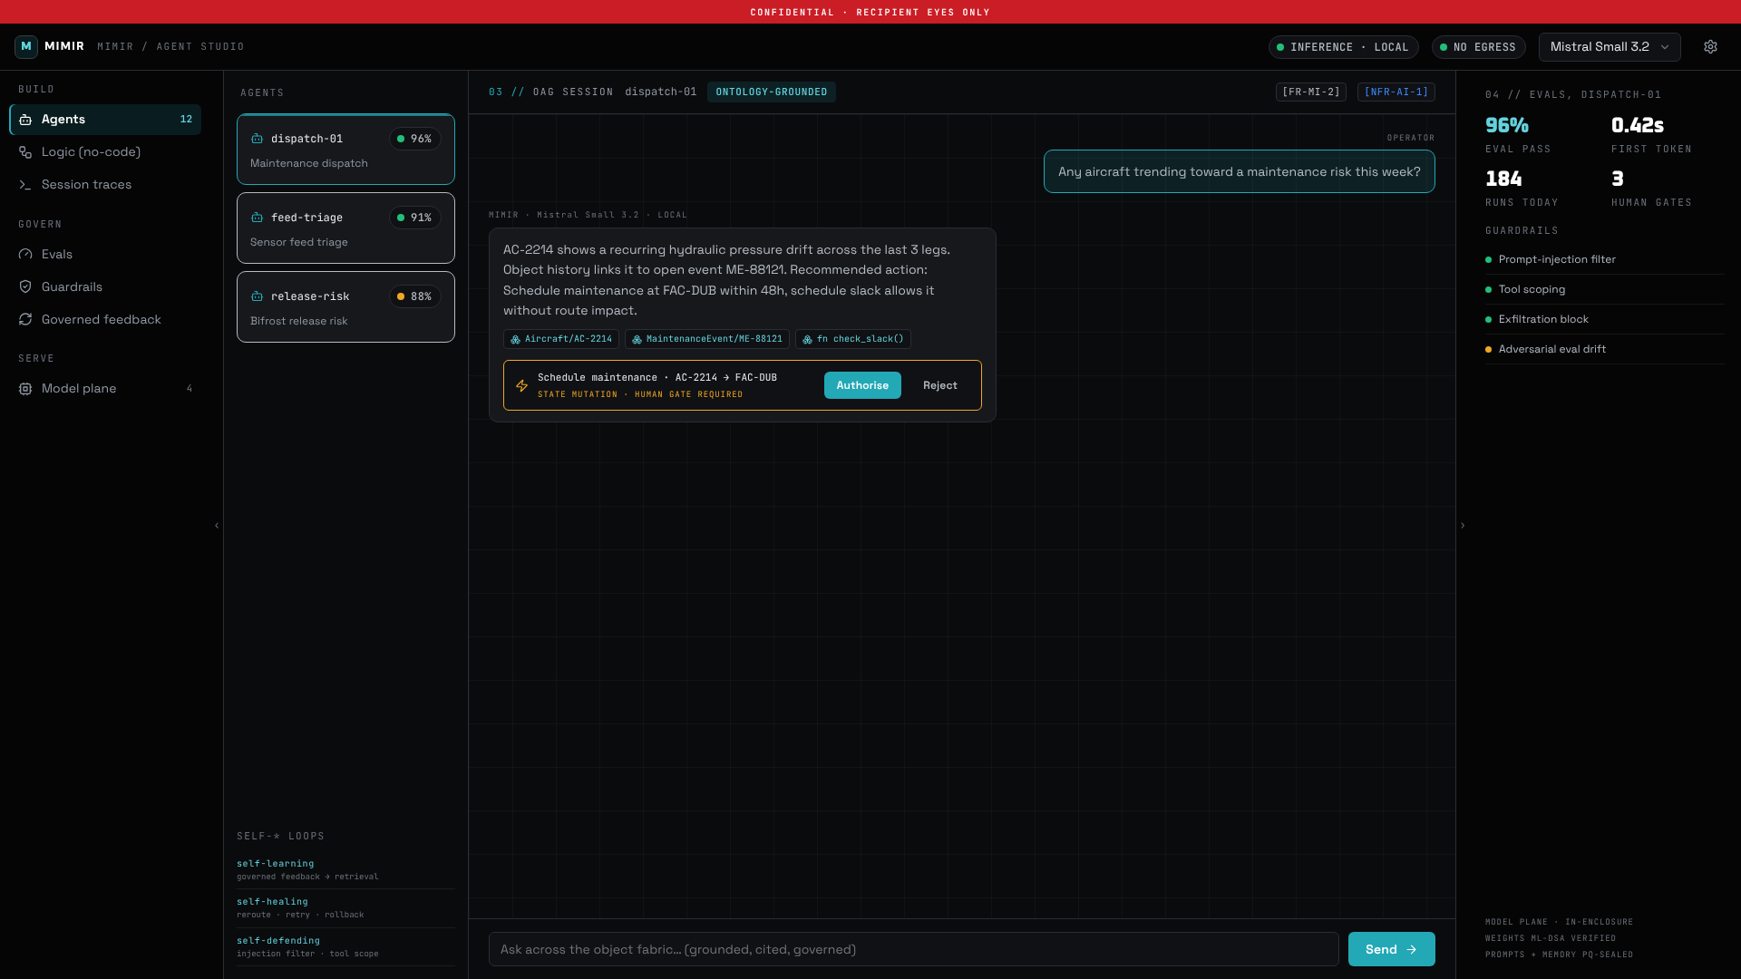

09 // MIMIR · LOCAL AGENTIC AI
AI that never phones home
All inference runs in-enclosure over PQ-mTLS. Every product calls Mimir; nothing calls a hosted model.
A model loads only from a signed manifest whose weights stream to the signed digest. One changed byte and the service refuses to start.
Granite 3.3 2B Instruct (Apache-2.0) served on llama.cpp today: first token in 325 ms on a 12-core CPU. vLLM on GPU is wired, not yet run.
Grounded, cited answers and input guardrails are tested libraries. The running service answers a prompt without retrieval.
AI proposes, humans dispose: in the agent loop, a tested library, no consequential action runs without a recorded human decision.
MIMIR CONSOLE · AGENT STUDIO · BUILT-IN SAMPLE DATA
MIDGARD · VELDRIS LTD · LAUNCH 2026
10
Notes:
Mimir is the local AI product. The inference plane is a running service: a certified caller opens a PQ-mTLS channel, policy decides whether it may infer, and every call, permitted or denied, is written to a sealed ledger the service re-verifies on restart. We have run a real model end to end: Granite 3.3 2B on CPU, staged from a signed manifest. (≈1 min)

Slide 11
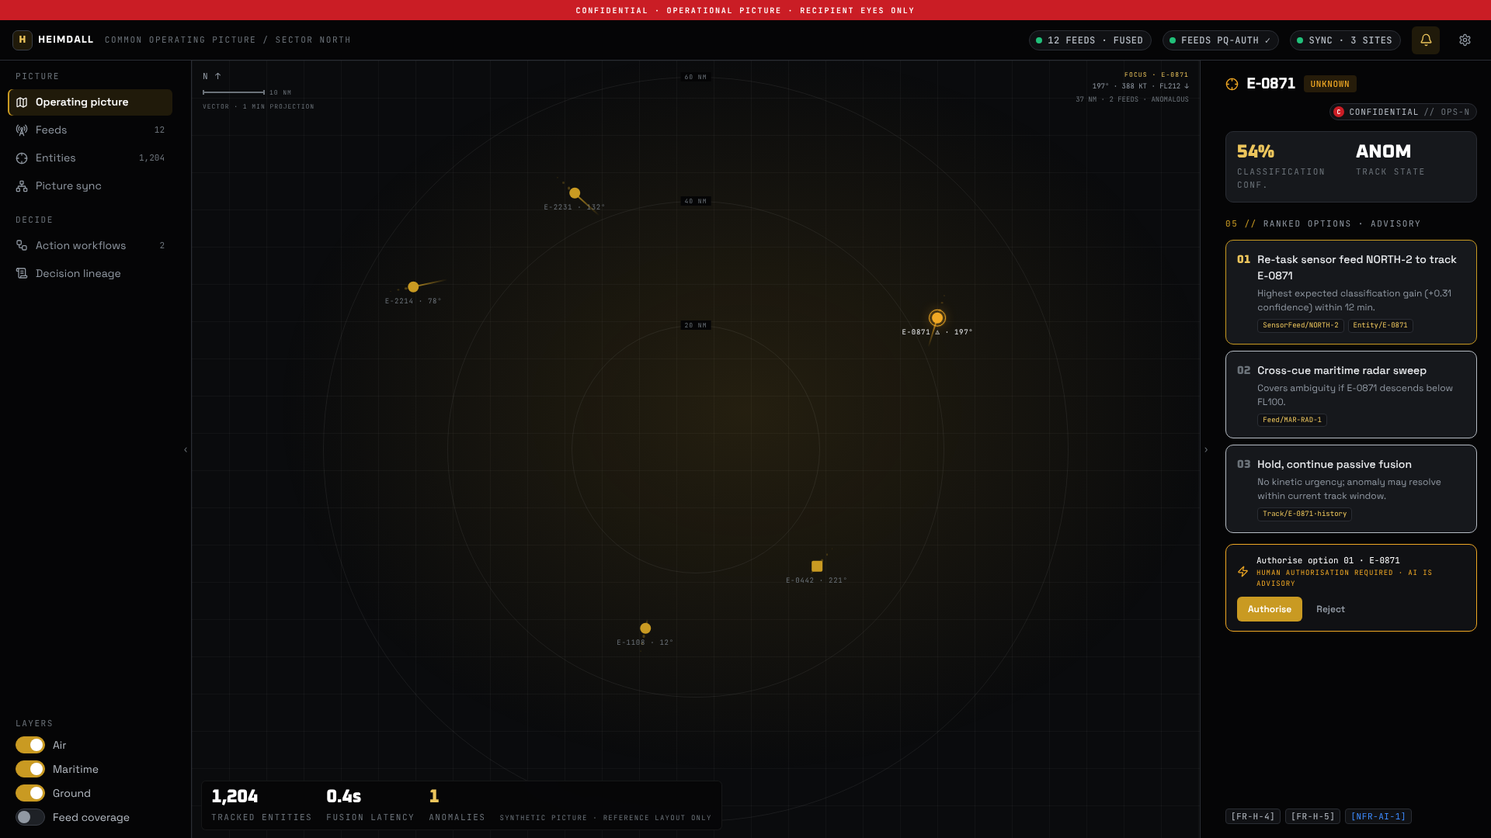

10 // HEIMDALL · OPERATIONAL FUSION
Many feeds, one picture everyone shares
Sources submit observations signed with their certified mesh key; an observation is fused only if policy, feed identity, signature and audit all pass.
Observations sharing an entity key fuse into one tracked entity with contributing feeds, first and last seen, and latest attributes.
The picture is sealed at rest after each change and recovered on restart; analysts read it as JSON or in the console.
Ranked, cited options and human-authorised workflows are tested libraries. The running service does not generate options yet.
HEIMDALL CONSOLE · COMMON OPERATING PICTURE · SYNTHETIC REFERENCE LAYOUT
MIDGARD · VELDRIS LTD · LAUNCH 2026
11
Notes:
Heimdall is the operational-fusion product. The feed gateway runs as a service today: a source with a certified identity signs its observations, four checks gate each one, refusals are audited too, and the fused picture survives a restart. The console view here is the product's own synthetic reference layout. (≈0.75 min)

Slide 12
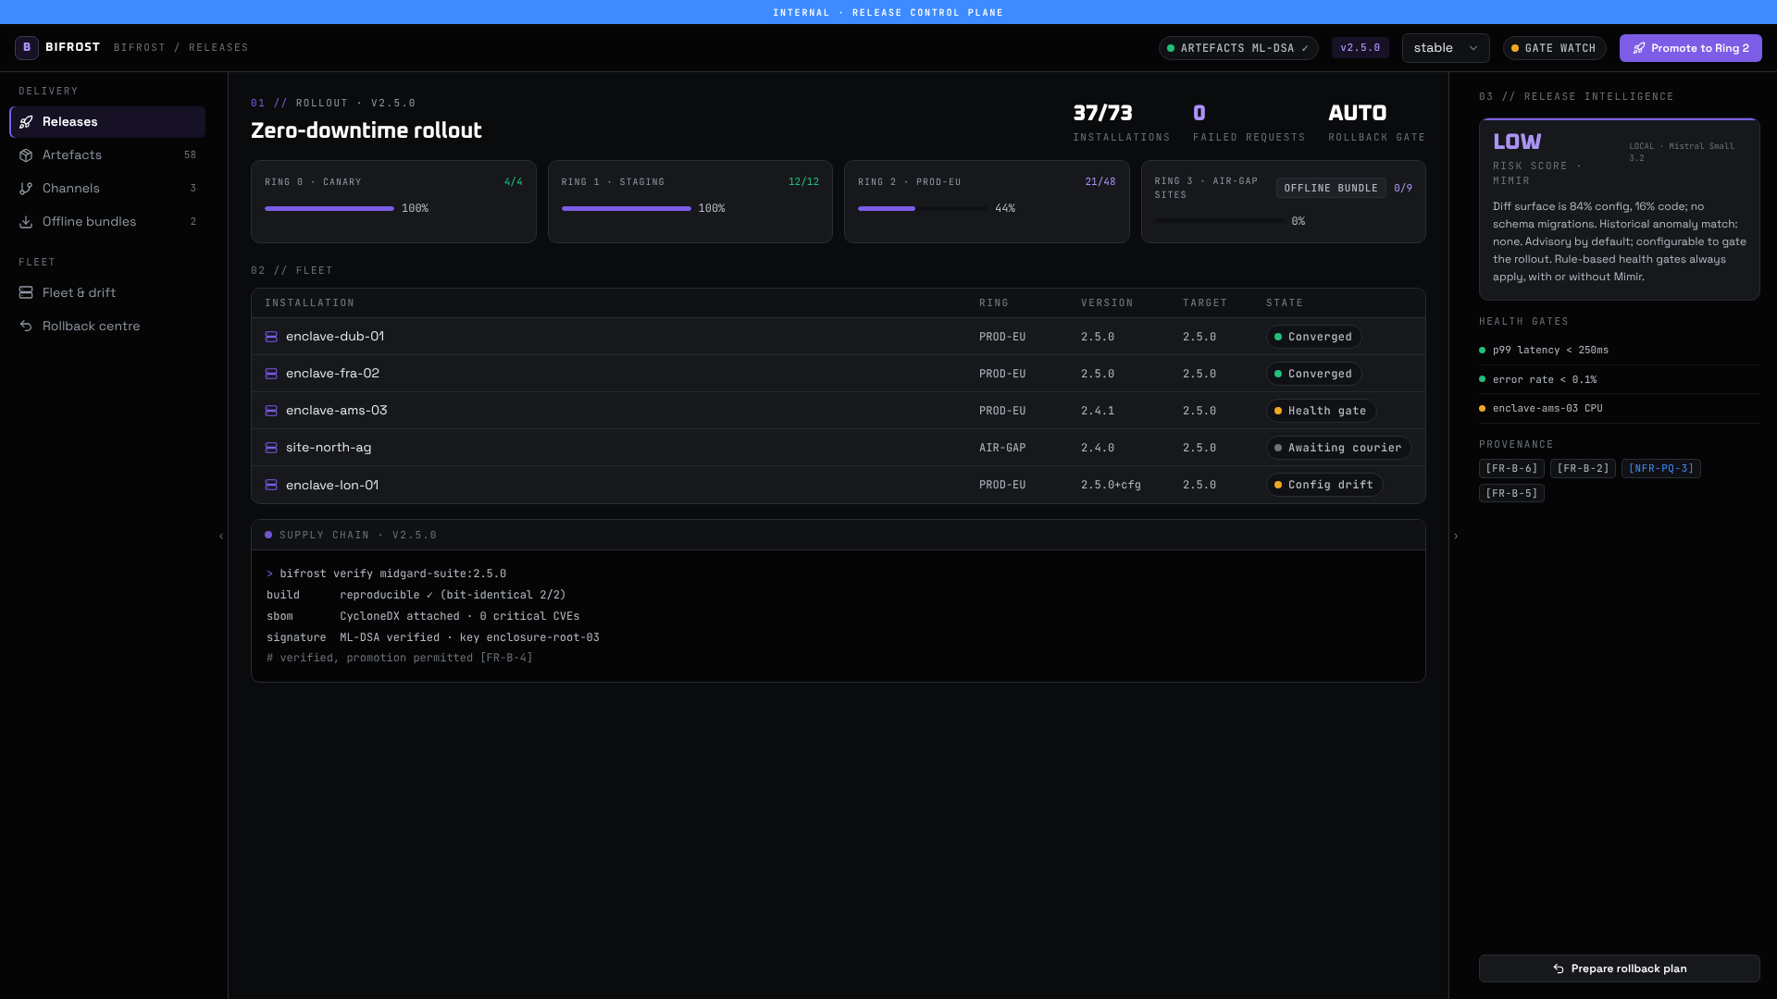

11 // BIFROST · CONTINUOUS DELIVERY
Nothing deploys unless it proves itself
Every binary is rebuilt bit-for-bit, gets a CycloneDX SBOM, an offline CVE and licence scan, an ML-DSA signature and an attestation, in that order, each gate fail-closed.
Services ship as verify-before-run images: the binary is re-verified inside the container before it starts.
Ring-by-ring rollout with health gates and automatic rollback is a tested library. Services run one replica today.
The fleet manager records every installation's version, liveness and drift from its channel over PQ-mTLS.
Air-gapped sites receive one signed bundle on media. It verifies itself offline and streams a model's weights without holding them in memory.
BIFROST CONSOLE · RELEASE CONSOLE · BUILT-IN SAMPLE DATA
MIDGARD · VELDRIS LTD · LAUNCH 2026
12
Notes:
Bifrost is the continuous-delivery product, and it is also how Midgard itself ships. The release pipeline has been rehearsed end to end: all eighteen binaries gated, six images built and started through their own verifying entrypoints, a fifty-four-artefact bundle packed and installed on a cluster, and an image with one changed byte refusing to start. (≈0.75 min)

Slide 13
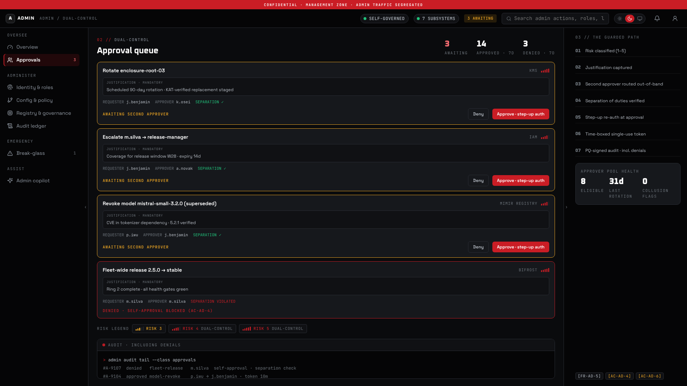
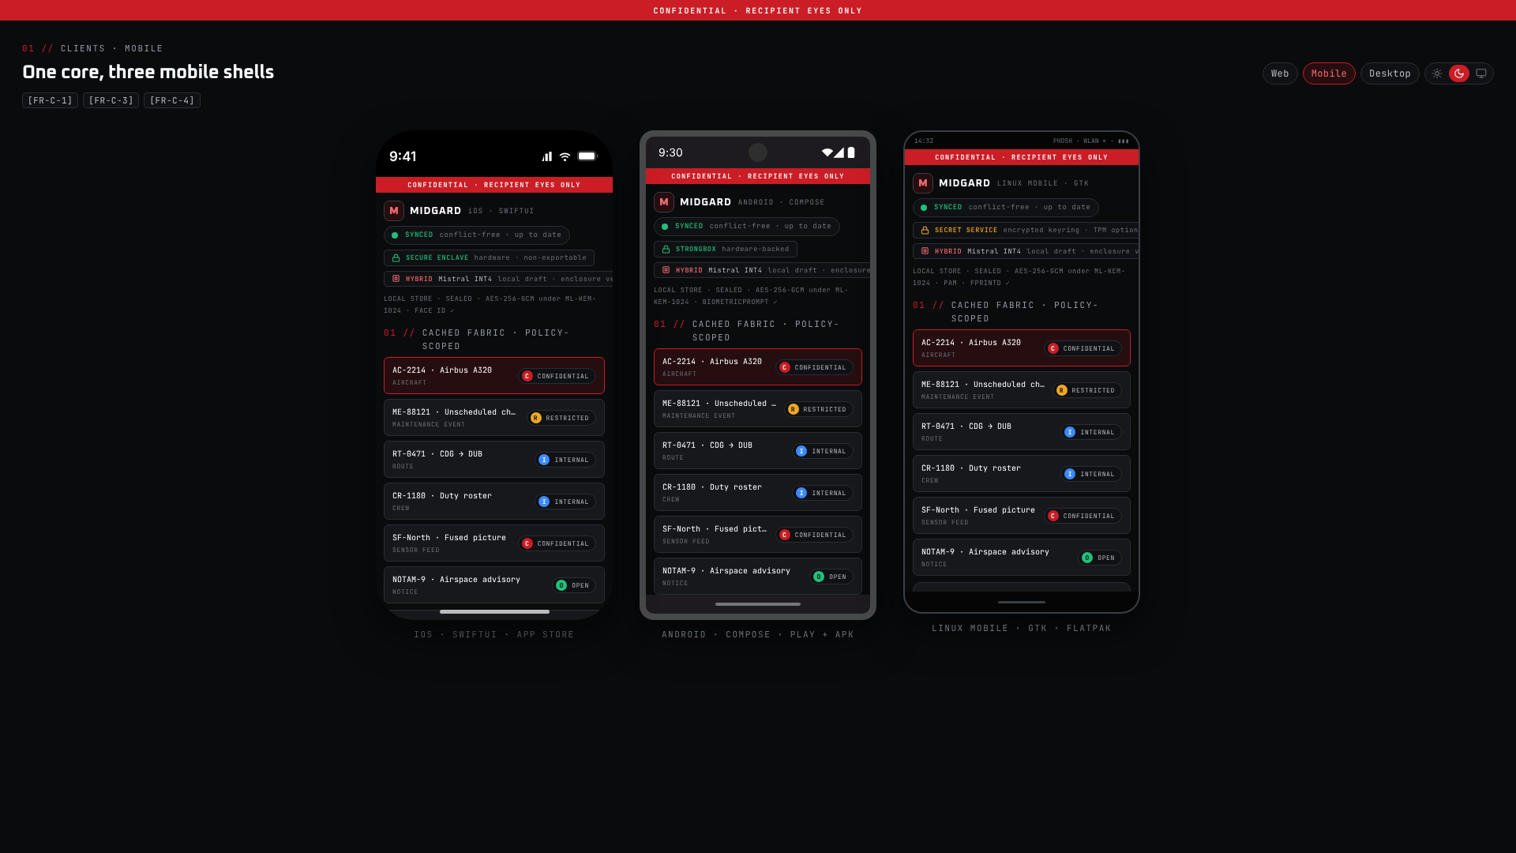
12 // CONTROL & REACH
No single person can do the dangerous things. And it works where the work happens.
Admin Control Panel
Client platforms
Dual control with a second, different approver: live for enrolment, a tested library for other high-risk changes. Break-glass is a tested library.
One shared core, tested as a library. Native, desktop, web and extension shells are specified in SAD_06; none is built, so no key is held in device hardware.
MIDGARD · VELDRIS LTD · LAUNCH 2026
13
Notes:
Two cross-cutting layers. The admin control panel is designed to govern itself: role-separated RBAC with no super-admin, and dual control, which is live today for enrolling a principal. The guarded-action orchestrator, break-glass and its alerts are tested libraries, and the console runs on sample data. And the client platforms: one shared core, tested as a library, with offline-first, conflict-free sync. The native, desktop and web shells are specified and not built yet. (≈0.75 min)

Slide 14
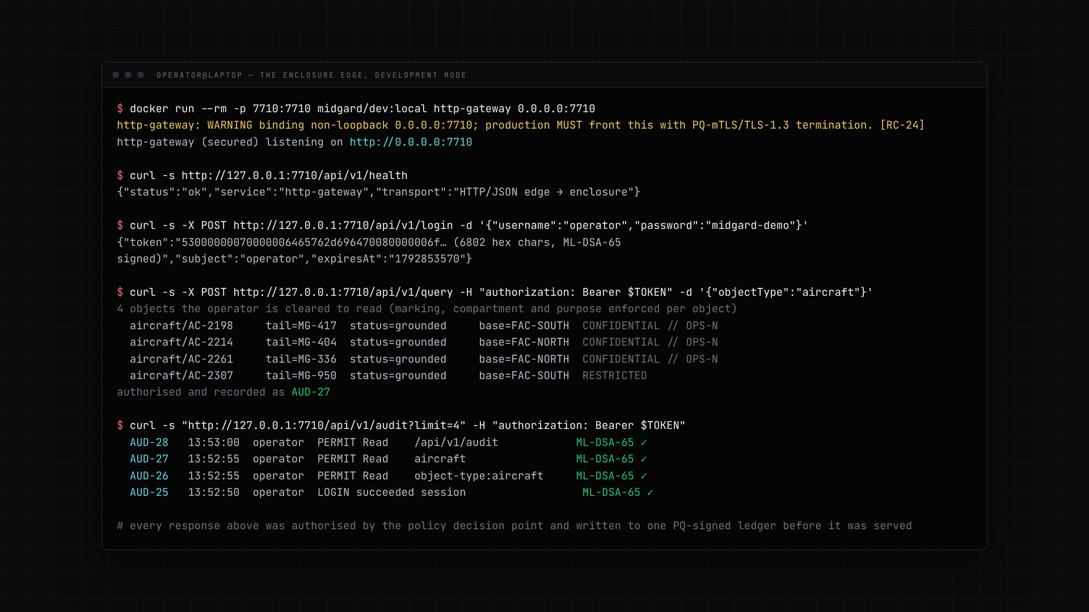
13 // LIVE DEMO
The enclosure edge, end to end
What you will see
01
The edge starts in a container. Login returns an ML-DSA-signed token; a query returns only the objects the operator is cleared for, with the audit id that authorised it.
02
Object fabric. "Ground aircraft" is refused until a person authorises it, then the authorisation itself is audited.
03
Policy dry-run and audit lineage. Every entry from the session is already there, each one ML-DSA-65 verified.
04
Forge, Mimir, Heimdall, Bifrost, Admin and the client shells, on built-in sample data.
MIDGARD-LAUNCH-DEMO.MP4 · 1920×1080 · 3 MIN 35 S · CLICK TO PLAY
MIDGARD · VELDRIS LTD · LAUNCH 2026
14
Notes:
Play the video. It is about four minutes and it was recorded against the software as it is: the Midgard console is talking to the real Rust edge running in a container, and the other consoles run on their built-in sample data. Watch for three things: the token that comes back from login is post-quantum signed; the grounding action is refused until a person authorises it, and the authorisation is audited; and every ledger entry shows as re-verified. If the embedded video will not play, open midgard-launch-demo.mp4 beside the deck. (≈5 min)

Slide 15
14 // POST-QUANTUM BY DEFAULT
Every layer, already migrated
LAYER | MECHANISM | STANDARD
In transit | PQ-mTLS between every service and at the edge: hybrid X25519 + ML-KEM-768, session resumption, certified workload identities | NIST FIPS 203
At rest | AES-256-GCM data keys wrapped under ML-KEM-1024 custody roots; every stateful store is a sealed, append-only journal | FIPS 203 · SP 800-38D
Identity & tokens | ML-DSA-65 for issuer, audit and mesh keys; ML-DSA-signed session tokens and admin passkeys | NIST FIPS 204
Release signing | ML-DSA-87 release key; ML-DSA-65 Bifrost admission key; SLH-DSA available for long-lived artefacts | FIPS 204 · FIPS 205
Agility | Pluggable backends; the FIPS backend passes ACVP known-answer tests in-repo; backends are mutually exclusive at compile time | ACVP KATs
Fail closed, everywhere
Signature verification, policy enforcement, journal replay and certificate revocation all refuse rather than degrade. A tampered ledger stops the service. A changed weight byte stops the model. A changed image byte refuses to start.
THREAT MODEL · docs/security/THREAT_MODEL.md
Not yet done: FIPS 140-3 module certification of the crypto module is external work and gates GA. Key custody today is software; HSM and TPM trust roots are designed and documented, not wired.
MIDGARD · VELDRIS LTD · LAUNCH 2026
15
Notes:
The cryptography, layer by layer. In transit, every hop is a hybrid handshake: classical X25519 alongside ML-KEM-768, so an attacker has to break both. At rest, data keys are AES-256-GCM, wrapped under ML-KEM-1024 custody roots. Service identities, session tokens and audit entries are signed with ML-DSA-65; release signing uses ML-DSA-87; SLH-DSA is available for long-lived artefacts. The FIPS backend passes the official known-answer tests in the repository, and the two backends are mutually exclusive at compile time so a build cannot quietly mix them. What is not yet done is FIPS 140-3 module certification itself, which is external. (≈1.5 min)

Slide 16
15 // PROOF
Measured, not promised
Each figure names its run. The acceptance gate has not been run at this commit; that run comes before the tag.
72
873
0
ACCEPTANCE CRITERIA, EACH MAPPED TO A TEST
TEST FUNCTIONS IN THE TREE
NETWORK CALLS
One script runs them all under docker --network none. No run is recorded for this commit yet.
Counted from the source. How many ran and passed is recorded with the gate run, before the tag.
Vendored dependencies; builds, tests and the gate need no network at all.
18 / 18
54
325 ms
BINARIES GATED
ARTEFACTS IN ONE SIGNED BUNDLE
FIRST TOKEN · GRANITE 3.3 2B · CPU
Reproduced, SBOM, scanned, signed, attested. A new binary without a gate entry fails CI.
Packed by the rehearsed release pipeline and installed offline on a 3-node kind cluster.
A certified PQ-mTLS inference call answered by a real model, staged from a signed manifest.
MIDGARD · VELDRIS LTD · LAUNCH 2026
16
Notes:
These are measurements, each with its run. The 72 acceptance criteria each map to a test, and the tree holds 873 test functions. The gate has not been run at this commit; the run that is recorded comes before the tag. Every one of the 18 binaries the workspace builds passes the per-artefact gate, and a missing one fails the build. The release pipeline produced a fifty-four-artefact signed bundle that installed on a three-node cluster, and the deployment tier passed its restart and cross-node handshake checks there. The GPU and HSM checks skipped because we have no such hardware yet, and the record says so. (≈1.5 min)

Slide 17



16 // WHERE WE ARE
Five services run and are tested. Release candidate prepared. GA gated on named blockers.
DONE · v0.1.0-rc.1 PREPARED
BEFORE GA · NAMED BLOCKERS
NEXT 90 DAYS
The edge serves the real object fabric with one PQ-signed ledger
Five services on one PQ-mTLS runtime: gateway, Mimir, Bifrost fleet, Heimdall feed, Forge worker
Docker compose and a Helm chart; run on a 3-node kind cluster
PostgreSQL, S3 and Kafka connectors; egress broker
Real model serving from signed manifests (Granite on CPU)
Release pipeline rehearsed end to end, 2026-09-15
Key custody is software: keystores are files, no HSM wired in
GPU serving (vLLM) is wired but has not run; 800 ms target unproven
FIPS 140-3 module certification (external)
Key ceremony and a provisioned signing runner, then tag
Consoles other than Midgard's still run on sample data
Single replica per service: recovery, not redundancy
Tag v0.1.0-rc.1 and publish the draft pre-release
Run the deployment tier on real HSM, GPU and multi-node hardware
Live sources through Forge into the fabric; PostgreSQL TLS
Wire Forge, Mimir, Heimdall and Bifrost consoles to their services
Design-partner pilots on the compose and Helm paths
Disclosure decision on the design documents
GO / NO-GO RECORD · docs/compliance/GA_READINESS.md · CURRENTLY NO-GO, EVERY BLOCKER NAMED
MIDGARD · VELDRIS LTD · LAUNCH 2026
17
Notes:
Where we are, honestly. Five services run and are tested, most other subsystems are tested libraries, and version 0.1.0-rc.1 is prepared: the edge on the real fabric, five services on one PQ-mTLS runtime, compose and Helm deployment, connectors, real model serving, and a release pipeline rehearsed end to end on the fifteenth of September. What blocks general availability is external or hardware-bound: HSM-backed key custody, GPU serving, FIPS 140-3 certification, and the key ceremony and signing runner that let us tag the release. The authoritative go/no-go record is GA_READINESS.md and it currently reads no-go, naming every blocker. The next ninety days are about closing those and putting live data through Forge into the fabric. (≈2 min)

Slide 18


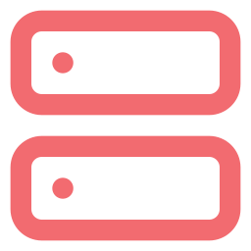

17 // NEXT STEPS
Run it on a laptop today. Run it in an air-gapped site tomorrow.
Laptop
Docker compose
Kubernetes
Air-gapped sites
Development mode, one command. Real edge, real policy, real signed ledger, illustrative data.
Five services, non-root, read-only filesystems, PQ-mTLS between them. just compose-up.
Helm chart: hardened StatefulSets, default-deny network policies. Runs on a 3-node kind cluster.
One signed .mgbundle on media. Every artefact is verified offline, then installed.
What we are asking for
Veldris Ltd
Design partners for a pilot on the compose or Helm path, with your own ontology and data.
Security teams to review the open core: threat model, crypto backends, supply-chain gates.
Feedback on the 90-day roadmap and the GA blockers you just saw.
github.com/veldris-ltd/midgard-app
hello@veldris.io · sales@veldris.io
security@veldris.io · /.well-known/security.txt
APACHE-2.0 CORE · CYCLONEDX SBOM PER RELEASE · REPRODUCIBLE BUILDS
MIDGARD · VELDRIS LTD · LAUNCH 2026
18
Notes:
To close. Midgard runs on a laptop with one command, on docker compose with five services, on Kubernetes through a hardened Helm chart, and in air-gapped sites from a signed bundle. We are looking for three things: design partners willing to run a pilot on the compose or Helm path, security teams to review the open core, and feedback on the roadmap you just saw. The repository, the specification and the verification record are all public. Thank you. Questions. (≈1 min)

