Slide 1
Technology In Pyschology
Michael Velez

Slide 2
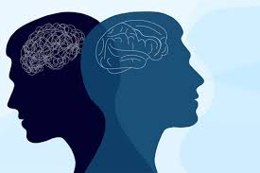
Overview
What is Pyhscghology? The scientific study of the mind and behavior, aiming to understand, explain, and predict how people think, feel and act,
How is technology changing psychology? With the use of technology now things like therapy and counseling can be done from your computer wherever you are. Also AI is helping diagnose patients and also help with note taking.
What I will be covering? Brain Imaging Therapy, Digital Apps, AI in physchology, Virtual Reality Therapy, Social Media & Mental Health

Slide 3
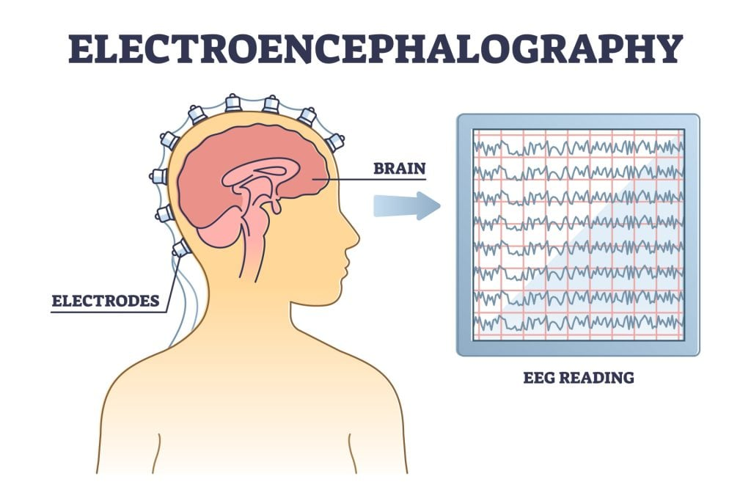
Brain Imaging Technology
What does it do? Neuroimaging helps with finding out the differences in brain structure and helps diagnose brain injuries, tumors and disorders.
EEG- A EEG records electrical activity in the brain using sensors placed on an individuals scalp
-It is mostly used for watching over brain waves, sleep disorders, and also sometimes ADHD
-Usually only takes 20-60 minutes

Slide 4


Digital Mental Health Apps
01.
02.
Calm
Headspace
-Headspace is also an app designs to help with mental health which also provides guided mediations, sleeping podcast, yoga excerises and more.
-Many users use the 3 minute sessions to help with stress, anxiety, and to become more focused.
-Has over 100 million users
-Calm is an app designed to help with mental health by providing guided sessions to improve mental health and focuses on meditation, sleep and relaxation.
-It offers things like breathing excersies, calming music, and also even bed time stories
-Has around 4.5 million active paying subscribers

Slide 5


AI in psychology
-WIth the help of AI, now there is websites like Chatgpt and Claude where you can talk to a chatbot, to give you advice or even ways to improve your mental health
-Lots of psychologist are using AI to help them take notes and to create plans for patients
-Lots of psychologist really enjoy using AI to help them with the work overload especially to organize all of their work
Con: Using AI can sometimes result in a breach of patients information,being used and stolen.

Slide 6


Virtual Reality Therapy
Conditions VR Therapy Can Address
Virtual Reality Therapy integrates digital environments into therapeutic practices to enhance treatment for various mental health conidtions.
Phobias
Social Anxiety
Depression
Insomnia
Why?
Enhances traditional mental health treatments, and is interactive
Allows individuals to process emotions, practice coping techniques in a safe and controlled way

Slide 7
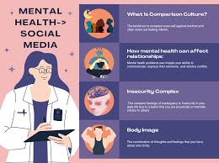

Social Media And Mental Health
Ways to safely use social media
Set time limits
Speicifc time you use social media
Only follow close friends and family
An average person spends about 145 minutes on social media a day
Social media impacts our overall well being by fueling anxiety, depression,lonliness
Social media filters create false illusions which cause people to feel self conscious
According Health Uc Davis “In 2020, 44% of all internet users in the U.S said they have experienced online harassment

Slide 8
Work Cited
https://www.apa.org/education-career/guide/science
https://www.alliant.edu/blog/psychology-and-technology-current-trends-shaping-our-world#:~:text=Technology%20is%20impacting%20psychology%20in%20many%20ways:,symptoms%20and%20diagnoses%20*%20Deliver%20treatment%20options
https://www.simplypsychology.org/neuroimaging.html
https://www.calm.com/
https://www.headspace.com/
https://www.apaservices.org/practice/news/artificial-intelligence-psychologists-work
https://www.canvashealth.org/specialty-virtual-reality-vr-therapy/

