Slide 1
Self-Organizing Maps (SOM)
Praktikum 6

Slide 2
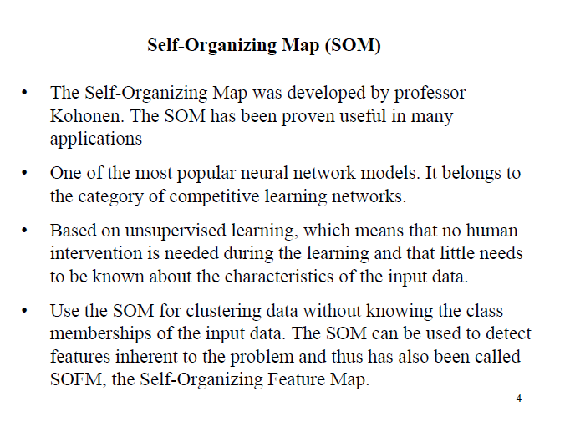

Slide 3
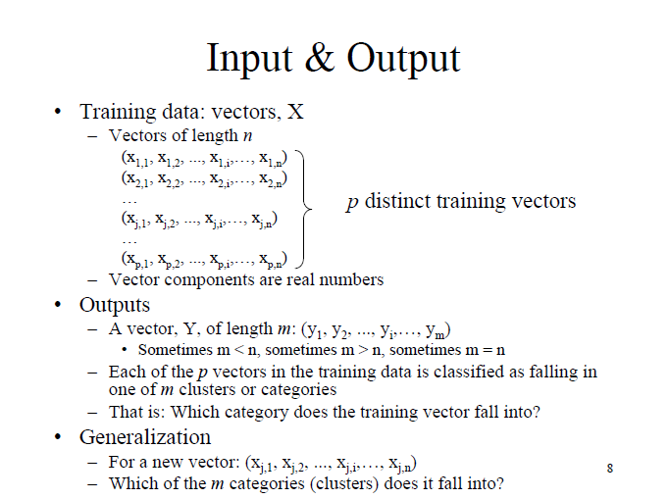

Slide 4
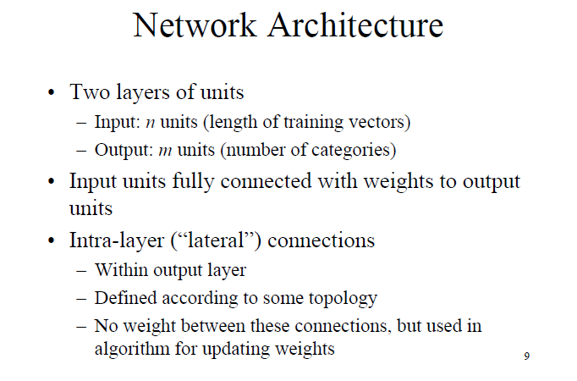

Slide 5
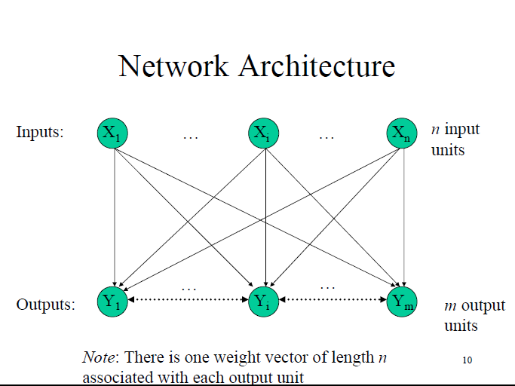

Slide 6
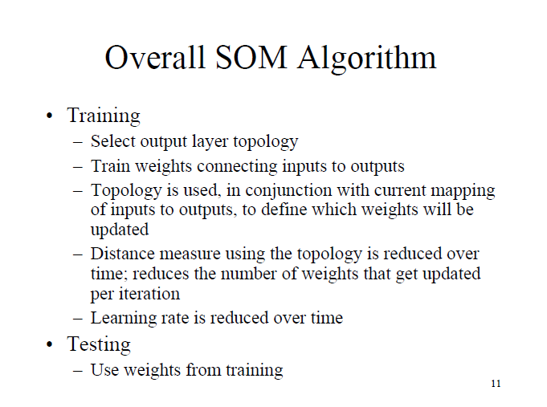

Slide 7
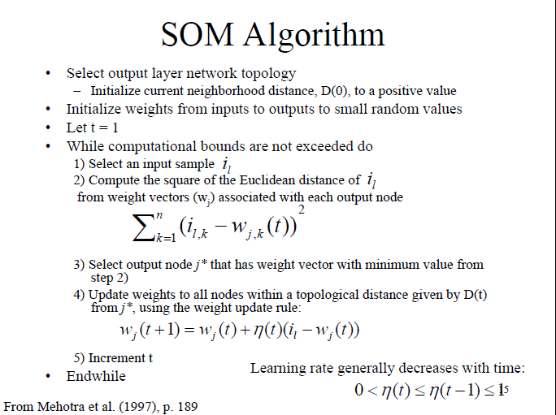

Slide 8
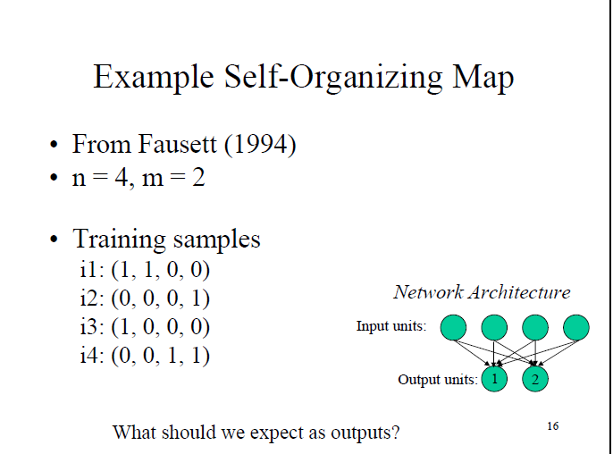

Slide 9
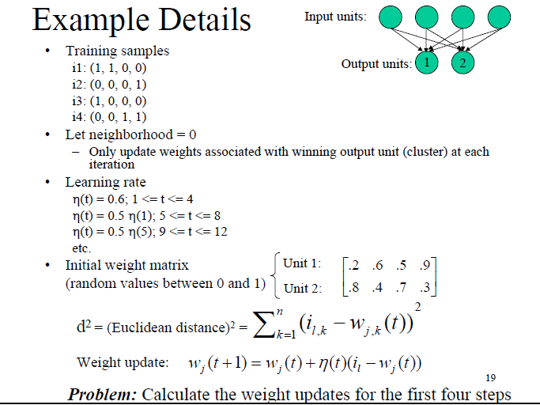

Slide 10
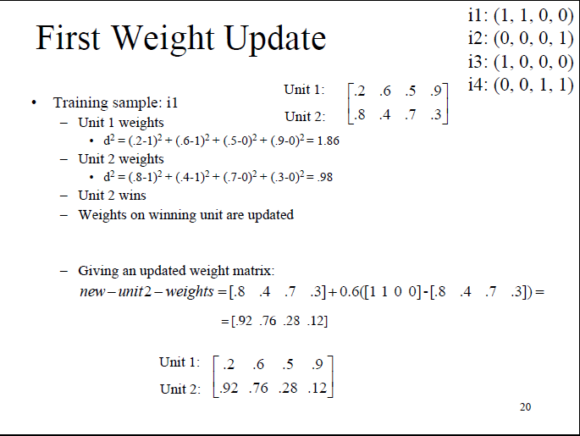


Slide 11
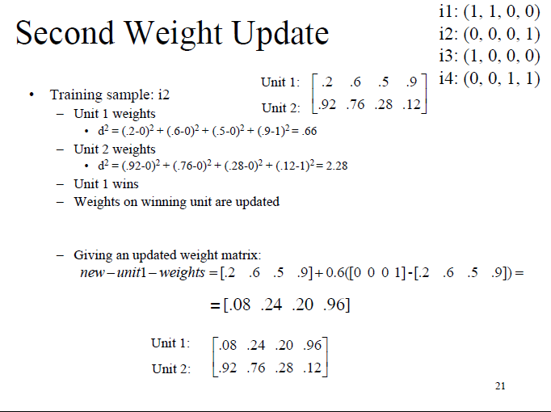

Slide 12
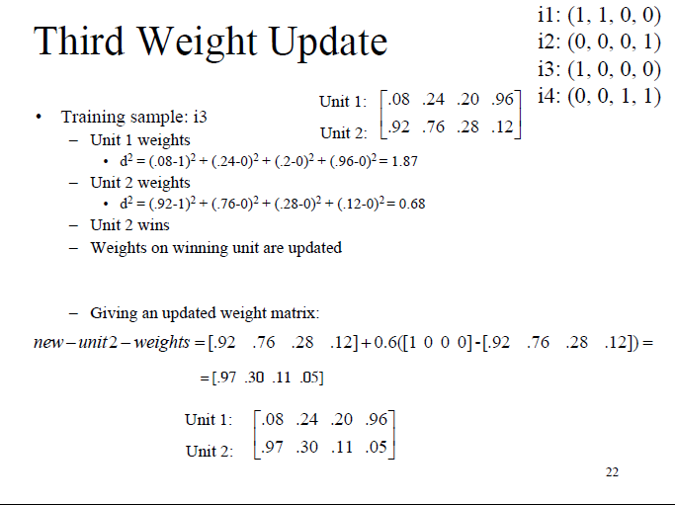

Slide 13
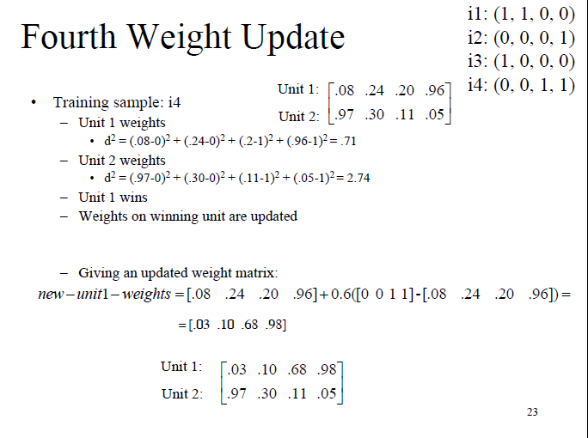

Slide 14
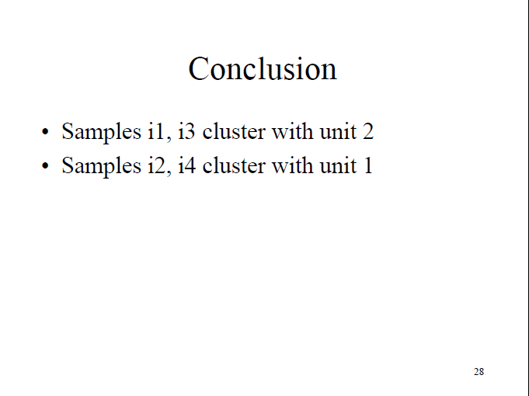

Slide 15
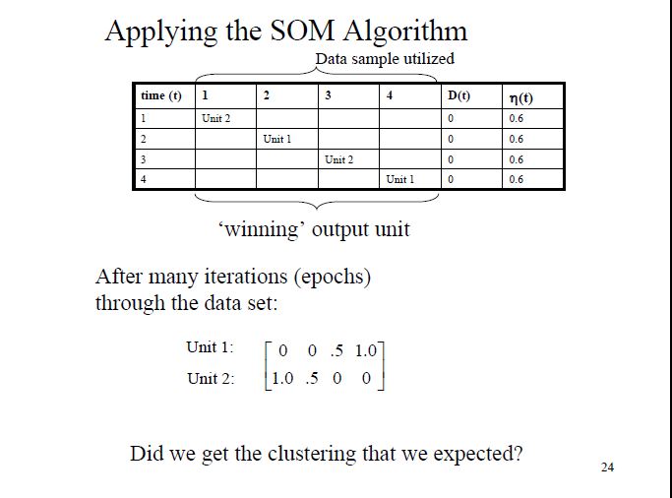

Slide 16
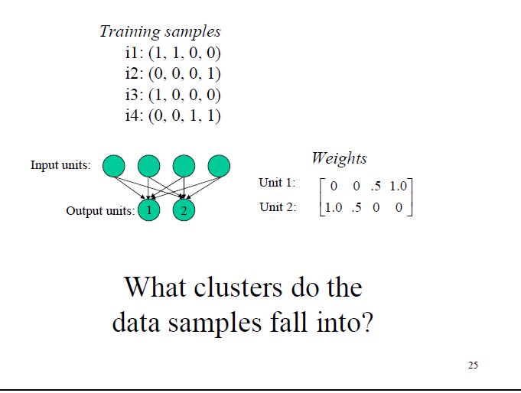

Slide 17
References
Wireless Localization Using Self-Organizing Maps by Gianni Giorgetti, Sandeep K. S. Gupta, and Gianfranco Manes. IPSN ’07.
Wikipedia: “Self organizing map”. http://en.wikipedia.org/wiki/Self-organizing_map. (Retrieved March 21, 2007).
AI-Junkie: “SOM tutorial”. http://www.ai-junkie.com/ann/som/som1.html. (Retrieved March 20, 2007).

