Slide 1



NoSQL Databases
NoSQL Concepts
Databases
Telerik Software Academy
http://academy.telerik.com

Slide 2
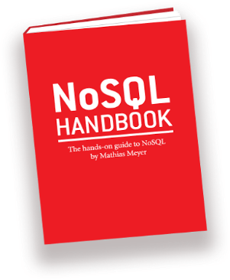
Table of Contents
NoSQL Databases
Overview
Data models
Relational vs NoSQL Databases

Slide 3

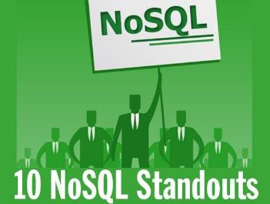

NoSQL Databases
Overview, Models, Concepts, Examples

Slide 4
Relational vs. NoSQL Databases
Relational databases
Data stored as table rows
Relationships between related rows
Single entity spans multiple tables
RDBMS systems are very mature, rock solid
NoSQL databases
Data stored as documents or other values
Single entity (document) is a single record
Documents do not have a fixed structure

Slide 5
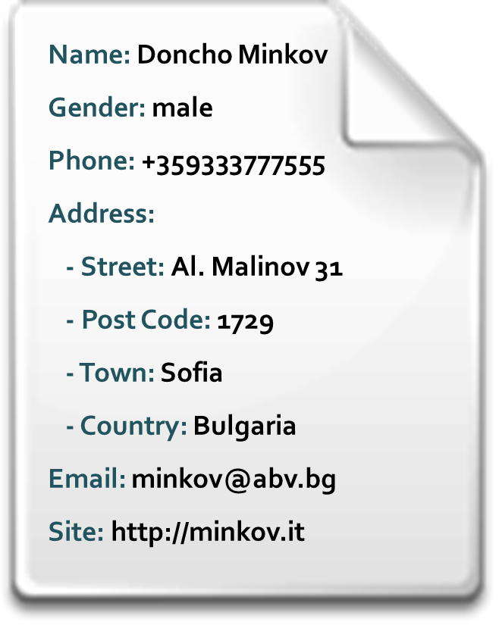

Non-Relational Data Models
Document model
Set of documents, e.g. JSON strings
Key-value model
Set of key-value pairs
Hierarchical key-value
Hierarchy of key-value pairs
Wide-column model
Key-value model with schema
Object model
Set of OOP-style objects

Slide 6
What is NoSQL Database?
NoSQL databases
Schema-free document storage
Still support indexing and querying
Still support CRUD operations (create, read, update, delete)
Still supports concurrency and transactions
Can have nested values
Highly optimized for append / retrieve
Great performance and scalability
NoSQL == “No SQL” or “Not Only SQL”?

Slide 7

Relational vs. NoSQL Models
Relational Model
Document Model
Name | Doncho Minkov
Gender | male
Phone | +359333777555
Email | minkov@abv.bg
Site | http://minkov.it
Name: Doncho Minkov
Gender: male
Phone: +359333777555
Address:
- Street: Al. Malinov 31
- Post Code: 1729
- Town: Sofia
- Country: Bulgaria
Email: minkov@abv.bg
Site: http://minkov.it
*
1
Street | Al. Malinov 31
Post Code | 1729
*
1
Town | Sofia
*
1
Country | Bulgaria

Slide 8
NoSQL Databases
http://academy.telerik.com

Slide 9



Free Trainings @ Telerik Academy
Telerik School Academy
schoolacademy.telerik.com
Telerik Software Academy
academy.telerik.com
Telerik Academy @ Facebook
facebook.com/TelerikAcademy
Telerik Software Academy Forums
forums.academy.telerik.com

