Slide 1
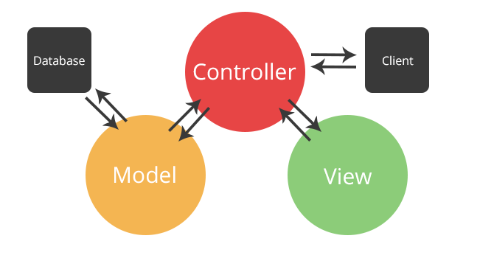
Introduction to MVC
Model-View-Controller
SoftUni Team
Technical Trainers
Software University
https://softuni.bg

Slide 2
Table of Contents
What is MVC?
What is its origin?
What is its idea?
What are the MVC Components?
What is a Model?
What is a View?
What is a Controller?

Slide 3
Have a Question?
sli.do #csharp-web

Slide 4
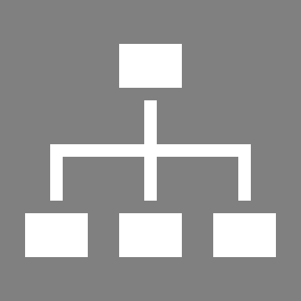
The MVC Pattern

Slide 5
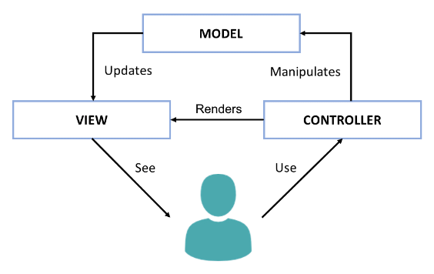
The Model-View-Controller (MVC) Pattern
The Model-View-Controller (MVC) pattern
Controller
Handles user actions
Updates the model
Renders the view (UI)
Model
Holds app data
View
Displays the UI, based on the model data
Notes:
Another important concept from software development is the Model-View-Controller (MVC) pattern.
MVC is an architectural pattern for structuring Web back-end apps,
by dividing their logic into 3 separate components: models, views and controllers.
The MVC pattern is illustrated at the diagram, which shows the interactions between the MVC components.
MVC is complex and some developers need time to understand it.
We shall spend significant time, effort and practical work to learn it, later at SoftUni.
But now, let's briefly explain the MVC pattern.
MVC splits the app into controllers, views and models.
Users interact with the controllers, which modify the data in the models and visualize the data using the views.
For example, let's take a phonebook app.
Users see the phonebook entries on the screen. They are rendered by a view component.
The app model holds the phonebook entries. This is the data model behind the views.
Controllers are responsible for handling the user actions, such as "view the phonebook", "search", and "add new entry".
The controllers, models and views are strongly interconnected, but each of them has well defined responsibility.
The idea of MVC is to build a better app structure, which simplifies development and improves maintenance.
The presentation logic, which displays elements on the screen is always located in the views.
The logic for user interaction, which handles the user input, is always located in the controllers.
The data models and data related logic are in the models.
The MVC app structure is very popular in Web back-end frameworks (such as ASP.NET MVC, Django and Spring MVC).
Variants of MVC sometimes are used in some Web front-end frameworks and mobile app frameworks.
In the MVC model, controllers handle user actions, such as clicking a button or choosing an item from a list.
Depending on the user action, controllers may update the app data model.
Then, controllers render a view (the user interface), which visualizes the data model.
For example, in our phonebook app, the phonebook controller handles the action "click on a phonebook entry".
The action handler loads the data about the selected phonebook entry into a data model object.
Then it shows a view, which displays this data object.
Models holds app data.
Typically models are data classes, which hold the data, that should be displayed at the screen.
For example, in our phonebook app, the data model, used to visualize a phonebook entry, is a data object, holding the phonebook entry details.
Views displays the UI for certain screen from the app, based on the data from the model.
For example, in our phonebook app, the view, which displays the phonebook entries,
takes as an input a data model, holding a list of phonebook entries.
The view iterates over the entries one by one and displays them in a table or list.
MVC is an important paradigm for structuring Web apps back-end developers should learn it.
At SoftUni, we teach MVC as part of the server-side Web development courses and modules.

Slide 6
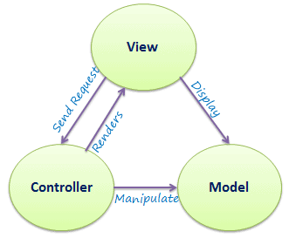
The MVC Pattern
Model–view–controller (MVC) is a software architectural pattern
Originally formulated in the late 1970s by Trygve Reenskaug as part of the Smalltalk (object-oriented programming language)
Code reusability and separation of concerns
Originally developed for desktop, then adapted for internet applications

Slide 7
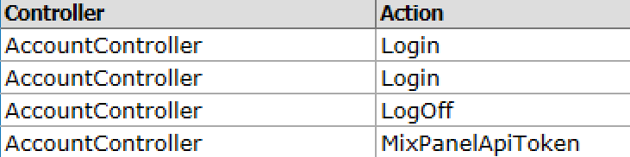
Controller
The Controller in MVC represents:
Process user's actions and produces a response
Process the requests with the help of Views and Models
A set of classes that handles
Communication from the user
Overall application flow
Application-specific logic
Every Controller has one or more "Actions"

Slide 8
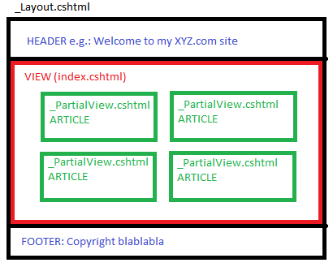
View
The View in MVC represents:
Defines how the application’s user interface (UI) will be displayed
May support Master Views (layouts) and Sub-Views (partial views or controls)
In Web apps: template to dynamically generate HTML

Slide 9
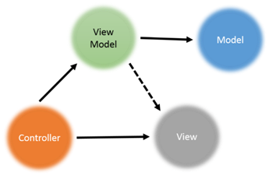
Model
The Model in MVC represents:
A set of classes that describes the data we display in the UI
May contain data validation rules
Two types of models
View model / binding model
Maps the UI of the Web page to C# class
Part of the MVC architecture
Database model / domain model
Maps database table to C# class (using ORM)

Slide 10
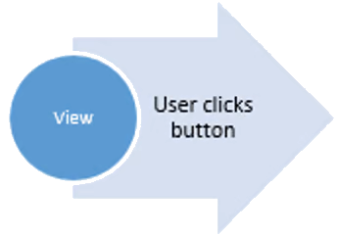
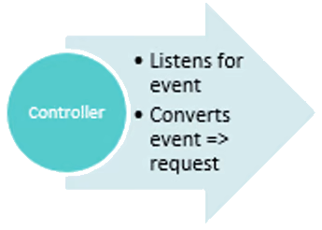
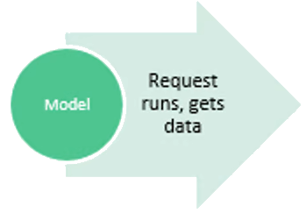
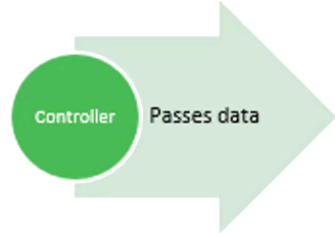
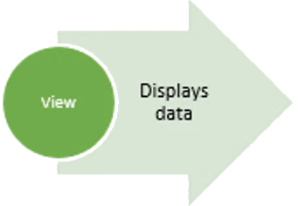
MVC Steps
Incoming Request routed to Controller
Controller processes Request and creates a Model (view model)
Controller also selects appropriate result (for example: View)
Model is passed to the View
The View transforms Model into appropriate output format (HTML)
Response is rendered (HTTP Response)

Slide 11
The MVC Pattern for Web
HTTP Request
Front controller (dispatcher)
/Some/Page/
Delegate request
User
Controller
HTTP Response
CRUD model
Select view & pass data (view model)
View
(render UI)
Model (data)
Use model data

Slide 12
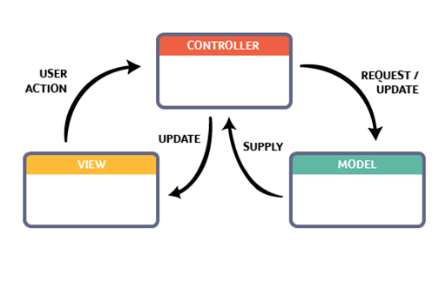
MVC Workflow – Example
AnimalsController
methods: Cat() => View()
(contains control logic)
User Interaction
Cat.cshtml
CatViewModel
properties: Name and Age
(defines display / UI)
(defines data for UI)

Slide 13
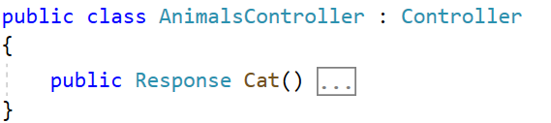
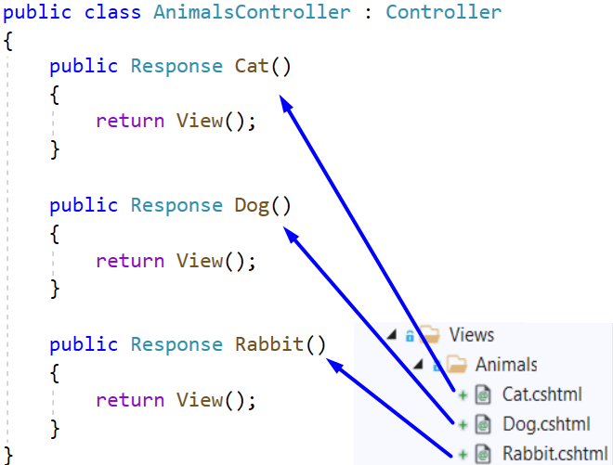
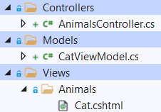
MVC Structure – Example
MVC requires the name of all controller classes to end with "Controller"
Views folder includes a separate folder for each controller
View name should match the name of a controller action

Slide 14
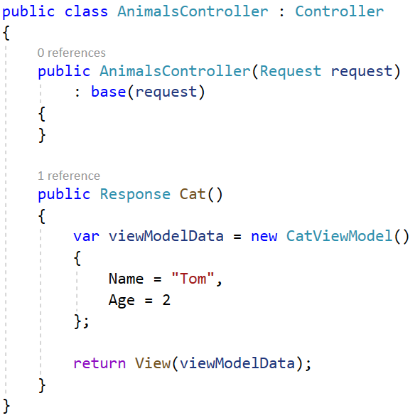
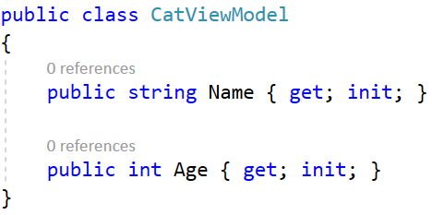

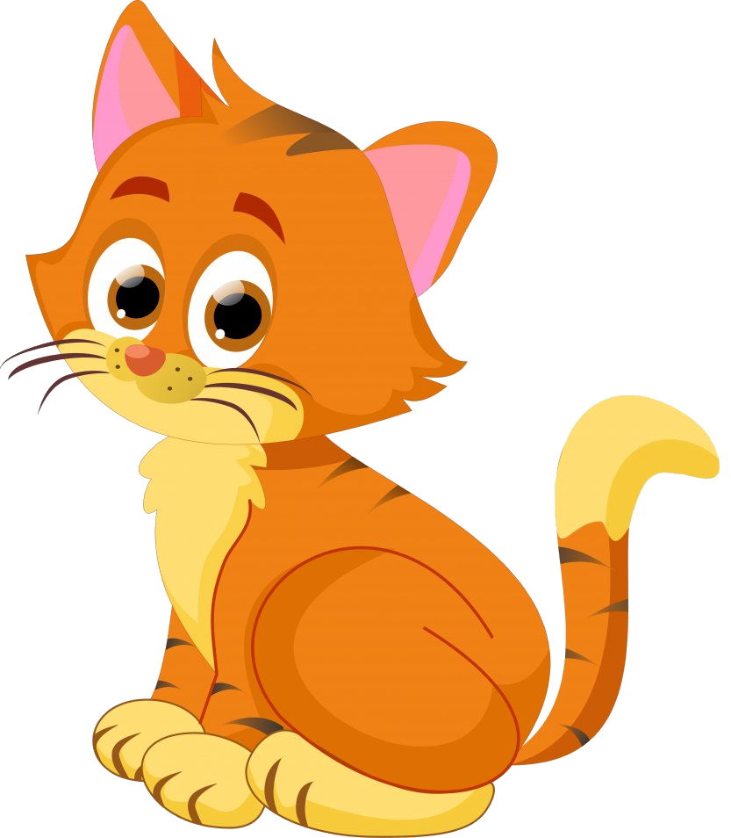
MVC – Example (1)
Model class holds object properties
Controllers inherit the Controller class
Views use and display model data
Controller action creates a model with data
Controller action returns a View with model data
Name: Tom
Age: 2

Slide 15
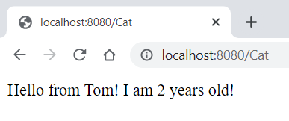
MVC – Example (2)
URL path is the controller action name
View is displayed and it has the model data
Name: Tom
Age: 2

Slide 16
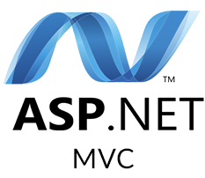
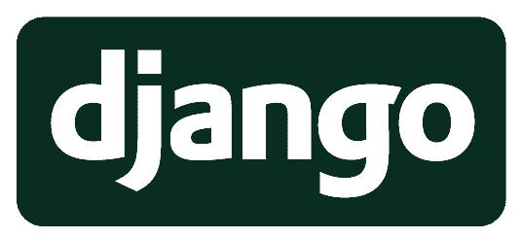
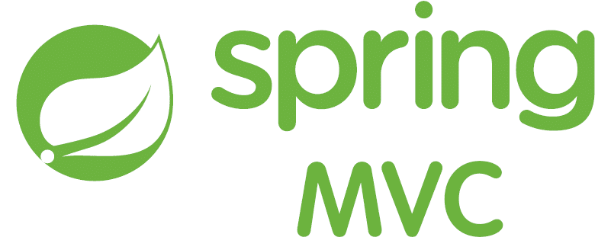
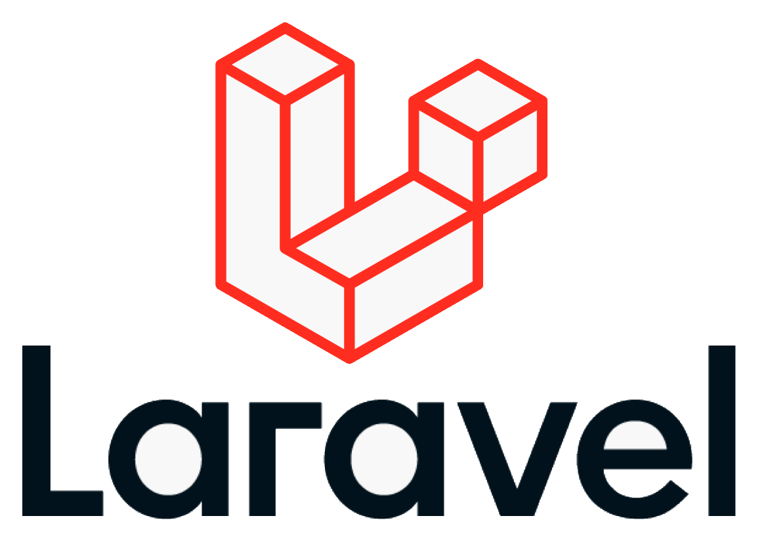
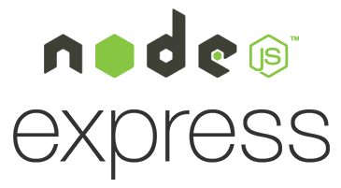
Web MVC Frameworks
Web MVC frameworks are used to build Web applications
It provides the MVC structure and engine to build Web apps
Controllers handle HTTP GET / POST and render a view
Views display HTML + CSS, based on the models
Models hold app data for views, prepared by controllers
Examples of Web MVC frameworks:
ASP.NET MVC (C#), Spring MVC (Java), Express (JS), Django (Python), Laravel (PHP), Ruby on Rails (Ruby), Revel (Go), …
Notes:
Web MVC Frameworks are software development frameworks, which implement the Model-View-Controller pattern as foundation to build Web apps.
Web MVC frameworks (such as Spring MVC, Django and ASP.NET MVC) are used build server-side Web applications.
Under the MVC framework Web apps define controllers (holding actions), views and model components.
Actions in the controllers handle the HTTP GET and POST requests from the client Web browser.
They perform the requested operation (such as retrieving data or adding new data)
and render a view to display the result in the client Web browser.
Controllers implement the operations, used to interact with the users.
These operations are invoked as HTTP requests by the client Web browser.
For example, clicking a button, or submitting a Web form, executes an HTTP request,
which is handled by a controller action at the back-end.
Views render data as HTML + CSS for displaying in the client Web browser.
Views are called by the controller actions to render the UI.
They take as input a data model and visualize the data from the model as HTML.
The rendered HTML is returned as an HTTP response.
For example, a view can render a list of items as HTML.
Models hold the app data, which is prepared by controllers to be rendered in the views.
In most cases models are simple data objects or collections of objects.
When a controller wants to return data for displaying in the client Web browser,
it loads the data from the database, puts it in a data model object,
and sends it to the view, which renders it for as HTML.
Examples of popular back-end Web MVC frameworks are the following:
ASP.NET MVC (for C# developers),
Spring MVC (for Java developers),
Express.js (for server-side JavaScript developers),
Django (for Python Web developers),
Laravel (for PHP Web developers),
Ruby on Rails (for Ruby developers),
Revel (for Go Web developers),
and many others …
Almost all the server-side Web development is driven by Web MVC frameworks,
so you need to learn at least one of them if you want to be a back-end developer.
We shall learn MVC frameworks at SoftUni, at the end of our end-to-end training program for software engineers.

Slide 17
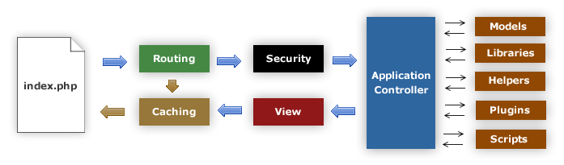
MVC Frameworks
CakePHP (PHP)
CodeIgniter (PHP)
Spring (Java)
Perl: Catalyst, Dancer
Python: Django, Flask, Grok
Ruby: Ruby on Rails, Camping, Nitro, Sinatra
JavaScript: AngularJS, JavaScriptMVC, Spine
ASP.NET MVC (.NET Framework)
ASP.NET Core (.NET Core)

Slide 18
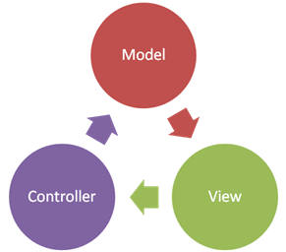
Summary
…
…
…
MVC is an architectural design pattern
Originally developed for Desktop apps only
Later met its application in the Web
MVC Components
Model – the data component
View – the presentation (UI) component
Controller – the functional component

Slide 19
Questions?
Notes:
19

Slide 20
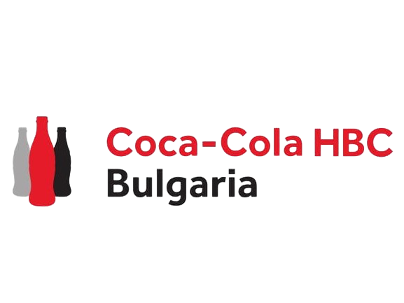
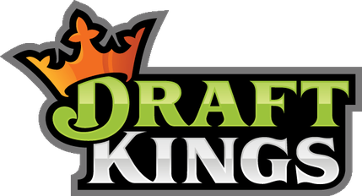

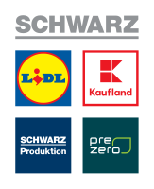
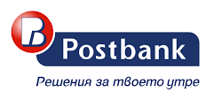
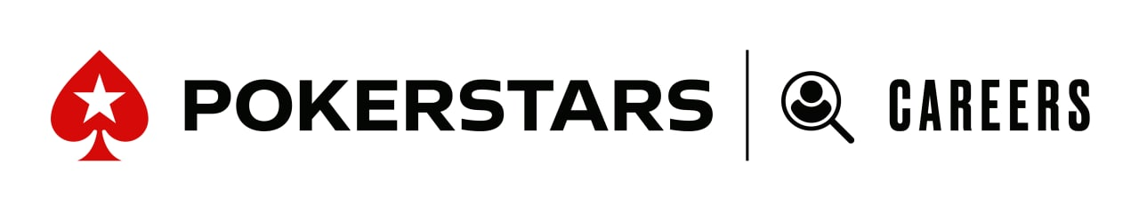
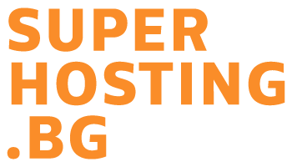
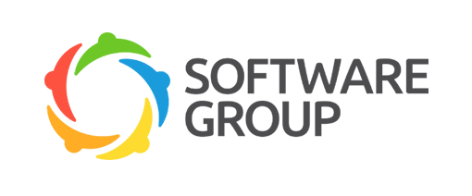
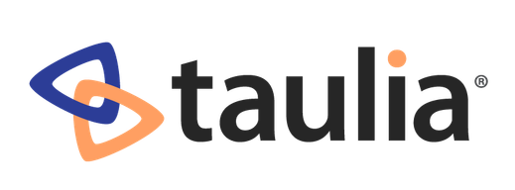

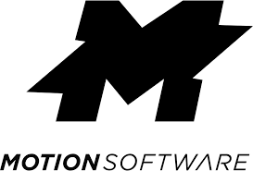

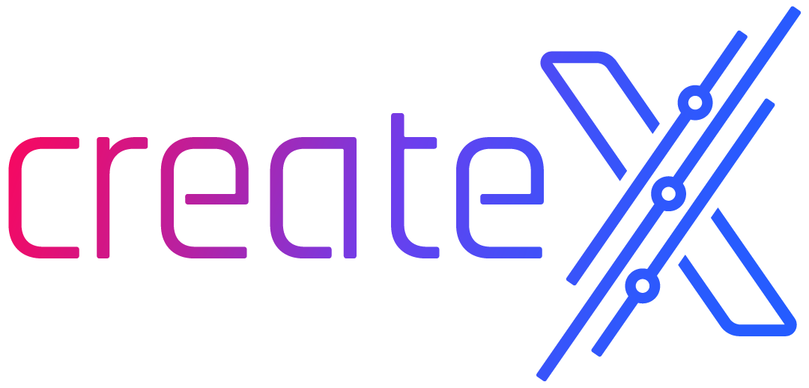
SoftUni Diamond Partners

Slide 21
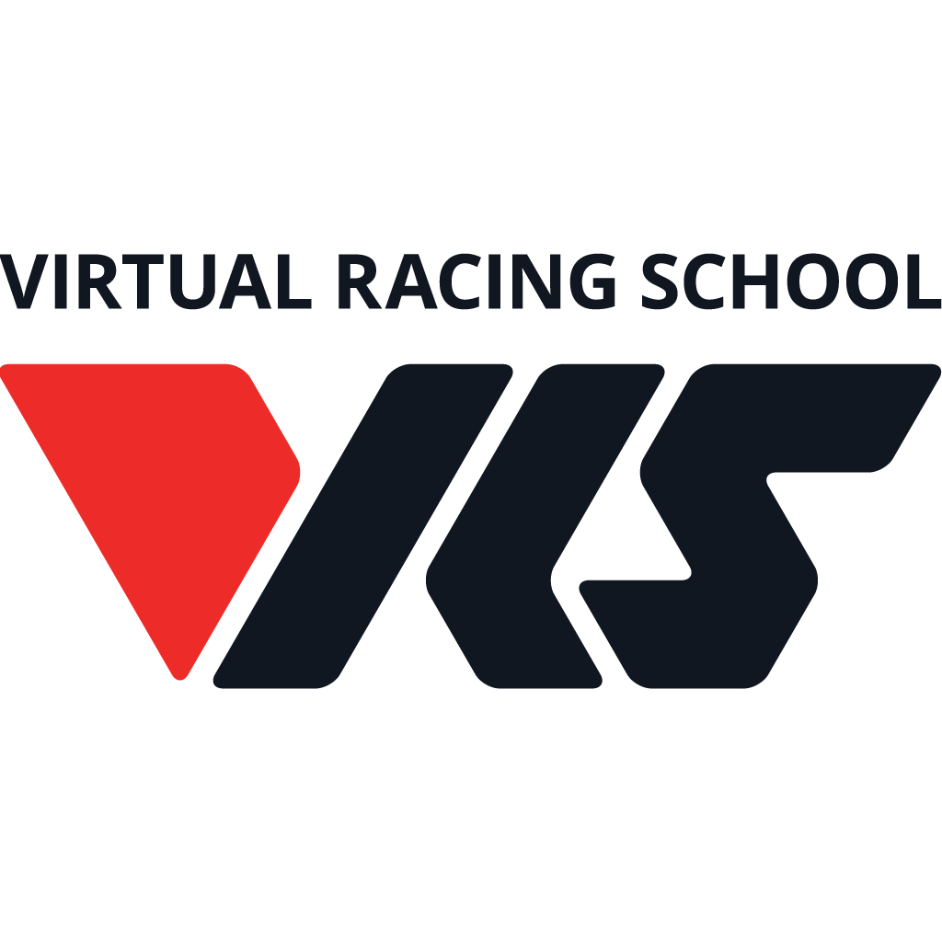
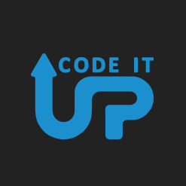
Educational Partners

Slide 22
Trainings @ Software University (SoftUni)
Software University – High-Quality Education, Profession and Job for Software Developers
softuni.bg, about.softuni.bg
Software University Foundation
softuni.foundation
Software University @ Facebook
facebook.com/SoftwareUniversity
Software University Forums
forum.softuni.bg
22
Notes:
22

Slide 23
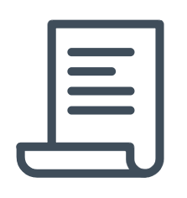
License
This course (slides, examples, demos, exercises, homework, documents, videos and other assets) is copyrighted content
Unauthorized copy, reproduction or use is illegal
© SoftUni – https://about.softuni.bg
© Software University – https://softuni.bg
Notes:
23

